Slide 1
The Four Ps of Marketing
Entrepreneur 3209

Slide 2
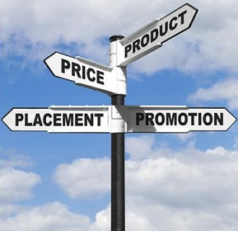
Marketing & Advertising
There are four Ps associated with marketing:
Product
Price
Place
Promotion

Slide 3
1. Product / Services
Product – the particular good made or service offered
Businesses develop products / services because (1) they can & (2) they see a need
During this development they have to consider quality, design, features, & benefits

Slide 4
2. Price
Price: What a customer is charged for a good or a service
Must cover your costs and make a profit
Businesses must be price sensitive & look at their competitors’ price for the same products
Consumers are very price conscious and look for competitive prices at other stores or on the Internet.

Slide 5
3. Place
Place: The methods a business uses to sell and distribute its products
Channels of Distribution
Direct Channel connects consumers directly to the producer (bakery)
Indirect Channel sells to the consumer through other channels(wholesaler, retailer, catalogue, e-commerce)
Specialty Channel distribute products by using vending machines, telemarketing, catalogue sales, e-commerce, and door-to-door sales. No retail store is involved.
Notes:
THE FOUR Ps OF MARKETING
Place (Channels of Distribution)
A product does not change as it moves through the distribution chain.
If the product is changed or altered that is the end of that channel and a new one begins.
See Figure 8.4, “Channels of Distribution”, on page 243.
Direct Channels
Simplest form of distribution.
Direct channel distribution does not use intermediaries or businesses that take possession of the goods before the consumers do, they add costs to the product so that they realize a profit.
With direct channels consumers can readily inform the producers of their needs and they may feel more confident about the product because they deal directly with the company that produces it.
Indirect Channels of Distribution
Importers: Importers are businesses that seek out foreign products to bring into their own country. Importers may negotiate distribution deals with foreign manufacturers, buy the goods, store the goods, and may sell the goods. To eliminate risk importers can arrange only delivery of foreign goods to Canadian businesses.
Wholesalers: Wholesalers buy goods from producers or importers and resell the goods to retailers. The manufacturer may require that the retailer buy a minimum quantity of goods. Using a wholesalers may mean that the retailer pays a higher price but they get the quantity they need and the wholesaler may store the products close by.
Retailers: Linked directly to consumers, retailers buy merchandise customers want, keep it in stock, and display it so that customers can examine it in an easy-to-reach location.

Slide 6
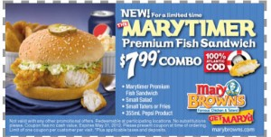
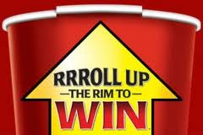
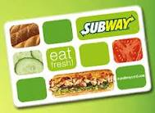
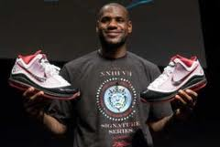
4. Promotion
Promotion: an attempt to sell a product.
Encourages consumers to buy products by using
coupons
contests
premium
Free Samples
Special events
Notes:
THE FOUR Ps OF MARKETING
Place (Channels of Distribution)
Specialty Channels
See Figure 8.5, “Specialty Channels of Distribution”, on page 246.
Vending Machines: Vending machines, that can sell virtually anything, can be placed where consumers are.
Telemarketing: Using the telephone to sell products and services is very popular. A sales pitch or scripted presentation that anticipates all possible consumer responses is delivered to people once the automated call distributors (ACDs), a computerized dialing system, calls them.
Catalogue Sales: Catalogues from retailers provide information about merchandise that consumers can purchase by mail, phone, or at the store.
E-commerce: The most important specialty channel, e-commerce is selling products and services online. For consumers it is convenient and competitive and for manufacturers and retailers it reduces distribution costs.
PROMOTION
Coupons: offer consumers money off the price of a product but redemption rates, a method of determining effectiveness, are only about 5%.
Contests: increase brand recognition through an anyone can enter and win concept that is not gambling and cannot require a purchase to enter.
Premiums: are when the consumer makes a purchase and they get something for free.
Customer loyalty cards are stamped with each purchase and, when full, entitles the customer to a discount or a free product.
Samples: samples are small “trail” sizes of a product that are given to consumers, it is expensive but often results in increased sales.
Special Events: are used to attract customers and increase sales.

Slide 7
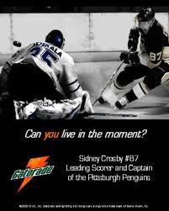
Promotion also includes advertising:
Flyer
Billboard
Newspaper
Magazine
Television
Radio
Internet

Slide 8
Part A: Marketing & Advertising
Good advertisements sell products by making the consumer remember the brand name of their products or services.
12. The four standard rules for creating good advertising are summarized as follows:
1. Attract attention – develop a good headline
2. Gain interest – make people want to read, watch, or listen
3. Build desire – help the customer want your product
4. Get action – always ask for the sale
Notes:
CREATING GOOD ADVERTISING
Can be referred to as the AIDA principal: Attention, Interest, Desire, and Action
See Figure 8.7, “Rules for Creating Good Advertising”, on page 255.
Attract Attention: Print ads need a good headline, it should not be more than seven words, it should mention the brand, and should encourage receiver to read the rest of the ad. Broadcast ads attract attention with sound, unusual visuals, attractive people, celebrities, or something funny.
Gain Interest: Print ads should be easy to read and to the point. Broadcast ads should get to the message quickly. Visual images should be strong.
Build Desire: Print ads should build desire with words, adding benefits with each line. Broadcast ads repeat brand names.
Get Action: Ask the consumer to buy now, give them reasons, and provide the necessary information so that they can.
TYPES OF ADVERTISING
Advertising, that always is the advertisers’ point of view, costs a lot of money.
Publicity, usually more believable that advertising, is information about a business, either positive or negative, that appears in the media and is not paid for by the business.
Some companies hire public relations (PR) firms that can influence the media with well written positive stories about the business.

Slide 9
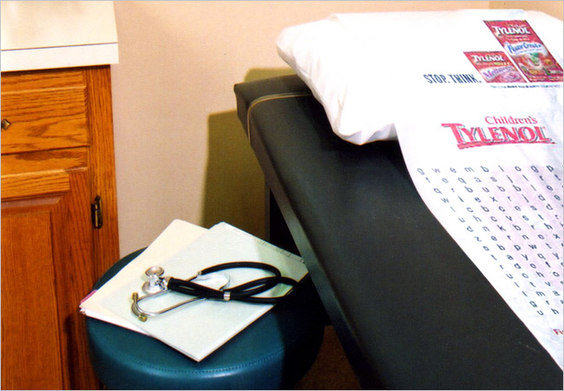
Part A: Marketing & Advertising
Ads for Children's Tylenol were placed in pediatricians' examination rooms.

Slide 10
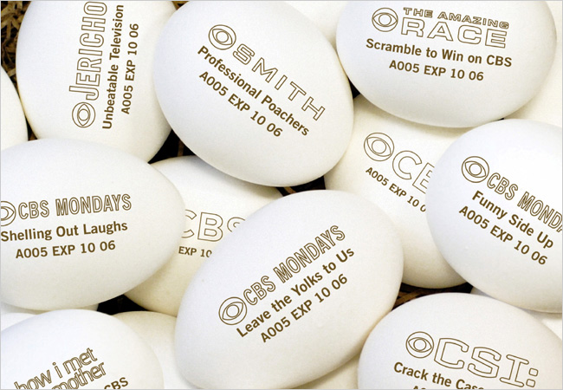
Part A: Marketing & Advertising
CBS stamped promotions for its fall lineup onto eggs that were distributed nationwide.

Slide 11
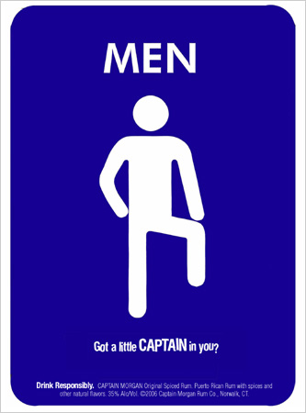
Part A: Marketing & Advertising
In the case of Captain Morgan Rum, the pitch appeared directly on the men's restroom signs in bars.

