Slide 1
Sensation and Perception
AP Psychology
Ms. C. Fahey

Slide 2
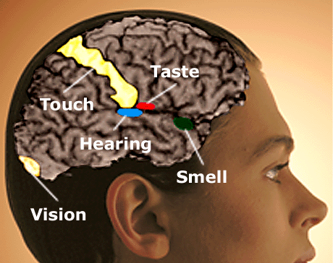
The Basics
We do not actually experience the world directly, but instead we experience it through a series of “filters” we call senses.
The study of these sense and their effect on our behavior is called sensory psychology.

Slide 3
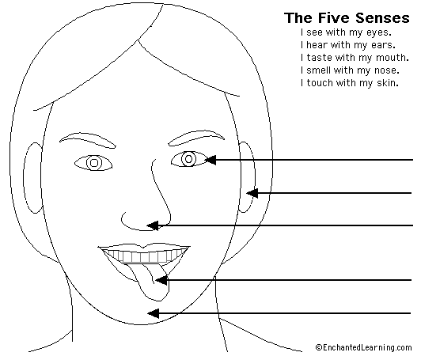
Sensation
Sensation: The process by which a stimulated receptor (eyes, ears…) creates a pattern of neural messages that represent the stimulus in the brain, giving rise to our initial experience of the stimulus.

Slide 4
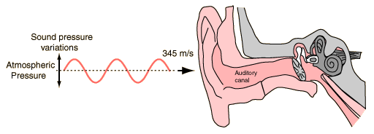
Our Senses
You will notice that all of our sense organs are very much alike.
They all transform physical stimulation (such as light waves or sound waves) into the neural impulses what give us sensations (such as light and dark).

Slide 5
Perception
Perception: A mental process that elaborates and assigns meaning to the incoming sensory patterns.
Perception creates an interpretation of sensation.
Do you see faces or vases?

Slide 6
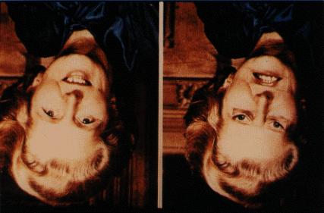
Sensation and Perception
Perception is essentially an interpretation and elaboration of sensation. Therefore, sensation refers to the initial steps in the processing of a stimulus.
These pictures should look similar

Slide 7
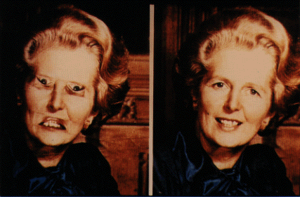
The True Picture

Slide 8
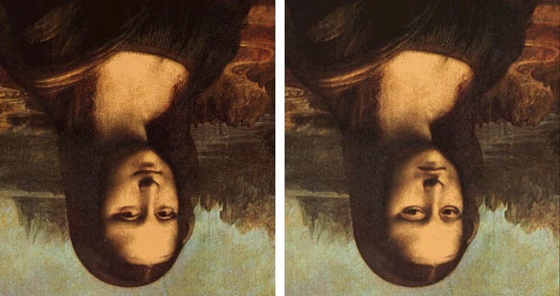
The Famous Mona Lisa…Frown or Smile

Slide 9
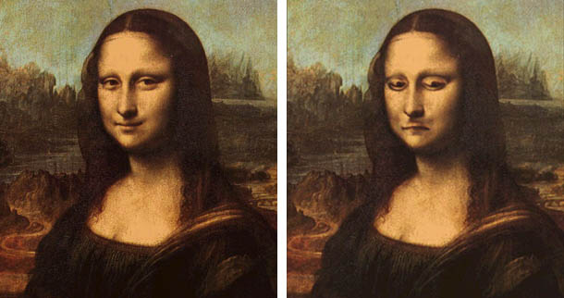
The Famous Mona Lisa…Frown or Smile

Slide 10
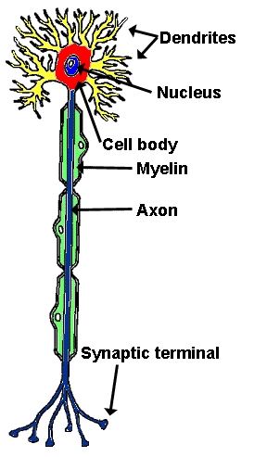
Big Idea
Although it seems the brain interacts directly with the outside world, it does not.
The brain senses the world indirectly because the sense organs convert stimulation into the language of the nervous system: neural messages.
In short, the brain never receives stimulation directly from the outside world.

Slide 11
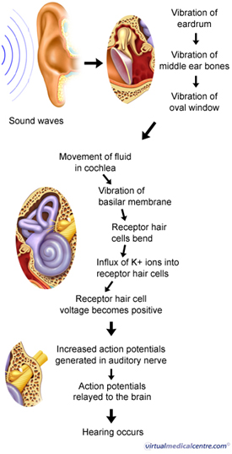
Transduction: Changing Stimulus to Sensation
In all the sense organs, it is the job of sensory receptors to convert incoming stimuli information into electrochemical signals—neural activity.
Transduction: The sensory process that converts energy, such as light or sound waves, into the form of neural messages.
Transduction with Hearing

Slide 12
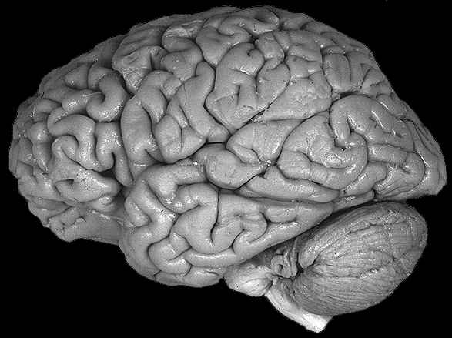
The neural impulse carries a code of the sensory event in a form that can be further processed by the brain.
Light Waves
Neural Signals

Slide 13
The Process of Transduction
Transduction begins with the detection by a sensory neuron of a physical stimulus.
When the appropriate stimulus reaches the sense organ, it activates specialized neurons called receptors.
The receptors respond by converting their excitation into a nerve signal.
Think of this as the way a bar-code reader converts a series of lines into an electrical signal that a computer can match with a price.

Slide 14
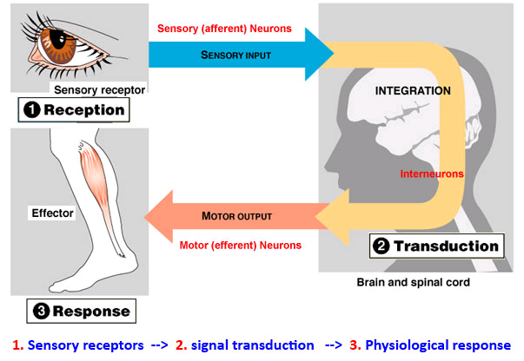

Slide 15
A Simple Example
Close both of your eyes. Press gently in the corner of one eye. You should “see” a pattern caused by pressure of your finger, not by light.
These light sensations are phosphenes, or visual images caused by fooling your visual system into thinking it sees light.

Slide 16
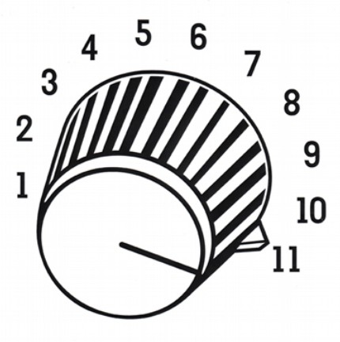
Sensory Adaptation
Sensation is critically influenced by change. Thus, our sense organs are change detectors.
Their receptors specialize in gathering information about new and changing events.

Slide 17
Sensory Adaptation
Sensory adaptation is the diminishing responsiveness of our sensory systems to prolonged stimulation.
Unless it is quite intense or painful, stimulation that persists without change in intensity usually shifts to the background of our awareness.
Until now, many of you are probably unaware that your sense of touch had adapted to the pressure of the chair against your legs.

Slide 18
Thresholds
What is the weakest stimulus that an organ can detect?
Absolute threshold: The level of stimulus necessary for a stimulus to be detected.
Operational definition of absolute threshold: The presence or absence of a stimulus is detected correctly half the time over many trials.

Slide 19
Because there is a fuzzy line between detection and nondetection, a person’s absolute threshold is not necessarily absolute.
It varies continually with our mental alertness and physical condition
Sense Modality
Detection of Threshold
Light | A candle flame at 30 miles on a dark, clear night.
Sound | The tick of a mechanical watch under quiet conditions at 20 feet.
Taste | One teaspoon of sugar in two gallons of water.
Smell | One drop of perfume diffused into the entire volume of a three-bedroom apartment.
Touch | The wing of a bee falling on your cheek from a distance of one centimeter.

Slide 20
Thresholds
Difference thresholds: The smallest amount by which a stimulus can be changed and the difference be detected, half of the time.
Think about when you are watching TV and a commercial comes on. Can you tell a difference?

Slide 21
Just Noticeable Difference
Just Noticeable Difference (JND): The minimal amount of change in the signal that is still recognizable.
Just noticeable difference, JND and difference threshold are used interchangeably.

Slide 22
Laws of Sensation
Weber’s Law: to be perceived as different, two stimuli must differ by a constant minimum percentage (rather than a consistent amount.
Fechner’s Law: The size of JND is proportional to the intensity of the stimulus; the JND is large when the intensity of the stimulus is high.
Steven’s Power Law: A law of magnitude that is more accurate than Fechner’s law and covers a wider variety of stimuli.

Slide 23
Signal Detection Theory
Signal detection theory says that sensation depends on the characteristics of the stimulus, the background stimulation and the detector.
This theory takes the observer’s characteristics into account and says that stimulus judgment often happens outside of consciousness.

Slide 25
Signal Detection Theory
Signal detection theory recognizes that the observer, whose physical and mental characteristics are always in flux, must compare a sensory experience with ever-changing expectations and biological conditions.

Slide 26
Subliminal Persuasion
Advertising executive James Vicary announced that he had discovered an irresistible sales technique called “subliminal advertisement.”
He said he could present images so quickly that the conscious mind would not perceive them, but the unconscious mind would, and the images would work on the viewer’s desires unnoticed.
As to be expected, the public was outraged, but fascinated. People began worrying that they were being manipulated by powerful psychological forces.
Lets try it now!!!!

Slide 27
A_ _OM_BI_E

Slide 28
Do Subliminal Messages Work?
100
Based on studies, some people do respond to stimuli below the absolute threshold, under some circumstances.
The problem is people behave different thresholds at different levels, so what could be subliminal (or below the threshold) for one person, may be supraliminal (above the threshold) for another person.
75
Percentage
of correct
detections
50
Subliminal
stimuli
25
0
Low
Medium
Absolute
threshold
Intensity of stimulus

Slide 29
Simplest Explanation
The simplest explanation for reports of success with subliminal persuasion lies in the purchaser's expectations and in the need to prove they did not spend their money foolishly.
The same reason we read horoscopes!

Slide 30
College Students and Therapy Tapes
Self-esteem and memory tapes were randomly assigned to university students to listen to daily for 5 weeks.
On half of the tapes they switched the labels.
Some students thought they were hearing tapes about memory when they were really hearing self-esteem tapes, others had the reverse.
Impact? Test showed there was no impact on the students self-esteem or memory. But, in both cases the students thought they were getting the benefits promised by the self-help tapes.
(Greenwald, 1991)

Slide 31
Backmasking- More Subliminal Messaging? Listing to Songs in Reverse
There are legend about hidden messages in songs. Led Zeppelin's Stairway to Heaven was one of the first songs to have supposed hidden, satanic messages.
http://jeffmilner.com/backmasking.htm
Why does this seem to work?

Slide 32
How our Senses are Alike
Vision, hearing, smell, taste, touch, pain and body position are all similar for three reasons.
First, they all transduce stimulus energy into neural impulses.
Second, they are all more sensitive to change than to constant stimulation.
Third, they all provide us with information about the environment we are in.

Slide 33
How Our Senses are Different
With the exception of pain, all the senses taps a different form of stimulus, and each sends the information it gathers to a different part of the brain.
The senses all operate in much the same way, but each extracts different information and sends it to its own specialized processing region of the brain.

Slide 34
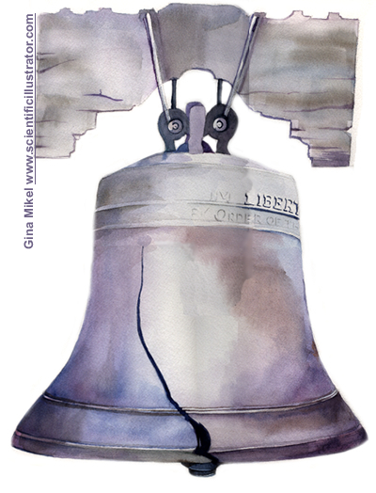
See a bell or hear a bell?
Different sensations occur because different areas of the brain become activated. Whether you hear a bell or see a bell depends ultimately on which part of the brain receives stimulation.

Slide 35
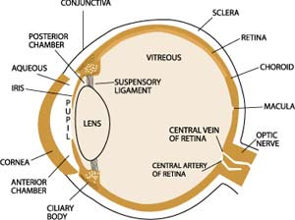
Vision
Vision is the most complex, best developed and most important sense for humans and other highly mobile creatures.
Think of the eye as the brain’s camera.
It gathers light, focuses it, converts it to a neural signal and sends these signals on for further processing.

Slide 36
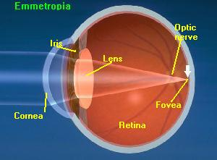
How the Eye Works
The eye transduces the characteristics of light into neural signals that the brain can process.
This transduction happens in the retina, the light sensitive layer of cells at the back of the eye.

Slide 37
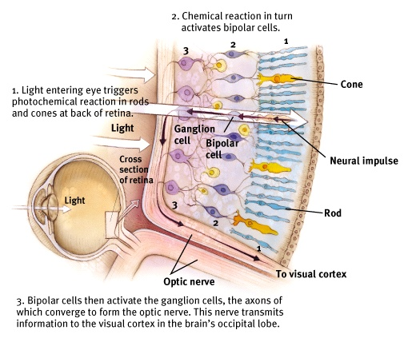
How the Eye Works

Slide 38
Photoreceptors
Photoreceptors: Light-sensitive cells (neurons) in the retina that convert light energy into neural energy.
Rods: Photoreceptors that are especially sensitive to dim light, but not color. (125 mil/eye)
Cones: Photoreceptors that are especially sensitive to colors but not dim light. (7 mil/eye)
Cones are responsible for our ability to “see” colors.

Slide 39
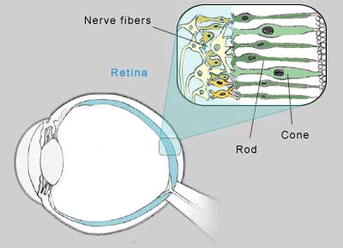
Photoreceptors: Rods, Cones

Slide 40
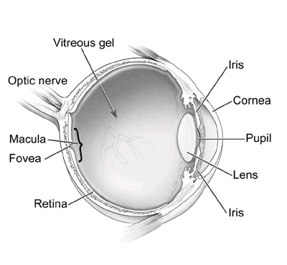
The Fovea
The fovea is the area of sharpest vision.
It has the highest concentration of rods and cones.

Slide 41
The Optic Nerve and The Blind Spot
Optic Nerve: The bundle of neurons that carries the visual information from the retina to the brain.
This is where the stimulus, once changed into a neural impulse, gets passed onto the brain.
Blind Spot: The point where the optic nerve exits the eye and where there are no photoreceptors.
Any stimulus that falls on this area cannot be seen.

Slide 42
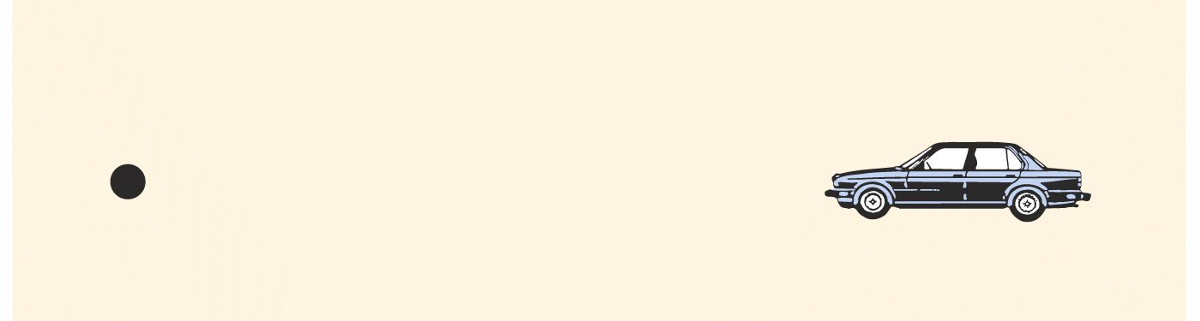
Example From the Book
In your book, turn to page 236.
Can you make the car disappear?
This phenomenon is a result of our blind spots.

Slide 43
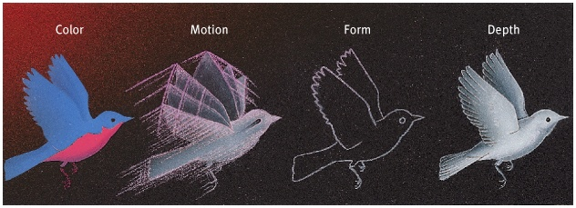
The Visual Cortex
In the visual cortex, the brain begins working by transforming neural impulses into visual sensations of color, form, boundary and movement.
This process is called parallel processing-the simultaneous processing of several aspects of a problem

Slide 44
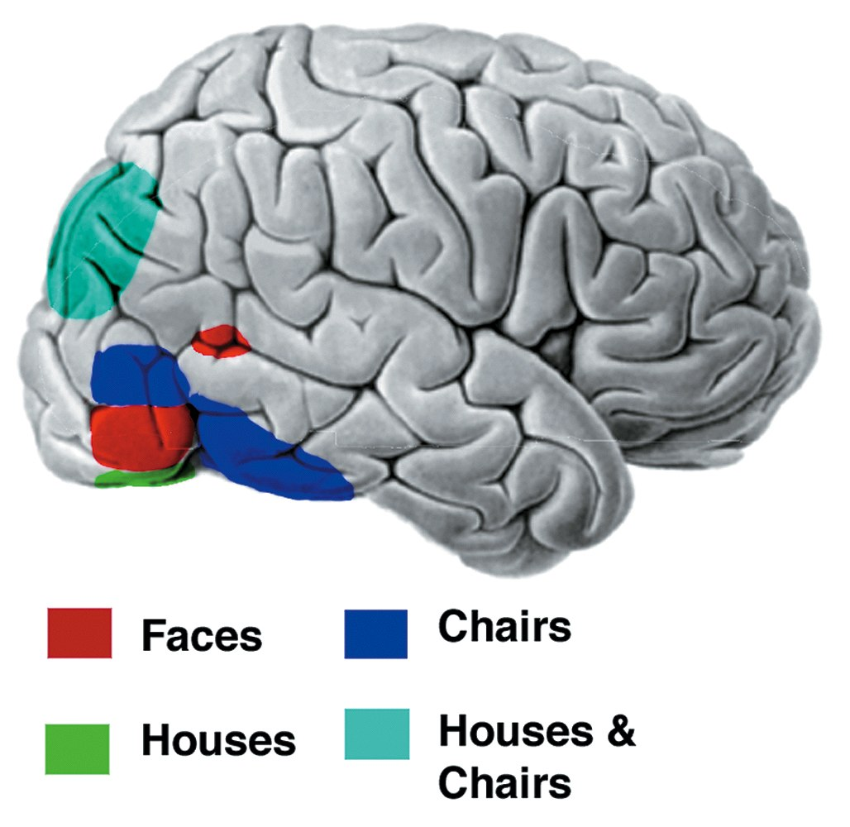
Different parts of the visual cortex are used to identify different images

Slide 45
After Images
Stare at the eye of the red parrot while you slowly count to 20, then immediately look at one spot in the empty birdcage. The faint, ghostly image of a blue-green bird should appear in the cage.

Slide 46
Explanation of Ghostly After Images
The ghostly birds are called afterimages.
As you stare at the red bird, light-sensitive cells at the back of your eyes become less responsive to red light. This is called the opponent processing theory.
Opponent Processing Theory: there are some color combinations that we never see, such as reddish-green or yellowish-blue.
Color perception is controlled by the activity of two opponent systems; a blue-yellow mechanism and a red-green mechanism
When you shift your gaze to the birdcage, your visual system “subtracts” red light from the white light that’s being reflected from the white background. White light minus red light is blue-green light.

Slide 47
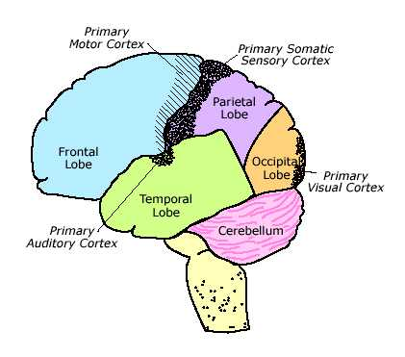
Continued Processing
With further processing, the cortex combines these sensations with memories, motives, emotions, and sensations to create a visual world.

Slide 48
A Colorless World
Despite the way the world appears, color does not exist outside the brain, because color is a perception that the brain creates based on the wavelength of light striking our eyes.
Color is created when the wavelength in a beam of light is recorded by the photoreceptors in the form of neural impulses.
It is then sent to specific regions of the brain for processing.

Slide 49
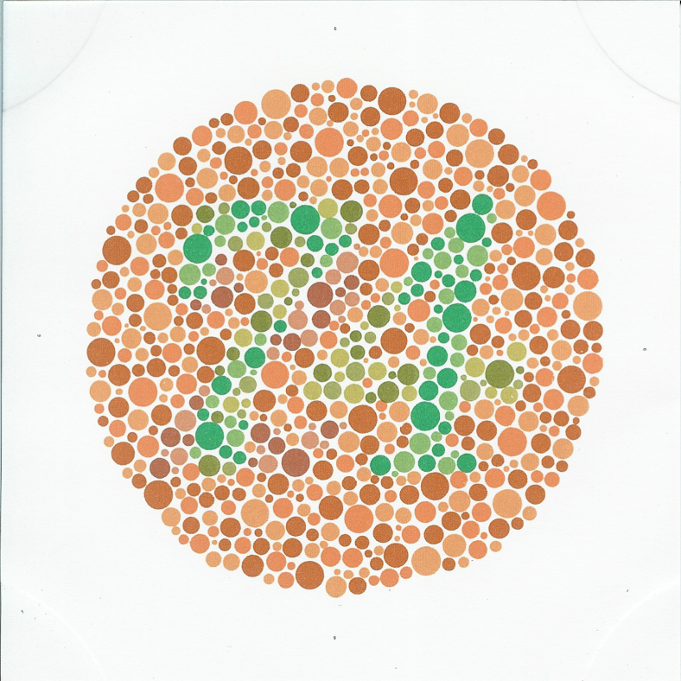
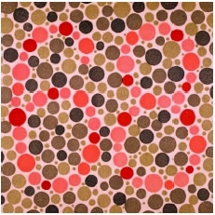
Color Blindness
Not everyone sees color in the same way because some people are born with a color deficiency.
While some people can see no color at all, and are totally color blind, it is rare.
More common is color weakness, where people have a hard time distinguishing between certain colors.

Slide 50
Various Types of Color Blindness

Slide 51
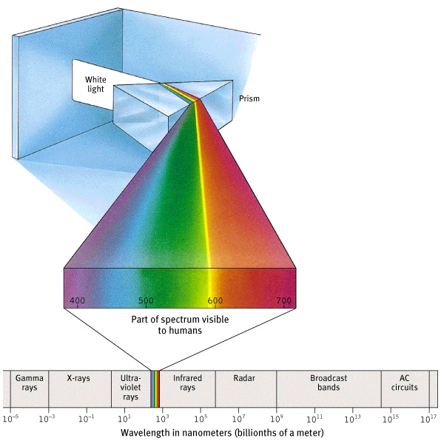
The Spectrum of Electromagnetic Energy
Humans can detect about 5 million different hues.
Shorter Wavelengths
Longer Wavelengths

Slide 52
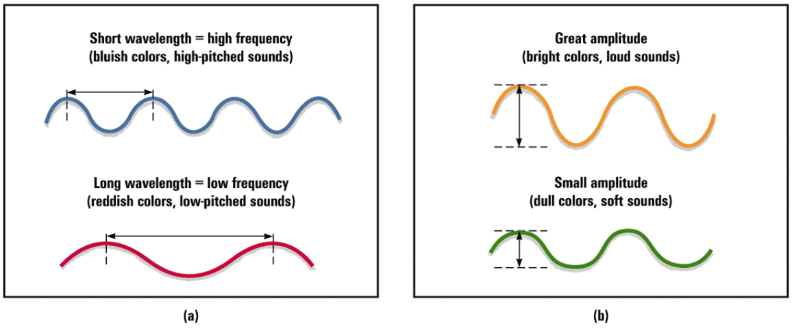
Vision- Physical Properties of Waves
Short wavelength=high frequency
(bluish colors, high-pitched sounds)
Great amplitude
(bright colors, loud sounds)
Long wavelength=low frequency
(reddish colors, low-pitched sounds)
Small amplitude
(dull colors, soft sounds)

Slide 53
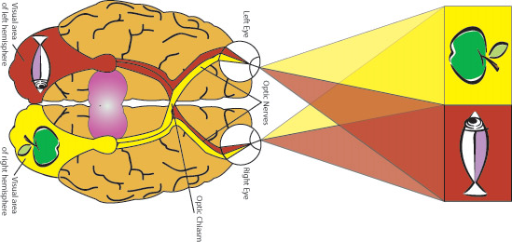
The Visual Pathway

Slide 54
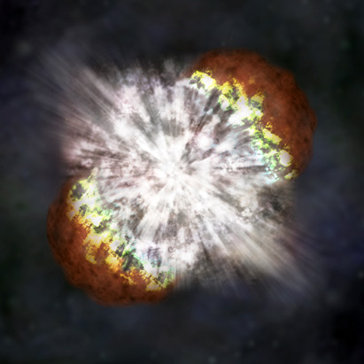
Hearing
The vibrational energy of vibrating objects, such as guitar strings, transfer the surrounding medium-air-as the vibrating objects push the molecules of the medium back and forth.
In space, there is no air, so the sound wave would have no medium to push. Any explosion would be eerily without sound.

Slide 55
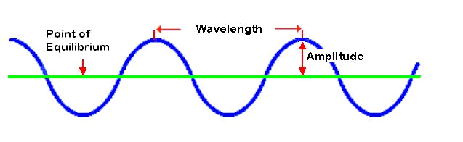
Frequency and Amplitude
There are two physical characteristics of sound: frequency and amplitude.
Frequency: The number of cycles completed by a wave in a given amount of time-determines pitch.
Amplitude: The physical strength of a wave-the “volume” of the sound.

Slide 56
The Process of Hearing
The middle ear transmits the eardrum’s vibrations through a “piston” made of 3 small bones (the hammer, anvil and stirrup) to the cochlea (snail shaped tube).
The incoming vibrations cause the cochlea’s membrane (oval window) to vibrate, moving the fluid that fills the tube. This motion causes ripples in the basilar membrane (hair cells).
The movement of cells triggers impulses in the adjacent nerve fibers which form the auditory nerve that connects via the thalamus to the temporal lobe.

Slide 57
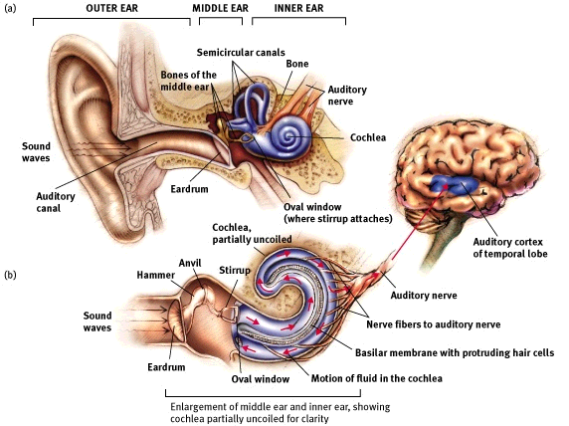
See pages 126-127

Slide 58
Audition
Place Theory
The theory that links the pitch we hear with the place where the cochlea’s membrane is stimulated.
Frequency Theory
The theory that the rate of nerve impulses traveling up the auditory nerve matches the frequency of a tone, thus enabling us to sense its pitch.

Slide 59
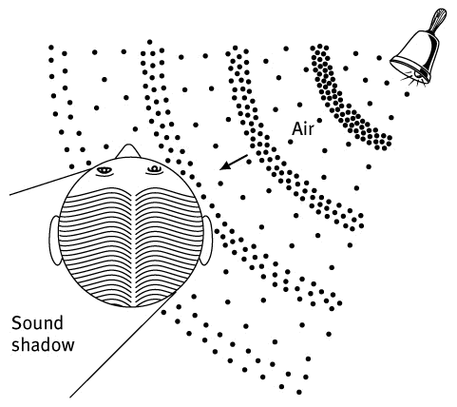
How We Locate Sounds
Notes:
Experiment—have someone sit in front of class with eyes closed. Clap hands around head and ask student to identify where the sound comes from—will be able to do so when the sounds come from one side or the other, but less clearly able to do so when the sounds overhead in back or in front
The perceived difference in sounds is related to the time at which the sound is received

Slide 60
If a tree falls in the forest…
The question “If a tree falls in the forest and there is no one around to hear it, does it still make a sound?” can now be answered.
No, it would make no sound.
Sound is a purely psychological sensation that requires an ear (and the rest of the auditory system) to produce it.

Slide 61
Deafness
There are generally two types of deafness.
Conduction deafness is an inability to hear, resulting from damage to the structures of the middle or inner ear.
Nerve deafness (Sensorineural Deafness) is an inability to hear, linked to a deficit in the body’s ability to transmit impulses from the cochlea to the brain.

Slide 62
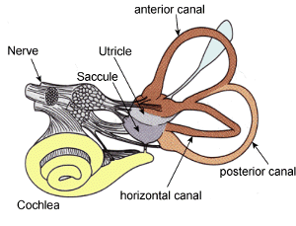
Position and Movement
There are two physical mechanisms that keep track of body position.
Vestibular sense: The sense of body orientation with respect to gravity
The receptors for this information are tiny hairs in the semicircular canal of the inner ear.
Vestibular System

Slide 63
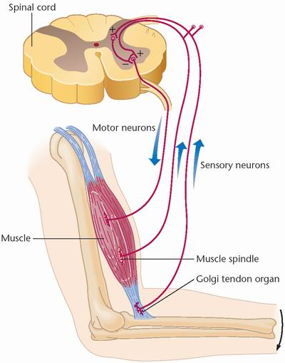
Position and Movement
The kinesthetic sense keeps track of body parts, relative to each other.
Kinesthesis provides constant sensory feedback about what the muscles in your body are doing.
Receptors for kinesthesis reside in joints, muscles and tendons. These receptors are usually automatic, unless the person is learning a new skill.

Slide 64
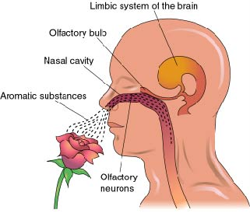
Smell
The sense of smell is olfaction.
Odors first interact with receptor proteins associated with hairs in the nose.
The hairs convey information to the brains olfactory bulbs, located on the underside of the brain.
In humans, olfaction has a close connection with memory.
Certain smells, such as a favorite perfume, can evoke emotion-laden memories.

Slide 65
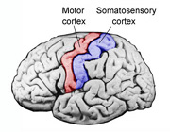
Taste
The sense of taste is gustation.
Human taste has four main qualities: sweet, sour, bitter and salty.
Specialized nerves carry nothing but the taste messages to the brain. There taste is realized on a specialized region of the parietal lobe’s somatosensory cortex.

Slide 66
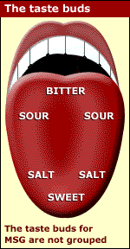
Taste
Taste receptors can be easily damaged by alcohol, smoke, acids or hot foods.
Fortunately, gustatory receptors are frequently replaced.

Slide 67
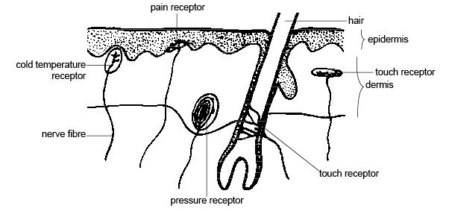
The Skin Senses
Skin senses are also connected to the somatosensory cortex.
The skin’s sensitivity to stimulation varies tremendously over the body, depending on the number of receptors in each area.

Slide 68
A Touch Sensation Experiment
Touch localization demonstration, concentrate on where the sensations of touch are felt:
Touch two index fingers together, feel it in both
Touch finger to bottom lip, light taps, felt mostly in lip even though both are being stimulated
Touch ankle, now its felt mostly in finger
Touch localization depends on the relative lengths of the pathways from the stimulated parts to the brain

Slide 69
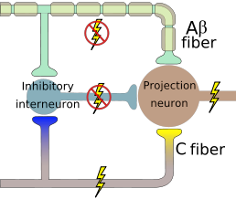
Pain Receptors
Gate-control theory: An explanation for pain control that proposes we have a neural “gate” that can, under some circumstances, block incoming pain.
Pain is sensed by two different sensory pathways, one moving very fast, one moving slower.
The level of pain one feels results from the combination of information from both pathways.

Slide 70
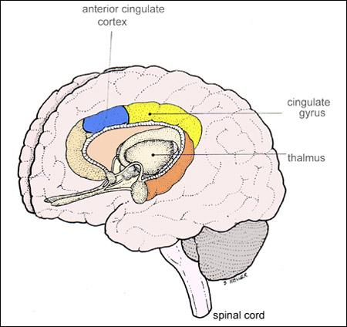
Gate-Control Theory
Ultimately, pain signals are routed to the anterior cingulate cortex located along the fissure separating the frontal lobes.
Pain medication works by blocking the faster of the two neural pathways.

Slide 71
Perception
Perception: A mental process that elaborates and assigns meaning to the incoming sensory patterns.
Perception brings meaning to sensation. It produces an interpretation of the world, but it isn’t a perfect representation.
We perceive the world not exactly as it is, but as it is useful for us to perceive it.

Slide 72
Describe This Picture
The Forest Has Eyes by Bev Doolittle
Bottom-Up: Lines, angles and colors…a guy riding a horse through the forest
Top-Down: We consider the title and direct our attention to aspects that will give meaning to it.

Slide 73
Bottom-Up and Top-Down
Bottom-Up processing: Analysis that emphasizes the characteristics of the stimuli rather than our concepts and expectations.
Top-Down perception: Analysis that emphasizes the perceiver’s expectations, concept memories and other cognitive factors, rather than individual characteristics.

Slide 74
Feature Detectors
Our brains have specialized cells whose job it is to identify specific features of a stimuli.
We do not know how the brain combines these features to make a single percept. This problem is known as the binding problem.

Slide 75
Perceptual Consistency
The ability to recognize the same object as remaining “constant” under changing conditions is called perceptual consistency.
There are three examples of perceptual consistency including size (different distances), color (different lighting) and shape (different angles).

Slide 76
Types of Blindness
Inattentional Blindness: Failing to see visible objects when our attention is directed elsewhere.
Moon-walking Bear
Change Blindness: Failing to notice change in the environment around us.
Card Trick
Choice Blindness: Failing to notice a change in a previously selected item
Face Test

Slide 77
Illusions
Sometimes your mind will play a trick on you and interprets a stimulus incorrectly.
When your mind interprets an image that is demonstrably incorrect, it is called an illusion.
Lets look at an illusion!

Slide 78
The Hermann Grid
Stare at the center of grid. Note how dark fuzzy spots appear at the intersections of the white bars.
Now focus on the intersections, there are no spots.
Why does this illusion exist?
While most cones have a direct neural pathway to the brain, rods do not and have to share with many other neurons. Not all can send their information at the same time, so we are left with mini “blind spots.”

Slide 79
How the Illusion Works
The reason for this illusion lies in the way the receptor cells in your visual pathway interact with each other.
The firing of certain cells that are sensitive to light-dark boundaries inhibits other cells that would detect the white lines. This blocking process makes you sense darker regions.

Slide 80
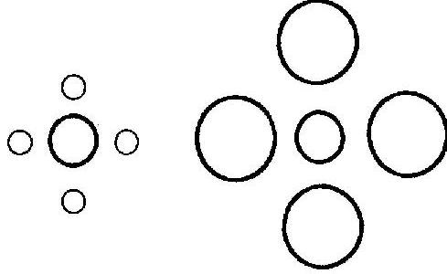
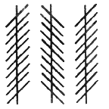
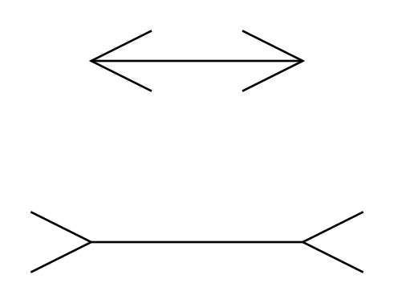
Other Illusions at the Perceptual Level
Ebbinghaus Illusion
Poggendorf Illusion
Zollner Illusion
Muller-Lyer Illusion

Slide 81
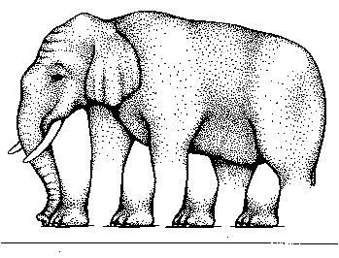
More Illusions at the Perceptual Level

Slide 82
Muller-Lyer Illusion
One theory for why this illusion exists is that we unconsciously interpret the lines as 3D images. We see the ends as angles that point toward us or away from us. Therefore, we judge the outside corner to be closer and shorter.
But what if you lived in a culture that had no square-cornered buildings?
Muller-Lyer Illusion

Slide 83
The Zulus
This questions was addressed in the 1970s when scientists took this image to South Africa and the Zulu people who live in a rounded culture.
Almost exclusively, the Zulu perceived the lines as being the same size.
What does this lead us to conclude about perception? (Hint: learned or inherited?)

Slide 84
The Gestalt Theory
Gestalt Psychologists argue that the brain forms a perceptual whole that is more than the mere sum of its sensory parts.

Slide 85
Pre-wired
Humans see a square as a single figure rather than four lines.
Psychologists argue that examples like this show that humans organize sensory information into meaningful patters. The most basic of these patterns are pre-wired into our brains at birth.

Slide 86
Figure and Ground
Gestalt Psychology divides perceptual experience into figure and ground.
Figure: The part of a pattern that commands attention…stands out.
Ground: The part of the pattern that does not command attention…background.

Slide 87
Closure: Filling in the Blanks
Our minds do a funny thing, they provide closure. That is, they make us see incomplete images as wholes by supplying the missing segments or filling in gaps.
Generally, humans have a natural tendency to perceive stimuli as complete and balanced even when the pieces are missing.

Slide 88
What shapes do you see in each image?

Slide 89
Law of Perceptual Grouping
Law of Similarity: The Gestalt principle that we tend to group similar objects together in our perceptions.
Do you see x o x o x
rows or x o x o x
columns? x o x o x
x o x o x
x o x o x

Slide 90
Law of Perceptual Grouping
Law of Proximity: The Gestalt principle that we tend to group objects together when they are near each other.
Do you see 5 Xs and 5 Os, or 5 pairs of Xs and Os?
XO XO XO XO XO

Slide 91
Law of Perceptual Grouping
Law of Continuity: The Gestalt principle that we prefer percepts of connected and continuous figures to disconnected and disjointed ones.
Are these two continuous lines, or do they have breaks?

Slide 92
Law of Perceptual Grouping
Law of Common Fate: The Gestalt principle that we tend to group similar objects together that share a common motion or destination.
Think a school of fish, a flock of seagulls, a murder of crows

Slide 93
Laws of Perceptual Grouping
Law of Pragnanz: The Gestalt principle which states that the simplest organization, requiring the least cognitive effort, will emerge as the figure.
What is wrong with this image?

Slide 94
Context and Expectations
Humans often use context to help interpret out sensations. Once you identify a context, you form expectations about what you are likely to experience.
Context is an enormously useful cue to identify ambiguous stimuli.

Slide 95
Perceptual Set
Perceptual set is a readiness to detect a particular stimulus in a given situation—think of when you are afraid and staying home alone and you notice every noise and think it is a threat.
Here is another example. What is the last word in each line?
FOX; OWL; SNAKE; TURKEY; SWAN; D?CK
BOB; RAY; DAVE; BILL; TOM; D?CK

Slide 96
More Perceptual Sets

Slide 97
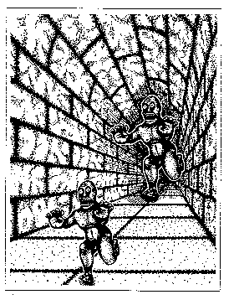
Which monster is bigger?

Slide 98
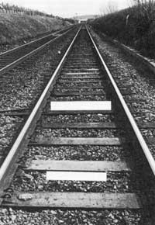
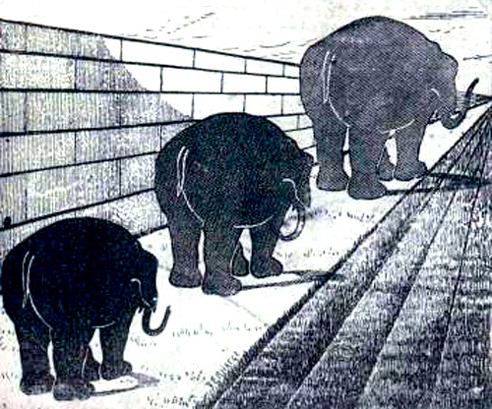
Cultural Influences on Perception
Look at the Ponzo Illusions below.
Which Line is longer?
Which Elephant is Biggest?

Slide 99
Cultural Influences on Perception
To most of us, like “A” looks longer. Psychologist says this may be a result of the culture we have grown up in which includes structures with long parallel lines that seem to converge in the distance.
People who live in cultures without these such lines, like those in Guam see them as the same length. There are no long, straight railroad tracks or roads in Guam.

Slide 100
Cultural Influences on Perception
Research has supported the conclusion that people who live in cultures without long, parallel figures are less likely to report the top line being the longer figure.
These results strongly support the argument that a person’s experiences affect their perceptions.

Slide 101
A Music Experiment
Now we will do an experiment based on music and perception.
For this experiment, all you have to do is sit back and enjoy the music.

Slide 102
Good Music-Cultural Context
Subway Concert
A description of the study

Slide 103
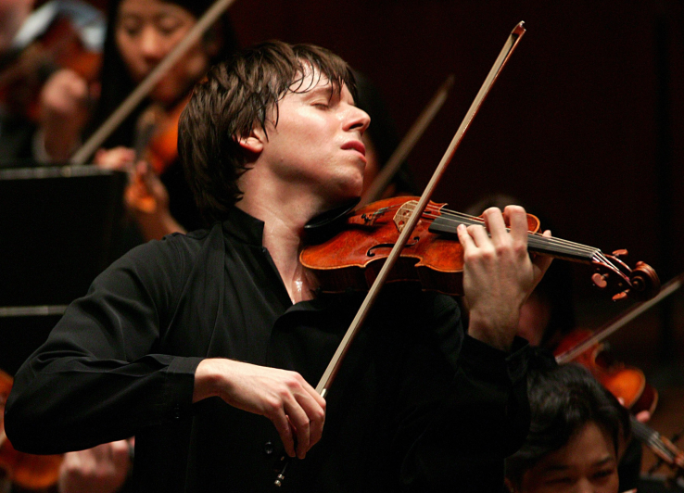
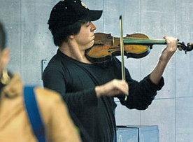
A Matter of Perception
In January of 2007, the Washington Post did a social experiment about perception. They had Joshua Bell, one of the world top violinists, play during the morning commute at a Washington subway station.
Though over 1,000 people walked by, few stayed to listen. The week prior Bell filled a concert hall in Boston with tickets selling for over $100.

Slide 104
The End
If you assume your senses give you an accurate and undistorted picture of the world, you are probably wrong. If you don’t believe me, try this.
Silently read the backwards statement below. Flip if over in your mind. What does it say?
.rat eht saw tac ehT

Slide 105
Answer
How many people saw this:
The cat saw the rat.
Look at it again:
.rat eht saw tac ehT
How many people saw this:
The cat was the rat.
Answer:
The cat was the tar.

