Slide 1
Diversity in Ecosystems
Slide Show4

Slide 2
In Canada, 250 species of plants and animals are “at risk”.
By “at risk” we mean categorized as;
Extinct, (species not found anywhere)
Endangered, (close to extinction)
Extirpated, (No longer exist in one part, but can be found in another)
Threatened, (Likely to become endangered if nothing is done)
Vulnerable. (any species at risk because of low or declining numbers)

Slide 3
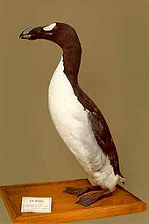
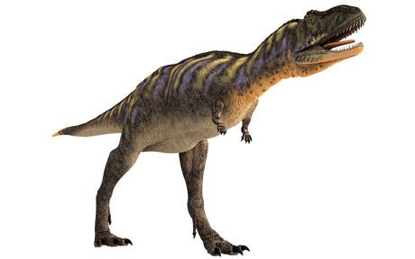
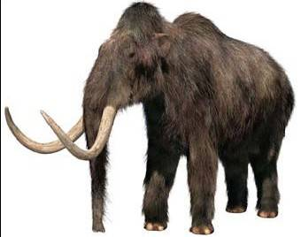
Extinct, (species not found anywhere)
Dinosaurs, Great Auk, Wooly Mammoth

Slide 4
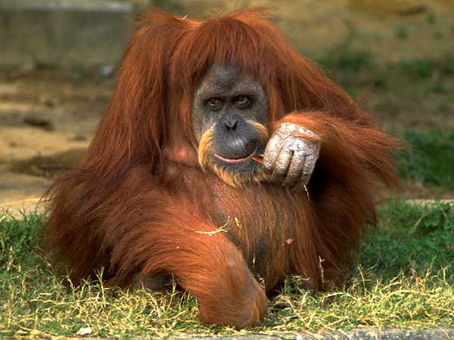
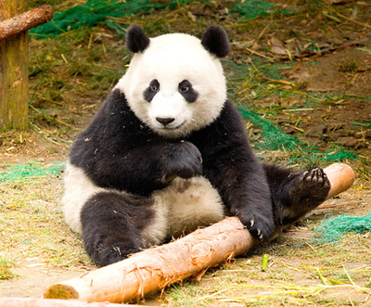
Endangered, (close to extinction)
Panda, Orangatang

Slide 5
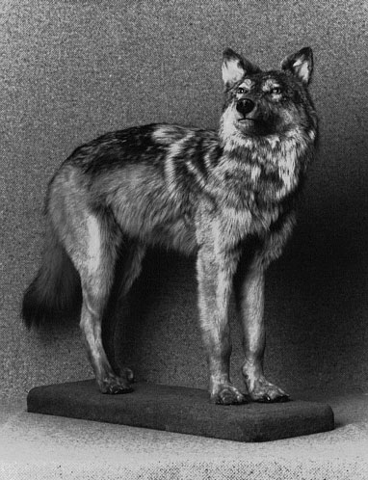
Extirpated, (No longer exist in one part, but can be found in another)
The Newfoundland Wolf

Slide 6
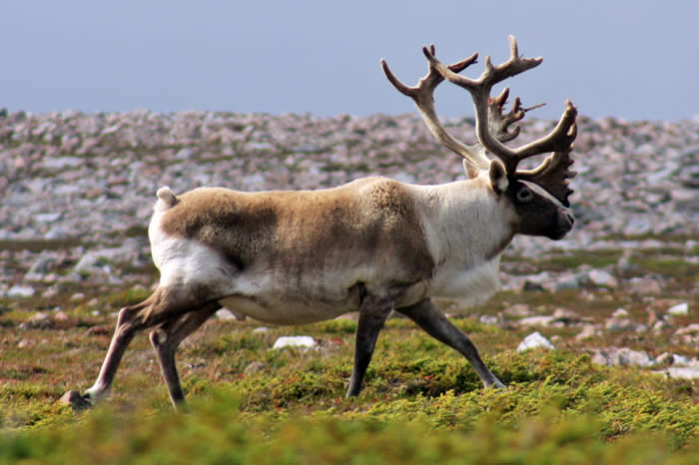
Threatened, (Likely to become endangered if nothing is done)
Newfoundland Woodland Caribou

Slide 7
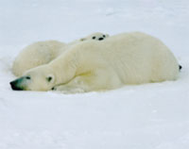
Vulnerable. (any species at risk because of low or declining numbers)
Polar Bear

Slide 8
Causes of Extinction:
Loss of Habitat
Pollution of air and water
Large-scale disaster (natural environmental change)
Climate changes
Competition from other species
→The single largest factor that cause species to be At-Risk is humans!!!!!

Slide 9
Effects of Extinction:
Loss of Biodiversity
Collapse of food chains
Endangered Species: A species that is close to extinction in a large area.

Slide 10
Humans, a recent addition to the planet, have had a profound effect on other organisms.
In the early years of the 21st century, it is estimated that one species will become extinct every 30 minutes.
The majority of threatened species can be found in tropical rainforests.

Slide 11
Nearly 500 million different species have inhabited the planet. Of these, more than 90% have become extinct or have evolved into new species.
Mass Extinction is the destroying of large numbers of species due to large scale disaster

Slide 12
For your discussion:
Scientists believe they can sustain endangered species - maybe even one day resurrect some that have died out - using DNA technology
http://www.youtube.com/watch?v=68QhIQLeVUA&feature=related&safety_mode=true&persist_safety_mode=1&safe=active

