Slide 1
Diversity in Ecosystems
Slide Show4

Slide 2
Disappearing Frogs
Frogs of Canada:
We can expect to find Frogs in just about every Ecosystem across the country
They’ve been around for about 400 million years and even survived the extinction of the dinosaurs!!!
Today, we find that their numbers are decreasing and that about 30% of our Frog species are in trouble
The main cause of this is believed to be the growing human population

Slide 3
Health of Ecosystems
Scientists believe that the health of amphibians is an indicator of how healthy an Ecosystem is
Example: a frog occupies two ecosystems in its lifetime: What are they? The eggs develop into tadpoles in ponds; adults live in forests and grassland areas.
As a result, any problem that exists in either of these Ecosystems will have an effect on the Frog population

Slide 4
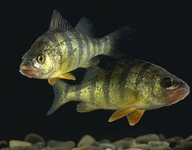
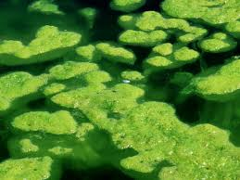
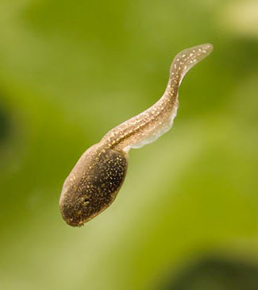
Frogs are also part of two very different food chains:
Dead Algae→Tadpole→Water Boatman→Yellow Perch

Slide 5
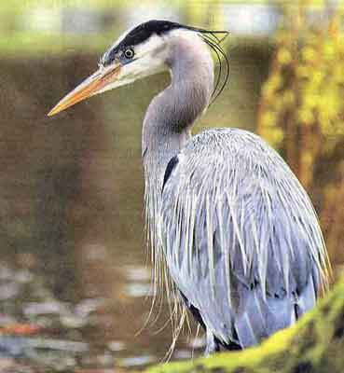
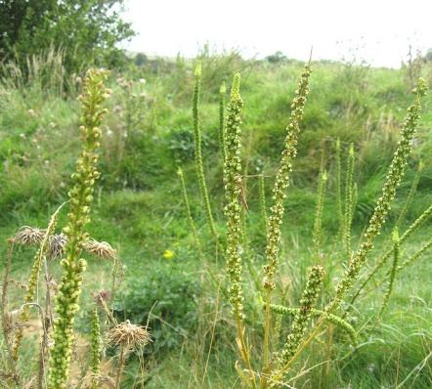
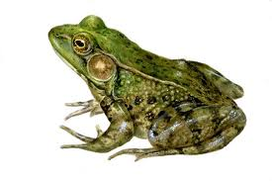
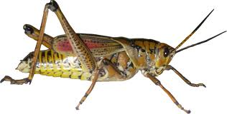
Grasses→Grasshopper→Frog→Heron
What would happen if Frogs were wiped out?

Slide 6
Why are the Frogs Disappearing?
1. Loss of Habitat
2. Air and Water Quality
3. Ultraviolet Radiation
4. Climate Change

