Slide 1
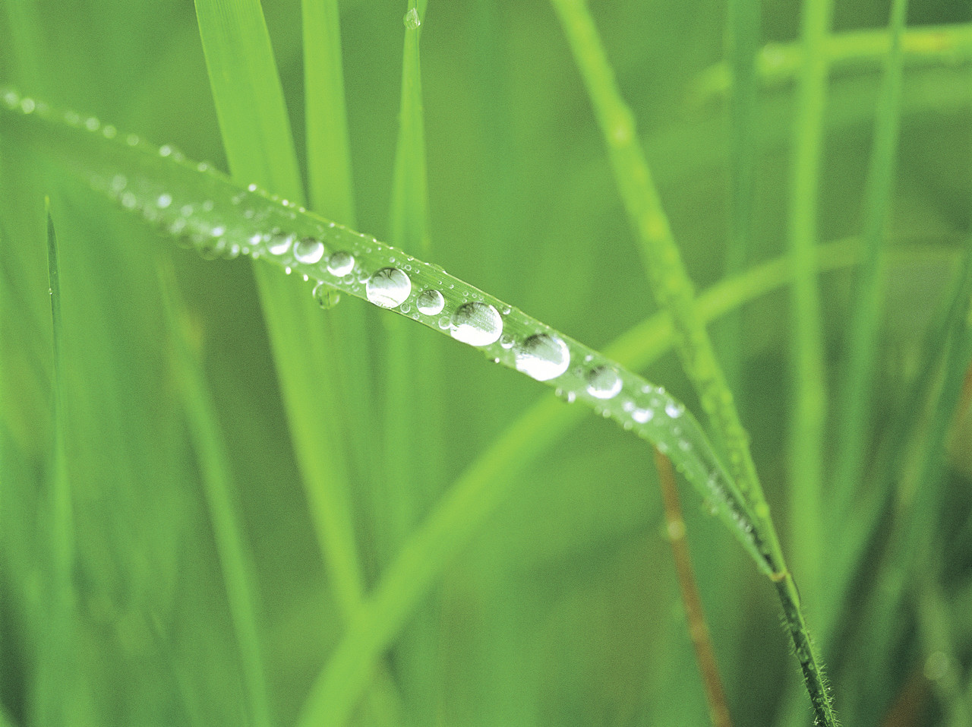
Diversity in Ecosystems
Slide Show 2

Slide 2
The Earth as a closed ecological system:
Content: Page 6-7
Closed System: A system in which there is no, or minimal, input of new material from the outside. (Self-sustaining)
The earth is like this
Only the sun’s energy can enter and some heat can leave

Slide 3
The Earth as a closed ecological system:
We have a number of resources which must be managed properly and recycled
There are nonrenewable resources
If we run out of oil, for example, there won’t be any more arriving by courier, it is gone forever

Slide 4
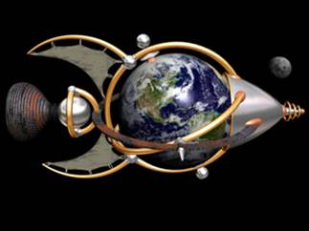
The Earth as a Spaceship:

Slide 5
The Earth as a Spaceship:
Think of a spaceship
There is a supply of oxygen, food, and shelter
All organisms on board work together to make sure all the systems are working properly
Really, it is an ecosystem

Slide 6
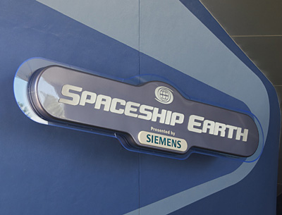
The Earth as a Spaceship:
We can think of the planet Earth as a spaceship
If any malfunction occurs, the red alert flashes and something must be done or else the whole system will fail

Slide 7
Sustainability:
The development of our resources to meet our present needs without reducing the ability of future generations to meet theirs
If we make sure we don’t take or use too much now, we ensure that there will be some later
A sustainable system is one that survives, functions and is renewed over time

Slide 8
http://www.youtube.com/watch?v=ROZJmX73FF4
http://www.youtube.com/watch?v=VuH-ThmNUjM&feature=related

