Slide 1
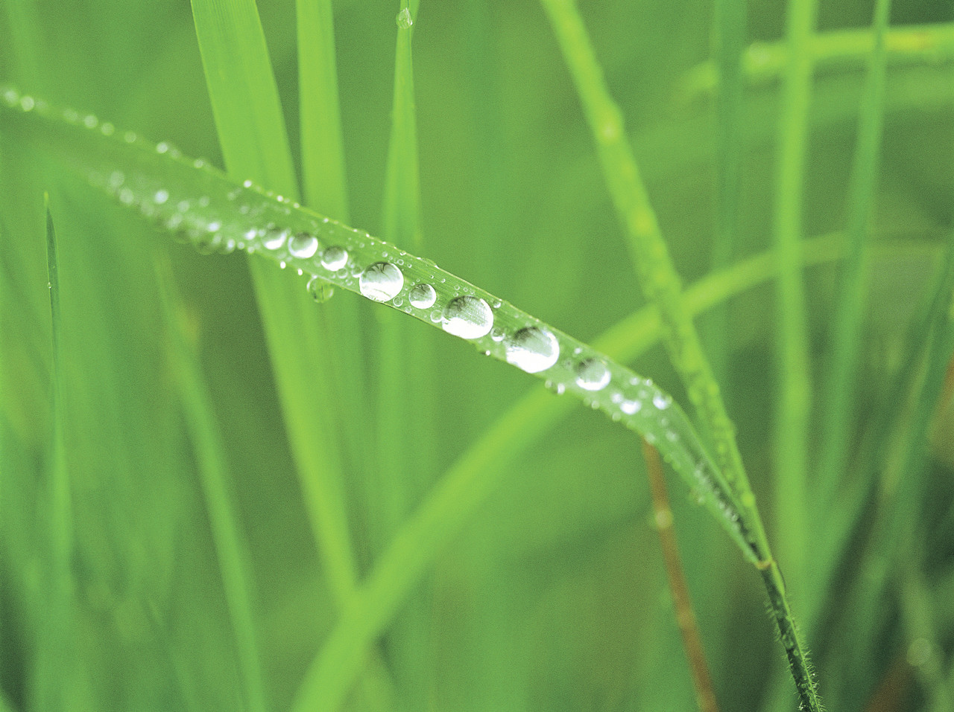
Introduction to Ecology and Ecosystems

Slide 2
Paradigm Shift:
Rare occurrence that represents a change in the way people view the world.
Most people cling to their beliefs even when there is evidence to the contrary
The “shift” occurs when
more and more people
begin to view the world
in the “new” way

Slide 3
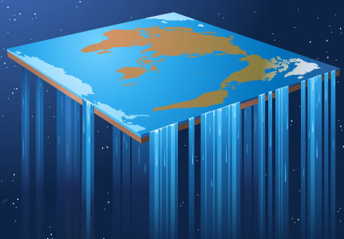
Can you think of any paradigm shifts in history?
  The world is round or flat!!!!
  The earth revolves around the sun or vice versa!!!!

Slide 4
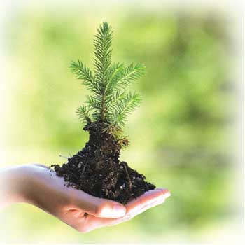
Explore your thoughts
  Do you think there is a current paradigm shift underway with regard to the environment and sustainability?
  People used to think that the world and everything in it exists for our sole benefit. Is this still true today?

Slide 5

Explore your thoughts
  What is the value of a forest? Lake?
  Do trees only have value when harvested?
  Is it important to take care of our environment? Why or why not?

Slide 6
Our Changing Attitudes Towards the Environment:
What do people do now that they didn’t do 40 years ago?
  Recycle
  Very few will throw trash out the car window
  Overfishing, pollution, and global warming, for example, are publicized topics today
Bill Nye Pollution Solutions (23mins)

