Slide 1
Reproductive Technologies

Slide 2
Human Infertility vs Human Sterility
Infertility
Term describing couples not having the ability to have more children than wished. Couples are considered to be infertile if they have been unsuccessful for one year in becoming pregnant
Sterility
Term used to describe couples unable to have any children

Slide 3
Causes of Human Infertility/ Sterility
Blocked oviduct: the oviducts become blocked usually as the result of an STI not allowing for fertilization of the egg
Failure to Ovulate: usually caused by hormonal imbalance( FSH/LH estrogen etc)
Endometriosis: painful condition where the endometrium grows outside the uterus. Results in non implantation of fertilized egg
Obstruction in Vas deferens or Epididymis:
STI’s, varicose veins.etc may cause obstructions in the vas deferens causing sperm to not be released from the male and into he female. No fertilization results

Slide 4
Low sperm count– caused by numerous factors including overheated testicles, smoking and alcohol
Abnormal sperm– caused by STI’s , overheated testicles and toxins

Slide 5
Technological Solutions to Infertility
These are technological advances that help overcome the barriers/ causes of infertility
Intra uterine insemination (IUI) – formerly known as AI (artificial insemination),washed prepared sperm are placed in the uterus near the egg during ovulation. This procedure is used in conjunction with fertility drugs.
In vitro Fertilization (IVF) – fertilization of an egg occurs outside the body. The fertilized egg is implanted in the uterus
In Vitro Maturation (IVM) follicles are removed from a woman and causes to mature . Several ooyctes are used for in vitro fertilization
Super ovulation- injections of drugs (fertility drugs) causes several follicles within the ovaries to mature. Several eggs are released with hopes of fertilization.
Surrogate motherhood- a fertilized egg is placed into the uterus of another woman or sperm from a male is used to fertilize the egg of another female
Embryo storage (Cyropreservtion)- fertilized eggs or embryos are preserved by freezing them. Can be used at a later date etc.

Slide 6
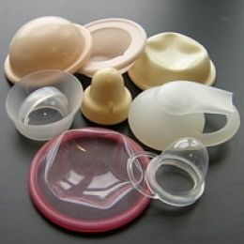
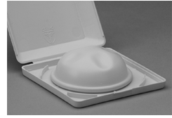
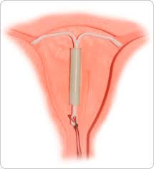
Birth Control Technologies
These are technologies aimed at controlling reproduction /birth
They are classified on the basis of how they control birth.
Barrier methods- technologies aimed at keeping conception from happening.
They include:
condoms( both male and female)
diaphragm( blocks the cervix)
spermicidal jellies and foams (contain chemicals
that help kill sperm)
IUD-intrauterine device (blocks implantation in the uterus

Slide 7
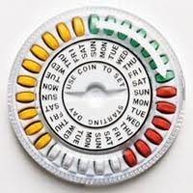
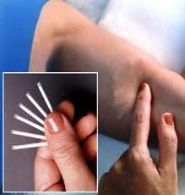
Hormonal methods
The use of hormones to stop conception.
They include:
Birth control Pill- a pill containing progesterone/ estrogen hormones that blocks the release of an egg
Norplant- slow release hormones are implanted
under the skin. They block the release of the egg.
Depo Provera- injections of hormones are given every few months. These hormones block the release of eggs.
Morning after Pill- This is a pill taken after intercourse. If an egg is fertilized, it is kept from implanting in the uterus.

Slide 8
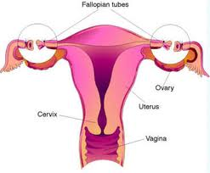
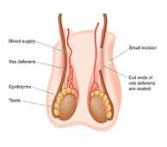
Surgical methods
The use of surgery to help prevent conception.
They include:
Tubal Ligation- the oviducts( fallopian tubes) are cut and tied
Vasectomy- The vas deferens in males is cut and tired

Slide 9
Other methods
These include:
Abstinence
Rhythm Method- using timing and temperature to determine time when woman is ovulating. Intercourse is avoided during this time.

