Slide 1
Plant Reproduction

Slide 2
Flowering Plants
Known as Angiosperms (covered seed plants)
Undergo sexual reproduction
Have evolved to be away from water, thus no dependence on water for reproduction
Have evolved specialized structures for reproduction

Slide 3
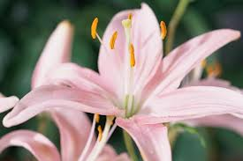
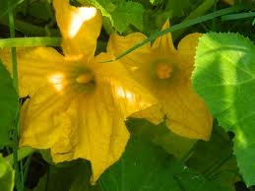
Two Types of Flowering Plants
Perfect Flower
Has both male and female reproductive structures
Capable of undergoing self-pollination (fertilization)
Imperfect Flower
Has either male or female reproductive structure only.

Slide 4
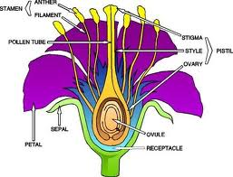
Reproductive structures of Flowering Plants

Slide 5
Female Reproductive Structures
Pistil: female reproductive structure of a flower. Made up of the Stigma, style and Ovary
Stigma: Sticky portion on top of thr style in a flower.
Function: Trap Pollen from the air for reproduction.
Style: Slender tube leading from the stigma to the ovary in a flower
Function: Passage way for pollen leading to the ovary.
Ovary: reproductive structure of a flower that contains eggs. Eggs are created by meiosis in this structure. Eggs contain haploid (n) chromosome number.
Function: Site of fertilization within the flower.

Slide 6
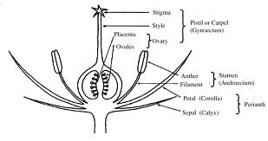
Female Structures

Slide 7
Male reproductive Structures
Stamen: The male reproductive structure of a flower. Made up of the Anther and Filament.
Anther: Reproductive structure of a flower that contains Pollen. Pollen is crested by Meiosis.
Function: Create pollen for fertilization
Pollen: Small round structures located within the anther of a flower that contains the male sex cells ( sperm) . Pollen contains haploid(n) the chromosomes number as the parent cell.
Filament: long slender stalk that holds up the anther

Slide 8
Creation of Egg and pollen within Flowering Plants
Note: both eggs and pollen are created through MEIOSIS within the flowering plants.
EGG FORMATION WITHIN A FLOWER
Within the ovule of a flower, a diploid cell undergoes meiosis to create 4 haploid (n) cells. Three of these cells die.
The remaining haploid cells undergoes mitosis three times to create a total of 8 haploid structures within the ovary. One of these will be the egg.

Slide 9
Egg Formation
`
n
n
These Die
Mitosis 3 Times
n
2n
n
n
n
n
n
n
n
n
Meiosis in Ovary
n
n
n
n
n
n
n
n

Slide 10
Pollen Formation within a Flower
A diploid (2n) cell within the sac of the anther undergoes meiosis to produce 4 haploid (n) cells called microspores.
Each microspore undergoes mitosis to create two haploid nuclei known as the tube nucleus and the generative nucleus
The outer wall of the microscope hardens and is now called a pollen grain.

Slide 11
Nucleus (DNA)
Generative Nucleus
Meiosis
Mitosis
Tube Nucleus
Diploid cell in anther
Microspores (n)
Pollen Grains

Slide 12
Sexual Reproduction / Fertilization in Flowering Plants.
The following events happen during reproduction in a flowering plant
Pollen grains reach the stigma and stick to the surface of the style
The tube nucleus begins to dig a pollen tube down through the style on its way to the ovary
At the same time the generative nucleus divided by mitosis to produce two haploid sperm nuclei(sperm)
The sperm nuclei make their way down through the pollen tube and into the ovule
One of the sperm fertilizes the egg and produces a diploid (2n) zygote.
The other sperm joins with the two polar nuclei to from a triploid (3n) structure known as an endosperm.
The ovule becomes the SEED and eventually a new plant.
The endosperm provides food for the developing seed

Slide 13
Terminology
Ovule: area inside the ovary where an egg and two polar nuclei are found. The ovule is the site of fertilization within a flower
Tube nucleus: nucleus within a pollen grain that forma the pollen tube in a flower
Generative Nucleus: nucleus within a pollen grain that produces two sperm nuclei or sperm
Pollen Tube hollow tube leading from the stigma to an ovule within the ovary of a flower
Polar Nuclei; two haploid (n) structures within the center of an ovule
Zygote: a fertilized egg. A diploid (2n) structure
Seed structure formed from the ovule of a flower. It contains the zygote(developing plant) and endosperm.
Endosperm triploid structure formed when a sperm nucleus fuses with two polar nuclei within an ovule. This is food source within a seed for s developing plane embryo
Fruit: A swollen ovary of a plant. It surrounds and helps to protect developing seeds.

