Slide 1
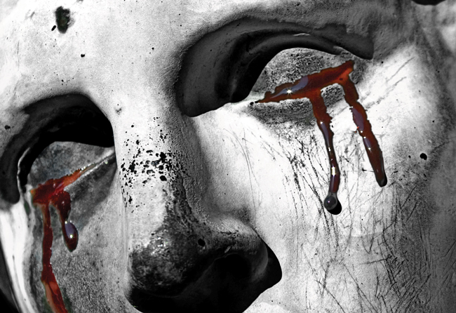
Oedipus Rex The Tragic Hero

Slide 2
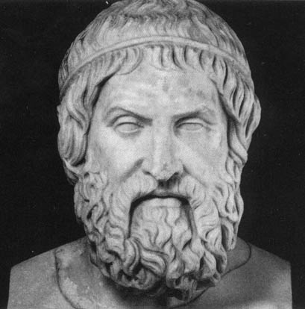
Aristotle’s Definition of a Tragic Hero
A person of high birth, but not pre-eminently just, who, through some flaw in his character, precipitates his own destruction

Slide 3
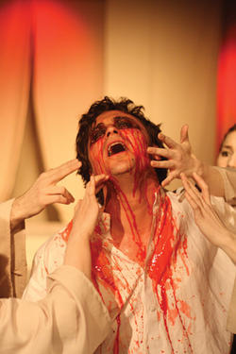
Oedipus’ Tragic Flaw:
Hubris

Slide 4
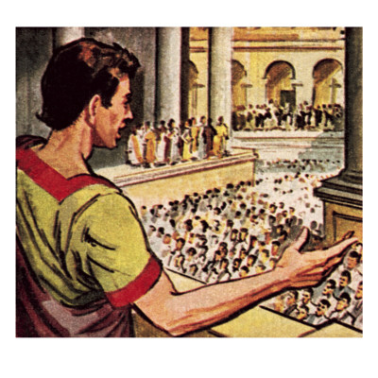
First sign is in the prologue when Oedipus wants to make all decisions in front of the crowd so everyone can see his greatness.

Slide 5
- He quickly makes laws against Laius’ killer, without thinking them through
-He brings the curse of Laius’ against himself – rash decision

Slide 6
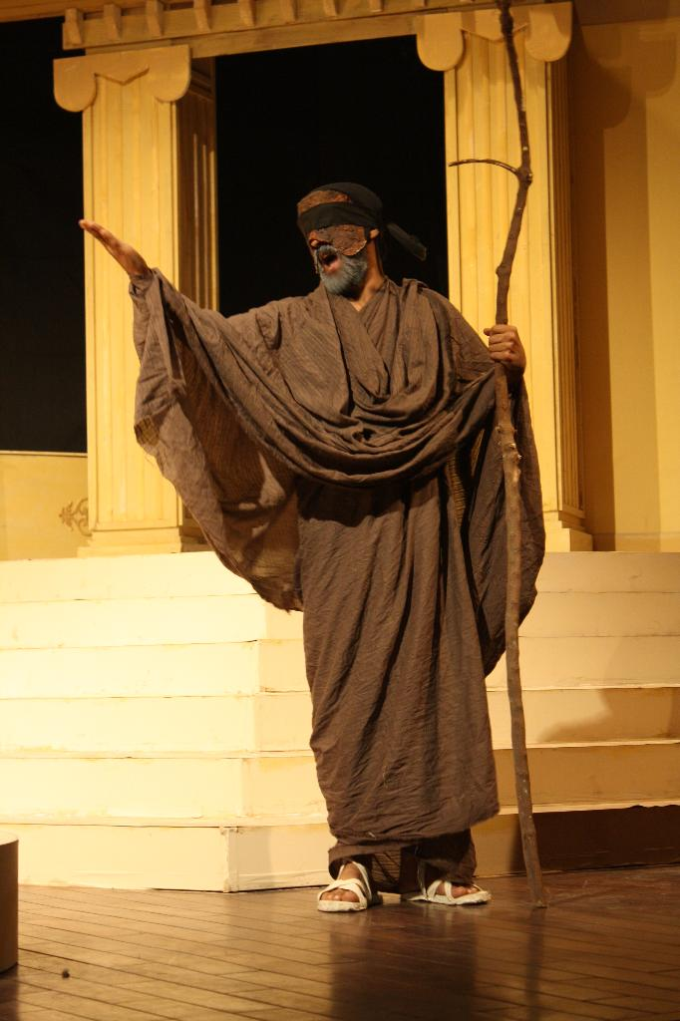
- Oedipus makes fun of Teiresias and accuses him of conspiracy when he won’t talk – doesn’t realize that Teiresias is trying to help him by not talking

Slide 7
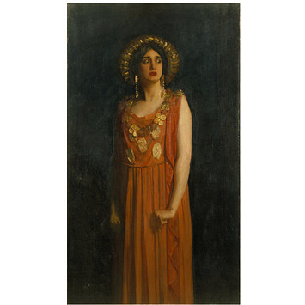
- Various people (Teiresias, Jocasta) try to get him to stop pushing the issue, but Oedipus needs to know the truth behind his past – at whatever cost

Slide 8
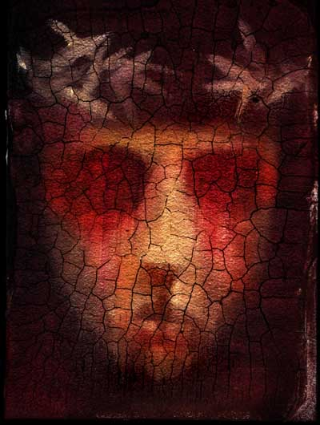
Oedipus as a Tragic Hero

Slide 9
High Birth
- Son of the King and Queen of Thebes (Adopted son of the King and Queen of Corinth)

Slide 10
Flaw in Character
- Excessive pride, hubris. Oedipus’ pride and determination to prove his worth as King left him to seek the truth about Laius’ murder. Pride blinded him to the fact that people tried to stop him – he couldn’t see it.

Slide 11
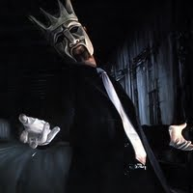
Precipitates own destruction

Slide 12
- Oedipus made numerous decisions that lead to his downfall
His temper caused him to kill Laius
- His pride and rashness caused him to bring the curse down on himself as well as everyone else in Thebes

Slide 13
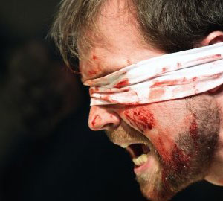
- He repeatedly did not listen when people told him not to pursue the truth

Slide 14
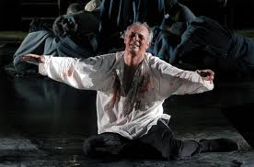
Destruction

Slide 15
Oedipus realizes that he killed his father, married his mother and had children with her
- Because of his law, he banned himself from Thebes
- In the end, his wife killed herself and he blinded himself so he wouldn’t have to face his parents in the afterlife.

Slide 16
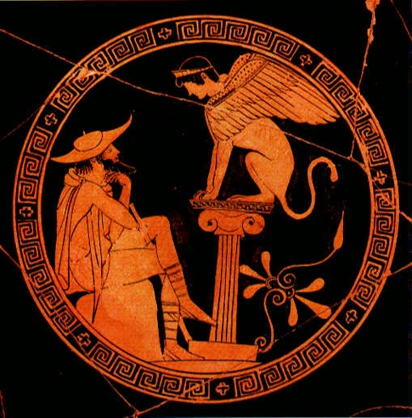
The Tragedy of Oedipus

