Slide 1
Oedipus Rex
Themes, Symbols and Motifs

Slide 2
Themes

Slide 3
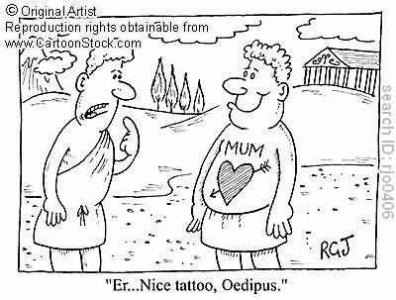

Slide 4
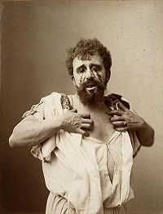
Blindness
Physical- Oedipus blinds himself
Intellectual- Oedipus’ inability to see the truth (ignorance)

Slide 5
In the beginning Oedipus has perfect physical vision, however he is blind and ignorant to the truth about himself and his past. He really wants to see and know, but cannot.

Slide 6
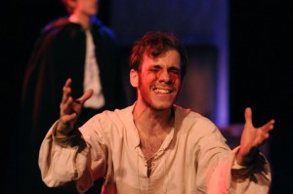
It is obvious that Oedipus would like to overcome his blindness

Slide 7
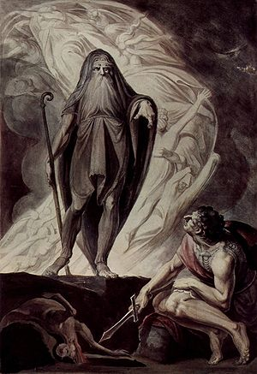
Irony- we are introduced to a physically blind prophet “Teiresias”- but he can see the truth about Oedipus

Slide 8
Oedipus eventually sees the truth (he comes full circle). He can see the truth about his life but does not want to accept his fate. Now Oedipus blinds himself so he cannot see

Slide 9
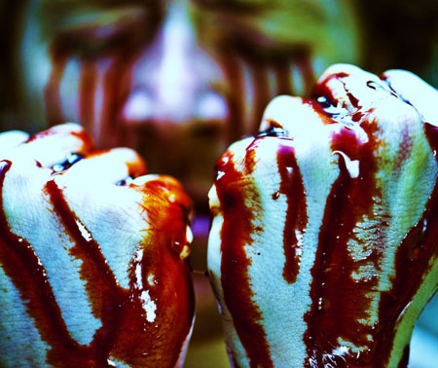
Oedipus is a coward. He didn’t want to see the truth as he saw it

Slide 10
Willingness to Igonore the truth

Slide 11
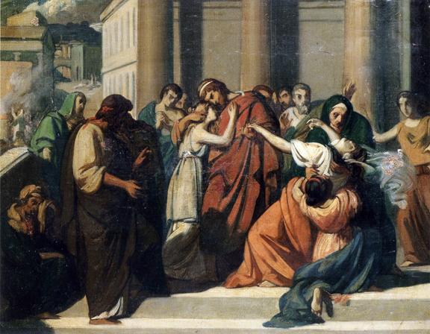
When Jocasta and Oedipus get close to the truth about Laius’ murder, Oedipus hangs onto the hope that he may be innocent

Slide 12
Jocasta says she was told Laius was killed by a group of robbers (strangers), however Oedipus is aware that he killed a man alone in similar circumstances. This is the moment wherein Oedipus must seek the truth

Slide 13
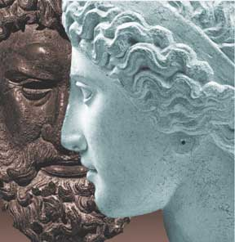
Jocasta and Oedipus react to the servant’s story as history. Both cannot think what will occur if the servant were wrong

Slide 14
Jocasta tells Oedipus about the similar prophecy of her son and does not recognize the similarities of the story. (Neither Jocasta or Oedipus recognize the truth).

Slide 15
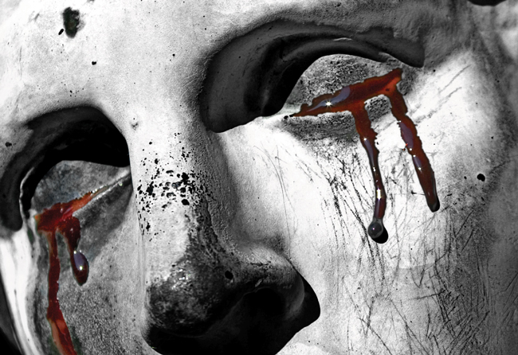
These speeches display tragic irony to the audience; it also shows how desperate Jocasta and Oedipus are to hide the truth. They look at the circumstances and details of every day life and pretend not to see them

Slide 16
Limits to Free Will

Slide 17
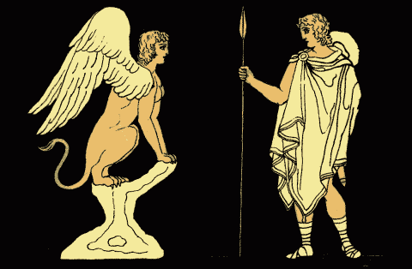
Prophecy is a central part of the play.

Slide 18
1.)Creon returns from the Oracle at Delphi (plague will be lifted if Thebes banishes the Killer of Laius)
2.)Teiresias Prophesies the capture of the one who is both father and brother of his children

Slide 19
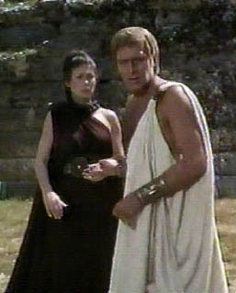
3.)Oedipus tells Jocasta of his prophecy
4.)Jocasta tells Oedipus of her prophecy

Slide 20
Oedipus and Jocasta debate how much prophecies should be trusted. When all the prophecies come true, it appears that one of Sophocles’ aims is to justify the powers of gods and prophets

Slide 21
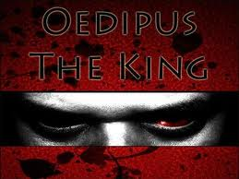
Again, Oedipus’ blindness is shown. He is foolish to think he can escape the prophecy

Slide 22
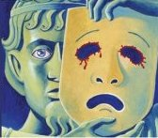
Oedipus wants to flee his fate, but his fate always catches up with him
Oedipus has a tragic flaw (pride)= hubris

Slide 23
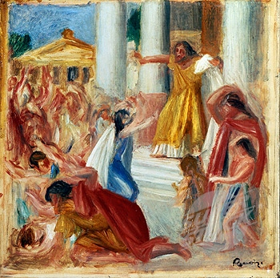
Error and disaster can happen to anyone
Humans are powerless against fate and gods

Slide 24
Symbols

Slide 25
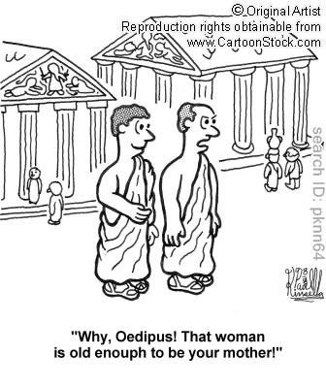

Slide 26
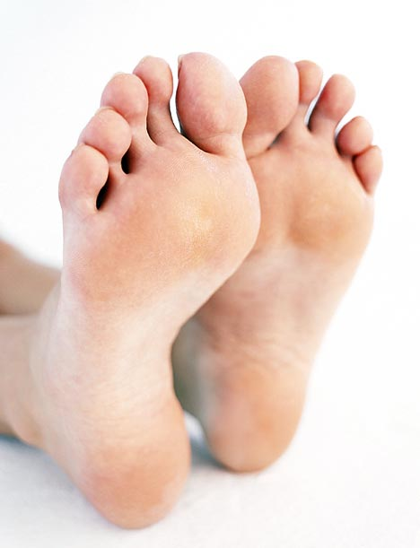
Oedipus’ Swollen Foot

Slide 27
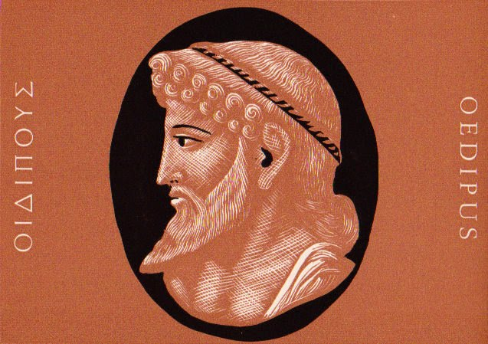
Name came from the fact he was left on the mountains with his ankles pinned together

Slide 28
Injury symbolizes the way fate marked him and set him apart, and the way his movements are confined and constrained since birth

Slide 29
The Three Way Crossroads

Slide 30
Laius was slain at a place where 3 roads meet (symbolizes fate and power of prophecy)
Symbolizes the crucial moment, long before the events of the play, when Oedipus began to fulfill the dreadful prophecy

Slide 31
Crossroads- place where a choice must be made
Symbolize moments where decisions will have important consequences but where different choices are still possible

Slide 32
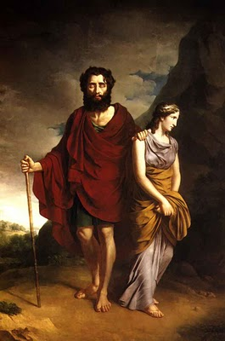
Part of distant past, dimly remembered and at the time Oedipus didn’t realize he was making fateful decision

Slide 33
Motifs

Slide 34
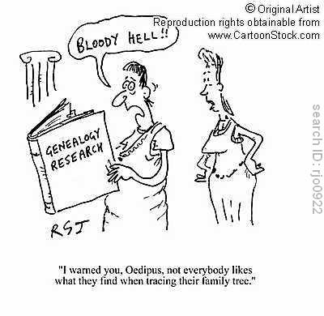

Slide 35
Motifs- recurring structures, contrasts or literary devices that can help to develop the texts’ major themes

Slide 36
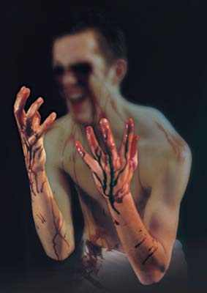
Suicide
Jocasta hangs herself
Oedipus inflicts violence on himself

Slide 37
Sight and Blindness
References to eyesight and vision are frequent in the play
Image of clear vision is used as a metaphor for knowledge and insight
Also references to literal and metaphorical blindness

Slide 38
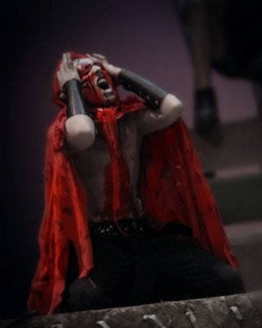
Oedipus has been blind to the truth for years

