Slide 1
Learning: Classical and Operant Conditioning Learning
AP PSYCHOLOGY
Ms. C. Fahey

Slide 2
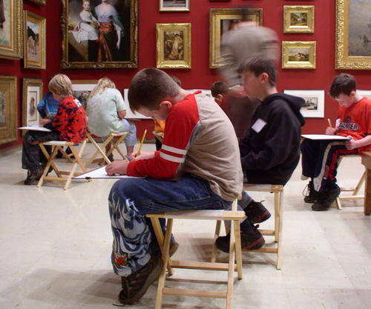
Learning
Learning is a lasting change in behavior or mental process as the result of an experience.
There are two important parts:
a lasting change…a simple reflexive reaction is not learning
learning regarding mental process is much harder to observe and study.

Slide 3
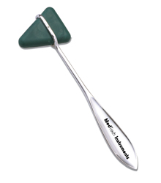
Life without Learning
Learning is more than school, books and tests. Without learning our lives would simply be a series of reflexes and instincts.
We would not be able to communicate, we would have no memory of our past or goals for the future.

Slide 4
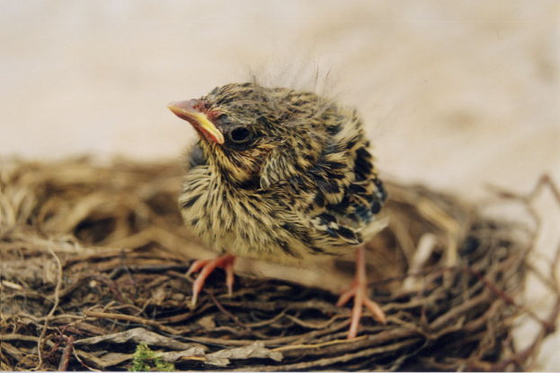
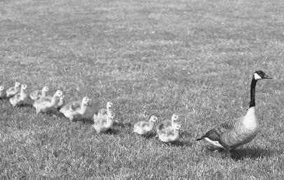
Learning’s Effects on Behavior
In humans, learning has a much larger influence on behavior than instincts.
Learning represents an evolutionary advance over instincts.

Slide 5
Types of Learning
SIMPLE AND COMPLEX LEARNING

Slide 6
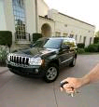
Simple Learning
Habituation: Learning not to respond to the repeated presentation of a stimulus.
Ex-Emergency sirens in the city
How often do you look when a car alarm goes off?

Slide 7
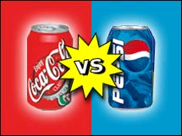
Simple Learning
Mere Exposure Effect: A learned preference for stimuli to which we have been previously exposed.
Ex-A coach/parent’s voice
Which do you prefer?
Which did your parents drink when you were a little kid?

Slide 8
Complex Learning
Behavioral Learning: Forms of learning, such as classical and operant conditioning which can be described in terms of stimuli and responses.
Classical conditioning is more simple learning, operant conditioning is more complex learning.

Slide 9
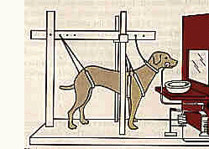
Ivan Pavlov and Classical Conditioning
One of most famous people in the study of learning is Ivan Pavlov.
Originally studying salivation and digestion, Pavlov stumbled upon classical conditioning while he was experimenting on his dog.
Classical Conditioning: A form of learning in which a previously neutral stimulus (stimuli w/o reflex provoking power) acquires the power to elicit the same innate reflex produced by another stimulus.

Slide 10
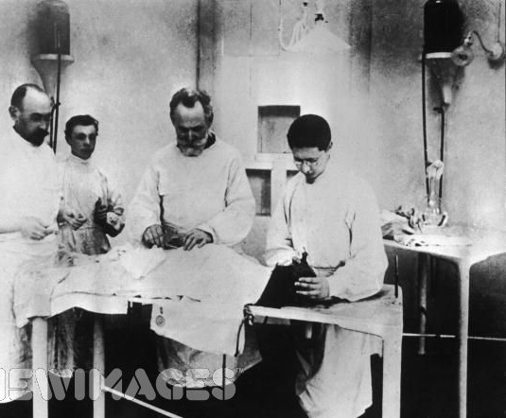
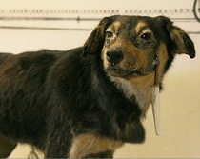
Pavlov’s Findings Explained
Pavlov discovered that a neutral stimulus, when paired with a natural reflex-producing stimulus, will begin to produce a learned response, even when it is presented by itself.
Neutral Stimulus: Any stimulus that produces no conditioned response prior to learning.

Slide 11
Pavlov’s Experiment

Slide 12
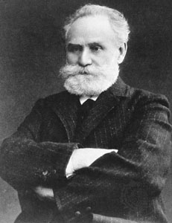
Pavlov’s Experiment
Watch Pavlov’s Experiment Video
Ivan Pavlov

Slide 13
Components of Conditioning
There are 5 main components of conditioning. Classical Conditioning always involves these parts. They are:
Neutral Stimulus
Unconditioned Stimulus (UCS)
Unconditioned Response (UCR)
Conditioned Stimulus (CS)
Conditioned Response (CR)

Slide 14
Unconditioned Stimulus (UCS)
UCS: A stimulus that automatically-without conditioning or learning- provokes a reflexive response.
In Pavlov’s experiment, food was used as the UCS because it produced a salivation reflex.
Classical conditioning cannot happen without UCS. The only behaviors that can be classically conditioned are those that are produced by unconditioned stimulus.

Slide 15
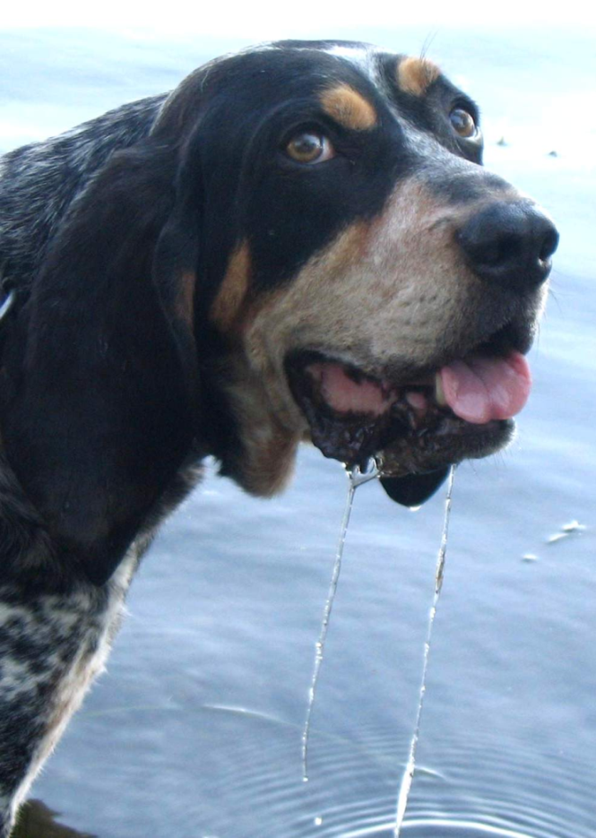
Unconditioned Response (UCR)
UCR: A response resulting from an unconditioned stimulus without prior learning.
In Pavlov’s experiment, the UCR was the dog salivating when its tongue touched food.
Realize that the UCS-UCR connection involves no learning or acquisition.

Slide 16
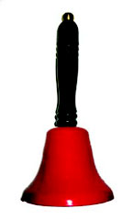
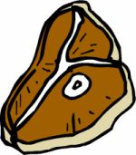
From Unconditioned to Conditioned
During acquisition, a neutral stimulus is paired with the unconditioned stimulus.
After several trials the neutral stimulus will gradually begin to elicit the same response as the UCS.
Acquisition: The learning stage during which a conditioned response comes to be elicited by the conditioned stimulus.
=

Slide 17
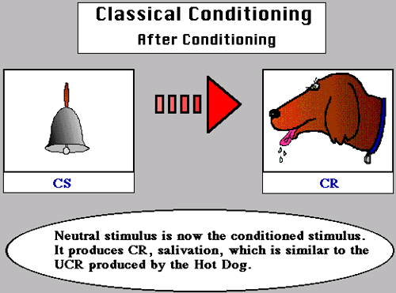
Conditioned Stimulus
A CS is the originally neutral stimulus that gains the power to cause the response.
In Pavlov’s experiment, the bell/tone began to produce the same response that the food once did.

Slide 18
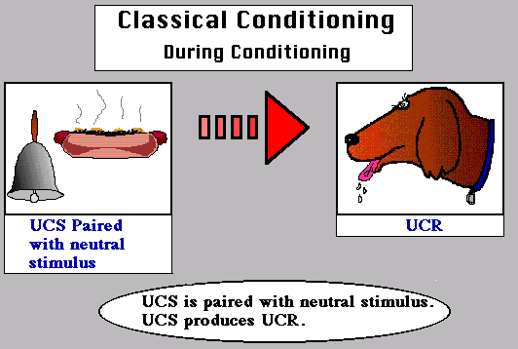
Conditioned Response
A CR is a response elicited by a previously neutral stimulus that has become associated with the unconditioned stimulus.
Although the response to the CS is essentially the same as the response originally produced by the UCS, we now call it a conditioned response.

Slide 19
Classical Conditioning

Slide 20
Extinction
Extinction: The diminishing (or lessening) of a learned response, when an unconditioned stimulus does not follow a conditioned stimulus.
To acquire a CR, we repeatedly pair a neutral stimulus with the UCS. But, if we want to reverse this learning, we must weaken the strength of the connection between the two stimuli.
It is important to realize that extinction does not mean complete elimination of a response.

Slide 21
Spontaneous Recovery
Extinction merely suppresses the conditioned response, and the CR can reappear during spontaneous recovery.
Spontaneous Recovery: The response after a rest period of an extinguished conditioned response.
Spontaneous recovery is weaker than the original CR.

Slide 22
Classical Conditioning
Acquisition
(CS+UCS)
Strength
of CR
Spontaneous
recovery of
CR
Extinction
(CS alone)
Extinction
(CS alone)
Pause

Slide 23
Reinforcement Procedures
What if we could not distinguish between stimuli that were similar?
The bell ending class vs. fire alarm
The door bell vs. our cell phones
Discrimination: The ability to distinguish between two similar signals stimulus.

Slide 24
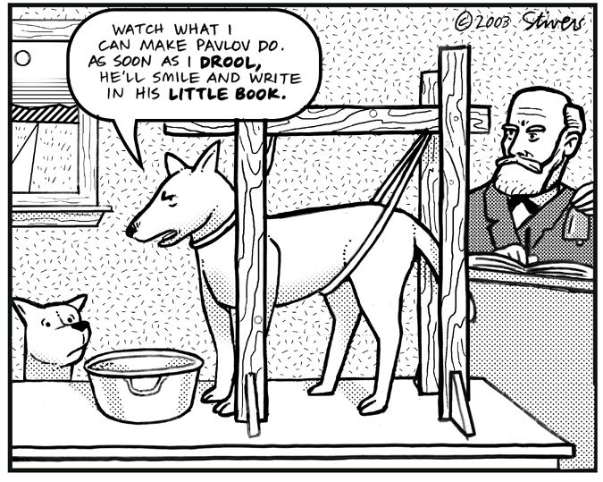

Slide 25
