Slide 1
Module 14
Infancy and Childhood

Slide 2
Maturation
Maturation is the orderly sequence of biological growth by which an organism develops over time, both physically and mentally.
Studies have shown that, when raised under adequate environment, maturation follows a predictable pattern.
Maturation sets the basic course of development, experience adjusts it.
Nature and nurture at work.

Slide 3
Maturation

Slide 4
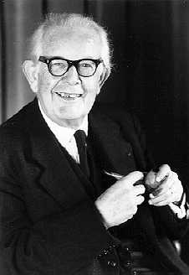
Cognitive Development: Piaget’s Theory
Jean Piaget developed a theory about development called the Cognitive Theory of Development.
Piaget’s theory was a discontinuous stage model of development which said children will undergo a revolutionary change in thought at each stage.

Slide 5
Cognitive Development Piaget’s Theory
Piaget’s theory was based on three key ideas:
Schemas
Assimilation and accommodation
Stages of cognitive development
Schemas are mental structures that guide thinking.
According to Piaget, they are also the building blocks of development.
Schemas form and change as we develop and organize our knowledge to deal with new experiences and predict future events.

Slide 6
Cognitive Development: Piaget’s Theory
Assimilation: process that modifies new information to fit with existing schemas or with what is already known.
Babies suck on anything put in front of them as if it was a bottle.
Accommodation: process of restructuring or modifying schemas to incorporate new information.
When a child learns that a butterfly is not a “bird.”
Assimilation makes new information fit our existing view of the world. Accommodation changes our views to fit new information.

Slide 7
Piaget’s Stages: Sensorimotor Stage
Sensorimotor Stage (Birth to age 2): children mostly give reflexive responses with very little thinking involved.
Stranger Anxiety, or fear of strangers, is very common during this period (8 months).
A major step in thinking happens by year two, the ability to make mental images of objects, called mental representation.
This is the foundation of being able to problem solve

Slide 8
Piaget’s Stages: Sensorimotor Stage
Another key feature of this stage is object permanence, or the knowledge that objects exist independently of one’s own actions or awareness.
Object Permanence

Slide 9
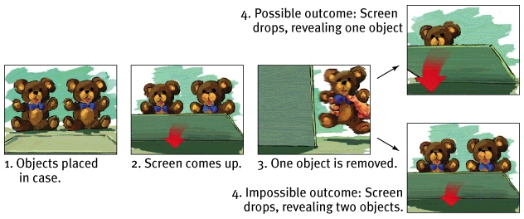
Piaget’s Stages: Preoperational Stage
Preoperational Stage (2 to 6/7 yeas of age): A stage marked by well-developed mental representation and the use of language.
Despite these increased abilities, however, children still cannot solve problems requiring logical thought, but they can recognize when something is not right.

Slide 10
Piaget’s Stages: Preoperational Stage
Piaget developed other key features of the preoperational stage, including:
Egocentrism: a self centered focus that causes children to see the world only in their own terms.
Talking to child on phone
Animistic thinking: believing inanimate objects have life and mental processes.
“Bad table”
Centration: an inability to understand an event because the child focuses their attention too narrowly.
Moving objects closer together—now more or fewer items?
Irreversibility: an inability to think through a series of events or steps and then reverse course.
Artificialism: believing all objects are made by people.

Slide 11
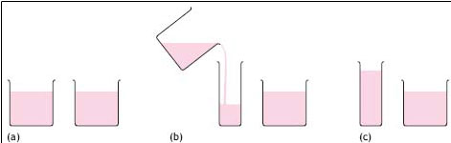
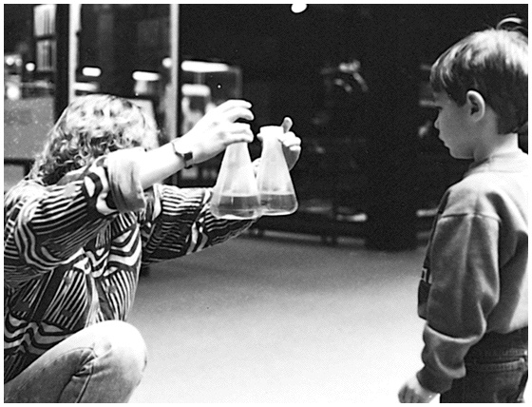
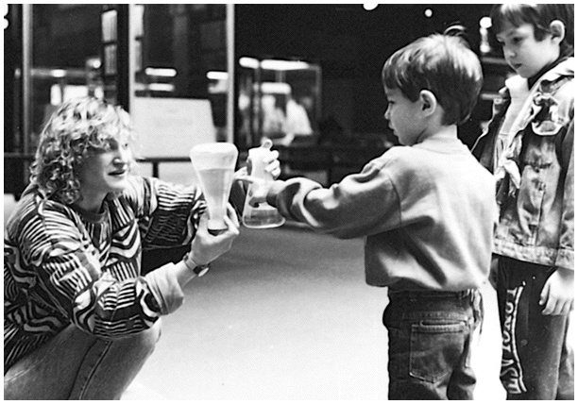
Piaget’s Stages: Concrete Operational Stage
Concrete Operational Stage (7 to 11 years): child develops the abilities of irreversibility, conservation and mental operations.
Conservation: the principle that quantity remains the same despite changes in shape.
Mental operations: the ability to solve problems by manipulating images in one’s own mind.

Slide 12
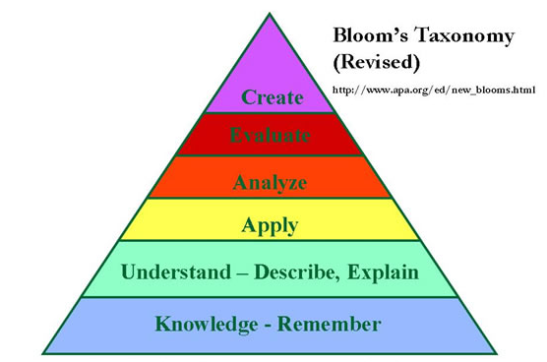
Piaget’s Stages: Formal Operational
In Piaget’s final stage, formal operational stage, he says people begin to think about issues like being more accepted by peers, and abstract issues like love, fairness and our reason for existence.
Consists of 4 unique structural properties:
Hypothetical reasoning
Analogical/Abstract reasoning
Deductive reasoning
Reflective abilities

Slide 13
Piaget’s Stages of Cognitive Development

Slide 14
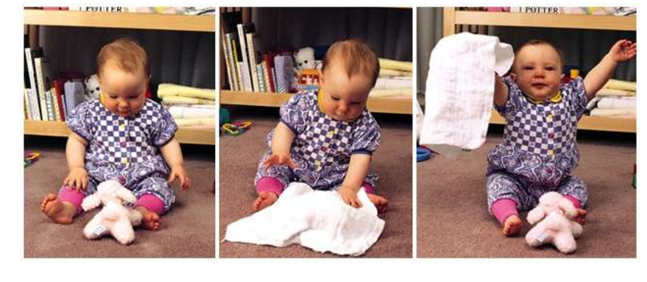
Infancy and Childhood: Cognitive Development
Object Permanence
the awareness that things continue to exist even when not perceived

Slide 15
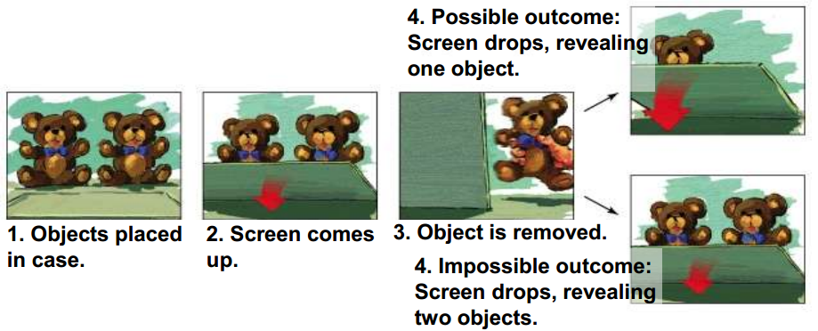
Infancy and Childhood: Cognitive Development
Baby Mathematics
Shown a numerically impossible outcome, infants stare longer (Wynn, 1992)

Slide 16
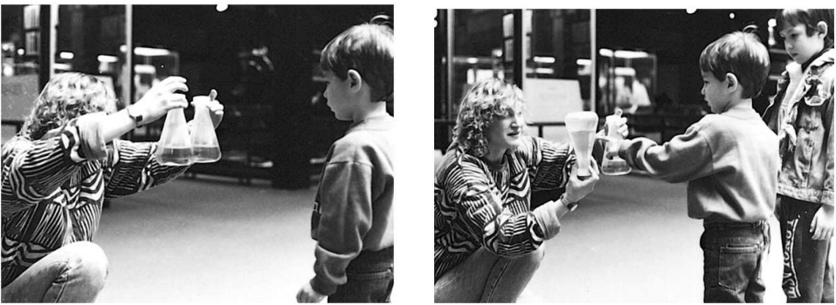
Infancy and Childhood: Cognitive Development
Conservation
the principle that properties such as mass,
volume, and number remain the same despite changes in the forms of objects

Slide 17
Infancy and Childhood: Cognitive Development
Egocentrism
the inability of the preoperational child to take another’s point of view
Theory of Mind people’s ideas about their own and others’ mental states - about their feelings, perceptions, and thoughts and the behavior these might predict
Autism
a disorder that appears in childhood
Marked by deficient communication, social interaction and understanding of others’ states of mind

Slide 18
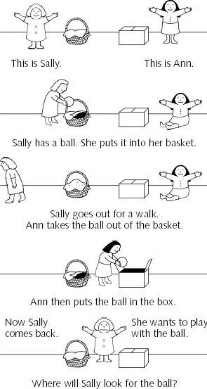
Theory of Mind
Theory of mind is the ability to infer (understand) other’s mental states, and know they may be different than our own.
Piaget thought this did not happen until around age 8, but studies suggest this actually happens as young as age 4 or 5.
Theory of Mind Video

Slide 19
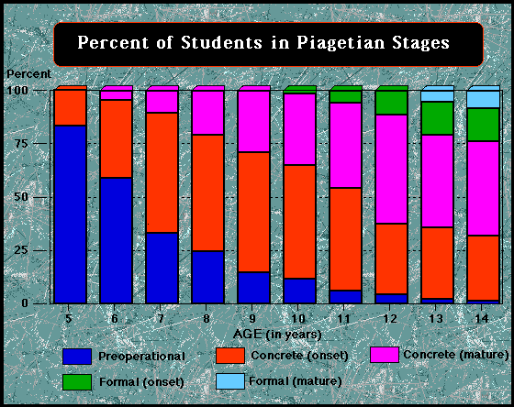
Piaget’s Theory Graphically

Slide 20
Social Development
Stranger Anxiety
fear of strangers that infants commonly display beginning by about 8 months of age
Attachment
an emotional tie with another person shown in young children by their seeking closeness to the caregiver and displaying distress on separation

Slide 21
Social Development
Critical Period
an optimal period shortly after birth when an organism’s exposure to certain stimuli or experiences produces proper development
Imprinting
the process by which certain animals form attachments during a critical period very early in life

Slide 22
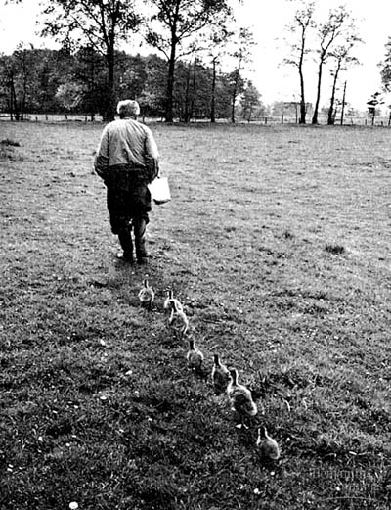
Imprinting
Example: A baby chick is hatched by a mother duck. The chick will follow the duck around and even try to get into the pond with the mother duck and her ducklings.
Dog and Duck

Slide 23
Imprinting with Human Babies
While human babies are not as capable to move around at an early age, they will develop a strong connection to anyone who responds regularly to their signals-crying, cooing, smiling...etc.

Slide 24
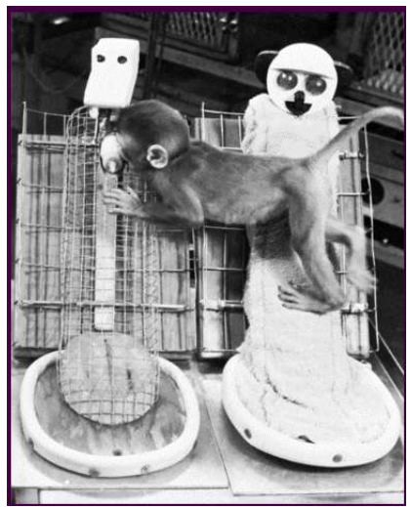
Social Development
Harlow’s Surrogate
Mother Experiments
- Monkeys preferred contact with the
comfortable cloth
mother, even while
feeding from the
nourishing wire
mother

Slide 25
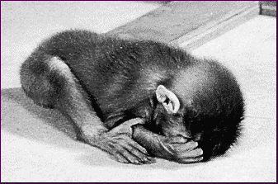
Just how Strong is Imprinting?
One study found that when mothers left the room, 2-4 month old babies’ skin temperature dropped, a sign of emotional distress. In these youngsters, skin temperature dropped even more when the mother was replaced by a stranger.
In contrast, skin temperature remained constant steady if the mother stayed in the room-even if the stranger was present.
Monkeys raised by artificial mothers were terror-stricken when placed in strange situations without their surrogate mothers.

Slide 26
Lasting Effects
Despite the strength of attachment and imprinting, individuals who lack healthy attachments in infancy are not necessarily doomed for life.
While attachment problems are good predictors of later problems with social relationships, many people do succeed in overcoming early attachment issues.

Slide 27
Attachment
During early development we also see attachment, or the enduring social-emotional relationship between a child and parent or caregiver.
Attachment occurs instinctively in many species. One example in birds is called imprinting where a powerful attraction occurs between infants and the first moving object or individual they spend time with.

