Slide 1
Modes of Reproduction
Types of Reproduction

Slide 2
There are two (2) types’ ways in which organisms reproduce or create offspring
Sexual reproduction
This is reproduction involving two(2) sets of DNA chromosomes
There is a fusion of an egg nucleus and sperm nucleus. This results in a combining of DNA from both parents.
Fertilization is the process of sperm nucleus meeting with egg nucleus
Offspring resemble the parents but are not identical to them

Slide 3
Asexual reproduction
This is reproduction involving only one(1) set of DNA /chromosomes.
Offspring are normally created through Mitotic divisions.
Offspring are clones or identical copies of the parent.
There are several different modes in which asexual reproduction occurs.

Slide 4
Modes of Asexual Reproduction

Slide 5
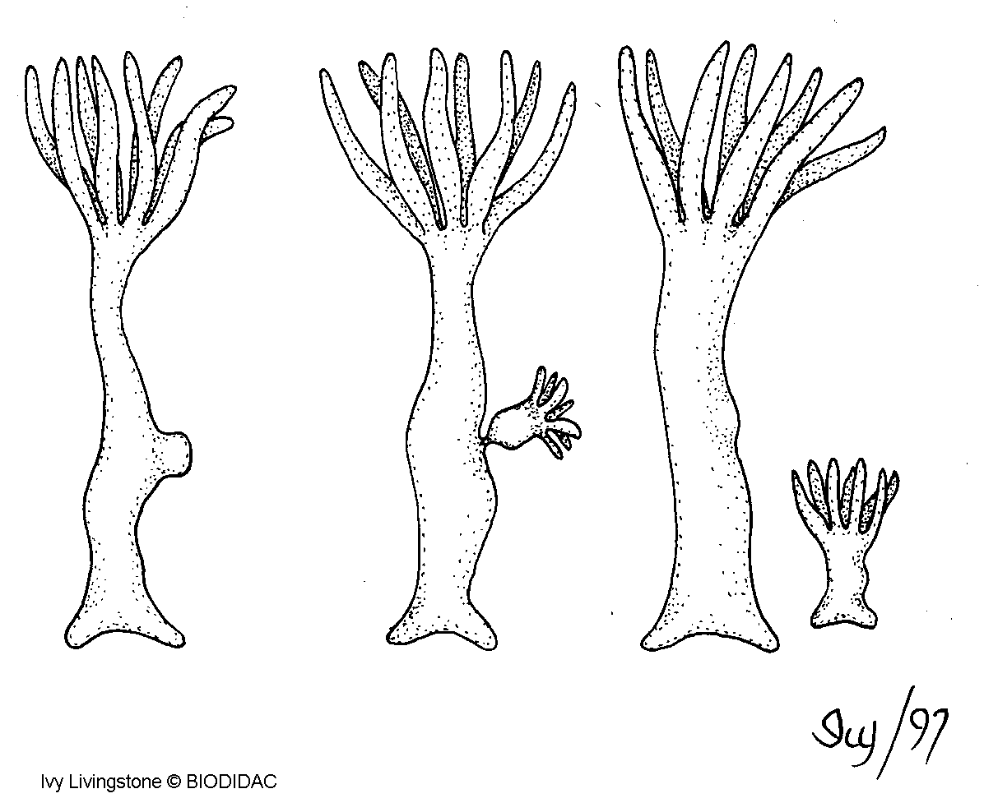
Budding
reproduction where an outgrowth occurs on an organism that later breaks off and grows into an entire organism
Ex. Yeast and Hydra

Slide 6
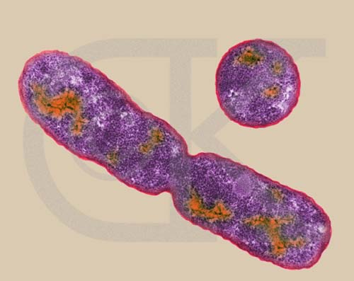
Binary fission
Reproduction where mitosis divides the DNA in an organism.
The organism then splits to create two(2) new organism
Ex. Bacteria

Slide 7
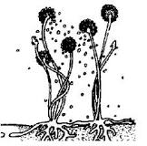
Spore Production
Reproduction where mitotic cell division creates a series of spores that grows into new organisms.
Spores small round strictures containing the diploid (2N) chromosome number of a parent cell
Spores are released from spore sacs
Ex Fungi, Rhizopus (Bread mold)

Slide 8
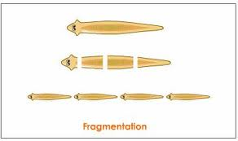
Fragmentation
reproduction where a portion of an organism breaks off.
The broken piece is able to grow into a full organism.
Ex. Cuttings or slips of house plants

Slide 9
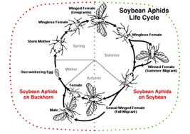
Parthenogenesis
reproduction where an organism produces haploid unfertilized eggs that grows into adults.
Ex. Insects Balsam woolly aphid,Wasps, whip tail lizards

Slide 10
Summary of Modes of Reproduction
 | Type of Reproduction
 | Sexual | Asexual
Amount of DNA/Parents | 2 sets of DNA/2 parents | 1 set of DNA/1 parent
Offspring | Resemble parents | Exact copies of parent
Mechanism(s) | Fertilization | Budding, Binary Fission, Spores, fragmentation, parthenogenesis

