Slide 1
Memory: Memory and its Parts
Unit 7
AP Psychology
Ms. Fahey

Slide 2
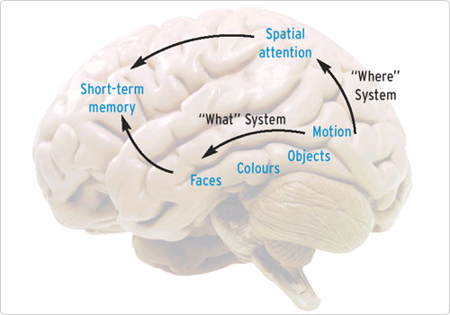
Memory
Memory: A system that encodes, stores and retrieves information.
While we are learning more about memory every day, psychologists still are unsure exactly what parts of the brain are involved and where it is all stored.

Slide 3
Memory
▪ persistence of learning over time
via the storage and retrieval of
Information
Flashbulb Memory
▪ a clear memory of an
emotionally significant moment
or event

Slide 4
Memory as Information Processing
- similar to a computer
- write to file
- save to disk
- read from disk

Slide 5
Memory’s Three Basic Tasks
According to the information-processing model, the human brain takes essentially meaningless information and turns it into meaningful patterns.
It does this through three steps:
Encoding
Storage
Retrieval

Slide 6
3 Basic parts: encoding
Encoding: the modification of information to fit the preferred format for the memory system.
Encoding
-the processing of information into the
-memory system
-i.e., extracting meaning
In most cases, encoding is automatic and happens without our awareness. Other encoding, however, like these notes, require extra encoding effort called elaboration to make the memory useful.

Slide 7
Encoding: Getting Information In

Slide 8
Encoding
The more time we spend learning novel information, the more we remember.
Time in minutes
taken to relearn
list on day 2
20
15
10
5
Using 16 unrelated 3 letter sequences
0
8
16
24
32
42
53
64
Number of repetitions of list on day 1

Slide 9
Encoding
Automatic Processing
▪unconscious encoding of incidental information
▪Space (where you left off reading)
▪Time (retrace your steps)
▪Frequency ( how often you run into a person)
▪well-learned information
▪word meanings
▪we can learn automatic processing

Slide 10
Encoding-3 types
When we are exposed to stimuli and encode information, we do it in three ways:
Semantic Encoding
encoding of meaning
including meaning of words
Acoustic Encoding
encoding of sound
especially sound of words
Visual Encoding
encoding of picture images

Slide 11
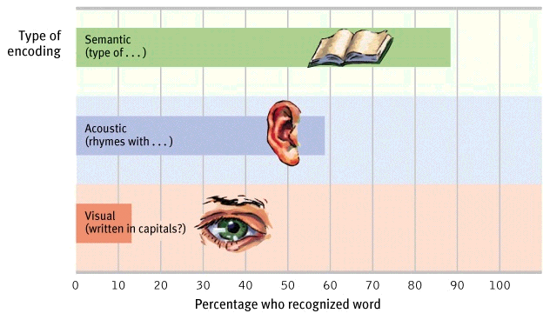
Encoding-Levels of Processing
Processing a word by its meaning (semantic encoding) produces better recognition of it lat a later time.

Slide 12
Encoding
Effortful Processing
requires attention and conscious effort
Rehearsal
conscious repetition of information to maintain it in consciousness to encode it for storage

Slide 13
3 basic parts: storage
Storage: the retention of encoding material over time.
In terms of storing material, we have three stages of memory
Sensory Memory
Working Memory (short-term memory)
Long-term Memory

Slide 14
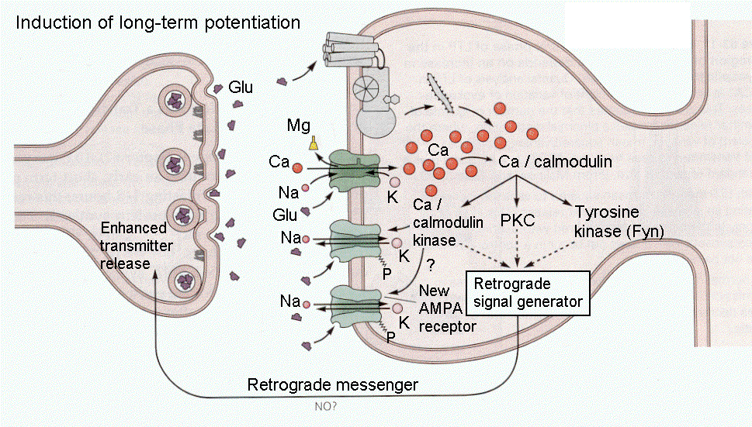
Synaptic Changes and storage
One physical change in the brain during memory storage is in the synapses.
Memories begin as impulses whizzing through the brain circuits, leaving a semi-permanent trace.
The more a memory is utilized, the more potential strength that neuron has, called long-term potentiation.
Neural basis for learning and remembering associations
This stuff gets super complicated…keep it simple for now

Slide 15
Strengthening Ltp
Research suggests that the best way to remember things is to study them and then sleep!
Once LTP (Long-Term Potentiation) has occurred, even passing an electrical current through the brain will not erase well stored memories.
More recent memories will be be wiped out
People who have a concussion and cannot remember what happened just before or after the injury have not had a chance to “consolidate” their memories to the long-term

Slide 16
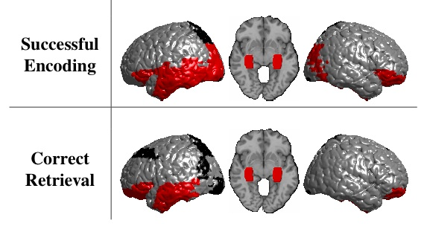
3 basic parts: retrieval
Retrieval: The locating and recovering of information from memory.
While some memories return to us in a split second, other seemed to be hidden deeper, and still others are never “recovered” correctly.

Slide 17
Eidetic imagery
Eidetic imagery is a technical term for a photographic memory.
Eidetic imagery can recall a memory in minute detail and portray the most interesting and meaningful parts most accurately. These images can last as short as a brief moment, or as long as days.
Eidetic imagery tends to be more common in children, and seems to decline as a person’s language abilities increase

Slide 18
3 stages of memory
We encode information and store it in one of three types of memory, depending on what we need the information for.
Our memory works like an assembly line, and before information can make it to our long-term memory, it must first pass through sensory memory and working memory.
Attention to important
or novel information
Sensory input
Encoding
External
events
Sensory
memory
Short-term
memory
Long-term
memory
Encoding
Retrieving

Slide 19
Sensory memory
Sensory memory is the shortest of our memories and generally holds sights, sounds, smells, textures and other sensory information for a fraction of a second.
Sensory memory holds a large amount of information, far more than ever reaches consciousness.
Sperling’s experiment: letters in rows, tone to indicate which row to recall.
Sensory memories lasts just long enough to dissolve into the next one, giving us the impression of a constant flow.

Slide 20
Sperling’s Test
George Sperling flashed a group of letters (see left) for 1/20 of a second. People could recall only about half of the letters
When he signaled to recall a particular row immediately after the letters disappeared with a specific tone, they could do so with near-perfect accuracy.
K | Z | R
Q | B | T
S | G | N

Slide 21
Sensory Memory
Not all sensory memory consists of images, each sensory receptor has its own sensory register.
Also, sensory images have no meaning associated with them, that is the job of the next stage, working memory.
Visual Stimulation-iconic memory
Auditory Stimulation-echoic memory
Tactile Stimulation-tactile sensory memory
Olfactory Stimulation-olfactory memory
Gustatory Stimulation-gustatory memory
Working Memory
Long Term Memory

Slide 22
Working Memory
Working memory is often known as short term memory. It is the place where we sort and encode information before transferring it to long-term memory, or forgetting it.
Generally, it holds information for about 20 seconds, far longer than sensory memory.
Most research suggest that we can hold seven pieces of information in our working memory, though it varies slightly.

Slide 23
Working memory
Working memory is subject to two limitations: limited capacity and short duration.
We do have coping mechanisms, however:
Chunking
Rehearsal

Slide 24
Chunking
A chunk is any memory pattern or meaningful unit of memory.
By creating these chunks, a process called chunking, we can fit more information into the seven available slots of working memory.
Example: 5036574100 vs. 503-657-4100

Slide 25
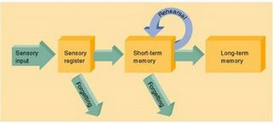
Rehearsal
Another memory technique is called maintenance rehearsal. This is a process where information is repeated to keep it from fading while in working memory.
This process does not involve active elaboration-assigning meaning to the information.

Slide 26
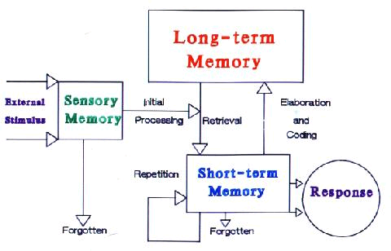
Levels of Processing
In working memory, information can be elaborated on, or connected with long term memories.
The Levels-of-processing theory says that information that is more thoroughly connected to meaningful items in long term memory will be remembered better.
Levels of Processing Theory

Slide 27
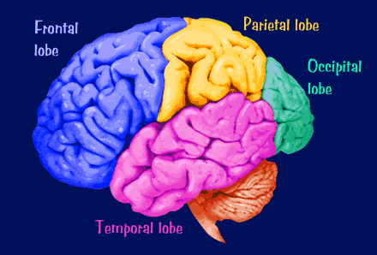
Working memory: location
While the location in the brain of all three stages of memory are still not fully understood, the likely location for the working memory is in the frontal cortex.

Slide 28
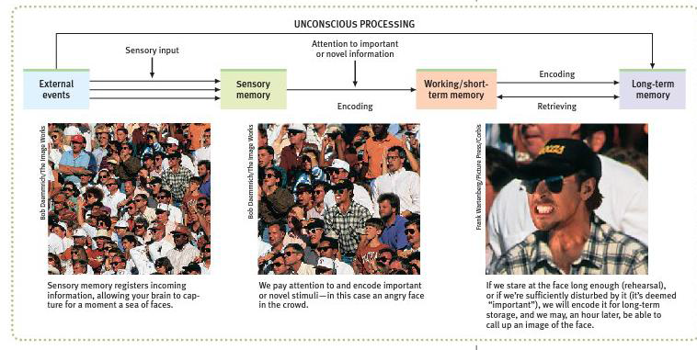
Working memory associates new and old information (from LTM) and solves problems.

Slide 29
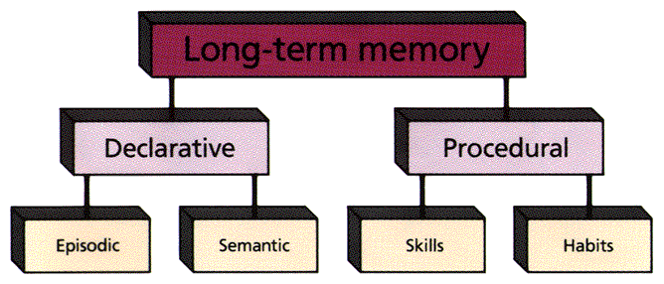
Long term memory
As far as anyone knows, there is no limit to the duration or capacity of the long term memory.
Long term memory is essentially all of your knowledge of yourself and the world around you. Unless an injury or illness occurs, this memory is limitless.

Slide 30
Short-Term Memory
-activated memory that holds a few items briefly
-look up a phone number, then quickly dial before the information is forgotten
Long-Term Memory
the relatively permanent and limitless storehouse of the memory system

Slide 31
Structure and Function of LTM
Long Term Memory
Declarative Memory
(Explicitly Memory)
(knowing what)
Semantic Memory:
-language
-Facts
-General Knowledge
Episodic Memory
-Events
-Personal Experiences
Procedural Memory
(Implicit Memory)
(knowing how)
Includes:
-Motor skills
-Operant Conditioning
-Classical Conditioning

Slide 32
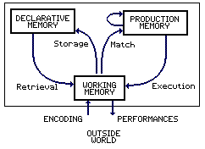
Long Term memory
Procedural memory (implicit) is the part of long term memory where we store memories of how things are done.

Slide 33
Long Term memory
Declarative memory (explicit) is the part of long term memory where we store specific information such as facts and events.
More often than procedural memory, declarative memory requires some conscious mental effort.

Slide 34
Declarative Memory
Declarative memory has two divisions:
Episodic Memory: This is the portion of memory that stores personal events or “episodes.”
This is the storage of things like time and place.
Semantic Memory: This portion of memory stores general knowledge, facts and language meaning.
This is specifically where all the information you “know” is stored.

Slide 35
Studies: implicit vs. explicit
People with amnesia who read a story once, will read it faster a second time, showing implicit memory.
There is no explicit memory though as they cannot recall having seen the text before
People with Alzheimer's who are repeatedly shown the word perfume will not recall having seen it.
If asked the first word that comes to mind in response to the letters per, the say perfume readily displaying learning.

Slide 36
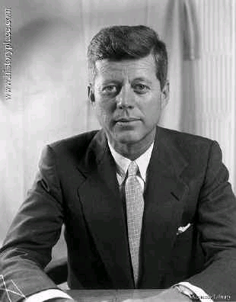
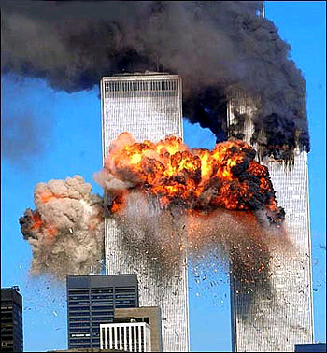
Flashbulb memory
Of all our forms of memory, a few are exceptionally clear and vivid. We call these flashbulb memories.
These tend to be memories of highly emotional events. Typically people remember exactly where they were when the event happened, what they were doing and the emotions they felt.
JFK’s Assassination
Ex. 9/11

Slide 37
Engram
The engram is the biological basis for long-term memory. It is also known as the memory trace.
Psychologists have been trying to identify exactly where exactly memory is stored. There are currently two theories; one involving the neural circuitry and the other at biological changes in synapses.

Slide 38
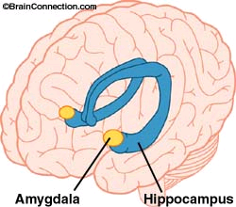
Parts of the brain used in memory
Two parts of the brain psychologists know for sure are involved in memory are the hippocampus and the amygdala.
In a process called consolidation, information in the working memory is gradually changed over to long term memories.
The amygdala seems to play a role in strengthening memories that have strong emotional connections.

Slide 39
Two types of forgetting
Retrograde Amnesia: The inability to remember information previously stored in memory.
Anterograde Amnesia: The inability to form memories from new material.
As memories form, neurotransmitters collect at the synapses, (before absolute threshold is crossed). These are called memory traces. A sharp blow to the head, or electric shock can prevent these traces from consolidating, making it hard to recall that information.

Slide 40
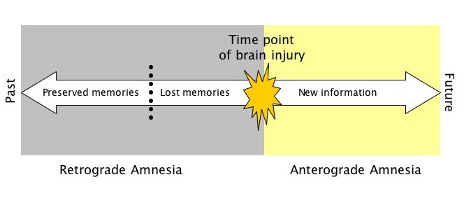
Types of Amnesia and forgetting
Retrograde amnesia is a form of amnesia where someone will be unable to recall events that occurred before the development of amnesia.
Anterograde amnesia is a loss of the ability to create memories after the event that caused the amnesia occurs

Slide 41
Types of memory
When dealing with long term memory retrieval, there are two types of memory:
Implicit memory: a memory that was not deliberately learned-no conscious awareness
Ex. Muscle memory—throwing a ball
Explicit memory: a memory that had been processed with attention and can be consciously recalled.
Ex. The three stages of memory
General rule: a memory is implicit if it can affect behavior or mental processes without becoming fully conscious. Explicit memories always involve consciousness.

Slide 42
Retrieval clues
Retrieval clues are the search terms we use to activate memory—think of a Google search. The more specific you are, the better the results will be.
Some memories are easily remembered, while others are much harder to bring up. For example, if you draw a blank on a test, it may be a result of the wording on the test not being the same as the wording you used while studying.

Slide 43
RECALL AND RECOGNITION
Memories can be cued in two ways:
Recall: a retrieval method in which one must reproduce previously presented material.
Ex. Essay test; police sketch of a suspect
Recognition: a retrieval method in which one must identify information that is provided, which has previously been presented.
Ex. Multiple choice test; police line-up

Slide 44
Other factors affecting retrieval
Encoding specificity principal: the more closely the retrieval clues match way the information was encoded, the better the information will be remembered.
Think Google search
Mood-congruent memory: a theory which says we tend to selectively remember memories that match (are congruent with) our current mood.
Has an affect on how people are treated for medical conditions

Slide 45
Memory Construction
We often construct our memories as we encode them, and we may also alter our memories as we withdraw them
We infer our past from stored information and what we assume
By filtering information and filling in missing pieces, our schemas (understanding of specific settings) direct our memory construction

Slide 46
Misinformation
As memory fades with time following an event, the injection of misinformation becomes easier.
Misinformation effect: incorporating misleading information into one’s memory of an event.
Imagination inflation occurs because visualizing something and actually perceiving it activate similar brain areas.

Slide 47
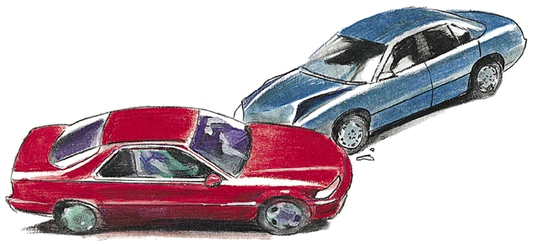
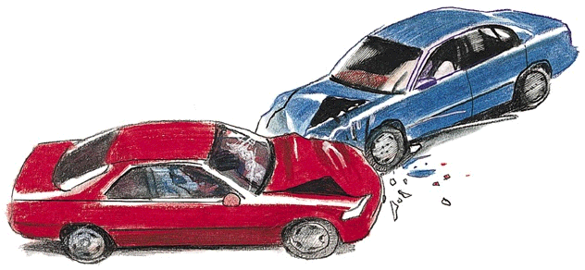
Misinformation effect
Depiction of actual accident
Eyewitnesses reconstruct memories when questioned
Leading question:
“About how fast were the cars
going when they smashed into
each other?”
Memory
construction

Slide 48
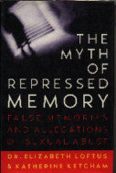
Repressed Memories
During the 1990s, the idea of repressing painful memories became a big topic.
While some psychoanalysts still support the idea of repressed memories, most psychologists agree that events that are traumatic are typically etched on the mind as vivid, persistent, haunting memories.

Slide 49
forgetting
As you know, not all the information you learn will stick in your brain. According to Daniel Schacter, this is the result of one of the “seven sins of memory:”
Transience
Absent-mindedness
Blocking
Misattribution
Suggestibility
Bias
Persistence

Slide 50
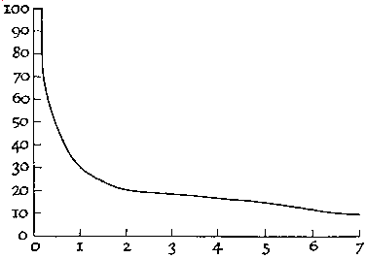
1) transience
Transience: the impermanence of long-term memories-based on the idea that memories gradually fade in strength over time-also known as “decay theory.”
Ebbinghaus’s Forgetting Curve
For most memories, there is a sharp decline in memory, followed by declining rate of loss

Slide 51
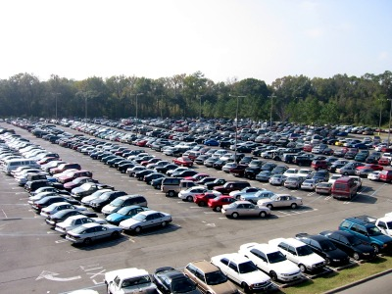
2) Absent-mindedness
Absent-mindedness: forgetting caused by lapses in attention.
Ex. Forgetting where you parked; losing your keys

Slide 52
3) blocking
Blocking: forgetting when a memory cannot be retrieved because of interference.
Proactive Interference: When an old memory disrupts the learning and remembering of a new memory.
Ex. Trying to put the dishes away at a new house
Retroactive Memory: When a new memory blocks the retrieval of an old memory.
Ex. Driving an automatic after driving a manual

Slide 53
Serial Position effect
The serial position effect is a form of interference related to the sequence in which material is presented.
Generally items in the middle are remembered less.
Primacy: relative ease of remembering the first information in a series.
Recency: Strong memories of the most recent information in a series
Info in the middle is exposed to both retroactively and proactively.

Slide 54
Encoding: Serial Position Effect
Percentage of
words recalled
90
80
Serial Position Effect--tendency to recall best the last items in a list
70
60
50
40
30
20
10
Immediate recall
Later recall
0
1
2
3
4
5
6
7
8
9
10
11
12
Position of word in list

Slide 55
4) misattribution
Misattribution: Memory faults that occur when memories are retrieved, but are associated with the wrong time, place or person.
Ex. Psychologist Donald Thompson accused of rape. Alibi was airtight as he was giving a TV interview the victim had been watching just prior to the assault.

Slide 56
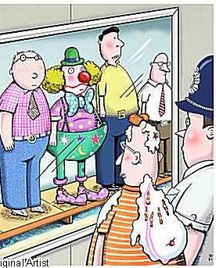
5) suggestibility
Suggestibility: The process of memory distortion as the result of deliberate or inadvertent suggestion.
Eyewitness accounts are one a large part of our legal system. Unfortunately they can be incredibly faulty.
With the misinformation effect, memories can be embellished or even created by cues and suggestions.

Slide 57
6) bias
Bias: The influence of personal beliefs, attitudes and experiences on memory.
Expectancy Bias: A memory tendency to distort recalled events to fit one’s expectations.
Self-consistency Bias: A commonly held idea that we are more consistent in our attitudes and beliefs, over time, than we actually are.

Slide 58
7) persistence
Persistence: A memory problem where unwanted memories cannot be put out of our mind.
Depressed people cannot stop thinking about how bad their life is and how unhappy they are. It can create a self-fulfilling problem.
Psychologists think that emotions strengthen the physical changes in the synapses that hold our memories, thus highly emotional memories can be harder to put out of mind.

Slide 59
Forgetting isn’t all bad
According to Schacter, the “seven sins” are actually a normal part of human memory, and are the results of adaptive features in our memories.
According to Schacter, each of the “sins” is for a reason:
Transience-to prevent memory overload
Blocking-to focus on task at hand
Absent-mindedness-ability to shift attention
Misattribution/bias/suggestibility-to focus on meaning and not detail
Persistence-to remember especially emotional memories

