Slide 1
Module 15
Adolescence

Slide 2
Adolescence
Adolescence
the transition period from childhood to adulthood extending from puberty to independence
Puberty
the period of sexual maturation when a person becomes capable of reproduction

Slide 3
Adolescence
Primary Sex Characteristics
body structures that make sexual reproduction possible
ovaries--female
testes--male
external genitalia
Secondary Sex Characteristics nonreproductive sexual characteristics
female--breast and hips
male--voice quality and body hair
Menarche (meh-NAR-key)
first menstrual period

Slide 4
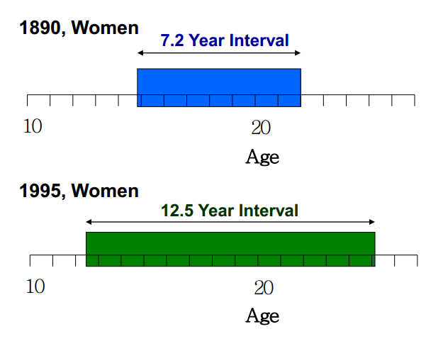
Adolescence
In the 1890’s the average interval between a woman’s menarche and marriage was about 7 years; now it is over 12 years

Slide 5
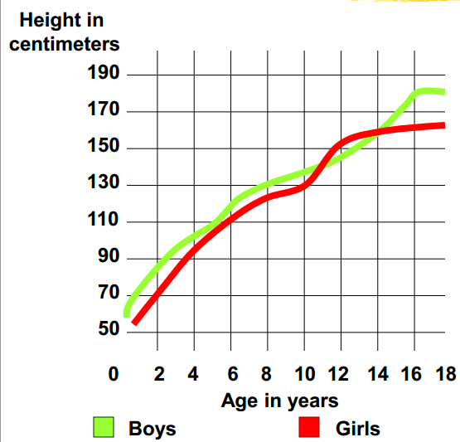
Adolescence
Throughout childhood, boys and girls are similar in height. At puberty, girls surge ahead briefly, but then boys overtake them at about age 14.

Slide 6
Body Changes at Puberty

Slide 7
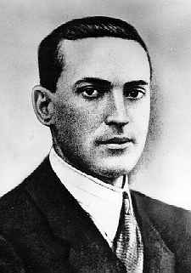
Lev Vygotsky
Piaget’s emphasis on how the child’s mind grows through interaction with the physicl environment is complemented by Vygotsky’s emphasis on how the child’s mind grows through interaction with the social environment.
Language is an important ingredient in social mentoring that provides the building blocks for thinking.
Lev Vygotsky
1896-1934

Slide 8
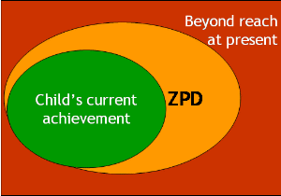
Zone of Proximal Development
Vygotsky stated that a child follows an adult's example and gradually develops the ability to do certain tasks without help or assistance.
Zone of proximal development presents it as “the distance between the actual developmental level as determined by independent problem solving and the level of potential development as determined through problem solving under adult guidance, or in collaboration with more capable peers”

Slide 9
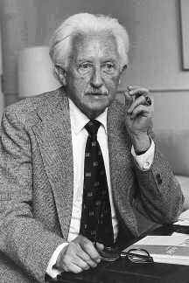
Erikson’s Theory of Psychosocial Development
Erik Erikson saw human development as a sequence of psychosocial stages, defined by common problems that emerge throughout life.
Erikson identified 8 stages, with each bringing a new challenge. To move onto the next stage of life, the problem of the previous stage must successfully be coped with.

Slide 11
Erikson’s Stages of Psychosocial Development
Approximate
age Stage Description of Task
Infancy Trust vs. mistrust If needs are dependably met, infants
(1st year) develop a sense of basic trust.
Toddler Autonomy vs. shame Toddlers learn to exercise will and
(2nd year) and doubt do things for themselves, or they doubt their abilities.
Preschooler Initiative vs. guilt Preschoolers learn to initiate tasks
(3-5 years) and carry out plans, or they feel
guilty about efforts to be independent.
Elementary Competence vs. Children learn the pleasure of applying
(6 years- inferiority themselves to tasks, or they feel
puberty) inferior.

Slide 12
Erikson’s Stages of Psychosocial Development
Approximate
age Stage Description of Task
Adolescence Identity vs. role Teenagers work at refining a sense of self by
(teens into confusion testing roles and then integrating them to
20’s) form a single identity, or they become
confused about who they are.
Young Adult Intimacy vs. Young adults struggle to form close relation-
(20’s to early isolation ships and to gain the capacity for intimate
40’s) love, or they feel socially isolated.
Middle Adult Generativity vs. The middle-aged discover a sense of contri-
(40’s to 60’s) stagnation buting to the world, usually through family
and work, or they may feel a lack of purpose.
Late Adult Integrity vs. When reflecting on his or her life, the older
(late 60’s and despair adult may feel a sense of satisfaction or
up) failure.

Slide 13
Erikson and Freud
Like Freud and many others, Erik Erikson maintained that personality develops in a predetermined order. Instead of focusing on sexual development, however, he was interested in how children socialize and how this affects their sense of self.
He saw personality as developing throughout the lifetime and looked at identity crises at the focal point for each stage of human development.

Slide 14
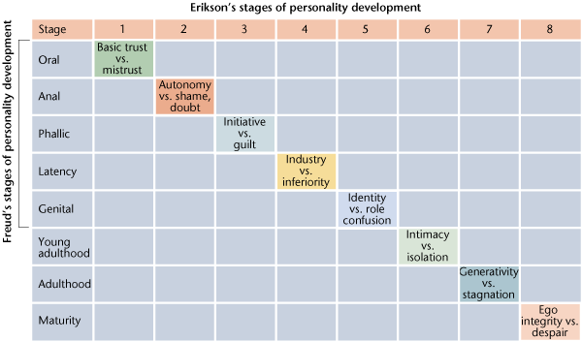
Erikson and Freud

Slide 15
Erikson Summarized
His model was a lifespan model of development, taking in 5 stages up to the age of 18 years and three in adulthood.
There is still plenty of room for continued growth and development throughout one’s life.
According to the theory, successful completion of each stage results in a healthy personality and successful interactions with others.
Failure to complete a stage can result in a reduced ability to complete further stages and resulting in an unhealthy personality and sense of self.
Stages can be resolved successfully at a later time.

Slide 16
Criticisms of Erikson
Critics of Erikson said his “research” was based on clinical observations and lacked rigorous scientific method.
Also, critics said it did not do enough to adequately capture the problems faced by girls and women.
Can you think of “problems” females face that do not have a place in Erikson’s stages?

Slide 17
Erikson’s Theory of Young Adulthood
The big challenge Erikson singles out for young adults is establishing close relationships with other adults.
The individual must resolve the conflict between wanting to establish closeness to another and fearing the vulnerability and risks such closeness can bring.
Making intimate commitments requires compromising personal preferences, accepting responsibilities and yielding some privacy and independence.

Slide 18
Erikson’s Deep Thought
Anything that isolates us from sources of social support-from a reliable network of friends and family-puts us at risk for a host of physical ills, mental problems, and even social pathologies.
We are social creatures and we need each others help to and support to be effective and healthy.

Slide 19
Erikson on Relationships
We are social creatures and we need each others help to and support to be effective and healthy.
Erikson said you must know who you are before you can begin to love someone else and share your life with that person.

Slide 20
Social Development
Basic Trust (Erik Erikson)
a sense that the world is predictable and trustworthy said to be formed during infancy by appropriate experiences with responsive caregivers
Self-Concept a sense of one’s identity and personal worth

Slide 21
Social and Emotion Development
Part of the health and happiness of humans derives from having healthy, happy, intimate relationships with people.
To go beyond the egocentric problem of young children, we must develop a theory of mind
Awareness that others may have beliefs, thoughts, desires and emotions different from one’s own.
Why would theory of mind be important to development and socialization?

Slide 22
Adolescence: Social Development
Identity
-one’s sense of self
-the adolescent’s task is to solidify a sense of self by testing and integrating various roles
Intimacy
-the ability to form close, loving relationships
-a primary developmental task in late adolescence and early adulthood

Slide 23
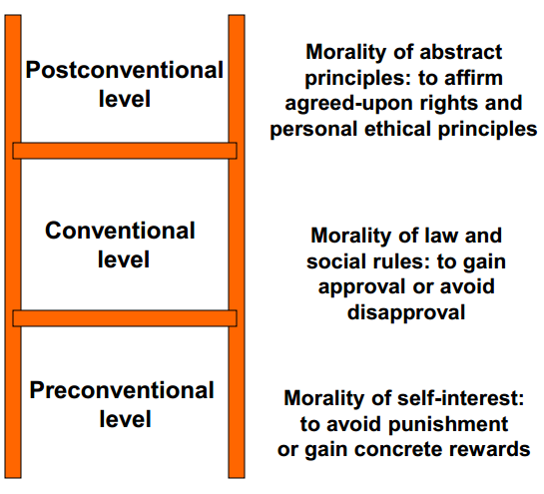
Kohlberg’s Moral Ladder
As moral development progresses, the focus of concern moves from the self to the wider social world.

Slide 24
Parenting
Most styles of parenting fall into one of four distinct styles that psychologists have found all around the world.
Authoritative
Authoritarian
Permissive
Uninvolved

Slide 25
Social Development – Child-Rearing Practices
Authoritarian
parents impose rules and expect obedience
“Don’t interrupt.” “Why? Because I said so.”
Permissive
submit to children’s desires, make few demands, use little punishment
Authoritative
both demanding and responsive set rules, but explain reasons and encourage open discussion

Slide 26
Parenting Styles
Style | Emotional Involvement | Authority | Autonomy
Authoritative | Parent is warm, attentive and sensitive to child’s needs and interests | Parent makes reasonable demands for the child’s maturity level; explains/ enforces rules | Parent permits child to make decisions in accord with developmental readiness
Authoritarian | Parent is cold and rejecting; frequently degrades the child | Parent is highly demanding; may use coercion by yelling commanding, criticizing and reliance on punishment | Parent makes most decisions for the child; rarely listens to child’s viewpoint
Permissive | Parent is warm but may spoil the child | Parent makes few or no demands-often out of misplaced concern for child’s self esteem | Parent permits child to make decisions before the child is ready
Uninvolved | Parent is emotionally detached, withdrawn and inattentive | Parent makes few of no demands-often lacking in interest or expectations for the child | Parent is indifferent to child’s decisions and point of view.

Slide 27
Results of Parenting
Does the type of parent you are matter?
Research suggests that children or parents who were authoritative tend to be confident, self-reliant, enthusiastic and overall happier.
Children with authoritarian parents tend to be anxious and insecure while those with permissive parents tend to be immature, impulsive, dependant and demanding.

Slide 28
Daycare: Bad or Good?
Day cares are growing in size and number in our country. There has also been a growing feeling that daycares might have adverse effects on children.
Research has shown that most children thrive in day care, especially socially. However, a poor-quality daycare experience can influence children to be aggressive, depressed or otherwise maladjusted.

Slide 29
Leisure Time
U.S. children have more free time than children in any other country.
In nonindustrialized societies, children average 6 hours of a day working at some sort of chores or labor.
The typical American child spends less than ½ hour doing chores.

Slide 30
Effects of Chores
While long hard work may teach discipline, responsibility and appreciation, there is little evidence that it produces positive changes in cognitive development.
American children also spend less time doing school work than children in other developed countries (though more than American children did in the past).

Slide 31
Leisure Time
A good portion of American children’s time is spent watching TV, talking on the phone, surfing the internet, or “hanging out.”
Many children spend the majority of their free time in structured activities like clubs or sports teams.
Are our children spending their time productively?

Slide 32
Gender Differences
It is clear that gender differences exist in children. The sexes tend to segregate themselves, which is a pattern that holds true across cultures.
Girls tend to organize themselves in small, cooperative groups. Boys often form larger groups that have a hierarchical structure.

Slide 33
Explanations for Differences
Evolutionary psychologists believe these gender differences have an innate basis, which may be related, in part to gender differences in testosterone levels.
Social-cognitive psychologists believe children also learn gender roles and gender related behaviors such as aggressiveness, competitiveness or cooperation.

Slide 34
Differences Between Then and Now
While most psychologists support Erikson’s thoughts on adult development, they realize that young adults today face different situations than they have in the past.
Today, many young adults live together before they are married. While this may be better in the long run, individuals may struggle with identity issues at the same time they are trying to deal with intimacy issues.

Slide 35
Module 15
Adulthood and Reflections on Developmental Issues

Slide 36
Psychology Beyond Adulthood
Until the last few years, there was little psychological research done on young adults, and almost none on people past their mid 20s.
Within the next 10 years, a big part of our population will be made up of baby boomers who are living longer and encountering more issues physically and psychologically than any group before them.

Slide 37
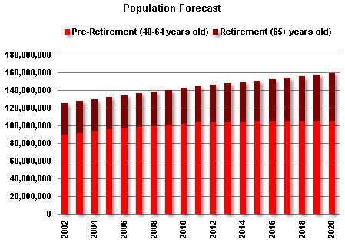
Aging Boomers

Slide 38
Adulthood: Physical Development
Menopause
the time of natural cessation of menstruation
also refers to the biological changes a woman
experiences as her ability to reproduce declines
Alzheimer’s Disease
a progressive and irreversible brain disorder characterized by a gradual deterioration of memory, reasoning, language, and finally, physical functioning

Slide 39
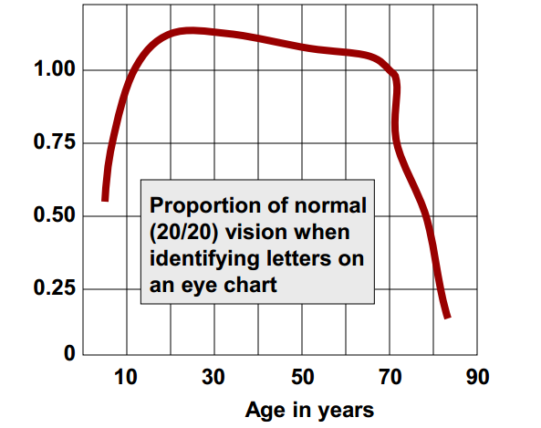
Adulthood: Physical Development
The Aging Senses

Slide 40
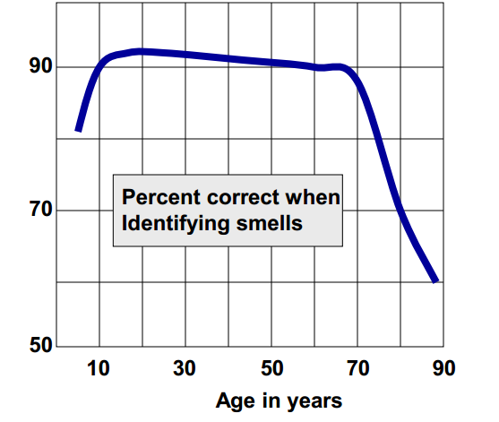
Adulthood: Physical Development
The Aging Senses

Slide 41
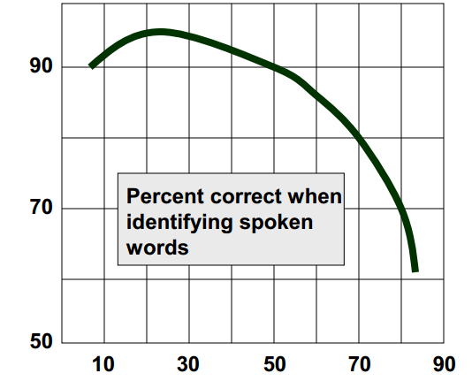
Adulthood: Physical Development
The Aging Senses

Slide 42
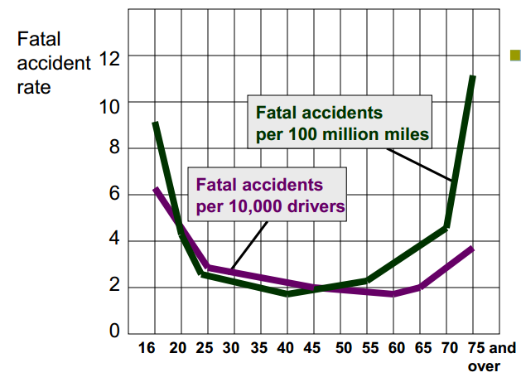
Adulthood: Physical Development
Slowing
reactions
contribute to increased accident risks among those
75 and older.

Slide 43
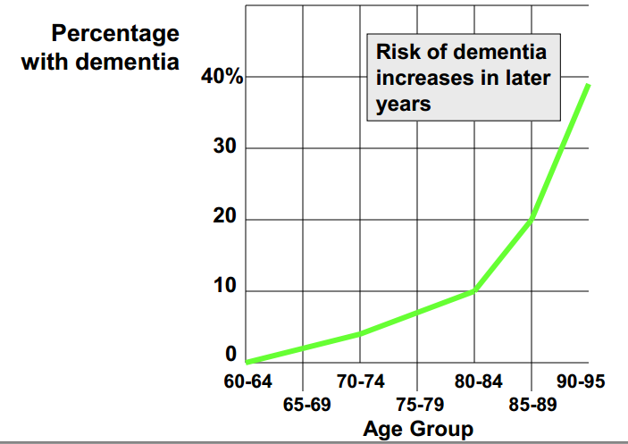
Adulthood: Physical Development
Incidence of Dementia by Age

Slide 44
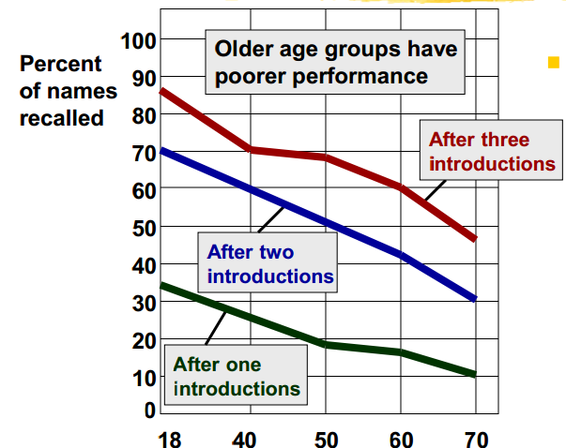
Adulthood: Cognitive Development
Recalling new names introduced once, twice, or three times is easier for younger adults than for older ones (Crook & West, 1990).

Slide 45
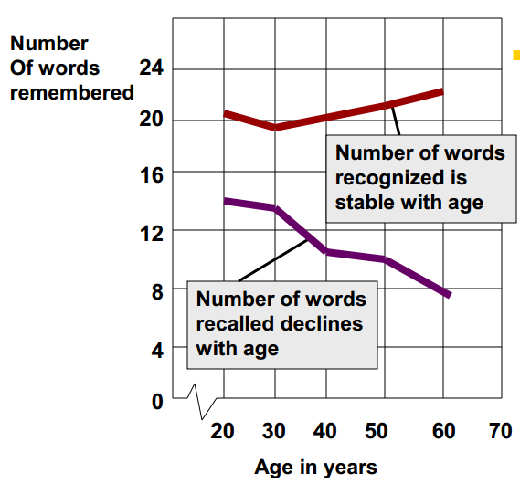
Adulthood: Cognitive Development
In a study by Schonfield & Robertson (1966), the ability to recall new information declined during early and middle adulthood, but the ability to recognize new information did not.

Slide 46
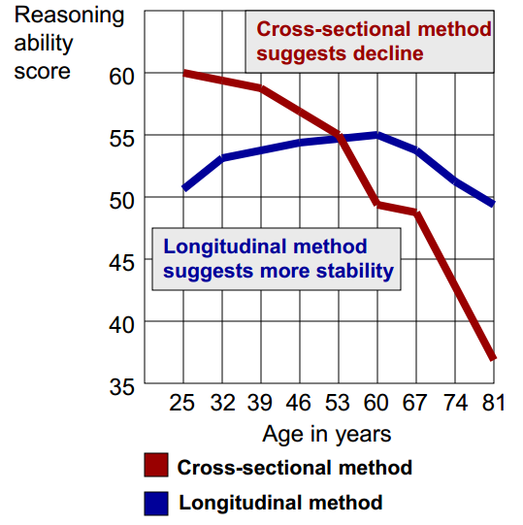
Adulthood: Cognitive Development
Cross-Sectional Study
a study in which people of different ages are compared with one another
Longitudinal Study
a study in which the same people are restudied and retested over a long period

Slide 47
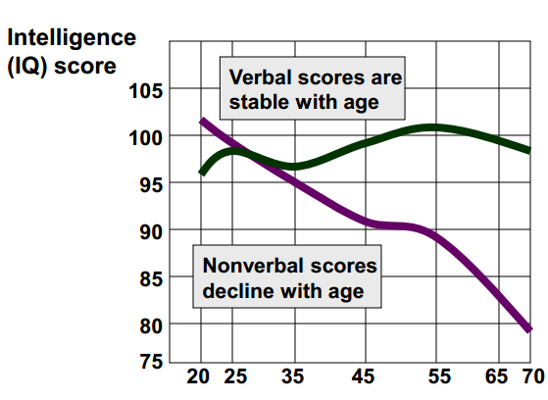
Adulthood- Cognitive Development
Verbal intelligence scores hold steady with age, while nonverbal intelligence scores decline (adapted from Kaufman & others, 1989)

Slide 48
Adulthood: Cognitive Development
Crystallized Intelligence
one’s accumulated knowledge and verbal skills tends to increase with age
Fluid Intelligence
ones ability to reason speedily and abstractly tends to decrease during late adulthood

Slide 49
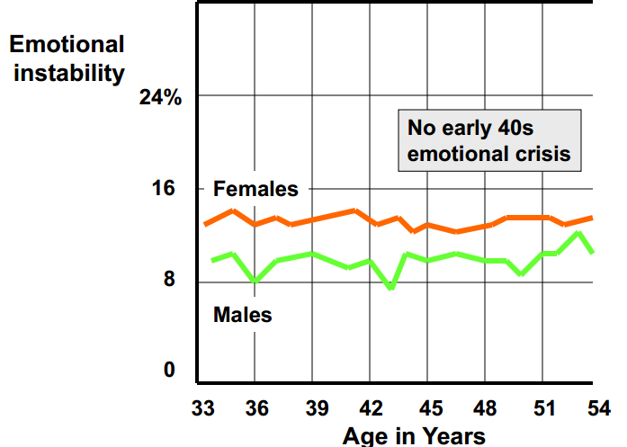
Adulthood: Social Development
Early-forties midlife crisis?

Slide 50
Adulthood: Social Changes
Social Clock
the culturally preferred timing of social events such as:
marriage
parenthood
retirement

Slide 51
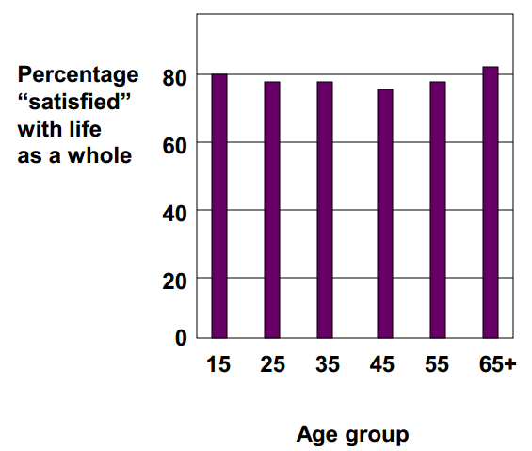
Adulthood: Social Changes
Multinational
surveys show that age differences in life satisfaction are trivial (Inglehart, 1990).

Slide 52
Challenges of Midlife
Erikson singled out generitivity, as the big challenge facing middle aged adults.
Generitivity is the process of making a commitment beyond oneself to family, work, society or future generations.
This is a crucial challenge of adults in their 30s, 40s and 50s.
The good news is that most people do not actually undergo a true midlife crisis or upheaval.

Slide 53
Erikson’s Last Stage
The last stage of Erikson’s model deals with elderly people.
The big challenge in this stage is ego-integrity vs. despair. Erikson describes this as the challenge to have a life we can look back on and have no regrets about and to enjoy a sense of wholeness.

Slide 54
In the End
Death is inevitable. It is something we will all go through. But, do we go through it the same way?
According to Elisabeth Kubler-Ross, we do, in five stages. While we each experience the stages differently, we will all go through the following:
Denial
Anger
Bargaining
Depression
Acceptance

Slide 55
The Stages
Denial- Refusing to believe the individual is sick.
Anger- Displays anger that individual is sick.
Bargaining- Making a deal, in return for a cure, they will fulfill a promise.
Depression- General depression affecting sleeping and eating patterns.
Acceptance-The realization that death is inevitable.

