Slide 1
Developing through the Life Span
AP Psychology
Ms. C. Fahey

Slide 2
Module 13
Prenatal Development and the Newborn

Slide 3
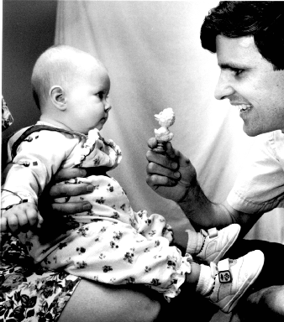
Developmental Psychology
Developmental psychology is the psychology of growth, change and consistency though the lifespan.
Developmental psychology looks at how thinking, feeling, and behavior change throughout a person’s life.
It looks at three debates:
Nature vs. Nurture
Continuity vs. Discontinuity
Stability vs. Change

Slide 4
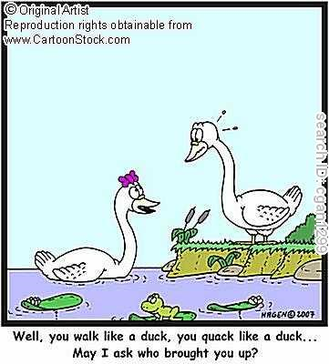
Nature vs. Nurture Issue
Developmental psychology seeks to answer two big questions about heredity and environment:
How much weight does each wield?
How do they interact?
Nature refers to the effects of heredity and nurture to the influence of environment.

Slide 5
How to Study the Nature-Nurture Interaction
There are two effective ways to study nature-nurture.
Twin studies: Identical twins have the same genotype, and fraternal twins have an average of 50% of their genes in common.
Adoption studies: Similarities with the biological family support nature, while similarities with the adoptive family support nurture.

Slide 6
Gradual vs. Abrupt Change
Think about how children become adults. Is there a predictable pattern they follow regarding thought and language and social development?
Do children go through gradual changes or are they abrupt changes?

Slide 7
Continuity View
The continuity view says that change is gradual.
Children become more skillful in thinking, talking or acting much the same way as they get taller.
We know that skilled behaviors often happen in this way as with the trial and error method of learning to walk or eat with a spoon. (Observable skills…what about mental processes?)

Slide 8
Discontinuity View
The discontinuity view sees development as more abrupt-a succession of changes that produce different behaviors in different age-specific life periods called stages.
This is evident in beginning readers who suddenly discover the connection between letters and sounds.

Slide 9
Discontinuity View
We often hear people taking about children going through “stages” in life (i.e. “terrible twos.”)
These are called developmental stages-periods of life initiated by distinct transitions in physical or psychological functioning.
Psychologists of the discontinuity view believe that people go through the same stages, in the same order, but not necessarily at the same rate.
However, if a person misses a stage, it can have lasting consequences.

Slide 10
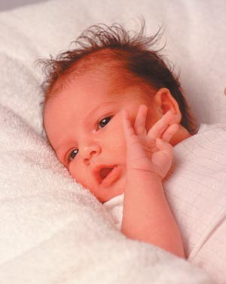
Capabilities of Newborns
People used to think that newborns began life as a “blank slate”-an empty brain and no abilities.
Tabula rasa
Studies have shown that newborns have innate abilities to find nourishment, interact with others and avoid harmful situations.

Slide 12
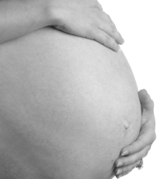
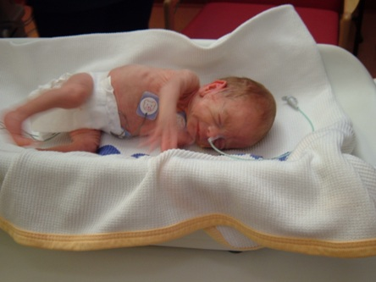
Developmental Periods to Know
Prenatal Period: The developmental period before birth.
Neonatal Period: Birth-1 month.
Infancy: 1 month-18/24 months.

Slide 13
Three Developmental Periods
Prenatal Period: 9 month developmental period before birth.
During this time, the genetic plan determines how all of the organs that will be formed later begin to form.
Here we get differentiation (cells forming specific organs). Before we differentiation, cells are “stem cells” and are capable of forming into any organ in the body.
One concern during this time are teratogens, or substances from the environment that can damage the developing baby.

Slide 14
A Tough Discussion
Thirteen states can terminate parental rights if evidence of substance abuse exists during pregnancy. Eight states require doctors to report if evidence of parental substance abuse exists.
How do you think the criminal justice system should deal with mothers who abuse drugs during pregnancy?
If states pursue offenders of this crime, how do you think society, in general would be affected?

Slide 16
Prenatal Stages of Development
Zygote
The fertilized egg
Enters a 2 week period of rapid cell division
Develops into an embryo
Embryo
The developing human organism from 2 weeks through 2nd month
Fetus
The developing human organism from 9 weeks after conception to birth

Slide 18
Prenatal Development and the Newborn
Teratogens
agents, such as chemicals and viruses, that can reach the embryo or fetus during prenatal development and cause harm
Fetal Alcohol Syndrome (FAS)
physical and cognitive abnormalities in children caused by a pregnant woman’s heavy drinking
symptoms include misproportioned head

Slide 20
Three Developmental Periods
Neonatal Period: Birth to one month old.
During this stage babies are capable of responding to stimulation from all of their senses.
Infancy Period: 1 mo. to 24 mo.
This is a period of rapid development, but is still heavily reliant on reflexive behavior.
Part of the reason we remember very little between birth and age 3 ½ is that our brain circuits are not fully developed

Slide 21
Learning in Development
During infancy, youngsters begin to exploit their abilities for learning.
Crying, cooing, smiling, etc.
Classical conditioning in newborns.
Stroking forehead and giving sweets: Newborns who were stroked on the forehead were classically conditioned to turn their head toward the side where the sweetened water was provided, even if the bottle of water wasn’t present.

Slide 22
Social Abilities
During infancy we also see babies engage in a lot of social interaction.
Synchronicity: close coordination between the gazing, vocalizing, touching and smiling of mothers and infants.
Babies are preprogrammed to their mother’s voice
Babies are preprogrammed to recognize faces
This is so strong that we will see infants engage in the same behavior as their mother.
Laugh when she laughs/cry when she displays negative emotion.

Slide 23
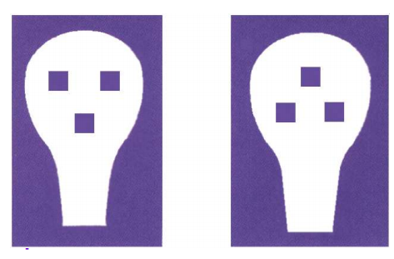
Prenatal Development and the Newborn
Rooting Reflex
tendency to open mouth, and search for nipple when touched on the cheek
Preferences
human voices and faces
facelike images-->
smell and sound of mother

Slide 24
Other Newborn Reflexes

Slide 25
Prenatal Development and the Newborn

Slide 26
Prenatal Development and the Newborn

Slide 27
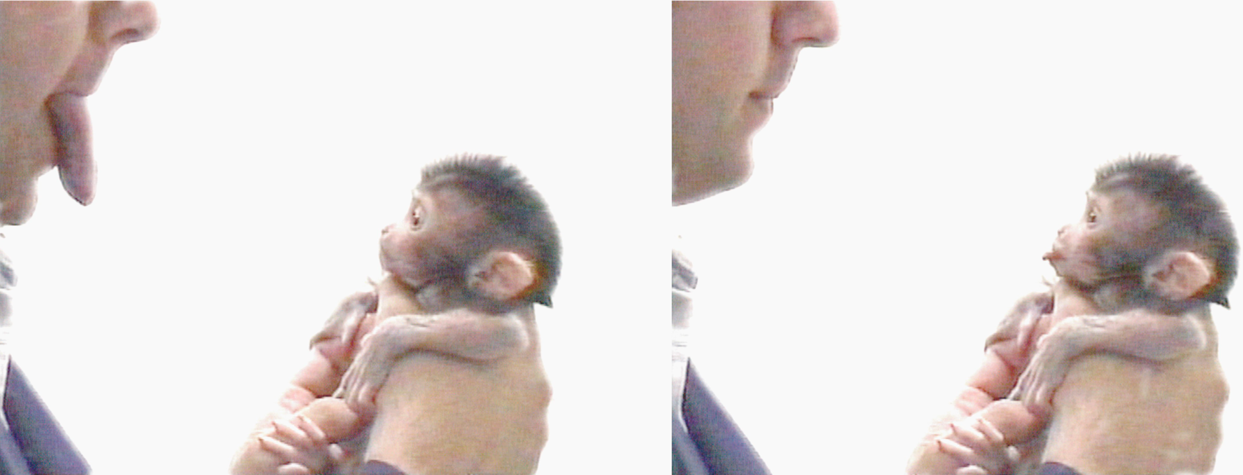
Mimicking
The idea that babies will mimic is not something that is unique to human babies.
Makak Neonatal Imitation

