Slide 1
Module 12 Environmental Influences on Behavior

Slide 2
Parents and Peers
Parents and Early Experiences
Peer Influence
Cultural Influences
Variations Across Cultures
Variations Over Time
Culture and the Self
Culture and Child-Rearing
Developmental Similarities Across Groups

Slide 3
Evolutionary Psychology: Understanding Human Nature
Natural Selection and Adaptation
Evolutionary Success Helps Explain Similarities
An Evolutionary Explanation of Human Sexuality

Slide 4
Gender Development
Gender Similarities and Differences
The Nature of Gender
The Nurture of Gender
Reflections on Nature and Nurture

Slide 5
Parents and Peers
Parents and Early Experiences
We have looked at how genes influence our developmental differences. What about the environment? How do our early experiences, our family, our community and our culture affects these differences?
Notes:
Preview Question 1: To what extent are our lives shaped by early stimulation, by parents, and by peers?

Slide 6
Experience and Brain Development
Early postnatal experiences affect brain development. Rosenzweig et al. (1984) showed that rats raised in enriched environments developed thicker cortices than those in impoverished environment.

Slide 7
Experience and Faculties
Early experiences during development in humans shows remarkable improvements in music, languages and the arts.
Courtesy of C. Brune

Slide 8
Brain Development and Adulthood
Brain development does not stop when we reach adulthood. Throughout our life, brain tissue continues to grow and change.
Both hotos courtesy of Avi Kani and Leslie
Ungerleider, National Institue of Mental Health
A well-learned finger-tapping task leads to
more motor cortical neurons (right) than baseline.

Slide 9
How Much Credit (or Blame) Do Parents Deserve?
Parental influence is largely genetic. This support is essential in nurturing children. However, other socializing factors also play an important role.
Miquel L. Fairbanks
Although raised in the same family,
some children are greater risk takers.

Slide 10
Peer Influence
Children, like adults, attempt to fit into a group by conforming. Peers are influential in such areas as learning to cooperate with others, gaining popularity, and developing interactions.
Ole Graf/ zefa/ Corbis

Slide 11
Nature, Nurture, and Human Diversity
Cultural Influences
Variations Across Cultures
Variations Over Time
Culture and the Self
Culture and Child-Rearing
Developmental Similarities Across Groups

Slide 12
Cultural Influences
Humans have the ability to evolve culture. Culture is composed of behaviors, ideas, attitudes, values and traditions shared by a group.
Kevin R. Morris/Corbis
Notes:
Preview Question 2: How do cultural norms affect our behavior?

Slide 13
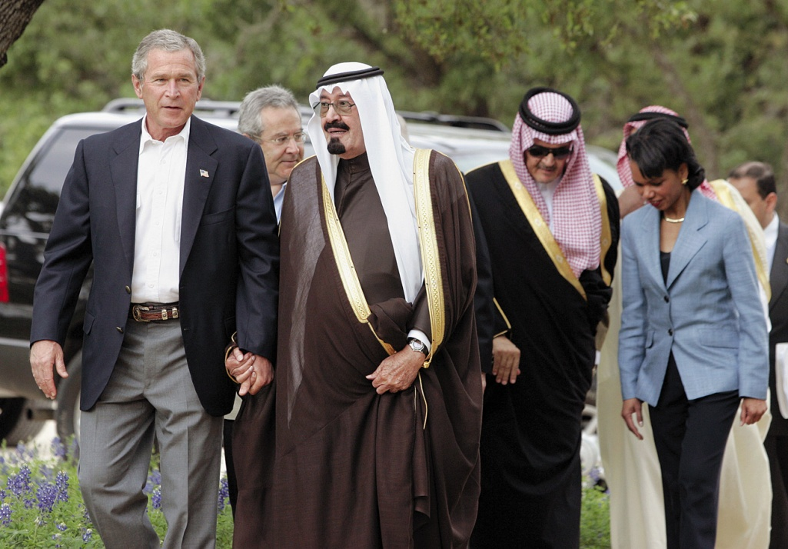
Variation Across Culture
Cultures differ. Each culture develops norms – rules for accepted and expected behavior. Men holding hands in Saudi Arabia is the norm (closer personal space), but not in American culture.
Jason Reed/ Reuters/Corbis

Slide 14
Variation Over Time
Cultures change over time. The rate of this change may be extremely fast. In many Western countries, culture has rapidly changed over the past 40 years or so.
This change cannot be attributed to changes in the human gene pool because genes evolve very slowly.

Slide 15
Culture and the Self
If a culture nurtures an individual’s personal identity, it is said to be individualist, but if a group identity is favored then the culture is described as collectivist.
A collectivist support system can benefit groups who experience disasters such as the 2005 earthquake in Pakistan.
Kyodo News
Notes:
Preview Question 3: How do individualist and collectivist influences affect people?

Slide 16
Culture and the Self

Slide 17
Culture and Child-Rearing
Individualist cultures (European) raise their children as independent individuals whereas collectivist cultures (Asian) raise their children as interdependent.
Jose Luis Palaez, Inc./ Corbis

Slide 18
Culture and Child-Rearing
Westernized Cultures | Asian-African Cultures
Responsible for your self | Responsible to group
Follow your conscience | Priority to obedience
Discover your gifts | Be true to family-self
Be true to yourself | Be loyal to your group
Be independent | Be interdependent

Slide 19
Developmental Similarities Across Groups
Despite diverse cultural backgrounds, humans are more similar than different in many ways. We share the same genetic profile, life cycle, capacity for language, and biological needs.
Copyright Steve Reehl

Slide 20
Nature, Nurture, and Human Diversity
Gender Development
Gender Similarities and Differences
The Nature of Gender
The Nurture of Gender

Slide 21
Gender Development
Based on genetic makeup, males and females are alike, since the majority of our inherited genes (45 chromosomes are unisex) are similar.
Males and females differ biologically in body fat, muscle, height, onset of puberty, and life expectancy.
Notes:
Preview Question 4: What are some ways in which males and females tend to be alike and to differ?

Slide 22
Gender Differences in Aggression
Men express themselves and behave in more aggressive ways than do women. This aggression gender gap appears in many cultures and at various ages.
In males, the nature of this aggression is physical.

Slide 23
Gender and Social Power
In most societies, men are socially dominant and are perceived as such.
In 2005, men accounted for 84% of the governing parliaments.

Slide 24
Gender Differences and Connectedness
Young and old, women form more connections (friendships) with people than do men. Men emphasize freedom and self-reliance.
Oliver Eltinger/ Zefa/ Corbis
Dex Image/ Getty Images

Slide 25
Biology of Sex
Biological sex is determined by the twenty-third pair of chromosomes. If the pair is XX, a female is produced. If the pair is XY, a male child is produced.

Slide 26
Sexual Differentiation
In the mother’s womb, the male fetus is exposed to testosterone (because of the Y chromosome), which leads to the development of male genitalia.
If low levels of testosterone are released in the uterus, the result is a female.

Slide 27
Sexual Differentiation
Sexual differentiation is not only biological, but also psychological and social.
However, genes and hormones play a very important role in defining gender, especially in altering the brain and influencing gender differences as a result.

Slide 28
Gender Roles
Our culture shapes our gender roles — expectations of how men and women are supposed to behave.
Gender Identity — means how a person views himself or herself in terms of gender.
Notes:
Preview Question 5: How do nature and nurture together form our gender?

Slide 29
Gender Roles: Theories
Social Learning Theory proposes that we learn gender behavior like any other behavior—reinforcement, punishment, and observation.
Gender Schema Theory suggests that we learn a cultural “recipe” of how to be a male or a female, which influences our gender- based perceptions and behaviors.

Slide 31
Nature, Nurture, and Human Diversity
Reflections on Nature and Nurture

Slide 32
Reflections on Nature and Nurture

