Slide 1
Learning
Continued

Slide 2
Classical vs. Operant Conditioning
With classical conditioning you can teach a dog to salivate, but you cannot teach it to sit up or roll over. Why?
Salivation is an involuntary reflex, while sitting up and rolling over are far more complex responses that we think of as voluntary.

Slide 3
Operant Conditioning
An operant is an observable behavior that an organism uses to “operate” in the environment.
Operant Conditioning: A form of learning in which the probability of a response is changed by its consequences…that is, by the stimuli that follows the response.

Slide 4
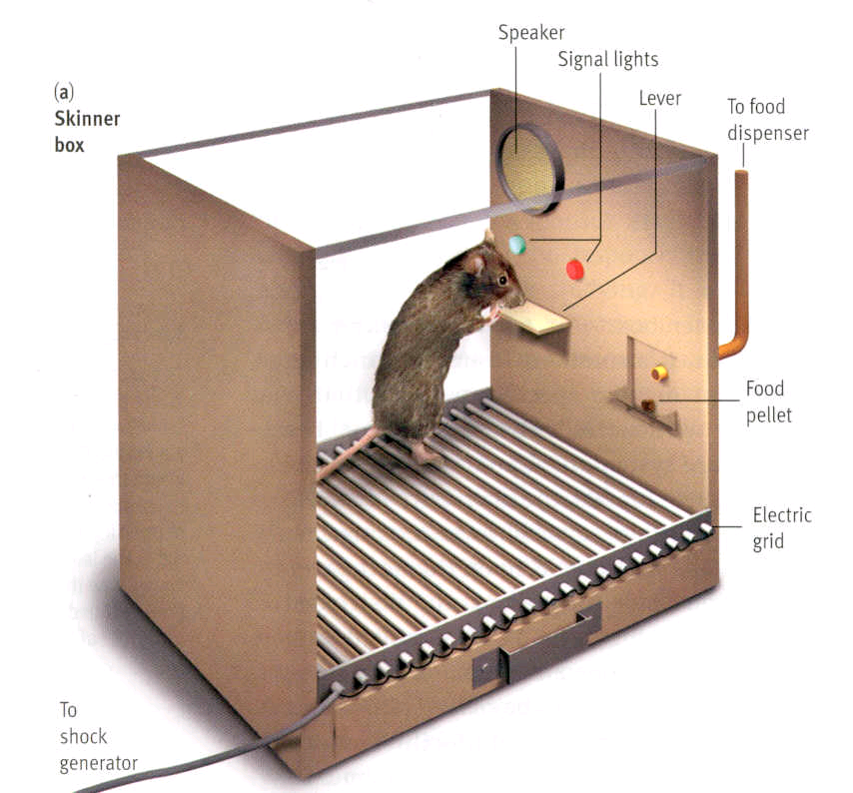
B.F. Skinner
B.F. Skinner became famous for his ideas in behaviorism and his work with rats.
Law of Effect: The idea that responses that produced desirable results would be learned, or “stamped” into the organism.

Slide 5
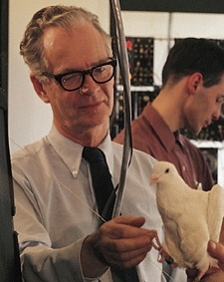
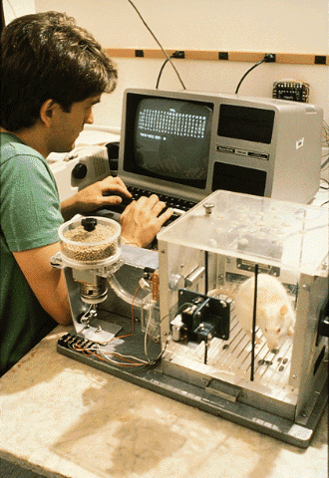
B.F. Skinner and The Skinner Box

Slide 6
Reinforcement
A reinforcer is a condition in which the presentation or removal of a stimulus, that occurs after a response (behavior), strengthens that response or makes it more likely to happen again in the future.
Positive Reinforcement: A stimulus presented after a response that increases the probability of that response happening again.
  Ex: Getting paid for good grades

Slide 7
Negative Reinforcement
Negative Reinforcement: The removal of an unpleasant or averse stimulus that increases the probability of that response happening again.
  Ex: Taking Advil to get rid of a headache.
  Ex: Putting on a seatbelt to make the annoying seatbelt buzzer stop.
The word “positive” means add or apply; “negative” is used to mean subtract or remove.

Slide 8
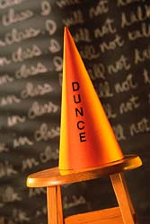
Punishment
A punishment is an averse/disliked stimulus which occurs after a behavior, and decreases the probability it will occur again.
Positive Punishment: An undesirable event that follows a behavior: getting spanked after telling a lie.

Slide 9
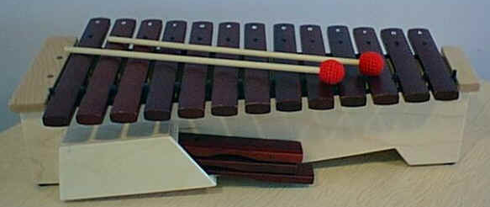
Punishment
Negative Punishment: When a desirable event ends or is taken away after a behavior.
  Example: getting grounded from your cell phone after failing your progress report.
  Think of a time-out (taking away time from a fun activity with the hope that it will stop the unwanted behavior in the future.)

Slide 10
Reinforcement/Punishment Matrix
The consequence provides something ($, a spanking…) | The consequence takes something away (removes headache, timeout)
Positive Reinforcement | Negative Reinforcement | The consequence makes the behavior more likely to happen in the future.
Positive Punishment | Negative Punishment | The consequence makes the behavior less likely to happen in the future.

Slide 11
Reinforcement vs. Punishment
Unlike reinforcement, punishment must be administered consistently. Intermittent punishment is far less effective than punishment delivered after every undesired behavior.
  In fact, not punishing every misbehavior can have the effect of rewarding the behavior.
It is important to remember that the learner, not the teacher, decides if something is reinforcing or punishing.
      Redi Whip vs. Easy Cheese

Slide 12
Punishment vs. Negative Reinforcement
Punishment and negative reinforcement are used to produce opposite effects on behavior.
  Punishment is used to decrease a behavior or reduce its probability of reoccurring.
  Negative reinforcement always increases a behavior’s probability of happening in the future (by taking away an unwanted stimuli).
Remember, “positive” means adding something and “negative means removing something.

Slide 13
Uses and Abuses of Punishment
Punishment often produces an immediate change in behavior, which ironically reinforces the punisher.
However, punishment rarely works in the long run for four reasons:
The power of punishment to suppress behavior usually disappears when the threat of punishment is gone.
Punishment triggers escape or aggression.
Punishment makes the learner apprehensive: inhibits learning.
Punishment is often applied unequally.

Slide 14
Making Punishment Work
To make punishment work:
  Punishment should be swift.
  Punishment should be certain-every time.
  Punishment should be limited in time and intensity.
  Punishment should clearly target the behavior, not the person.
  Punishment should not give mixed messages.
  The most effective punishment is often omission training-negative punishment.

Slide 15
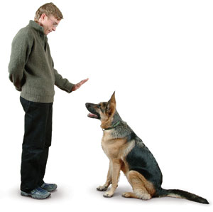
Reinforcement Schedules
Continuous Reinforcement: A reinforcement schedule under which all correct responses are reinforced.
  This is a useful tactic early in the learning process. It also helps when “shaping” new behavior.
Shaping: A technique where new behavior is produced by reinforcing responses that are similar to the desired response.
Dog training requires continuous reinforcement

Slide 16
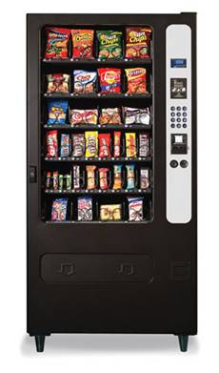
Continuous Reinforcement
Continuous Reinforcement:
A schedule of reinforcement that rewards every correct response given.
  Example: A vending machine.
What are other examples?

Slide 17
Reinforcement Schedules
Intermittent Reinforcement: A type of reinforcement schedule by which some, but not all, correct responses are reinforced.
  Intermittent reinforcement is the most effective way to maintain a desired behavior that has already been learned.

Slide 18
Schedules of Intermittent Reinforcement
Interval schedule: rewards subjects after a certain time interval.
Ratio schedule: rewards subjects after a certain number of responses.
  There are 4 types of intermittent reinforcement:
    Fixed Interval Schedule (FI)
    Variable Interval Schedule (VI)
    Fixed Ratio Schedule (FR)
    Variable Ratio Schedule (VR)

Slide 19
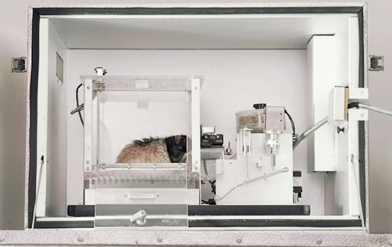
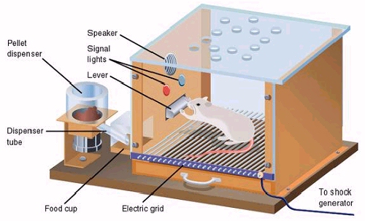
Interval Schedules
Fixed Interval Schedule (FI):
  A schedule that a rewards a learner only for the first correct response after some defined period of time.
  Example: B.F. Skinner put rats in a box with a lever connected to a feeder. It only provided a reinforcement after 60 seconds. The rats quickly learned that it didn’t matter how early or often it pushed the lever, it had to wait a set amount of time. As the set amount of time came to an end, the rats became more active in hitting the lever.

Slide 20
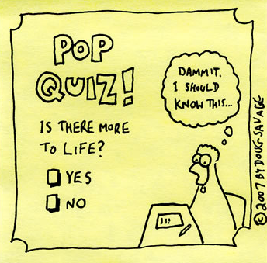
Interval Schedules
Variable Interval Schedule (VI):
A reinforcement system that rewards a correct response after an unpredictable amount of time.
  Example: A pop-quiz

Slide 21
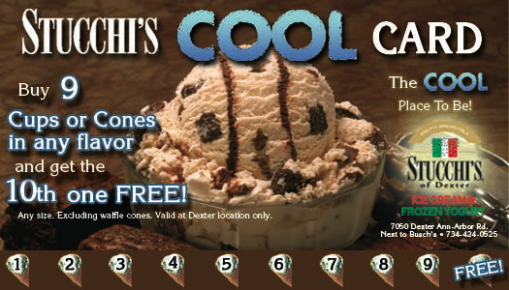
Ratio Schedules
Fixed Ratio Schedule (FR):
A reinforcement schedule that rewards a response only after a defined number of correct answers.
  Example: At Safeway, if you use your Club Card to buy 7 Starbucks coffees, you get the 8th one for free.

Slide 22
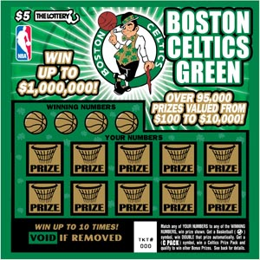
Ratio Schedules
Variable Ratio Schedule (VR):
A reinforcement schedule that rewards an unpredictable number of correct responses.
  Example: Buying lottery tickets

Slide 23
Schedules of Reinforcement
Number of
responses
Fixed Ratio
Intermittent Reinforcement Schedules-
Skinner’s laboratory pigeons produced these responses patterns to each of four reinforcement schedules
For people, as for pigeons, research linked to number of responses (ratio) produces a higher response rate than reinforcement linked to time elapsed (interval).
1000
Variable Ratio
750
Fixed Interval
Rapid responding near time for reinforcement
500
Variable Interval
250
Steady responding
0
10
20
30
40
50
60
70
80
Time (minutes)

Slide 24
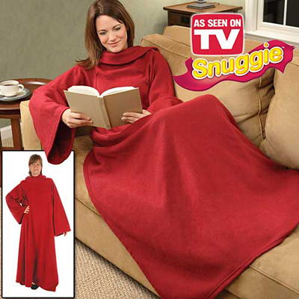
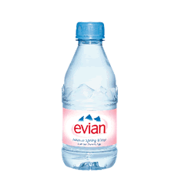
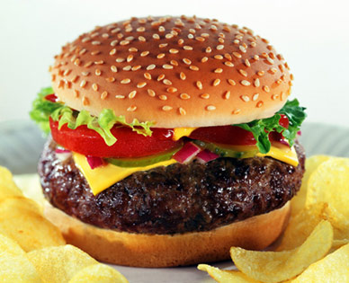
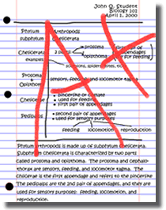

Primary and Secondary reinforcement
Primary reinforcement: something that is naturally reinforcing: food, warmth, water…
Secondary reinforcement: something you have learned is a reward because it is paired with a primary reinforcement in the long run: good grades.

Slide 25
Cognition & Operant Conditioning
Evidence of cognitive processes during operant learning comes from rats during a maze exploration in which they navigate the maze without an obvious reward. Rats seem to develop cognitive maps, or mental representations, of the layout of the maze (environment).
Notes:
Preview Question 5: Do cognitive processes and biological constraints affect operant conditioning?

Slide 26
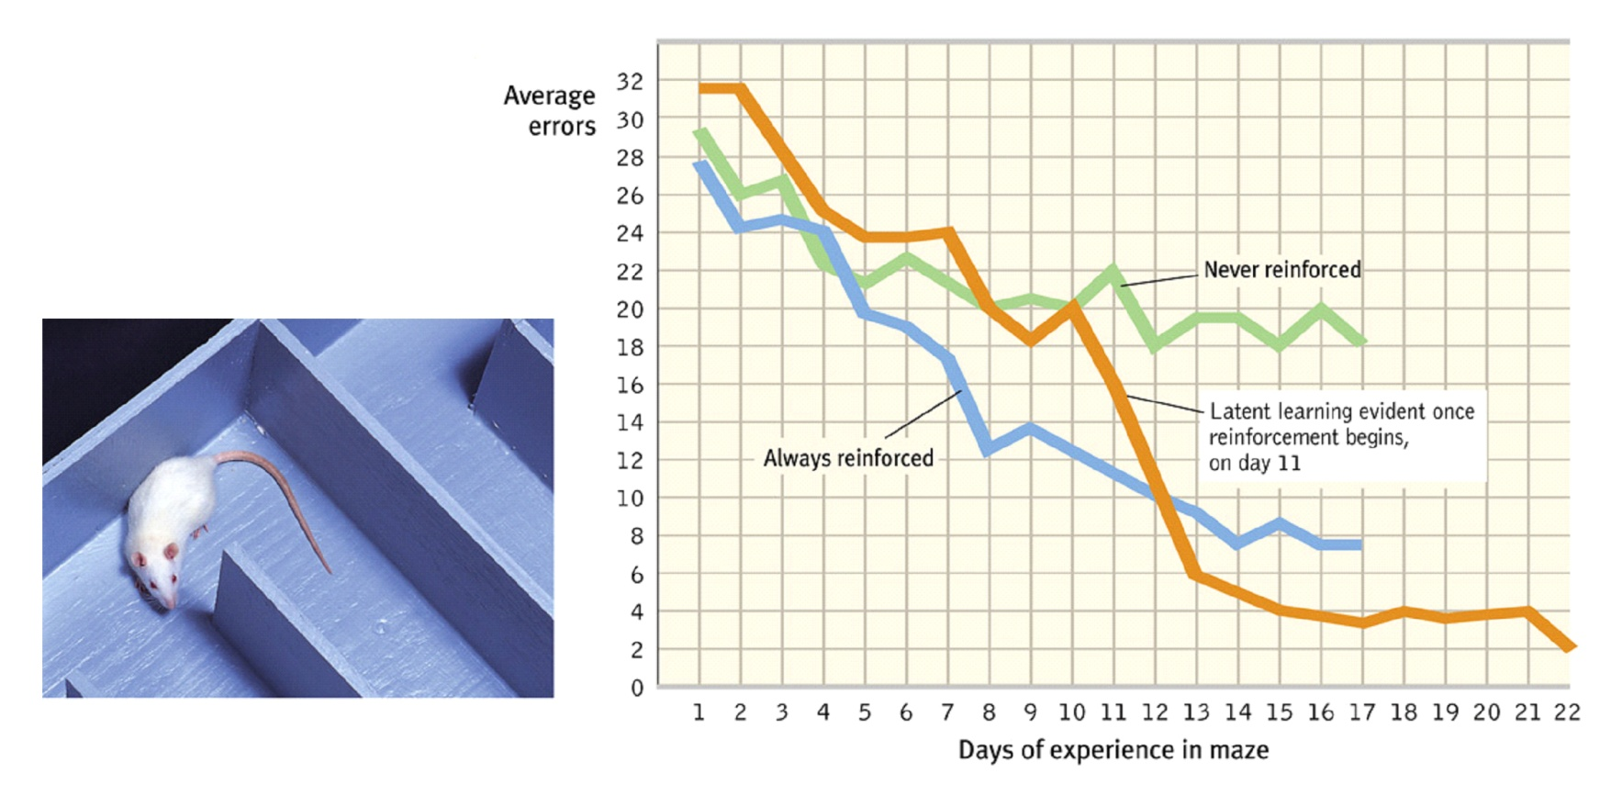
Latent Learning
Such cognitive maps are based on latent learning, which becomes apparent only when an incentive is given (Tolman & Honzik, 1930).

Slide 27
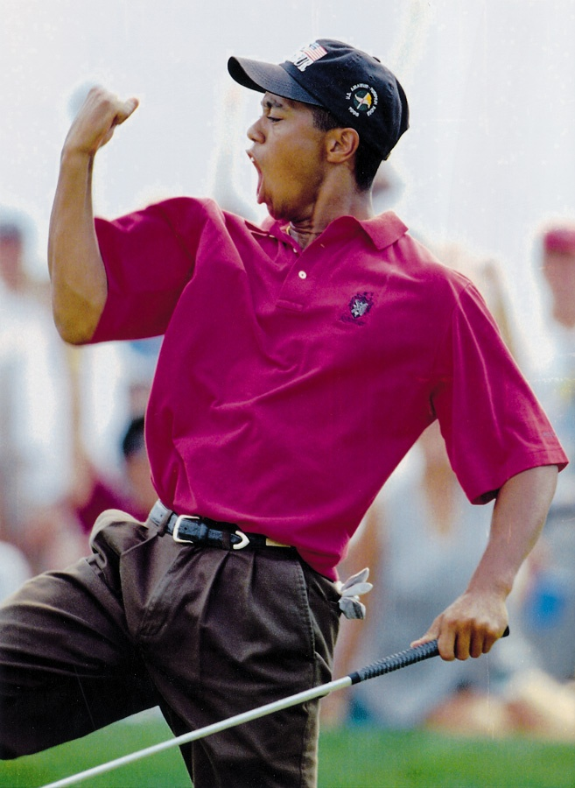
Intrinsic Motivation
Intrinsic Motivation: The desire to perform a behavior for its own sake.
Extrinsic Motivation: The desire to perform a behavior due to promised rewards or threats of punishments.

Slide 28
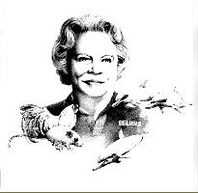
Biological Predisposition
Biological constraints predispose organisms to learn associations that are naturally adaptive.
Breland and Breland (1961) showed that animals drift towards their biologically predisposed instinctive behaviors.
Photo: Bob Bailey
Marian Breland Bailey

Slide 29
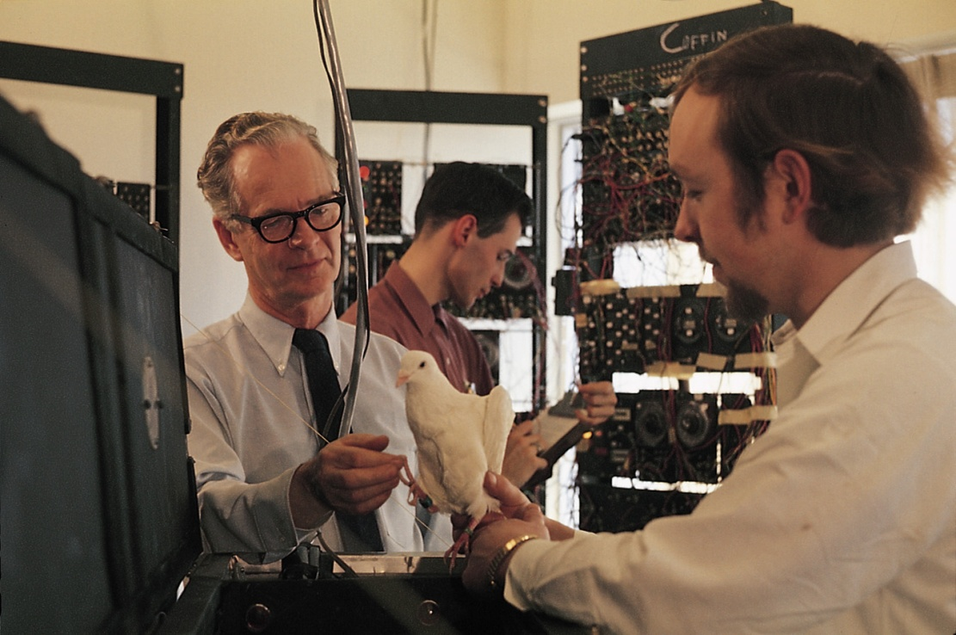
Skinner’s Legacy
Skinner argued that behaviors were shaped by external influences instead of inner thoughts and feelings. Critics argued that Skinner dehumanized people by neglecting their free will.
Falk/ Photo Researchers, Inc.

Slide 30

Applications of Operant Conditioning
Skinner introduced the concept of teaching machines that shape learning in small steps and provide reinforcements for correct rewards.
LWA-JDL/ Corbis
In School
Notes:
Preview Question 6: How might operant conditioning principles be applied at school, in sports, at work, and at home?

Slide 31
Applications of Operant Conditioning
Reinforcers affect productivity. Many companies now allow employees to share profits and participate in company ownership.
At work

Slide 32
Applications of Operant Conditioning
At Home
In children, reinforcing good behavior increases the occurrence of these behaviors. Ignoring unwanted behavior decreases their occurrence.

Slide 33

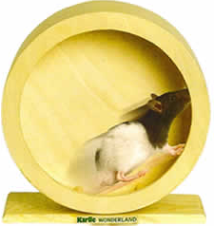
Two Important Theories
Token Economy: A therapeutic method based on operant conditioning that where individuals are rewarded with tokens, which act as a secondary reinforcer. The tokens can be redeemed for a variety of rewards.
Premack Principle: The idea that a more preferred activity can be used to reinforce a less-preferred activity.

Slide 34
Operant and Classical Conditioning
Classical Conditioning | Operant Conditioning
Behavior is controlled by the stimuli that precede the response (by the CS and the UCS). | Behavior is controlled by consequences (rewards, punishments) that follow the response.
No reward or punishment is involved (although pleasant and averse stimuli may be used). | Often involves rewards (reinforcement) and punishments.
Through conditioning, a new stimulus (CS) comes to produce the old (reflexive) behavior. | Through conditioning, a new stimulus (reinforcer) produces a new behavior.
Extinction is produced by withholding the UCS. | Extinction is produced by withholding reinforcement.
Learner is passive (acts reflexively): Responses are involuntary. That is behavior is elicited by stimulation. | Learner is active: Responses are voluntary. That is behavior is emitted by the organism.

Slide 35
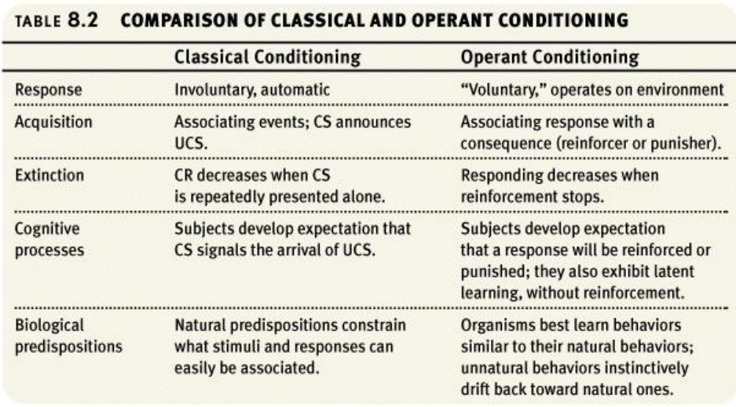

Slide 36
A Third Type of Learning
Sometimes we have “flashes of insight” when dealing with a problem where we have been experiencing trial and error.
This type of learning is called cognitive learning, which is explained as changes in mental processes, rather than as changes in behavior alone.

Slide 37
Wolfgang Kohler and Sultan
Kohler believed that chimps could solve complex problems by combining simpler behaviors they had previously learned separately.
Kohler taught Sultan the chimp how to stack boxes to obtain bananas that were over his head and how to use a stick to obtain something that was out of his reach. He taught Sultan these skills in separate situations.

Slide 38
Sultan’s Situation
When Sultan was put in a situation where the bananas were still out of his reach after stacking the boxes, Sultan became frustrated. He threw the stick and kicked the wall before sitting down.
Suddenly, he jumped up and dragged the boxes and stick under the bananas. He then climbed up the boxes and whacked the fruit down with the stick.
This suggested to Kohler that the animals were not mindlessly using conditioned behavior, but were learning by reorganizing their perceptions of problems.

Slide 39
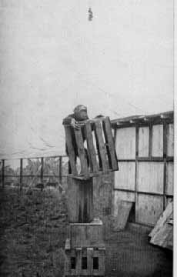
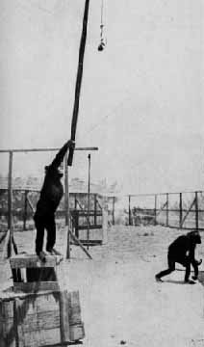
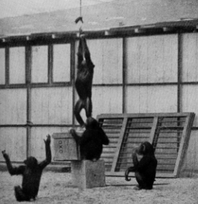
Sultan the Chimp

Slide 40
Cognitive Learning
Sultan was not the only animal to demonstrate cognitive learning. When rats were put into a maze with multiple routes to the reinforcer, the rats would repeatedly attempt the shortest route.
If their preferred route was blocked, they would chose the next shortest route to the reward.
Cognition Map: A mental representation of a place.

Slide 41
Latent Learning
In a similar study, rats were allowed to wander around a maze, without reinforcements, for several hours. It formerly was thought that reinforcements were essential for learning.
However, the rats later were able to negotiate the maze for food more quickly than rats that had never seen the maze before.
  Latent learning: Learning that occurs but is not apparent until the learner has an incentive to demonstrate it.

Slide 42
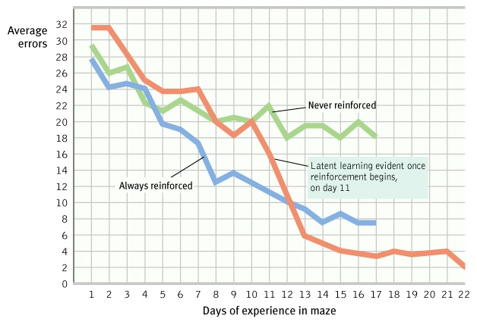
Latent Learning

Slide 43
Observational Learning
You can think of observational learning as an extension of operant conditioning, in which we observe someone else getting rewarded but act as thought we had also received the reward.
Observational learning: Learning in which new responses are acquired after other’s behavior and the consequences of their behavior are observed.

Slide 44
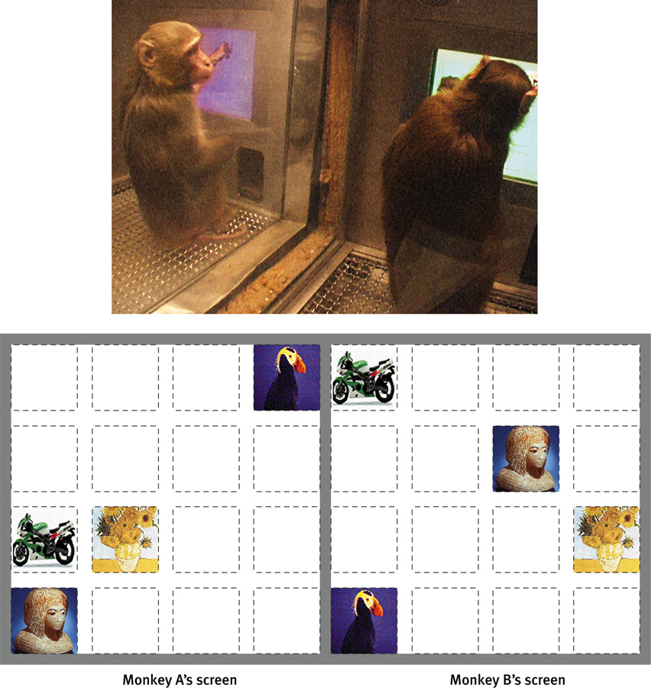
Learning by Observation
Higher animals, especially humans, learn through observing and imitating others.
The monkey on the right imitates the monkey on the left in touching the pictures in a certain order to obtain a reward.
© Herb Terrace
©Herb Terrace
Notes:
Preview Question 1: What is observational learning, and how is it enabled by mirror neurons?

Slide 45
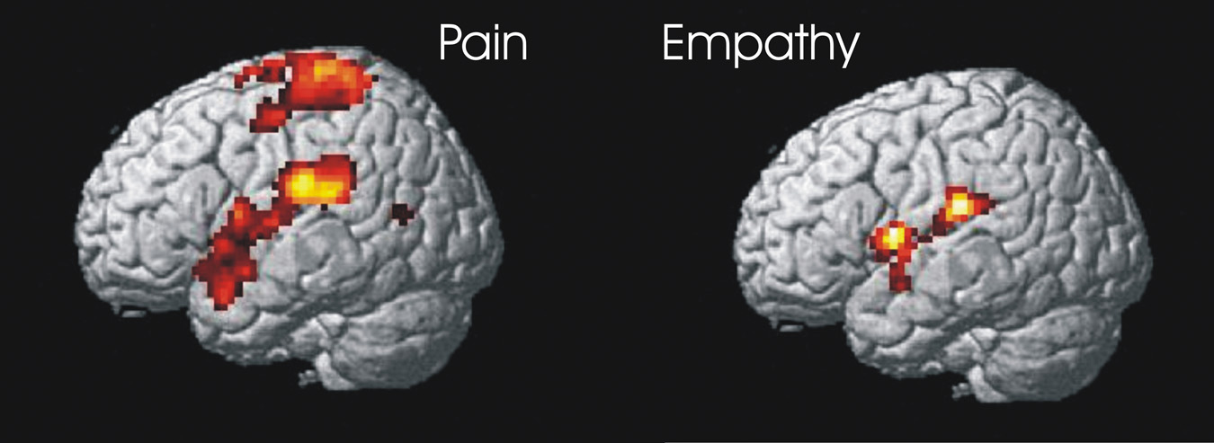
Mirror Neurons
Neuroscientists discovered mirror neurons in the brains of animals and humans that are active during observational learning.
Reprinted with permission from the American
Association for the Advancement of Science,
Subiaul et al., Science 305: 407-410 (2004)
© 2004 AAAS.

Slide 46
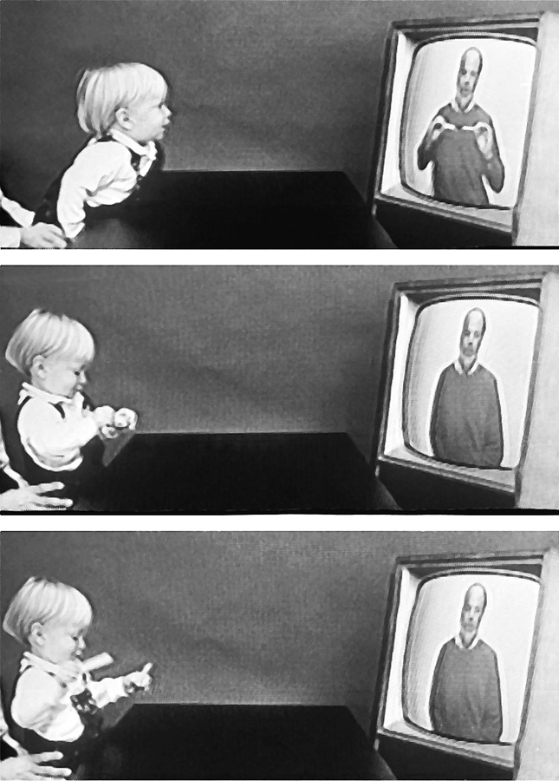
Imitation Onset
Learning by observation begins early in life. This 14-month-old child imitates the adult on TV in pulling a toy apart.
Meltzoff, A.N. (1998). Imitation of televised models by infants.
Child Development, 59 1221-1229. Photos Courtesy of A.N. Meltzoff and M. Hanuk.

Slide 47
Observational Learning
After observing adults seeming to enjoy punching, hitting and kicking an inflated doll called Bobo, the children later showed similar aggressive behavior toward the doll.
Significantly, these children were more aggressive than those in a control condition who did not witness the adult’s violence.

Slide 48
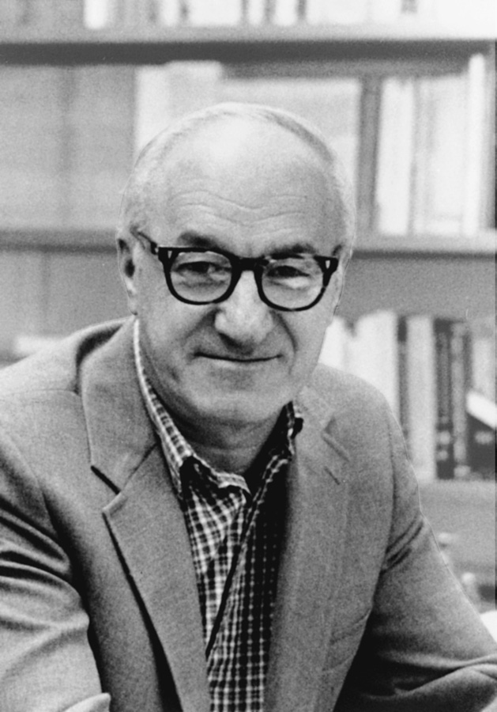
Bandura's Experiments
Bandura's Bobo doll study (1961) indicated that individuals (children) learn through imitating others who receive rewards and punishments.
Courtesy of Albert Bandura, Stanford University

Slide 49
Bobo the Clown
Video of the Bobo doll.
A Modern Representation of BoBo

Slide 50
Media and Violence
Does violence on tv/movies/video games have an impact on the learning of children?
Correlation evidence from over 50 studies shows that observing violence is associated with violent behavior.
In addition, experiment evidence shows that viewers of media violence show a reduction in emotional arousal and distress when they subsequently observe violent acts-a condition known as psychic numbing.

Slide 51
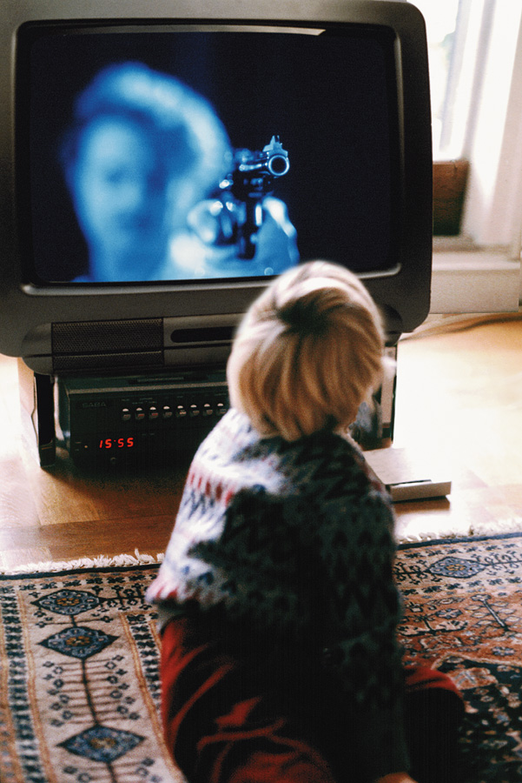
Applications of Observational Learning
Unfortunately, Bandura’s studies show that antisocial models (family, neighborhood or TV) may have antisocial effects.

Slide 52
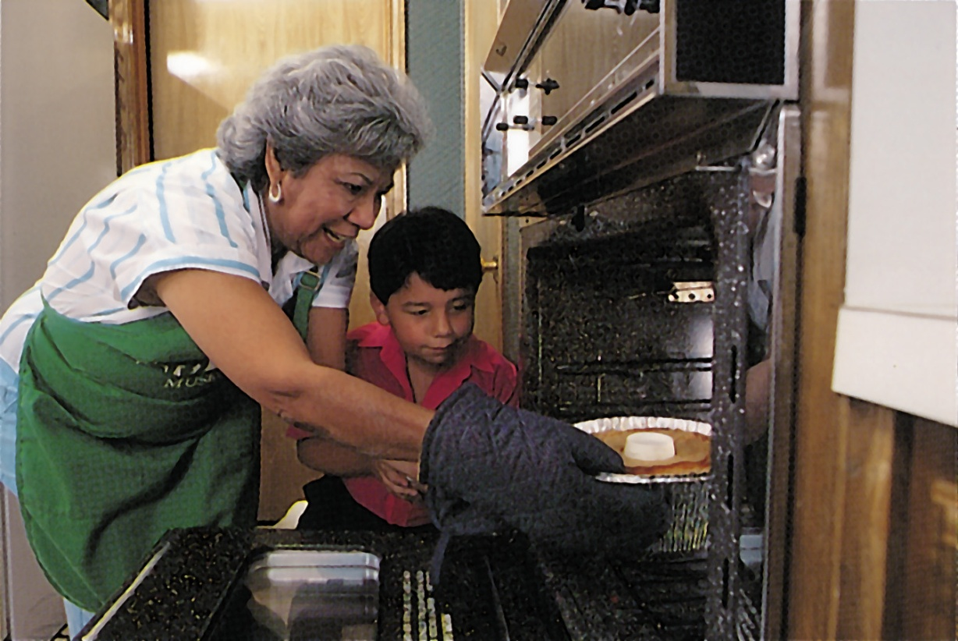
Positive Observational Learning
Fortunately, prosocial (positive, helpful) models may have prosocial effects.
Bob Daemmrich/ The Image Works
Notes:
Preview Question 2: What is the impact of prosocial modeling and of antisocial modeling?

Slide 53
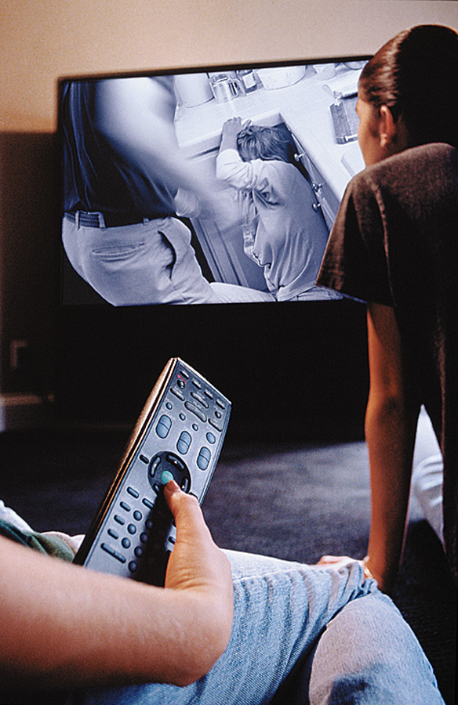
Television and Observational Learning
Gentile et al., (2004) shows that children in elementary school who are exposed to violent television, videos, and video games express increased aggression.
Ron Chapple/ Taxi/ Getty Images

Slide 54
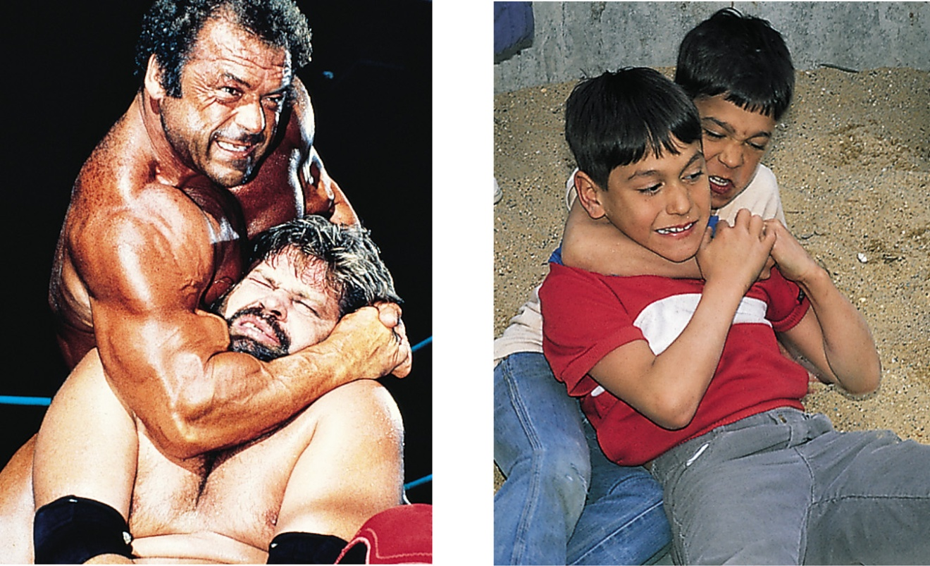
Modeling Violence
Research shows that viewing media violence leads to an increased expression of aggression.
Bob Daemmrich/ The Image Works
Glassman/ The Image Works
Children modeling after pro wrestlers

