Slide 1
Fertilization and Implantation

Slide 2
Fertilization: This is the process whereby the sperm meets the egg and genetic material (chromosomes) is mixed. ½ + ½ = 1 complete set
Implantation: This is the process whereby an embryo becomes embedded within the uterine lining

Slide 3
The process of fertilization
Fertilization occurs when sperm/ semen from the testis of a male pass through the vas deferens and out through the urethra (picking up fluid as it moves along) and is deposited into the vagina of a female. The sperm then swim up through the cervix of a female and into the uterus.
Sperm continue to swim up into the oviduct where an egg is supposed to be waiting.
An egg is released from the ovary (ovulation) and it passes to the oviduct.
While in the oviduct it unites with sperm to become fertilized.

Slide 4
So what happens after sex...
Tiny sperm cells find themselves inside of the uterus
fluid secreted by the female forms strands (musin) that help guide the sperm.
300-400 million sperm ejaculated
most destroyed in vagina or drain out
many destroyed by white blood cells in the uterus
half will travel up the wrong uterine tube
about 2,000-3,000 actually make it to the oocyte
whole trip only takes about 10 minutes
capacitation
sac of enzymes (acrosome) on top of sperm cell becomes more fragile
takes about 10 hours

Slide 5
The moment of conception
When a sperm meets the egg, the acrosome of the sperm releases a powerful enzyme (hyaluronidase) that digests a potion of thee egg membrane. The sperm's nucleus is deposited inside the egg and it releases its chromosomes which Are united with the chromosomes of the egg

Slide 6
Fertilization
Acrosomal reaction
enzymes in acrosome break down cells and glycoproteins surrounding egg cell
requires 100s of sperm
one sperm finally makes it through
proteins allow two cells to “dock” together
Must prevent polyspermy
more than one sperm fertilizing egg
inactivate docking proteins
secrete protein fluid that pushes other sperm away

Slide 7
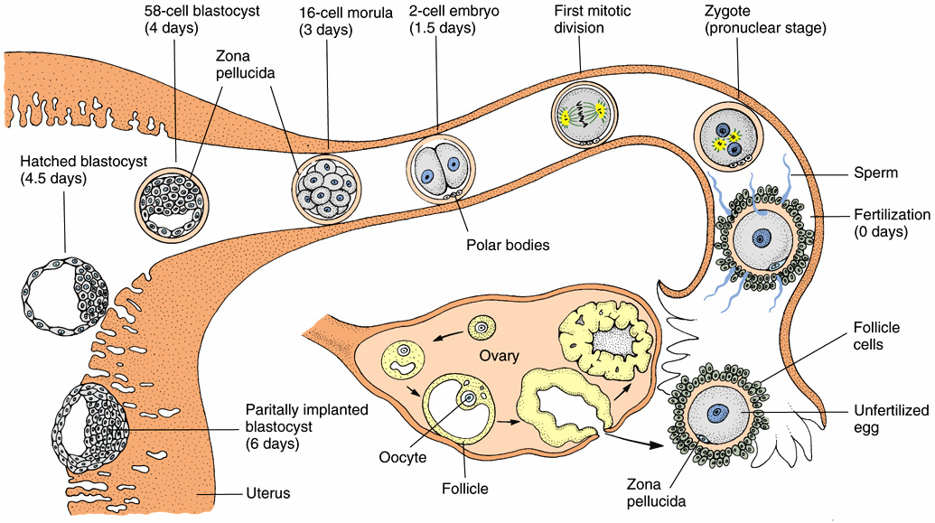
Mammals

Slide 9
Embroyonic Development
After fertilization the zygote( fertilized egg) now called an Embryo undergoes a series of distinct stages as it continues to develop.
Cleavage- the series of cell divisions without growth in an embryo. The cells become smaller and smaller. This occurs immediately after fertilization
Morula- the embryo exists as a solid mass of identical cells. Created from the continued division of cells in the embryo
Blastocyst- the embryo now exists as a hollow ball of identical cells. This is created from the repeated cell divisions.
The blastocyst is made up of an inner mass of cells and an outer mass of cells. The inner mass of cells will develop into a baby while the outer- called the trophoblast gives rise to the germ layers
Grastula- the embryo now exists as a ball of cells with distinct cell layers known as germ layers. During this stage the cells of the embryo begin to grow and rearrange themselves into 3 distinct layers. This process is known as grastrulation.
The three germ layers are known as ectoderm, mesoderm and endoderm

Slide 10
Ectoderm- the outer layer. Forms the skin and nervous system of the baby
Mesoderm- the middle layer. Forms the muscles, bones and many organs
Endoderm- the inner layer. Forms the digestive and respiratory tract

Slide 11
Summary of Embryonic Development
Fertilization
Embryo located in oviduct
Cleavage begins
Cleavage continues
Morula
Cleavage continues
Implantation into uterus occurs here
Blastocyst
Gastrulation begins
Grastula
contains
Ectoderm
Mesoderm
Endoderm

Slide 12
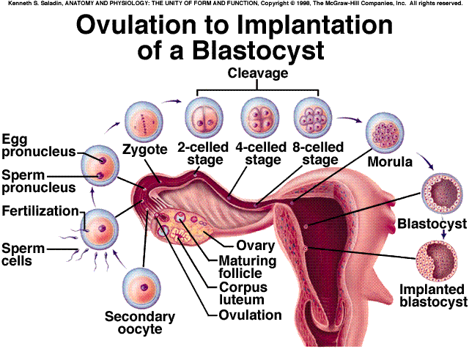

Slide 14
Mammalian Gastrulation

Slide 19
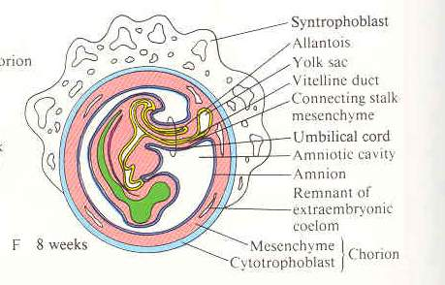

Slide 20
Travels of a Young Zygote
Cleavage of the zygote begins while it is still in the oviduct, producing a solid ball of cells (morula). The morula enters the uterus, continuing to divide and becomes a blastocyst.
Implantation
The uterine lining becomes enlarged and prepared for implantation of the embryo in the trophoblast layer. Twelve days after fertilization, the trophoblast has formed a two-layered chorion. Human chorionic gonadotropin (HCG) is secreted by the chorion, and prolongs the life of the corpus luteum until the placenta begins to secrete estrogen and progesterone.
Home pregnancy tests work by detecting elevated HCG levels in the
woman's urine.
Maternal and embryonic structures interlock to form the placenta, the nourishing boundary between the mother's and embryo's systems. The umbilical cord extends from the placenta to the embryo, and transports food to and wastes from the embryo.

Slide 22
The Embryonic Membranes
These are a series of membranes that surround, nourish and protect the developing embryo. They are known as the primary membranes.
Note: These membranes are not part of the embryo!!!!
They develop from the germ layers.
Chorion: This is the outermost layer of cells of the embryo. They become the Placenta
Placenta: Structure that exchanges nutrients and wastes between the embryo and mother
Allantois and Yolk sac: These parts develop into the umbilical cord
Umbilical cord: structure connecting fetus to the placenta
Amnion: This membrane develops into the Amniotic membrane
Amniotic membrane: a thin membrane sac that surrounds the fetus. It contains amniotic fluid that serves to protect the fetus and absorbs shocks

Slide 25
Stage of Birth
Stages
The period of time from fertilization to birth (usually 9 months) is divided into trimesters, each about three months long.
The First Trimester
The three embryonic tissue layers form (ectoderm, mesoderm and endoderm). Cellular differentiation begins to form organs during the third week. During the second month most of the major organ systems form, limb buds develop. The embryo becomes a fetus by the seventh week. Beginning the eighth week, the sexually neutral fetus activates gene pathways for sex determination, forming testes in XY fetuses and ovaries in XX fetuses.

Slide 26
The Second Trimester
The fetus increases in size during this trimester, and bony parts of the skeleton begin to form. Fetal movements can be felt by the mother.
The Last Trimester
During this trimester the fetus increases in size. Circulatory and respiratory systems mature in preparation for air breathing. Fetal growth during this time uses large parts of its mother's protein and calcium intake. Maternal antibodies pass to the fetus during the last month, conferring temporary immunity.

Slide 27
Birth
Birth is a positive feedback hormonal mechanism. During birth the cervix dilates to allow passage of the fetus. Uterine contractions propel the fetus through the birth canal, usually head first. Hormonal control of the birth process involves the release of oxytocin and prostaglandins.
The first stage of birth lasts from beginning of contractions to the full (10 cm) dilation of the cervix. Membranes of the amniotic fluid rupture, lubricating the vagina.
Strong uterine contractions of a minute in duration separated by two to three minute intervals propel the fetus down the birth canal. Abdominal muscles relax in synchrony with the uterine contractions.
After delivery of the baby, the umbilical cord is clipped and cut. The placenta (or afterbirth) in expelled through the vagina.
Secretion of milk does not occur until delivery, and the action of prolactin. Suckling by the infant causes production of oxytocin to promote release of milk into the ducts emptying into the nipple.

Slide 28
Twins
Twins are identified as babies that are born at approximately the same time or at least during the same pregnancy. There are two types of twins.
Fraternal twins_ These are twins created when Two separate eggs are fertilized in a female.
Fraternal twins can be of the same sex or opposite sex
Fraternal twins are no more alike than any other set of siblings
Identical twins- these are twins created when one sperm fertilizes one egg.
The blastocyst splits into two separate bodies early in development.
This results in two embryos with exactly the same DNA
These twins must be the same sex because their DNA is identical

Slide 33
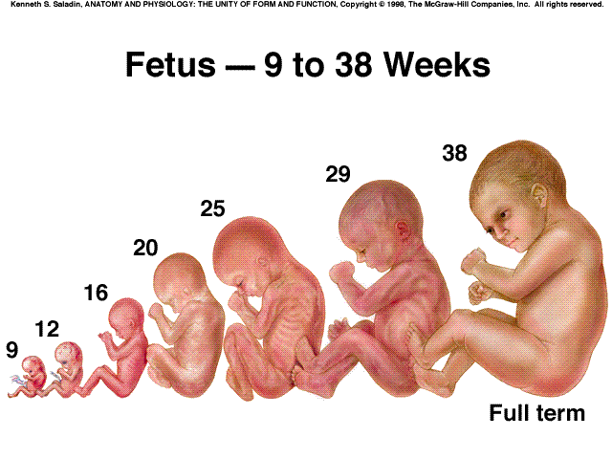

Slide 34
Childbirth
When gestation(period of pregnancy )is reached , childbirth begins. Childbirth occurs under the influence of hormones in 3 distinct stages
Dilation Stage
The following events occur during this stage
Pituitary releases oxytocin which causes uterine muscles to contract. This is the beginning of labour
The cervix opens and dilates (gets larger) (10 cm)
The amniotic membranes rupture(water breaks ) and amniotic fluid is released
Dilation stage usually lasts anywhere from 2-20 hrs

Slide 35
Expulsion stage
Contractions by the uterus forces the baby out through the cervix and into the birth canal(vagina)
The baby head rotates making it easier for the baby to be delivered
This stage lasts from 0.5- 2 hrs

Slide 36
Placental stage
About 15 minutes after childbirth the placenta and the umbilical cord are forced out through the vagina by contractions of the uterine muscles
The placenta is now called the afterbirth

Slide 37
Birth – the final stage of pregnancy

Slide 38
Birth – the final stage of pregnancy

Slide 39
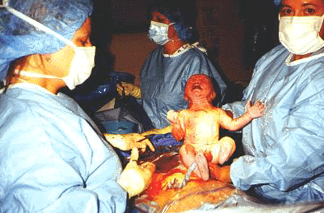
Birth – the final stage of pregnancy

Slide 40
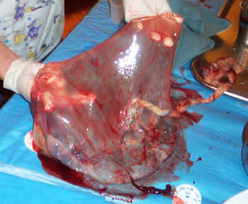
Placenta, Umbilical Cord and Membranes

Slide 41
Hormones and Pregnancy
The following hormones are involved either during or after pregnancy in a female
Progesterone: hormone secreted by the corpus luteum that maintains the uterus during pregnancy
HCG human chorionic gonadotropin hormone(HCG)
hormone released by the developing embryo that maintains the corpus luteum for the first three months of pregnancy. This helps maintain the edometrium.
Note: pregnancy test are given to women to test for the presence of this hormone. If found it conforms a pregnancy
Estrogen hormone that works with progesterone to maintain the uterus during pregnancy
Prolactin this hormone released by the pituitary that causes milk to be produced in the mammary glands( breast) after pregnancy. This allows a suckling baby to have milk.

Slide 42
The effects of Teratogens on development
As the baby grows various substances and factors can affect its normal development
Teratogen; any chemical or agent that causes a structural abnormality due to fetal exposure during pregnancy
Example of teratogens: cigarette smoke
alcohol
prescription drugs(some)
Effects of cigarette smoke on fetus
Cigarettes smoke constricts fetal blood vessels preventing it from getting oxygen
Babies are usually underweight and can suffer from convulsions

Slide 43
Effects of alcohol on a fetus
Alcohol affects the fetus brain, central nervous system and physical development
Babies are usually born with FAS ( fetal alcohol syndrome)
These babies usually display the following:
Mental delays and retardation
decreased height, weight an head size
Malformed face
Have aggression and or personality changes

Slide 44
Effects of prescription drugs on fetus
Various prescription drugs and over the counter drugs may have an impact on the developing fetus
Thalidomide
A prescription drug given to women in the 1960 to reduce morning sickness
Effects of thalidomide on a fetus: babies were either born with missing of deformed limbs
Other teratogens
These include such as x-rays, PCB, heavy metals are all tetragons that can cause birth defects and or abnormalities within a fetus

