Slide 1
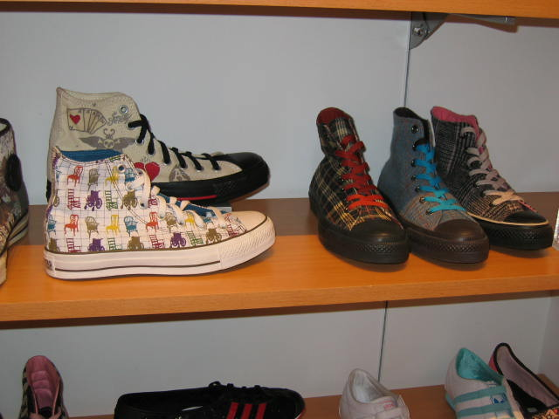
Chapter 5: Production Factors of Production
Production happens when an individual, business, or an organization makes a product, provides a service, or generates an idea or concept.
Six Factors of Production
Natural resources
Raw materials
Labour
Capital
Information
Management
Notes:
If you make something, you have been involved in production.
Factor of production is another name for economic resources.

Slide 2
Chapter 5: Production Factors of Production
Natural Resources
The six types of natural resources that primary industries supply us with are
agriculture
fishing and trapping
mining
water
fuel and energy
logging and forestry
Primary industries that take something out of the Earth or the sea can be referred to as extractive industries.
Notes:
NATURAL RESOURCES
Primary Industries are businesses or organizations where all items start out; one of the six natural resource industries.
Agriculture: The cultivation of the ground to grow crops (such as corn and mushrooms) and the raising and feeding of livestock (such as cattle and chickens).
Fishing and Trapping:The practice of catching or farming fish (such as the farming of Atlantic salmon). Taking game or animals from the wilderness (such as using trapping mink for the fur).
Mining: Excavating or digging the earth for metals or minerals (such as gold).
Water: Covers three fifths of the earth’s surface and is essential for all organisms.
Fuel and Energy: Petroleum
Logging and Forestry: Redwood timber
See Figure 5.1, “The Six Primary (or Extractive) Industries”, on page 156.

Slide 3
Chapter 5: Production Factors of Production
Raw Materials
Raw materials are any goods used in the manufacturing of other goods.
Two Main Types of Raw Materials
Ingredients ― raw materials that are combined or converted and become a part of the finished product.
Supplies ― raw materials that do not become a part of the finished product, but are used in the product creation process.
Notes:
RAW MATERIALS
Raw Materials: Ingredients that are transformed into another product.
Some form of raw material is used to make the products that we regularly consume.
Two examples of raw materials that we might purchase and use are raw fish and fresh vegetables.
Wheat (natural resource) → makes flour (raw material) → makes bread (raw material) → toast (finished product)
Ingredients: The raw materials that are combined to make a product, they have been converted from their “natural resource” state (except perhaps the water).
Supplies: The raw materials that are needed to produce a product but do not become a part of the product.

Slide 4
Chapter 5: Production Factors of Production Two Main Raw Materials
Supplies
Air filters for ventilation systems
Pants
Zipper
Fabric
Paper for invoices
Thread
Rivets
Sewing machine oil
Ingredients
Notes:
RAW MATERIALS
Ask student to get in small groups and select a product that they have in their possession and have them draw a diagram showing the ingredients and supplies needed to create the finished product.
Students can explain to the class the different ingredient and supplies used in producing their finished product.

Slide 5
Chapter 5: Production Factors of Production
Labour
Labour includes all of the physical and mental (cognitive) work needed to produce goods and services. Labour is expensive so most businesses seek ways to save on labour costs.
Businesses now automate and consolidate to save on labour costs. Automation means that many tasks are performed by more them one person using machines. Consolidation occurs when many small manufacturing sites close down and are centralized into one large site.
Outsourcing, the hiring of another company to perform tasks for any company, is another cost saving business option.
Notes:
LABOUR
Labour is all the physical and mental work needed to produce good or service.
To automate is have work once done by humans now done by machines. Often archived through increased mechanization.
Consolidation happens when small manufacturing sites are closed down and fewer or a single major site meets the business needs. It is centralizing work in one major site. Can use Tim Horton's example.
Outsourcing is hiring or subcontracting another company to perform tasks for your company.
Inexpensive labour available in countries such as India, Kenya, and Sri Lanka allows Canadian companies to save money by hiring firms for such work as telemarketing, HR, and payroll.
Outsourcing to overseas companies means less jobs for Canadians but a cost savings to Canadian businesses.

Slide 6
Chapter 5: Production Factors of Production
Capital
Capital is the money invested in the business and is often referred to as monetary capital. Capital can be transformed into other items to run the business such as a new truck. This type of capital is called liquid.
Some capital such as buildings or equipment are non-liquid. It is part of the business operations, and cannot be converted into liquid capital easily. These items are called capital goods.
Intellectual property, the ideas or the talent of a business’ workforce, is a non-tangible form of capital.
Notes:
CAPITAL
Capital is the value of a borrower’s assets that could be used to repay a debt.
Forms of liquid capital include: cash, stocks, bonds, accounts payable, etc.
Liquid means it can be transformed into other things (cash) at any time with minimum effort.
Non-liquid items that the business owns, that are a part of the everyday operation and that cannot be converted into liquid capital easily.
Non-liquid items can be referred to as capital goods.
Examples of capital goods include a delivery truck, industrial-size mixer, and laptop computer.
Intellectual property is a business’s trade secrets or the ideas or talent of its workforce.
Examples of intellectual property include the ideas and talents of workers such as athletes, computer programmers, writers, and science researchers.
See Figure 5.2, “Types of Capital”, on page 159.

Slide 7
Chapter 5: Production Factors of Production
Information
To produce goods and services in a competitive global market, businesses require more information about
new technology
customers
competition
political conditions
sources of supply
Accurate and usable information reduces a business’ risk and can enhance its profitability.
Notes:
INFORMATION
Business purchase and sell information. They also hire individuals (researchers) to obtain and analyze information for them.
Businesses provide information to others for free over the internet, making revenue through the pairing of advertising with the Internet site.
Examples of industrial directories and data bases are Frasers (Canadian) or Thomas Register (American).
MarketQuest and D-Code are examples of market research companies; they provide information about trends and new products, advertising effectiveness, public opinions, and the competition.
Ask students what other types of information Canadian businesses might find useful. (Answers might include: legal information, sources of workers, statistics, weather, patent, and copyright information, etc.)

Slide 8
Chapter 5: Production Factors of Production
Management
Management consists of the people who run the business and control or direct the factors of production (natural resources, raw materials, labour, capital, information, and so on). Management also allocates company resources and makes decisions that affect the day-to-day and long-term operations of the business.
In larger companies, higher-level managers and/or the board of directors make decisions regarding profit distribution. In a smaller business, a single business manager or owner may make all of the business decisions.
Notes:
MANAGEMENT
Management are the individuals who decide how best to use an organization’s human, financial, and material resources (factors of production).
Management allocates resources, capital and human, and decides what to purchase from whom, who to employ, what and where to sell or provide goods and services, etc.

Slide 9
Chapter 5: Production The Production Process
Purchasing, grading, processing, and quality control are the four stages of the production process.
Purchasing
Within a business, someone is responsible for purchasing the raw materials needed to produce the product or service. Purchasing may be the responsibility of a purchasing department, purchasing agent, buyer, or owner.
Some considerations when making purchasing decisions include
the quality of the raw material being purchased
the price of the raw material being purchased
any additional costs associated with the purchase of the raw material
Notes:
PURCHASING
Raw Materials are the ingredients that are transformed into another product.
Quality, may include the durability, pre-described specifications, size, reputation of business, etc.
Price, may be the monetary charge (dollar and cents) per unit purchased, price reduction with quantity purchased, terms or payment that may impact the material cost, penalties for such things as delivery time lines, etc.
Costs are hidden charges related to the purchase of the material, such as the transportation costs, taxes, trade duties, storage charges, expiration dates, etc.

Slide 10
Chapter 5: Production The Production Process
Processing
All non-service businesses convert one item into another through processing. This is called conversion processing.
Examples of raw materials that are refined to produce semi-finished or finished products include
bauxite → aluminum
sugar cane → sugar
wheat → flour
timber or logs → paper
Quality Control
Quality control are standards that ensure all produced products conform to prescribed levels of excellence. These standards are set by the company, the government, or another organization such as the International Organization for Standards (ISO). The latter organization sets worldwide standards for numerous industries in 157 countries.
Notes:
PROCESSING
Refining is the processing steps that converts a raw material into a semi-finished or finished product.
See the stages of aluminum processing on page 164.
Quality Control ensures that the standards for products that are set by the company, government, or outside organization are meet.
Quality standards for numerous industries, including businesses, consumers, customers, governments, and trade officials, are set by the International Organization for Standardization (ISO).
The ISO has 157 member countries.
The Standards Council of Canada (voice for 15 000 Canadians who set standards) represents the standard institutes in Canada.
ISO certification helps products meet international standards.

Slide 11
Chapter 5: Production The Production Process
Grading
Related to quality control, grading is the act of checking products for size and quality against fixed standards for the product or product category. Grading of products allows consumers to make informed purchasing decisions.
Many other products are not formally graded. These types of products do not meet manufacturer's standards and are often sold as “seconds” containing slight defects, such as towels or sheets. Products with surface damages such as appliances can be sold at reduced prices at “scratch and dent” sales.
Notes:
GRADING
Grading is the act of checking a product for size and quality against pre-described standards for the product of product category.

Slide 12
Chapter 5: Production Improving Productivity
Profitability and productivity are closely related. It is important that an increase in productivity results in an increase in profit.
Increased productivity consists of the following:
maintaining quality while increasing speed
increasing quality while maintaining speed
increasing both quality and speed at the same time
Improving and maintaining productivity is often dependent on
training
capital investment
investment in technology
new inventory systems
Notes:
Productivity is a comparison of the resources used with the products or services that result. If fewer resources are used per units produced, productivity increases.

Slide 13
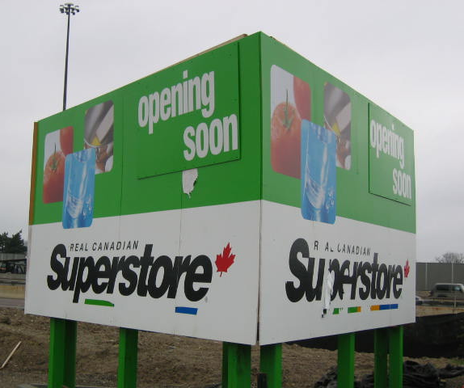
Chapter 5: Production Factors of Production
Training
Training programs that develop a person’s knowledge and experience are essential in the development of a productive employee.
Four Major Types of Training
Initial training
Ongoing training
Retraining
Specialized training
Capital Investment
Investment of capital into things, such as new computers, machinery, buildings, and facilities, contribute to increased productivity.
Notes:
TRAINING
Initial Training: Good training, at the onset of the job, can save money and increase employee productivity. Usually over several days, the employee is paid regular wages and taught the occupation basics. The training period should be long enough to ensure that quality is maintained, customers remain satisfied, and mistakes are reduced. Overall, since training is expensive it should be designed to retain the employee.
Ongoing Training: Employees are taught new systems, procedures, and processes. They are also given refresher courses in areas such as safety, customer relations, etc.
Retraining: A form of initial training when an employee is moved, promoted, or transferred to another job or occupation within the company.
Specialized Training: Courses, workshops and/or seminars, often called “professional development”, that often take place away from the normal workplace. Often delivered via professional conferences, these courses are usually very expensive but instill employees with new ideas, information, and enthusiasm that potential can improve productivity.
CAPITAL INVESTMENT
Capital Investment: A comparison between the cost of the investment against the benefit (increase in productivity) should result in the monetary gain from improved productivity paying for the investment over a fixed period of time.

Slide 14
Chapter 5: Production Factors of Production
Investment in Technology
Utilizing up-to-date technology enables companies to maintain
and improve upon their competitive edge. Robotics and
automation, the use of computer-controlled machinery to perform
repetitive tasks, is another way companies can improve
productivity.
New Inventory Systems
Just-in-time (JIT) inventory systems allow businesses to coordinate
suppliers, monitor warehouse storage, and keep track of factory
production to deliver goods on time. Requiring up-to-date statistical
information, this system saves time, money, space, and reduces
waste to increase productivity. Benefits include having the right
material, at the right time, at the right place, and in the right amount.
Notes:
INVESTMENT IN TECHNOLOGY
Robots are a major capital investment, however they do not get sick, need vacations, go on strike, and can work in extreme conditions 24 hours a day, seven days a week, without pay.
NEW INVENTORY SYSTEMS
Just-in-time (JIT): Computerized inventory systems that coordinates suppliers (and their deliveries), warehouse storage, and factory floor delivery. This means materials arrive when they are needed. Saves time, energy (heating warehouse space), factory space, therefore resulting in improved productivity.

