Slide 1
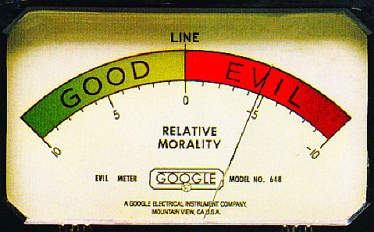
Chapter 3: Business Ethics and Social Responsibility Business Ethics
Ethics are rules that help us tell the difference between right and wrong. They encourage us to do the right thing.
What is Ethical Behaviour?
Ethical behaviour is conduct that conforms to ethics—individual beliefs and social standards about what is right and good.
Values tell us what is important. They help us make decisions about right and wrong.
Morals are rules we use to decide what is good or bad.
Notes:
WHAT IS ETHICAL BEHAVIOUR?
Ethics are important for getting along with others, living with yourself, and having a good character.
Some values are trustworthiness, respect, responsibility, caring, justice, and good citizenship.
A moral is that stealing is bad because it harms others.
Often personal values conflict with society morals.
Unethical behaviour (being bad or wrong) are decisions that do not conform to our values and morals and go against individual beliefs and social standards.
The consequences of unethical behavior range from upsetting others to jail time.

Slide 2
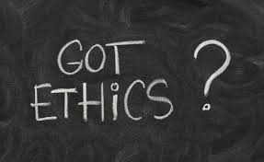
Chapter 3: Business Ethics and Social Responsibility Business Ethics
What Role Should Ethics Play in Business?
Business ethics are based on society’s ethics and those of the people who work for and buy from them.
A Code of Ethics
Some companies write a code of ethics, a document that explains specifically how employees should respond in certain situations.
Canadian laws address acceptable business behaviours. However, businesses can still behave unethically without breaking these laws.
Notes:
WHAT ROLE SHOULD ETHICS PLAY IN BUSINESS?
Individual beliefs and social standards vary from person to person, situation to situation, and culture to culture.
A code of ethics allows people to approach problems in the same way that is sanctioned by the business.
Creating and applying the code of ethics is not always easy.
Training and educational programs, regarding ethical conduct, are offered by some businesses.
See “Rogers Communication Inc. Code of Ethics and Conduct” on page 78.
Since not every situation is answered, by law or a company document, individuals need to rely on their own judgment first.

Slide 3
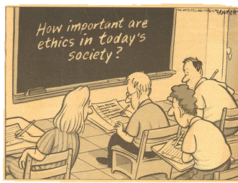
Chapter 3: Business Ethics and Social Responsibility Business Ethics
How Can Businesses Resolve Ethical Dilemmas?
A dilemma is a situation where a difficult choice must be made between two or more options.
An ethical dilemma is a moral problem with a choice between potential right and wrong. Some questions to consider are
Who will be helped by what you do?
Who will be hurt by what you do?
What are the benefits and problems of such a decision?
Will the decision survive the test of time?
.
Notes:
HOW CAN BUSINESSES RESOLVE ETHICAL DILEMMAS?
An ethical dilemma, for a business, usually weights profitability and competitiveness against values and morals.
Ethical dilemmas include; downsizing of staff, pollution control, disposal of toxic waste, depletion and allocation of scarce resources, cost containment, changes in law and technology, employee rights, discrimination against women and minorities, and product safety.
See Figure 3.1, “Ethical Dilemmas and Developments Over Time” on page 81.
Examples of issues that a whistle-blower might report:
Someone submitting false information on an expense report
A business that is ignoring hiring procedures for minorities
A business that ignores workplace safety codes
A business that is not observing mandated health codes

Slide 4
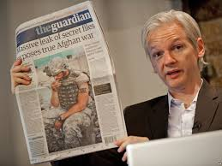
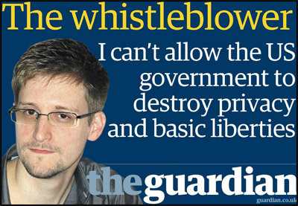
Ethics in Business
Whistle-blowing
Whistle-blowing happens when an employee informs officials or the public about an illegal or ethical violation.

Slide 5
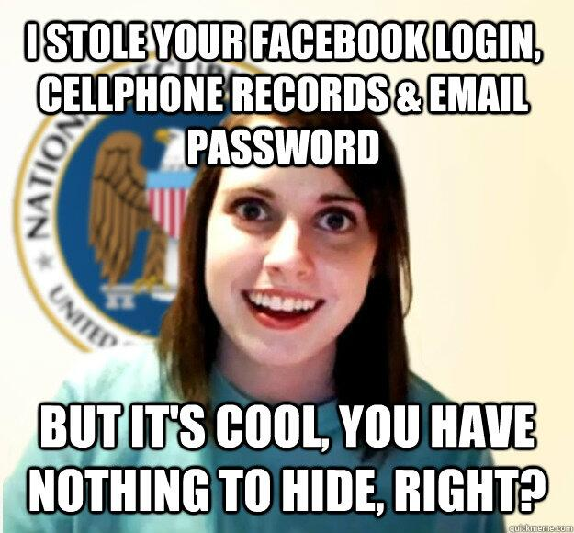

Slide 6
Chapter 3: Business Ethics and Social Responsibility Business Ethics
What Happens When People Do Not Behave Ethically?
When an individual acts unethically, his or her behaviour will most likely harm others. The individual could also be sent to jail for his or her actions. Major ethical issues include fraud, accounting scandals, and insider trading.
Fraud
Fraud is a crime of lying or pretending. Some businesses mislead consumers and trick them to buy their products or services. The Competition Act 2002 bans such fraud and deceptive business practices and defines these as
false or misleading advertising
“bait and switch” selling
double ticketing items for sale
Notes:
WHAT HAPPENS WHEN PEOPLE DO NOT BEHAVE ETHICALLY?
“Bait and switch” is advertising a bargain price for merchandise that is unavailable for sale in a reasonable quantity.
Double ticketing is placing two different prices on a product and selling it to the consumer at the higher price.
Fraud can involve consumers and businesses, it constantly changes and varies in its level of sophistication.
Common frauds include: Bank fraud, Consumer fraud, Contract fraud, Insurance fraud, Mail fraud, Pyramid scheme fraud, Stock market fraud, Telemarketing fraud, and Welfare fraud (see examples on page 83).

Slide 7
Chapter 3: Business Ethics and Social Responsibility Business Ethics
Accounting Scandals
An accounting scandal occurs when accountants or senior executives alter accounting records for personal benefit.
Accounting information is used inside and outside of the business to make decisions. When accounting irregularities are uncovered, a forensic accountant investigates legal and financial documents to find evidence of tampering.
Embezzlement, a type of accounting fraud, happens when an accountant or senior executive creates false accounts and redirects money into them for personal gain.
Business owners rely on outside accountants, auditors, to check and report on the validity of financial records.
Notes:
ACCOUNTING SCANDALS
Accounting scandals usually take place in large corporations.
Embezzlement usually occurs in small businesses and can go on for a long time before owners discover it.
The term “cooking the books” is sometimes used to describe large business fraud involving assets and liabilities.
A business owns assets, such as buildings, land, equipment, cash, and receivables that are valuable.
Liabilities are debts that a businesses owes such as accounts payable.
Types of corporate fraud related to accounting include; misusing or misdirecting funds, overstating revenues, understating expenses, overstating the value of assets to shareholders, and under-reporting debts.
Even auditors sometimes have difficulty detecting fraud committed by experienced accountants.

Slide 8
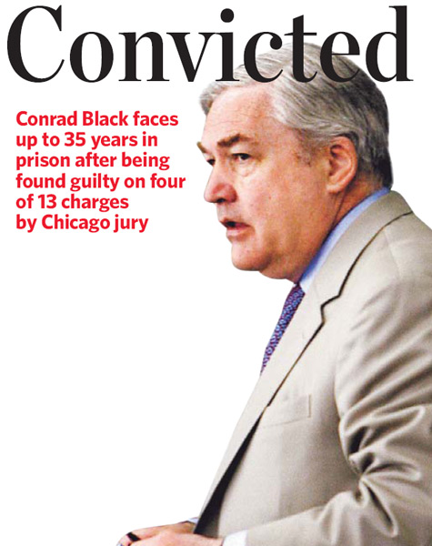

Slide 9
Chapter 3: Business Ethics and Social Responsibility Business Ethics
Insider Trading
Insider trading is buying or selling shares of a company based on confidential information. This type of trading is illegal.
Prosecution for insider trading falls under the provincial securities commissions. Punishment includes
fining the individual(s) for up to $1 million
turning over all profits from trading
incarcerating the person(s) for up to two years
being banned from future trading in securities
Notes:
WHAT HAPPENS WHEN PEOPLE DO NOT BEHAVE ETHICALLY?
Authorities at stock exchanges watch for the sale and purchase of stocks by individuals who may have access to information that gives them an unfair advantage over others.
When people who work for a company transfer stock ownership, to keep the transaction legal, they need to inform the stock exchange.

Slide 10
Chapter 3: Business Ethics and Social Responsibility Ethics and Corporate Social Responsibility
A business exhibits corporate social responsibility (CRS) through their values, ethics, and the contributions it makes to communities. CRS is driven by a desire to protect customers and to treat employees and shareholders fairly.
CSR Principles
Businesses that practice CSR principles support their employees and consumers by
providing a safe and healthy work environment
adopting fair labour polices
protecting the environment
being truthful in advertising
avoiding price discrimination
donating to charity
Notes:
CSR PRINCILPLES
Providing a safe and healthy work environment: could mean an employee wellness program, on-site daycare, fitness facilities, health, and safety committees
Adopting fair labour polices: could mean paying employees above minimum wage or offering flexible hours
Protecting the environment: could mean funding community based environmental programs or making the company greener
Being truthful in advertising: ensure that advertising does not contain inaccurate or deceptive claims, statements, or illustrations
Avoiding price discrimination: could mean using the manufacturers suggested list price
See Table 3.2 for the “Top 10 Reasons for Business Ethics”, page 92.
Donating to charity: allow charitable payroll deduction programs and host charitable events

Slide 11
Chapter 3: Business Ethics and Social Responsibility Ethics and Corporate Social Responsibility
Duty to Report
Corporations and their employees have a duty to report, which means
they must disclose all important information to shareholders, partners,
lenders, insurers, communities, regulators, consumers, employees, and
investors.
Laws that Govern Corporate Ethics
Workplace Safety
The Occupational Health and Safety Act (OHSA) of Ontario defines the
rights and responsibilities of employees in their workplace to ensure
their safety and health. These regulations were put in place to remind
companies that it is not only important to focus on making profits, but
also equally imperative to look after the safety and health their workers.
Notes:
LAWS THAT GOVERN CORPORATE ETHICS (SIX AREAS)
Workplace Safety
Many people still die or are injured on the job each year in Canada.
Work related illnesses also injure and kill workers.
OHSA ensures three basic rights in the workplace:
the right to to refuse unsafe work
the right to participate in workplace health and safety activities
the right to know about actual hazards in the workplace

Slide 12
Chapter 3: Business Ethics and Social Responsibility Ethics and Corporate Social Responsibility
Antidiscrimination Issues
Discrimination is denying a qualified individual an interview, job, or promotion based on his or her religion, gender, sexual orientation, or physical disabilities.
Gender discrimination is treating an employee differently based on their sex (male or female).
The glass ceiling refers to invisible barriers that may affect the career path of senior leaders in corporate positions.
Harassment
Many businesses have policies and procedures for dealing with harassment: behaviour that is threatening, disturbing, or makes others feel uncomfortable.
Notes:
LAWS THAT GOVERN COPRPORATE ETHICS (Six Areas)
Antidiscrimination Issues
Successful lobbying has improved the status of women in the workplace.
Some companies are not aware that they place barriers to advancement that adversely effect women, minorities, and disabled workers such as:
procedures
expectations
selection and recruitment practices
job assignments
performance evaluations
decisions about salaries
working environment
Educational programs and employing an antidiscrimination officer are ways to counteract barriers.
Harassment
Examples include bullying, stalking, and other forms that deal with sexual, racial, sexual orientation, or disability issues.
It can be written or verbal threats or insults about race, ethnicity, or skin colour; abusive comments about racial origins; ridicule based on cultural grounds; derogatory name calling; racist jokes; damage to property; the display of offensive material, and encouragement of others to commit any of the above.

Slide 13
Chapter 3: Business Ethics and Social Responsibility Ethics and Corporate Social Responsibility
Accessibility Issues
The duty to accommodate refers to an employer’s obligation to ensure accessibility for all employees. The Canadian Human Rights Act, Sections 2 and 15, states that employees with disabilities must be accommodated by business as long as undue hardship does not occur to the business.
Environmental Responsibility
Environmental concerns for business include the Earth’s air, land, and water. These issues affect Canadian businesses and others in the world
Environmental Protection Act
The Canadian Environmental Protection Act 1999 was the response of Environment Canada to the environmental disaster of the Exxon Valdez.
Kyoto Protocol
Canada signed the Kyoto Protocol in 1998 that states countries must reduce carbon dioxide emissions by 2012 (five percent less than in 1990).
Notes:
LAWS THAT GOVERN COPRPORATE ETHICS (Six Areas)
Accessibility Issues
Employees denied accommodation can file a complaint under the act (sections 2 and 15).
Failure by a business may result in legal action.
The law enforces the rights to a fair job interview that does not discriminate based on disability.
Accommodations can include changing the job tasks of the worker, allowing guide dogs, making the work space more user friendly (ramps and alternative equipment), sign-language support, and training of other workers.
Environmental Responsibility
Businesses may have avoided being responsible to society because of the stand that responsibility is first to owners, then customers, then employees, and then partners.
The Exxon Valdez was an oil tanker that ruptured and caused a catastrophic oil spill off the west coast of Canada.
With legislation some businesses still ignore laws because it can be costly to comply and because of the impact it could have on profitability.
See Table 3.4 for the “Highlights of Canada’s Environmental Protection Act (CEPA)”, page 99.
The Kyoto Protocol is sometimes referred to as the Kyoto Accord.
The Kyoto Protocol was signed in 1998 and ratified in Canadian Parliament in 2002.
Canada’s progress has been slow as reducing emissions is difficult and costly for business and individuals.

Slide 14
Chapter 3: Business Ethics and Social Responsibility Ethics and Corporate Social Responsibility
Business and the Environment
The way businesses respond to environmental concerns and laws tells us about their ethics or commitment to doing what is right.
Business is like a three-legged stool: each leg stands for a different goal. (See illustration on page 101 in the text.)
Business Goals
First leg: financial goals
Second leg: environmental goals
Third leg: social goals
 Problem: Corporate resources spent on environmental and social goals never equal what is spent trying to generate profits (financial goals).
Notes:
LAWS THAT GOVERN COPRPORATE ETHICS (Six Areas)
Business and the Environment
The leg imbalance is due in part to the obligation of managers to please owners (shareholders).
Most often a business’s desire to address environmental concerns comes about due to scrutiny by governments, the media, special interest groups, and consumers.
When a company’s reputation is at stake, the environment and social goals receive more investment.
Profits can be increased through good practices such as waste reduction and recycling programs and energy efficient processes and equipment.
It can also attract customers thereby enhancing competitive advantage in the marketplace.

Slide 15
Chapter 3: Business Ethics and Social Responsibility Social Responsibility
Labour Practices
In Ontario, the Employment Standards Act addresses the minimum employment conditions including
hours of work
overtime pay
minimum wage
holidays
vacations
equal pay for male and female employees
employee benefit plans
pregnancy, parental, and other leaves of absence
notice of termination of employment
severance and termination pay
Notes:
LAWS THAT GOVERN COPRPORATE ETHICS (Six Areas)
Labour Practices
Issues are complicated since some individuals, such as supervisors and managers, are exempt depending on jurisdictions.
Labour laws change.
In 2000 the hours of work per week was raised to 60, then cut back in 2004.

Slide 16
Chapter 3: Business Ethics and Social Responsibility Ethics and Corporate Social Responsibility
Pay Equity
Although pay equity legislation has changed considerably since its establishment in 1978, it still does not always deliver equal pay for work of equal value. The legislation prohibits employers from paying employees of one sex differently than from the other when the same or substantially the same work is done.
Privacy Laws
The Personal Information Protection and Electronic Documents Act (January 1, 2004) requires all provincially regulated businesses to explain what personal information they need from employees or customers and why they need it.
Notes:
LAWS THAT GOVERN COPRPORATE ETHICS (Six Areas)
Pay Equity
Same work is judged by assessing the skill, effort, and responsibility required and the conditions under which the work is performed.
Women who work full time, according to the Canadian Human Rights Commission, make an average of 72% for every dollar earned by a man.
Is this difference due to education, experience, and/or hours of work? Canadian economists estimate that 20 to 30 percent of the gap is due to discriminatory attitudes towards women.
Privacy Laws
People can demand full disclosure of personal information maintained on them, and they can challenge the accuracy or use of their personal information.

Slide 17
Chapter 3: Business Ethics and Social Responsibility Ethics and Corporate Social Responsibility
Fair Trade
Fair trade is the voluntary practice of helping producers in developing countries bypass expensive middlemen so they can sell their goods in other countries for a fair profit.
A grassroots movement starts out as the local action of or response by a group of people to a problem: the movement develops from the bottom up, not from the top down. For example, the fair trade initiative began with partnerships between farmers in less-developed countries and aid organizations (bottom up) to help them reach markets in Europe and North America (top down).
Fair-trade products are marked with logos such as the non-profit organization’s TransFair Canada symbol. Ethical trading means using trade to ensure that the basic labour rights of employees in other countries are respected.
Notes:
FAIR TRADE
Beginning about 50 years ago, fair trade began to help prevent unscrupulous middlemen and corporations from paying farmers so poorly they struggled to survive.
Farmers had no other way to earn money other than selling to others who often make large profits off of them.
Fair-trade goods, such as coffee, tea, rice, bananas, cocoa, sugar, honey, and fruit juices tend to cost more.
Consumers buy fair-trade knowing that they are supporting poor farmers in distant countries.
The TransFair Canada symbol assures consumers that the goods are certified and it benefits the producers and workers.
Organizations can buy products or ensure that their suppliers use fair-trade

