Slide 1
Unit 2 Entrepreneurship and New Ventures
SCO 4: Understanding Entrepreneurship

Slide 2
Characteristics of Entrepreneurs
Many of the characteristics of entrepreneurs can be learned. Your don't have to have the business wisdom of Bill Gates. But you do need to have enough personal motivation and drive to pursue your dreams.

Slide 3
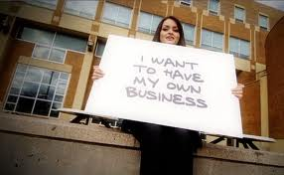
1. Entrepreneurs Own Their Own Business
Entrepreneurs own their own business. Entrepreneurs choose to work for themselves, rather than for someone else as an employee. Sometimes it is as a matter of necessity.

Slide 4
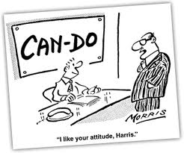
2. Entrepreneurs Are "Can Do" People
Every entrepreneur I have met has a "can do" attitude. When a problem arises they find a solution. They don't wait for direction from others. That doesn't mean they don't consult other professionals when needed. They gather the facts and then act upon them. They are people who are confident in their abilities.

Slide 5
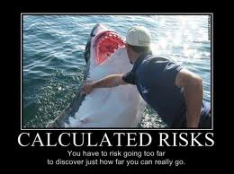
3. Entrepreneurs Accept Calculated Risks
Entrepreneurs are not afraid of taking a calculated risk. They are willing to sign their name to a million dollar loan. They just make sure they plan and are able to earn enough money from their business enterprise to pay the loan back. They have a backup plan when things go wrong.

Slide 6
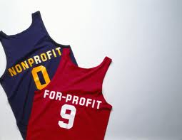
4. Entrepreneurs Are Driven By Profit Motives
Entrepreneurs are driven by profit motives. The challenge of earning a profit from their hard work is a motivating factor that drives them to success. They are not willing for someone else to tell them what they are worth. They want to determine what they will earn.

Slide 7
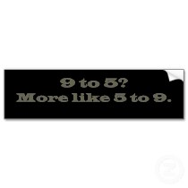
5. Entrepreneurs Work Long Hours
All the successful entrepreneurs I know work long hours. They are not nine to fivers. They get up early, and often work late into the night making telephone calls and preparing for the next day's work. They do what it takes to make their business successful.

Slide 8
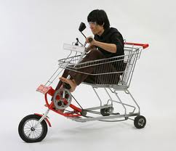
6. Entrepreneurs Are Innovative
Entrepreneurs are innovative. They are able to come up with new ideas to solve problems. Then they perfect their ideas and apply them to their problems. Often new inventions and businesses are born from a need to solve some problem. They look for a better way to do something, at less cost, and in less time.

Slide 9
7. Entrepreneurs Listen To Their Customers
Successful entrepreneurs listen to their customers. They try to accommodate their customer as long as the customer's request is reasonable and ethical. The "customer is always right" guides their relationship with their customer.

Slide 10
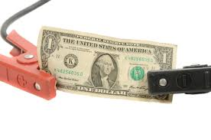
8. Entrepreneurs Know The Value Of A Dollar
Entrepreneurs know the value of a dollar. If they can save money by changing vendors, they do. They control costs as best as they can. Old Benjamin Franklin is right when he said "A dollar saved is a dollar earned". They expect value for every dollar they spend. They expect a return on every investment.

Slide 11
9. Entrepreneurs Plan For Success
Entrepreneurs plan for success. Success does not come by chance. They create a business plan and then stick to that plan. They know what they want to accomplish, and then work toward that goal. When things don't go as planned, they follow their backup plan.

Slide 12
10. Entrepreneurs Do What They Love
Entrepreneurs do what they love. They enjoy the field of work they have chosen. They always try to make it better. All the money in the world isn't worth doing something they hate. Why not enjoy what you do?

Slide 13
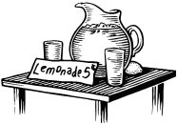
Entrepreneurial Skills
What skills are needed to be an entrepreneur? There are many skills that entrepreneurs develop over time, but there are a few skills that every entrepreneur must have before opening their “doors” for business

Slide 14
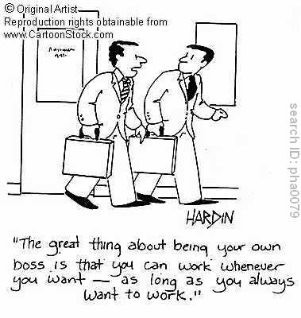
#1 Self-Motivation
The most important skill any entrepreneur needs is the ability to wake up in the morning and begin working. If you have been 10 minutes late to work everyday for the past five years, most likely that habit will not change if you own your own business. Not only do you need to be able to wake-up, but you also need to be able to begin and end work on time. Schedule your day and stick to your schedule.

Slide 15
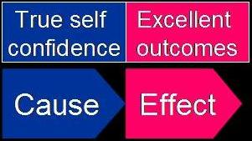
#2 Self-Confidence
Every entrepreneur needs to be confident in themselves, their product and their business. You need to know that your product can truly help people and that you are charging prices that are both fair to you and your clients.

Slide 16
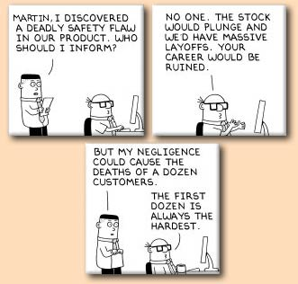
#3 Ethics & Morals
Ethics and morals are the foundation of every good entrepreneur. Early on you must decide what you and your business will stand for and what lines you will refuse to cross. Many entrepreneurs close their doors because the dollar outshines their morals. If you stray too far from your morals you will give yourself and your business a bad name.

Slide 17
#4 Time Management
Schedule your day and stick to your schedule. This cannot be emphasized enough. New entrepreneurs need to realize that every minute is valuable. When first starting out, most likely you will not have enough “work” to fill an eight hour day. This does not mean that you have time to take a 3 hour lunch with friends. Utilize this time to learn more skills related to your business, find ways to advertise and contact potential clients

Slide 18
#5 Sales
No matter how much you don’t like the idea of it, every business has to work with sales. Each industry and business has a unique way of handling their sales. As an entrepreneur, it is your job to figure out what type of sales you prefer and what type is best for your services or products.

Slide 19
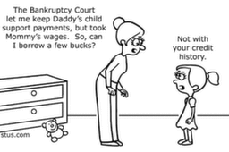
#6 Finance
When in business, knowledge of finance is a must. Knowing how to balance a checkbook and keep track of numbered invoices is all most small businesses need to start out. The most important aspect of small business finance is scheduling time specifically for your finance management and doing it.

Slide 20
Benefits of Entrepreneurship
1. Opportunity to get control – provides individuals with an opportunity to be independent and control their own future (self-employment).
2. Offers a chance to make a difference- provides a means to make a difference in society (provide jobs, tackle a social issue, etc…
3.To reap high Profits- Owning a business or a firm is the best way towards accumulation of wealth (financial independence).

Slide 21
4. Helps people work to their full potential- Owning a firm or a business acts as a test for the creativity skills, abilities, and determination of an entrepreneur and is taken up as a challenge towards success.
5. Offers a chance to pursue their interests- Most entrepreneurs don’t believe their work to be actual work. Most of them establish businesses closely associated with their interests. As such, there is no particular age for retirement of entrepreneurs.

Slide 22
Risks of Entrepreneurship
1. The risk of walking away from security and career path to create something new.
2. The risk of taking yourself and your family into an unfamiliar storm of stress and uncertainty.
3. The risk that you've miscalculated an opportunity, or your own internal resources as you plunge into a new venture.

Slide 23
Profile of an Entrpreneur
1. Problem Solver: Entrepreneurs have an uncanny ability to find solutions for difficult problems. Business environments will present you with many problems and your job is to quickly solve these problems.
2. Calculated Risk Taker: A successful entrepreneur is a good judge of acceptable risk levels. They always research a topic and have alternate plans should something unexpected arise. Starting a business is inherently risky so you must research and plan before jumping in with both feet.

Slide 24
3. Innovator: Most entrepreneurs will start several businesses. This is due to the fact that they always have great new business ideas flowing through their head. An entrepreneur will start a company and then move on to the next big project.
4. Delegate Tasks: When you are starting a business it's impossible to know everything or you will not have time to do everything yourself. Delegate some tasks and run the parts of the business that you excel in.

Slide 25
5. Handle Rejection Well: Dealing with rejection is part of being an entrepreneur. When you become an entrepreneur you step out of the comfort zone for many people. Whether it is out of jealousy or other factors there are many people that will not want you to succeed. You must overcome this by believing in your business and sticking to it until you obtain the level of success you desire.

Slide 26
Reflection
What are some of your strengths?
What are some of your interest?
In what areas of business would you like to work in?
In what areas of business can you use your strengths?
What is appealing about owning your own business???

Slide 27
SCO 5: Understanding Venture Potential

Slide 28
Where does ventures come from?
There are generally two sources for business ventures:
1. New idea’s or innovations (twist to an existing idea).

Slide 29
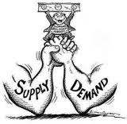
2. An identified demand in the marketplace.

Slide 30
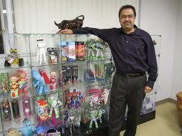
Where do Entrepreneurs get their ideas??
http://jan.ocregister.com/2011/04/03/where-do-entrepreneurs-get-their-ideas/57069/

Slide 31
Ideas come from…..
Intuition -now is the right time to jump into the game and start a business
Necessity – the feeling that you must start some type of business and you "feel" your way into a business.

Slide 32
Improving on other's ideas - skill sets to improve an existing product or service with a special touch.
Finding gaps in markets – identifying a product or service needed to support an existing market.

Slide 33
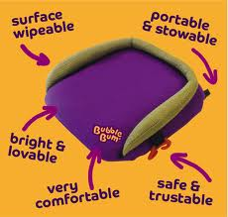
Improving on other's ideas - skill sets to improve an existing product or service with a special touch.
fulfill a basic need – providing the solution through business by fulfilling the need.

