Slide 1
Chapter 9 Homeostasis and Circulation
Biology 2201

Slide 2
Dynamic Equilibrium
A state of balance in an environment
Achieved by internal control mechanisms that counteract outside forces that could change the inside environment (body)

Slide 3
Homeostasis
The steady state of conditions inside a living organism that allows it to function properly
Homeostasis is the dynamic equilibrium of the internal environment of the human body

Slide 4
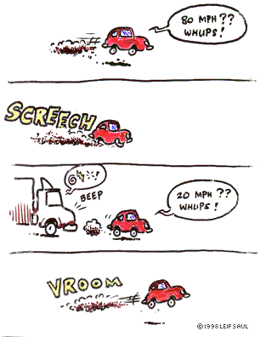
Not too fast… Not too slow

Slide 5
Examples of Homeostasis
Temperature Regulation
Food and Water Balance
Regulation of blood sugar levels
Regulation of blood calcium levels

Slide 6
Body Systems Involved in Homeostasis:
Nervous System
Endocrine System
Circulatory System*
Digestive System
Excretory System

Slide 7
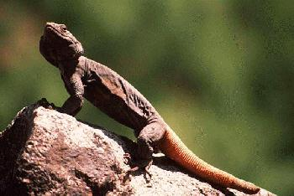
Temperature Regulation
Homeotherms
Warm blooded - body temperature stays relatively constant (Endotherm)
birds and mammals
Poikilotherms
Cold blooded animals - body temperature fluctuates depending on their environment (Ectotherm)
Lizards

Slide 8
Normal body temperature is 37.5 C
Body generates heat as a by product of the metabolic process and uses several different mechanisms to control the rate at which heat is lost through he skin.

Slide 9
How is temperature controlled?
Behaviourally
wearing more or less clothing
Exercising
Physiological
Shivering
Vasoconstriction
Vasodilation
Sweat

Slide 10
Physiologically - how does it work?
Negative Feedback Loop
3 parts Receptor (Skin)
Integrator (Brain)
Effector (Sweat or shiver))
See Pg. 302-303 in textbook

Slide 11
Negative Feedback Loop Example

Slide 12
Receptor
(skin)
Effectors
(sweat;
vasodilation)
Effectors
(shivering…)
Heat
Gained
Heat
lost
Integrator
(hypothalamus
of brain)
Pg. 303

Slide 13
Negative Feedback Loop
A process by which a receptor, an integrator and an effector detects, processes and produces a response to a change in a body constant (for example temperature) so that a reverse affect may take place, enabling the body to stay constant.

Slide 14
Receptors
Found in every body organ and tissue.
Monitor temperature, blood PH, blood sugar, and blood pressure on a continual basis
Send nerve impulses to the brain as a result of environmental stimulants.
They are the first part involved in a negative feedback loop.

Slide 15
Integrator
Sends messages to effectors.
Acts as a messenger between the brain and muscles or organs
An example is the hypothalamus of the brain.

Slide 16
Effectors
Causes a change in internal conditions based on external stimuli
Sweat glands are an example that enable the body to cool off when they produce sweat.

Slide 17
What Makes it all Possible?
The Circulatory System
Transporting…
Blood
Water
Nutrients
Hormones
Sugars
Toxins

Slide 18
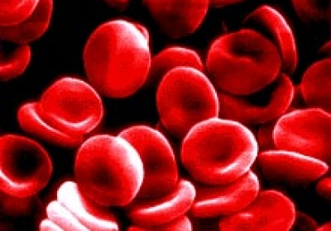
Circulatory System

Slide 19
Circulation System Evolution
Open circulatory
Blood is contained in blood vessels for only part of the time. While outside the vessels it filters through the body tissue. The blood in such a system does not transport oxygen. It is slow and inefficient, and found only in smaller organisms
sinuses (spaces surrounding organs)
hemolymph (blood & interstitial fluid)
Closed circulatory:
Blood is always contained in the blood vessels. The blood in such a system transports oxygen. It is fast and efficient, and found in large complex organisms.
Ex. Humans

Slide 20
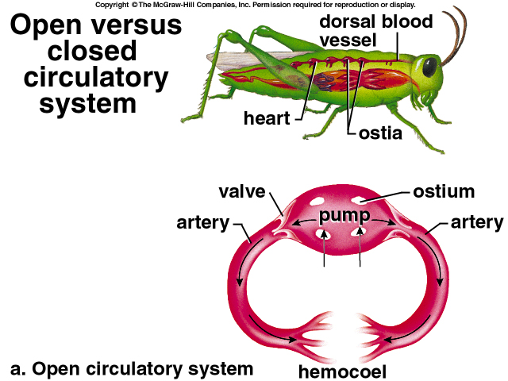

Slide 21
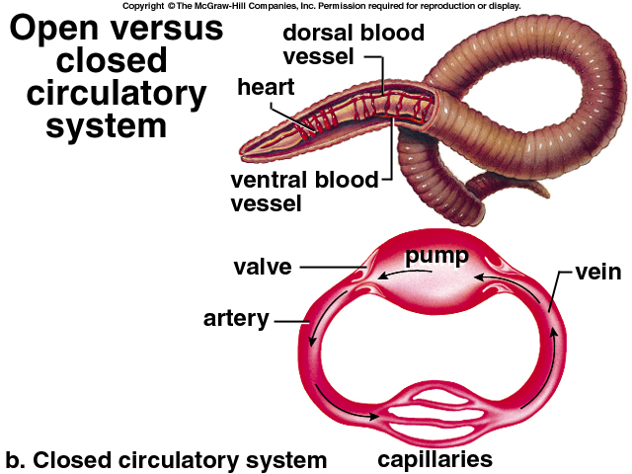

Slide 22
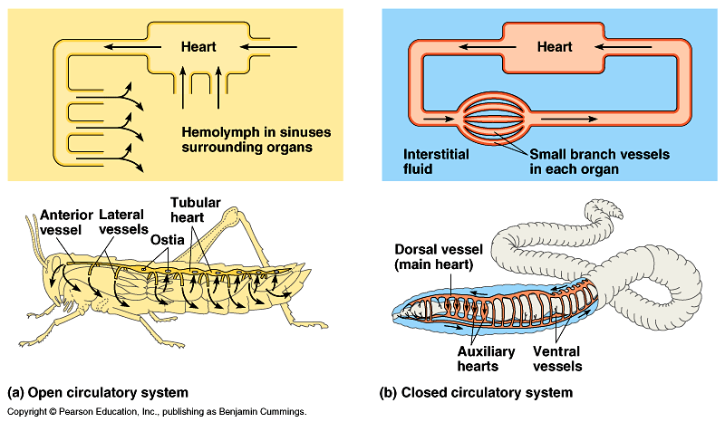

Slide 23
Circulation System Evolution
Fish: 2-chambered heart
Amphibians: 3-chambered heart
Mammals: 4-chambered heart

Slide 24
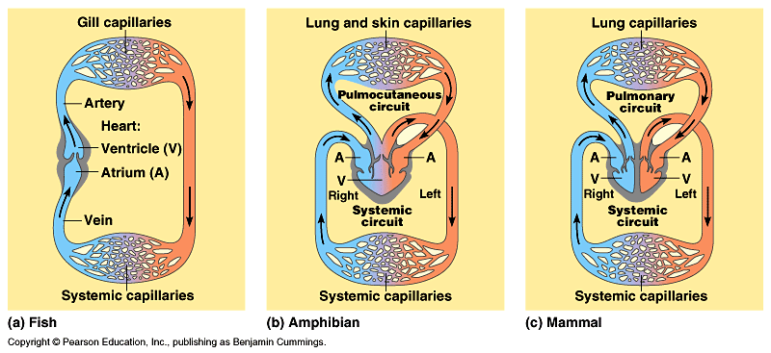
Comparison of Circulatory Systems

Slide 25
Three Cycles of Blood Circulation
Cardiac
Pathway blood takes in the heart
Pulmonary
Pathway of blood from the heart to the lungs and back
Remaining blood is here
Systemic
Path through the rest of the body
Includes all blood vessels other than those associated with lungs
80-90%of blood volume is here
Men have 5-6 L
Women have 4-5L

Slide 26
Coronary/Cardiac Circulation
Circulation in and around the heart

Slide 27
Pulmonary and Systemic Circulation

Slide 28
Pathway of a Blood Cell

Slide 29
3 Major Parts of the Circulatory system
Transport medium or Blood – carries materials through body
Transport vessels or Blood Vessels - routes blood travels
Pumping mechanism or Heart – pumps blood through body

Slide 31
Transport Vessels
3 major ones:
Artery
Vein
Capillary
Arteriole
venule

Slide 32
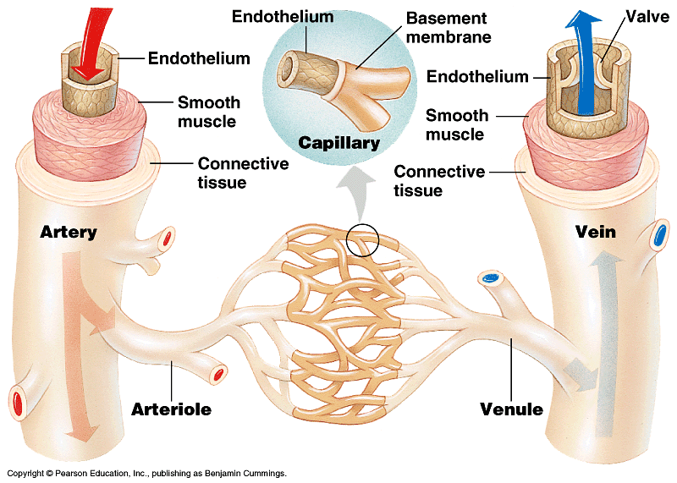

Slide 33
Arteries
Blood vessel that carries blood away from the heart
Carry oxygenated blood
Made up of elastic fibres and smooth muscle, thickest (middle layer)
Thin layer of epithelial cells reduces friction (inner layer)
Has elastic walls to allow expansion and contraction as blood flows through it
In measuring your pulse you can feel the artery contracting and expanding
At any given time 30% of blood in systematic circulation is found in your arteries

Slide 34
Veins
Blood vessel that carries blood to the heart
Carries deoxygenated blood
Has a thinner wall than arteries, but a larger circumference
Is not elastic
Gravity aide flow above the heart, one-way valves prevent back flow against gravity below the heart

Slide 35
Capillary
The smallest blood vessel, only a single cell thick
Average diameter is 8um
Join arteries to veins
Allows for the exchange of oxygen and nutrients in the blood for carbon dioxide and wastes in the body cells.
In closed circulatory system the blood itself is always contained in the capillaries and never flows out to the body’s cells directly

Slide 37
Arteriole
Arteriole: small artery
Arterioles share many of the properties of arteries
they are strong,
have a relatively thick wall for their size,
and contain a high percentage of smooth muscle.
Just like arteries, arterioles carry blood away from the heart and out to the tissues of the body.
arterioles are very important in blood pressure regulation. Are the most highly regulated blood vessels in the body, and contribute the most to overall blood pressure.
Arterioles respond to a wide variety of chemical and electrical messages and are constantly changing size to speed up or slow down blood flow.

Slide 38
Venule
Venule: small vein
Blood empties into the venule from the capillaries before entering the veins. Many venules unite to form a vein.
Venules range from 7 to 50μm in diameter.
25% of the blood from the veins is contained in the venules.^{[1]}
Venules are blood vessels that drain blood directly from the capillary beds.
They are extremely porous so that fluid and blood cells can move easily from the bloodstream through their walls.

Slide 39
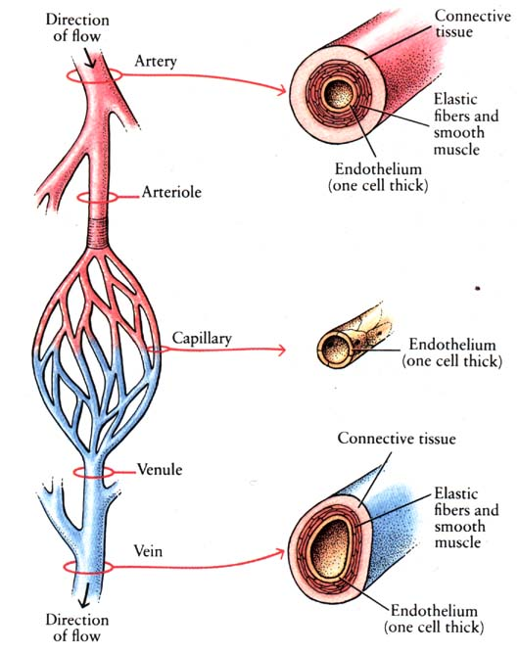

Slide 40
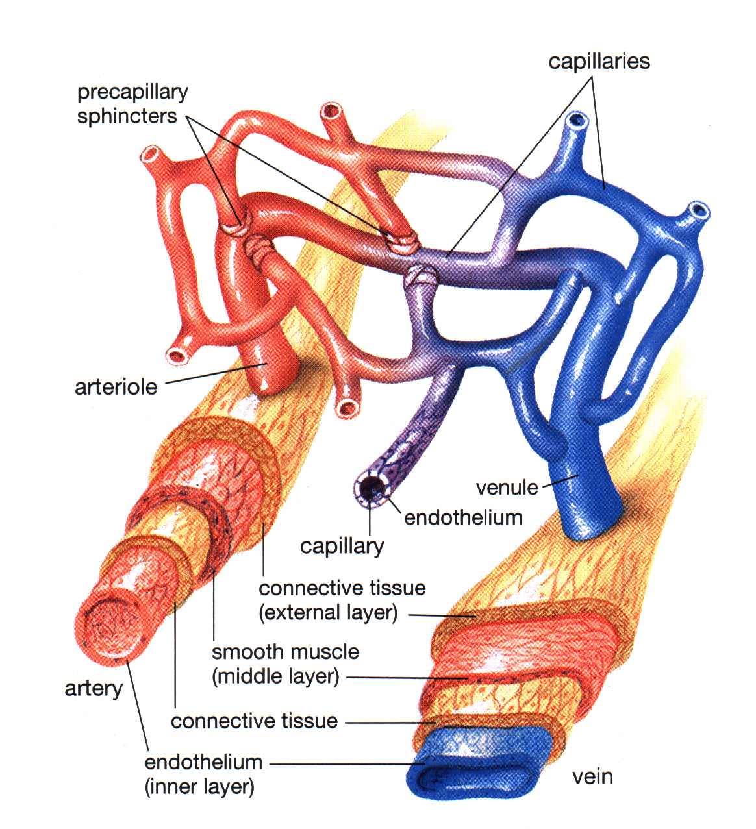

Slide 41
Transport Medium
Blood

Slide 42
Function of Blood
Transport of materials to and from the body cells
Oxygen
Carbon Dioxide
Nutrients
wastes
distribute heat in the body
Immunity : provides defense against invading organisms
serves as a regulator in the body

Slide 43
The Composition of Blood
4-6 L in humans
tissue
Plasma (Fluid)
55% of blood vol.
Cells (solid)
45% of the blood volume.
Three types: erythrocytes,
platelets, leucocytes

Slide 44
Components of blood
Plasma -55% of the blood
Water, proteins, dissolved gasses, sugars, vitamins, minerals and waste products
Red Blood Cells - 44% of the blood
White Blood Cells - 1% of the blood
Platelets -3rd major component

Slide 45
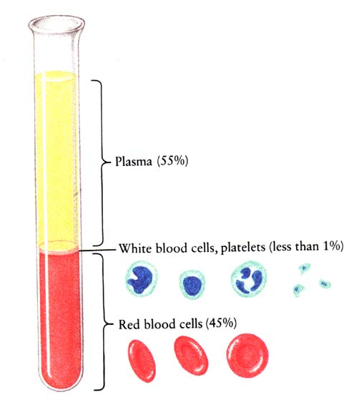
Red Blood Cells:
Transport O₂
White Blood Cells:
Protect the cells from infection/invasion
Platelets:
Clot the blood to prevent it from spilling out when a rupture of the fluid conduit occurs
Plasma:
Water, Glucose, hormones, etc. suspended in a viscuous goo

Slide 46
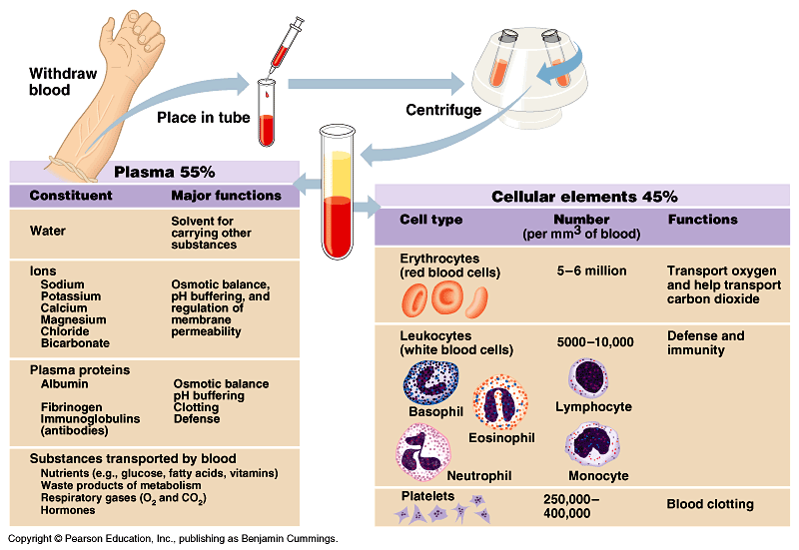

Slide 47
Blood Plasma
97% Water and clear golden fluid
Other 3% is dissolved substances
- nutrients, wastes
- enzymes, hormones
- antibodies
- proteins (albumin, globulin and clotting
proteins)
Has several functions:
Transports small molecules and ions
contains proteins involved in blood clotting
contains antibodies that are involved in disease fighting

Slide 48
Protein components of Plasma
Three major forms of protein:
(1) fibrinogen - important in blood clotting
(2) serum globulin - body defense
(3) serum albumin - helps regulate water balance in the blood. (osmotic balance) and blood pressure

Slide 49
Red Blood Cells (Erythrocytes)

Slide 50
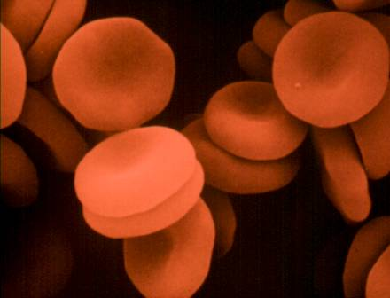
Blood Cells
(1) Erythrocytes
Red Blood Cells
Make up 44 % of total blood volume
Males 5.5 million/mL, females 4.5 million/ mL
Contains hemoglobin to transport oxygen
Carry 98% of O₂ and 40-45 % of CO₂ using hemoglobin
5 million per cubic millimeter
30 trillion per adult
Made in bone marrow,
Spleen: reservoir of RBC’s
No nucleus in mature ones, live ~ 3 months
Replaced at a rate of 1-2 million every second
8 um in diameter, disk shaped and biconcave

Slide 51
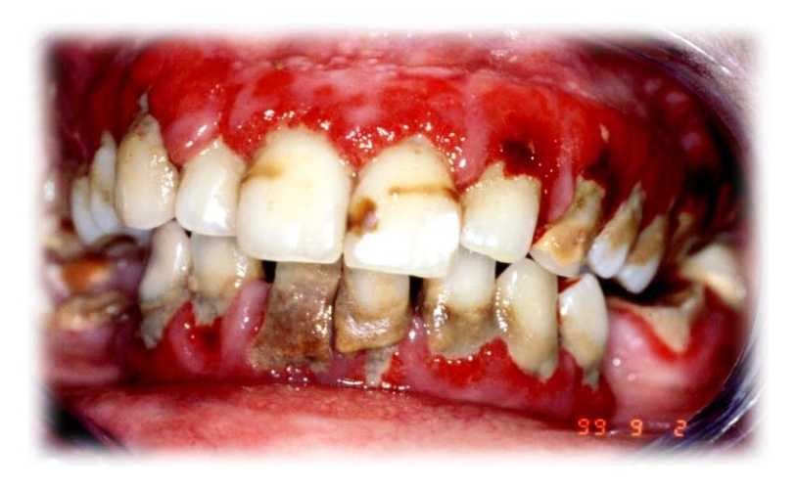
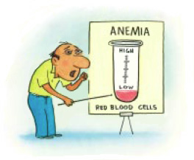
Diseases associated with Red Blood Cells
Anemia: This is a condition caused by either a lack of hemoglobin, or too few RBCs.
Symptoms of anemia include:
(1) dizziness
(2) weakness
(3) pale color
* Sickle-cell anemia is a hereditary disorder caused by an abnormal form of hemoglobin. The cells are sickle-shaped, and therefore carry little O₂. They tend to become clogged in the blood vessels.

Slide 52
White Blood Cells :Leukocytes

Slide 53
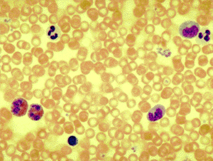
(2) Leukocytes
White blood cells
Fight off invaders(disease/illness)
Larger than RBC and contain a nucleus
Made in bone marrow and lymphatic tissue (movement not limited to vessels).
Make up 1% of total blood volume
Have a nucleus and are colorless
8000 per cubic millimeter
60 billion per adult
defend body against disease in 2 general ways:(i) engulf (eat) bacteria(ii) produce antib.

Slide 54
Leukocytes (White Blood Cells) Diseases
Leukemia: associated with high #’s of leukocytes.
Two types: macrophages and lymphocytes

Slide 55
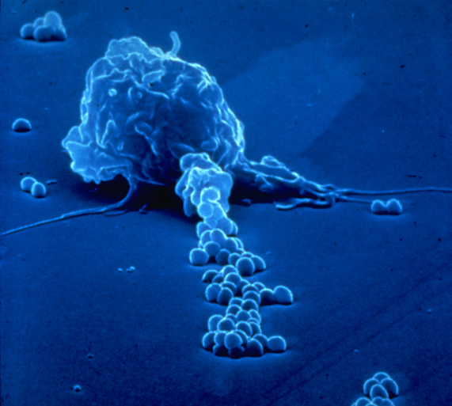
Macrophages
"engulfing" cells.
highly deformable cells.
They are able to creep actively into the smallest gaps (and so also to penetrate the vascular walls, for example) and work their way into the most diverse tissue types.
They form semi-liquid projections which are used for motility and also for trapping pathogens and other foreign bodies.
Part of body immune system

Slide 56
Lymphocytes
Non-phagocytic cells that play a role in immunity by recognizing and fighting off specific pathogens.
The three major types of lymphocyte are T cells, B cells and natural killers (NK) cells.
T cells and B cells are the major cellular components of the adaptive immune response
NK cells are a part of the innate immune system and play a major role in defending the host from both tumors and virally-infected cells.

Slide 57
Platelets

Slide 58
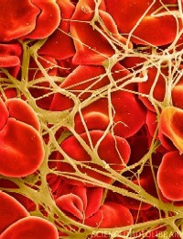
(3) Platelets
Cell fragments without nucleus.
Live 7 days.
Used in blood clotting
300,000 per cubic millimeter
1.5 trillion per adult
produced from bone marrow when bits of cytoplasm pinch off from larger cells within the marrow. These are cell fragments. They contain no nucleus.
Play a major role in blood clotting.

Slide 59
Blood Clotting
Blood clotting maintains homeostasis by preventing the loss of blood from torn or ruptured blood vessels. Major stages are as follows:
(1) Blood platelet strikes a rough, torn blood vessel, breaks apart, and releases the protein thromboplastin.
(2) Thromboplastin and calcium ions cause the conversion of the protein prothrombin into thrombin.
(3) Thrombin acts as an enzyme causing fibrinogen to form fibrin.
(4) Fibrin is insoluble and settles out as long strands trapping RBCs and platelets forming a blood clot.

Slide 60
Clotting Response
Fibrinogen (inactive/soluble) is converted to fibrin (active/insoluble)
Thrombus = clot
Haemophilia: unable to clot

Slide 61
Blood Typing
Blood type depends on the presence or absence of two special proteins (antigens A and B) on the surface of the R.B.C.
People are born with special antibodies (agglutinins) that work against R.B.C. antigens that their own blood does not have.
Example: blood type A has antigen A protein on the R.B.C., but contains anti-b antibodies or agglutinins in the plasma.

Slide 62
Major Blood Types

Slide 63
Blood Transfusions
Blood typing is important.
If someone gets the wrong type, the agglutinin in their plasma will react with the antigen on the R.B.C. of the donor.
The blood will agglutinate or clump.
Blood vessels become blocked and death will occur.

Slide 64
Steps to Follow to See if Agglutination Will Occur:
Identify the recipient and the donor.
Find the agglutinin of the recipient.
Find the antigen of the donor.
If the agglutinin of the recipient and the antigen of the donor are the same , agglutination will occur and transfusion cannot take place.

Slide 65
Blood Transfusion Chart
Type Antigen Agglutinin Receive from Give to
A
Anti-b
A, O
A, AB
A
B
B
Anti-a
B,O
B, AB
AB
A, B
none
A, B, AB, O
AB
O
none
Anti-a, Anti-b
O
A, B, AB, O
Blood Type O : universal donor
Blood Type AB: universal recipient

Slide 66
Rh Factor
Rh factor is a protein found on the RBC.
First discovered in the rhesus monkey, hence the name.
About 85% of humans have the Rh factor on their RBC and are said to be Rh+.
The remaining 15% are Rh-.

Slide 67
Rh Factor / Blood Transfusions
A person with Rh+ blood can receive both Rh+ blood and Rh- blood.
A person with Rh- blood can receive only Rh- blood. If given Rh+ blood, the recipient’s blood plasma produces anti-Rh antibodies causing the blood to agglutinate.

Slide 68
Rh Factor / Pregnancy
Can cause problems in pregnant women who have Rh- blood and a baby that is Rh+.
The systems are independent of each other, but sometimes there is a slight mixing of the bloods during birth.
If this occurs, the mother’s blood plasma will produce anti-Rh antibodies to fight the foreign Rh+ protein.
Usually not a concern on the first pregnancy, but can be on subsequent ones where the anti-Rh antibodies enter the baby’s blood and destroy its Rh+ blood cells.

Slide 69
Treatment
Problem can be eliminated if the Rh- mother is given an injection of anti-Rh antibodies called RhoGam, shortly after the birth of each Rh+ child.
These destroy any Rh antigens on the baby’s blood cells that have entered the mother’s system.
This means the mother’s immune system does not have to produce anti-Rh antibodies, and there is no problem with the next Rh+ baby.

Slide 70
Antigen: foreign proteins
Antibodies: fights off antigens, one is agglutinin (causes clotting)
Rh factor: an antigen/protein on RBC’s
Rh + = it’s present
Rh- = it’s absent

Slide 71
The Heart
double pump,
Found in the thoracic or chest cavity, under the ribs and sternum between the two lungs.
part of a two circuit path (no mixing)
Enclosed in pericardium (sac like membrane)
cardiac muscular tissue
4 chambers
2 upper receiving chambers:
Left Atrium
Right Atrium
2 lower pumping chambers:
Left Ventricle
Right Ventricle

Slide 72
top chambers or atria receive blood from circulation. They have relatively thin walls as compared to the ventricles.
bottom chambers or ventricles pump blood out into circulation. They have thick muscular walls.
Divided into left and right hand sides by a muscle called the septum.

Slide 73
right side consists of right atrium and right ventricle. This side carries deoxygenated blood into the lungs and is called pulmonary circulation.
Left side consists of the left atrium and left ventricle. This side carries oxygenated blood out to the body organs and is called systemic circulation.

Slide 74
Heart Facts
Don’t copy…..
Hold out your hand and make a fist. If you're a kid, your heart is about the same size as your fist, and if you're an adult, it's about the same size as two fists.
Your heart beats about 100,000 times in one day and about 35 million times in a year. During an average lifetime, the human heart will beat more than 2.5 billion times.
Give a tennis ball a good, hard squeeze. You're using about the same amount of force your heart uses to pump blood out to the body. Even at rest, the muscles of the heart work hard--twice as hard as the leg muscles of a person sprinting.

Slide 75
Double Circulation
Deoxygenated blood goes to
Superior /inferior vena cava to
Right Atrium to
Right Ventricle to
Pulmonary artery through semi lunar valve to
Lungs (picks up oxygen)
Oxygenated blood goes to
Pulmonary veins to
Left Atrium to
Left Ventricle to atrioventricular valve to
Aorta to
Systemic circulation (in body)
Becomes deoxygenated

Slide 76
Heart
Atria (atrium-singular)
Receives blood
Thin walls
Send blood to ventricles
Ventricles
Pumpers
Thick walls
Send blood to body/lungs

Slide 77
Septum: wall dividing heart into right left halves
right: deoxy
left: oxy
Valves: prevent backward flow

Slide 78
Parts of the Heart

Slide 79
Aorta
The largest artery
Carries blood from the left side of the heart into systemic circulation.

Slide 80
Atria
The upper chambers of the heart that receives blood from the veins and forces it into a ventricle
Plural for atrium.

Slide 81
Left Ventricle
The chamber on the left side of the heart that receives arterial blood from the left atrium and contracts to force it into the aorta.
Septum → The wall that separates the right and left ventricles.

Slide 82
Right Ventricle
The chamber on the right side of the heart that receives venous blood from the right atrium and forces it into the pulmonary artery.

Slide 83
Vena Cava
Either of two large veins that drain blood from the upper body (superior vena cava) and from the lower body (inferior vena cava) and empty into the right atrium of the heart.

Slide 84
Pulmonary Artery
A blood vessel that carries deoxygenated blood from the right ventricle of the heart to the lungs.

Slide 85
Pulmonary Vein
A blood vessel that carries oxygenated blood from the lungs to the left atrium of the heart.

Slide 86
Valves:
Atrioventricular Valves
Bicuspid:
Mitral valve
Between left atrium and ventricle
Two cusps (parts)
Tricuspid:
Between right atrium and ventricle
Semilunar valves:
entrance of arteries leading from heart
Aortic semilunar
Pulmonary semilunar

Slide 87
Atrioventricular Valves
On both sides of the heart the atria and ventricles are separated from one another by this set of valves. (These are also called the bicuspid and tricuspid valves).

Slide 88
Bicuspid Valve
A valve of the heart located between the left atrium and left ventricle that keeps blood in the left ventricle from flowing back into the left atrium.
Also known as the Mitral valve and is one of the two atrioventricular valves.

Slide 89
Tricuspid Valve
A valve of the heart located between the right atrium and right ventricle that keeps blood in the right ventricle from flowing back into the right atrium.
It is one of the atrioventricular valves

Slide 90
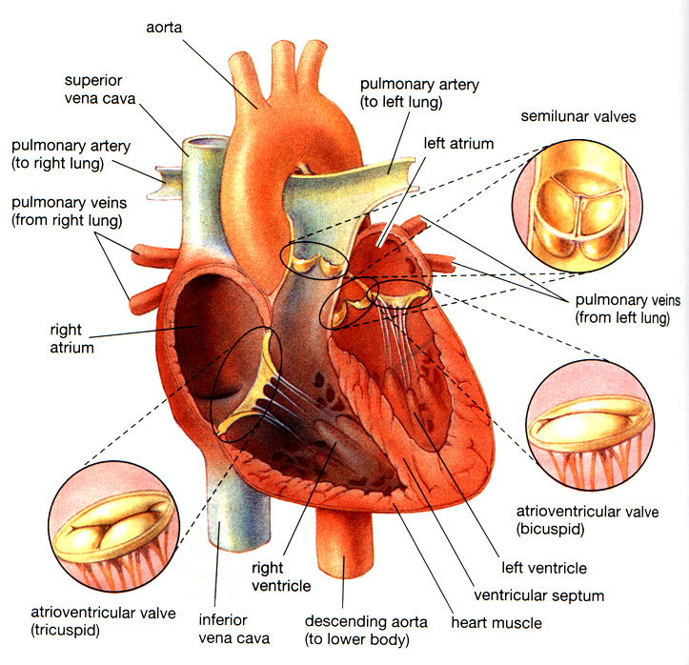

Slide 91
Sinoatrial/ SA/ Sinus Node
A small bundle of specialized cardiac muscle tissue located in the wall of the right atrium of the heart that acts as a pacemaker by generating electrical impulses that keep the heart beating.

Slide 93
How much blood does your heart pump?
Don’t copy…….
An average heart pumps 2.4 ounces (70 milliliters) per heartbeat. An average heartbeat is 72 beats per minute. Therefore an average heart pumps 1.3 gallons (5 Liters) per minute. In other words it pumps 1,900 gallons (7,200 Liters) per day, almost 700,000 gallons (2,628,000 Liters) per year, or 48 million gallons (184,086,000 liters) by the time someone is 70 years old.

Slide 94
Blood from ?
Blood from lungs
right atrium
?
valve
Left ventricle – has a thicker muscle wall than right side – why?
Right ventricle
RIGHT SIDE
LEFT SIDE

Slide 96
How do the valves work?
How many can you see?

Slide 97
out
in
in
Can you see the 4 valves?
Atrium and ventricle muscles force the blood through and out of the heart

Slide 98
VALVE between the atrium and ventricle
Ventricle wall
Ventricle chamber

Slide 99
Blood Flow
Superior and inferior vena cava
Right atrium
tricuspid Valve
Right ventricle
Pulmonary artery
Lungs
Pulmonary vein
Left atrium
bicuspid or mitral Valve
Systematic circulation
Aorta
Left ventricle

Slide 100
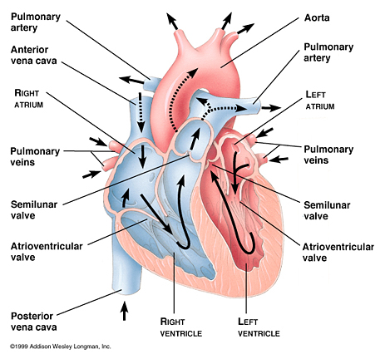

Slide 101
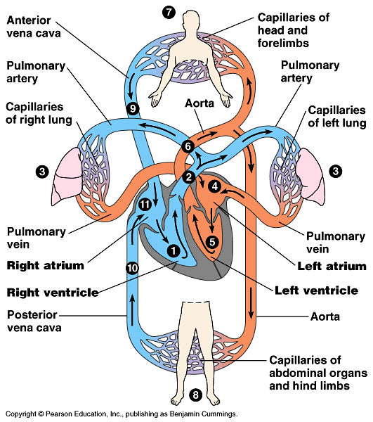

Slide 102
The heartbeat
Sinoatrial (SA) node (“pacemaker”):
Bundle of muscle tissue in right atrium
sets rate and timing of cardiac contraction by generating electrical signals in atria makes them contract simultaneously
Sends signal to a-v node
Atrioventricular (AV) node:
Receives signal from S-A node
relay point (0.1 second delay) spreading impulse to walls of ventricles
Change in voltage is measured using an elcetrocardiogram (ECG)

Slide 103
Lub
Dub
Don’t copy….
Your heartbeat makes a lub dub sound.
The "lub" results from closure of the tricuspid and mitral valves.
The "dub" marks the beginning of ventricular diastole. It is produced by closure of the aortic and pulmonary semilunar valves

Slide 105
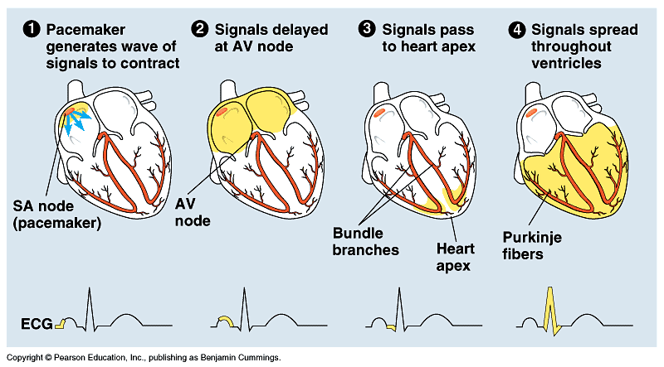
The Heartbeat

Slide 106
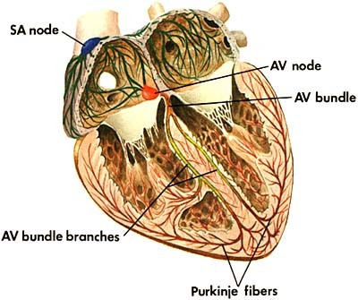

Slide 107
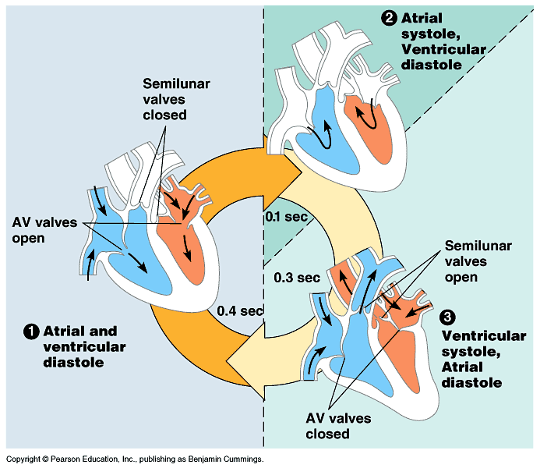

Slide 108
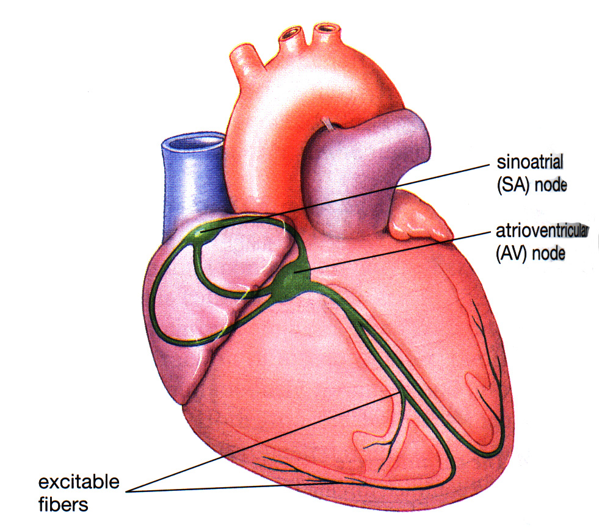
Coordination of the Beating
• Heart cells naturally beat slowly if ATP is present
• If there was no coordination, the heart cells would all beat randomly (fibrillation)
• Coordinated beating occurs because a group of cells (the pacemaker cells) send nerve impulses to the other cells stimulating them to beat at the right time
• Atria beat from top down, pause, Ventricals beat from bottom up

Slide 109
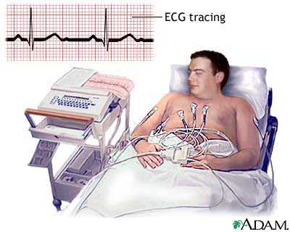
Electrocardiogram (ECG or EKG)
Measures changes in the voltage

Slide 110
Electrocardiograph
The tracing produced by an electrocardiogram.

Slide 111
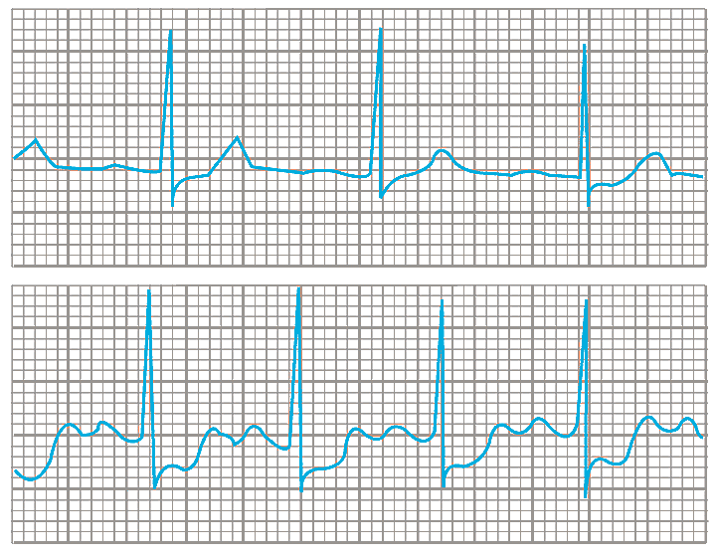

Slide 112
Ventricular Fibrillation
This is a condition where the ventricles contract randomly causing the heart to quiver or twitch.
Can be caused due to drug overdose
Can be stopped by applyng a sudden strong electrical current

Slide 113
Defibrillation:
An electrical charge to “reset” the S-A node and return regular heart rhythm.

Slide 114
Chemical Regulation of Heart rates
Factors that influence heart rate:
Amount of oxygen
blood pressure
activity
Medulla Oblongata:
heart rate control center of brain
Two parts
Accelerating center: increases rate
Inhibiting center: slows rate

Slide 115
Noradrenalin:
causes S-A node to fire more rapidly
Released when medulla oblongata detects high carbon dioxide levels
Acetylcholine:
slows S-A node firing
reduces blood pressure
Adrenaline:
Similar to noradrenalin but is released when angry, nervous, injured…etc

Slide 116
Blood Pressure
force that blood exerts against a vessel
main force that propels blood
determined by
cardiac output
peripheral resistance
(elasticity of arterial walls)
systolic pressure/diastolic pressure
measured in mm/Hg by sphygmomanometer
Blood pressure = systolic/diastolic
Average = 120/80 mmHg

Slide 117
Systolic Pressure
The blood pressure that is exerted on blood vessels only in short bursts following the ventricular contractions.
Highest pressure in the cardiac cycle generated by the left ventricle

Slide 118
Diastolic Pressure
The blood pressure that blood vessels are exposed to most of the time (pressure of the blood during the hearts resting phase).
Lowest pressure in the cardiac cyle occurs immediately before another contraction of the ventricles

Slide 119
Sphygmomanometer
An instrument for measuring blood pressure in the arteries.
Hypertension
Condition where blood pressure is abnormally high

Slide 120
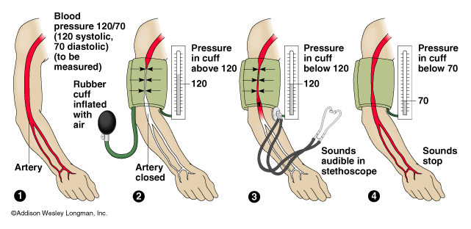
Sphygmomanometer

Slide 121
Human Heart Terminology
Cardiac cycle: sequence of filling and pumping
Systole- contraction
Diastole- relaxation
Cardiac output:
volume of blood per minute pumped form each ventricle.
Cardiac output = stroke volume x heart rate
Heart rate: number of beats per minute (average= 70 beat/min)
Stroke volume- amount of blood pumped with each contraction (average = 70ml/beat)
Pulse: rhythmic stretching of arteries by heart contraction

Slide 122
Average stroke vol= 70 ml/beat
Average heart rate = 70 beat/min
Cardiac output= stroke vol x heart rate
= 4900 ml/min
Average person: 4000 – 6000ml of blood
So it takes the heart ~ 1 minute to circulate entire blood volume

Slide 123
Fitness and Cardiac Output
More exercise:
Increases stretchiness and strength of ventricles and enlarges them
Increases force and stroke volume of each pump
SO…move same amount of blood with less beats

Slide 124
Heart Defects
Septal defects
Heart murmur

Slide 125
Septal Defect
A hole in the septum that
allows oxy-genated and deoxygenated blood to mix.
Blue babies
Fix with surgery

Slide 126
Heart Murmur
Restricts the flow of blood from the heart
Whooshing or rasping sound
Mitral valve prolapse”: bicuspid valve doesn’t close tight, blood flows back into left atrium from ventricle.

Slide 127
Cardiovascular disease I
Heart attack-
death of cardiac tissue due to coronary blockage
Stroke-
death of nervous tissue in brain due to arterial blockage
Embolism

Slide 128
Stroke
A condition that occurs when a blood clot blocks an artery going to the brain and causes the brain to be starved of oxygen, killing the brain tissue

Slide 129
Heart Attack
A condition that occurs when a blood clot blocks an artery going to the heart muscle and causes the heart to beat irregularly or stop altogether. A part of the heart actually dies when this happens.

Slide 130
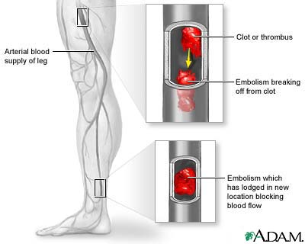
Embolism
blockage of a blood vessel by a blood clot, a piece of tissue, an air bubble, or a foreign object

Slide 131
Cardiovascular disease II
Hypertension: high blood pressure
is caused by:
increased blood volume (high salt intake causes blood to retain water)
Reduced elasticity of artery walls
Clogged vessels( due to high cholesterol)
Other factors:
Stimulants(nicotine, caffeine), heredity, age, obesity inactivity.
Hypercholesterolemia:
LDL (bad)
HDL(good)

Slide 132
Good vs Bad Cholesterol
Don’t copy….
Correlates to atherosclerosis
Low-density lipoproteins (LDL’s)
increase deposits in arterial plaques
High-density lipoproteins (HDL’s)
reduce depositing of cholesterol in arterial plaques
exercise increases
smoking decreases
Ratio of HDL/LDL most important indicator

Slide 133
Cardiovascular Disease III
Atherosclerosis
Arteriosclerosis

Slide 134
Atherosclerosis
Atherosclerosis
A narrowing of the arteries caused by cholesterol or fatty tissue buildup called plaques, ON the inner lining of the artery wall.
Results in a decreased blood flow
Can cause angina
Shortness of breath
Heart attack and strokes
Prevention
Diet low in saturated fat and cholesterol and high in fruits and vegetables

Slide 135
Arteriosclerosis
Arteriosclerosis
A condition where plaque material becomes deposited UNDER the inner lining of the arteries
Builds over a period of years due to poor diet
Blocks flow of blood in the artery
Can cause damage to platelets which triggers a blood clot which blocks blood supply and tissue dies
Can become an embolism which makes its way to the heart, brain causing damage , stroke, or heart attack

Slide 136
Atherosclerosis & Arteriosclerosis

Slide 137
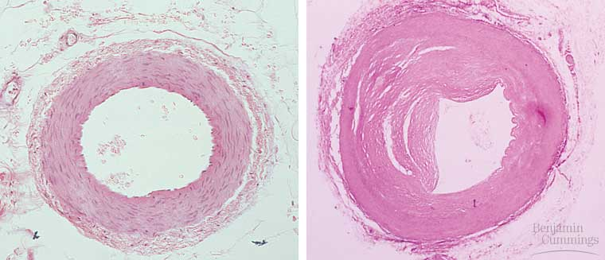
Atherosclerosis

Slide 138
Treatments for Cardiovascular disease
Clot busting drugs
Angioplasty
Coronary bypass surgery
Coronary shunt

Slide 139
Clot Busting Drugs
Medicines that help dissolve blood clots in arteries, allowing blood to once again flow through them.

Slide 140
Aspirin:
anti-clotting agent prevents embolisms
Digitalin:
Strengthens heart contractions and maintains blood output while slowing heart rate.(lowers blood pressure)
Thrombolytic “clot busting”drugs:
T-PA (tissue plasminogen activator)
Naturally produced and medically available.
Dissolves clots in ~3 hours

Slide 141
Angioplasty
A procedure in which a fine plastic tube is inserted into a clogged artery, a tiny balloon is pushed out from the tip of the tube and forces the vessel to open allowing blood to flow through.

Slide 142
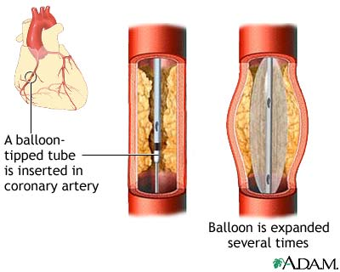
Angioplasty

Slide 143
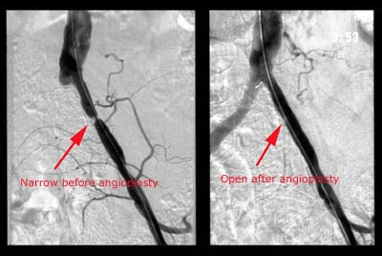
Angioplasty

Slide 144
Coronary Bypass Surgery
A common surgical procedure in which a segment of healthy blood vessel from another part of the body is used to create a new pathway around a blocked coronary artery.

Slide 145
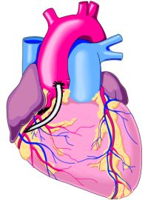
Coronary Bypass
Blockage
Bypass

Slide 146
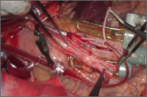
Coronary shunt:
tube used to redirect blood temporarily during bypass.
Creates bloodless field of view for surgeon
And uninterrupted blood flow during surgery

Slide 147
The lymphatic system
Lymphatic system:
system of vessels and lymph nodes, separate from the circulatory system, that returns fluid (1-2 L) and protein to blood
Only found in mammals
Works with white bloods cells to fight infection
Lymph:
colorless fluid, derived from interstitial fluid
Lymph nodes:
filter lymph and help attack viruses and bacteria
Make lymphocytes and macrophages: ( Body defense / immunity)
Swell when body fights infection.

Slide 148
Lymph capillaries:
are intertwined with cardiovascular capillaries
Have valves (no reverse flow)
Lymph re-enters circulatory system through ducts which empty into large vein near heart under the left clavicle
Transfers between plasma, lymph, interstitial fluid maintains bodies osmotic balance

Slide 149
