Slide 1
Introduction and History of Psychology Chapter 1
AP Psychology
Corrina Fahey
Holy Heart High School
Adapted from Trevor Tusow

Slide 2
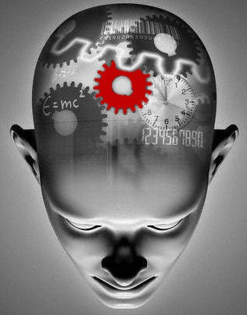
What is Psychology?
Psychology is the scientific study of behavior and mental processes.
“Psychology” has its roots in the Greek words of “psyche,” or mind, and “-ology,” or a field of study.”

Slide 3
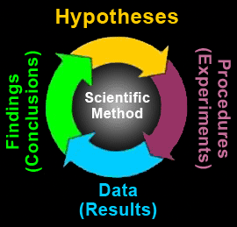
Scientific Method
The science of psychology is based on objective, verifiable evidence obtained using the scientific method.
What is the scientific method?

Slide 4
The Empirical Approach
Much like scientific method, the empirical approach uses a set of standards to conduct a study which emphasizes careful observation and scientifically based research.
Why is it important to use the empirical approach?

Slide 5
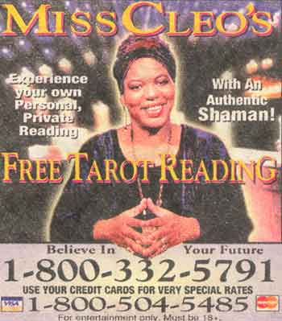
What is Real Psychology and What is Pseudo-psychology?
Pseudo-psychology is the phony or unscientific psychology which pretends to be the real thing.

Slide 6
Negative Effects of Pseudo-psychology:
People believe the fake psychology and miss out on real psychological insights which are more helpful and interesting.
Ex. Confirmation bias: Only paying attention to the events and evidence which confirms our desired beliefs.
Also, pseudo-psychology can produce a lot of fraud.
With increased incidents of fraud in the field of psychology, there is diminished public support for legitimate psychological science.

Slide 7
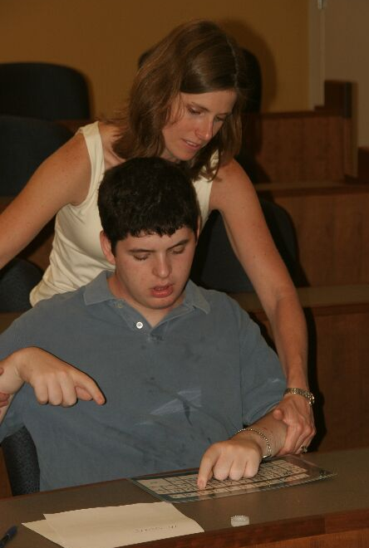
Facilitated Communication
Another example of pseudo-psychology was an autism treatment called Facilitated Communication.
After applying the scientific method to the practice, it proved to be no more accurate than Cleaver Han’s math calculations.

Slide 8
3 Ways of Doing Psychology
1. Experimental Psychologists:
These are the psychologists who do the basic research in psychology. Most are faculty members at a college or university.
This is the smallest group of the three major branches of psychology.

Slide 9
3 Ways of Doing Psychology
2. Teachers of Psychology:
This group overlaps with the experimental research group because most researchers also teach, but there has been an increase in the hiring of psychology teachers.

Slide 10
3 Ways of Doing Psychology
3. Applied Psychology:
This group uses the knowledge developed by experimental psychologists to address human problems such as training, equipment design and psychological treatment.

Slide 11
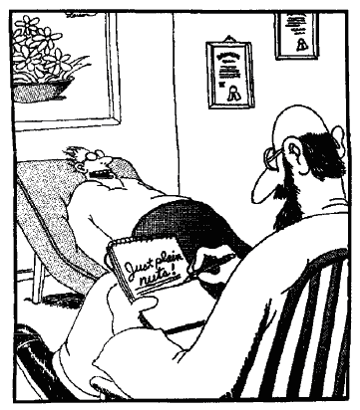
Psychology vs. Psychiatry
Psychiatry is a specialty in the medical field, not a part of psychology.
Psychiatrists hold MDs and have specialized training in the treatment of mental and behavioral problems.
Psychology is a much broader field which has many different specialties.

Slide 12
When and Where did Psychology Start?
While the Greeks get much of the credit for first identifying ideas about consciousness, other societies were also developing their own ideas.
Although both Asian and African cultures had ideas about psychology, it was the Greeks and later the Roman Catholic church which had the most influence on western psychology.

Slide 13
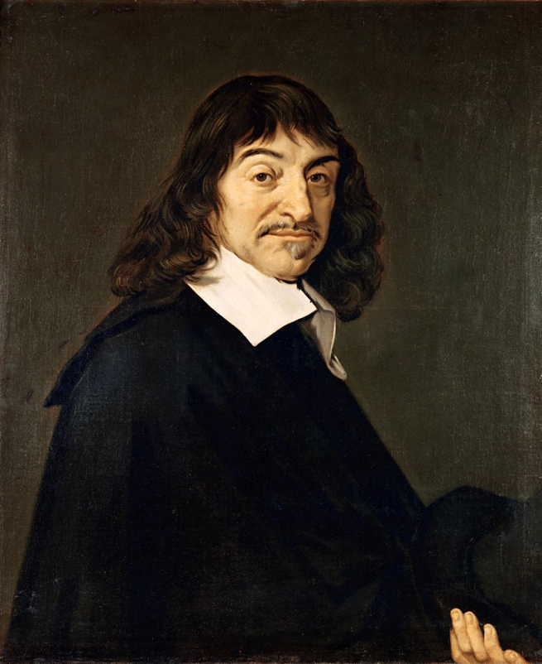
A Change in Perspective
For hundreds of years medieval Christian churches felt the human mind, like that of God, was an unsolvable mystery.
In the 17th C. the French philosopher Rene Descartes argued that human sensations and behaviors were based on activity in the nervous system.
He believed:
▪ Mind and body interact – mind controls body
▪ Interaction occurs in the pineal gland at the
top of the brain stem
▪ Reflexes not controlled by the mind
Rene Descartes 1596-1650

Slide 14
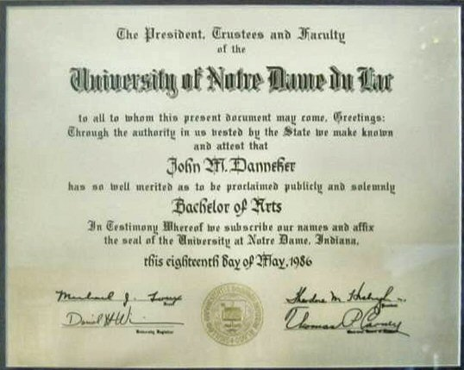
Psychology Becomes a Science
Despite Descartes arguments and scientific breakthroughs at the time, psychology didn’t become a recognized science until the mid 1800s.

Slide 15
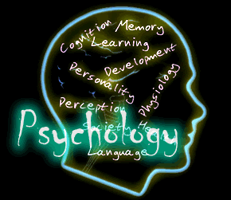
Modern Psychology Rooted in History
Modern psychology developed from several conflicting ideas including structuralism, functionalism, Gestalt psychology, behaviorism and psychoanalysis.

Slide 16
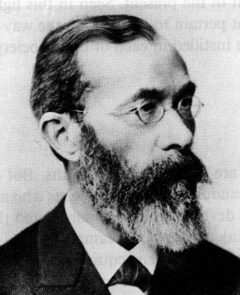
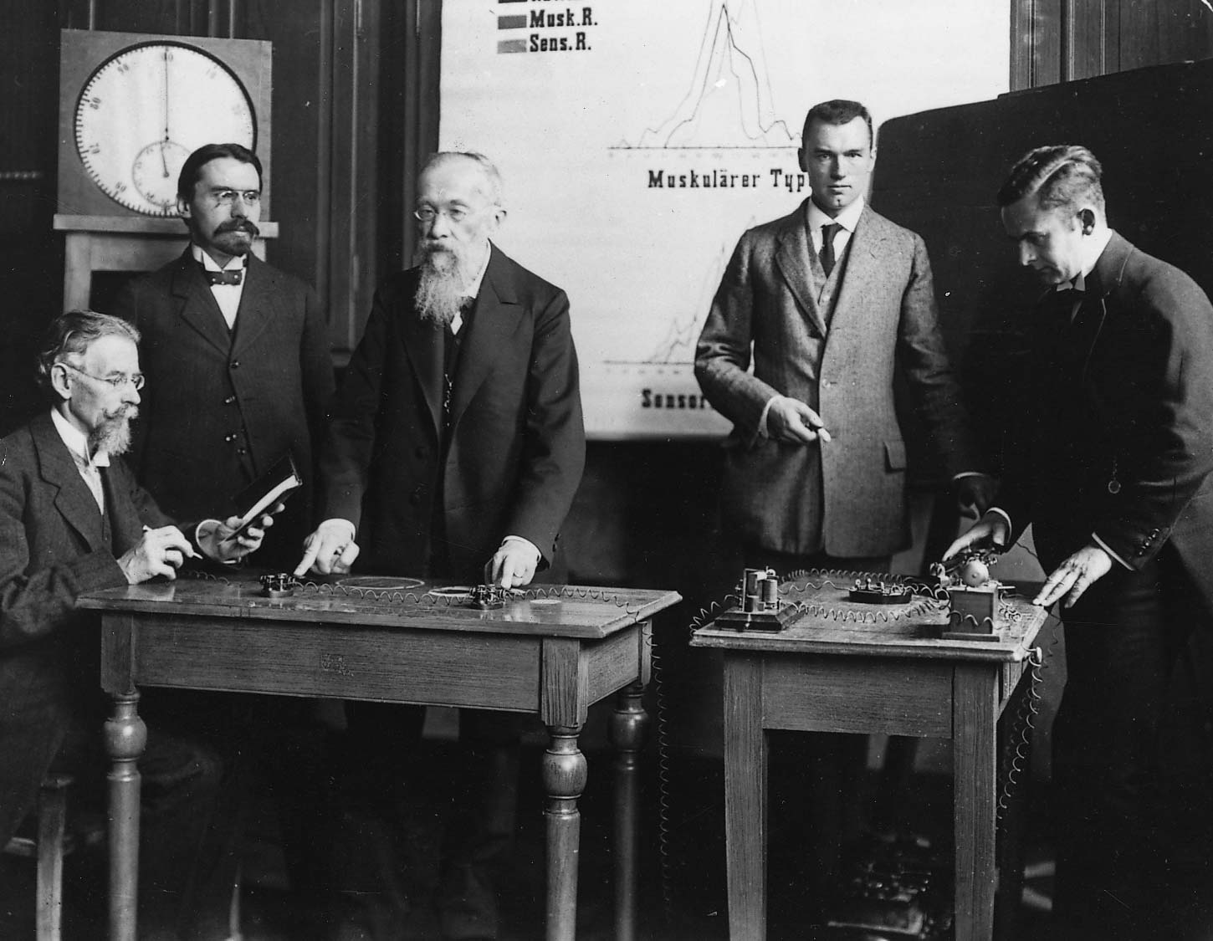
Structuralism
Wilhelm Wundt (Voont) was the first to declare himself a psychologist.
He believed in structuralism.
Wilhelm Wundt 1832-1929

Slide 17
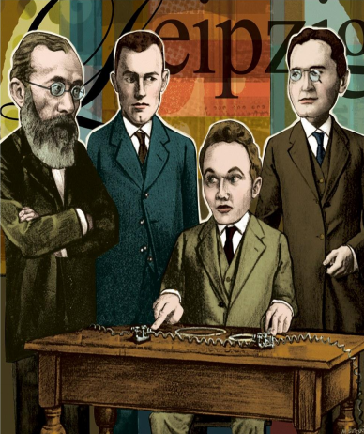
Wilhelm Wundt
(Father of Psychology as a science) opened the first psychology laboratory at the University of Leipzig (c. 1879)

Slide 18
Structuralism: devoted to uncovering the basic structures that make up mind and thought-looking for the elements of conscious experience.
Structuralism relies on introspection, or the process of reporting one’s own conscious mental experiences.
What would be the strengths/weaknesses of introspection?

Slide 19
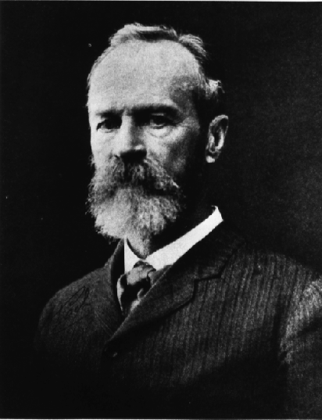
Critics of Wundt and Structuralism
Like most new theories, people began to dispute and refute structuralism.
William James (the first U.S. psychologist) believed that psychology should look at function and not just structure.
William James 1842-1910

Slide 20
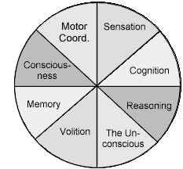
Functionalism- A theory that emphasized the functions of consciousness and the ways consciousness helps people adapt to their environment.
James thought that psychology should explain how people adapted-or failed to adapt-to everyday life outside the laboratory.
The parts of the functionalist view of psychology

Slide 21
James’ Functionalism
James’ criticism of Wundt’s structuralism was that it was boring and inaccurate because it was only done in the laboratory.
James wanted to see how people functioned in everyday life, not just in contrived situations.
Also he believed that mental process were not static. He described them as a “stream of consciousness.”

Slide 22
Gestalt Psychology
Gestalt psychology was the opposite of structuralism. Instead of looking at the individual parts, it wanted to examine the whole.
Gestalt psychology looked at how the brain works by studying perception and perceptual thinking.
Ex. Recognizing a person’s face.

Slide 24
Behaviorism
John B. Watson argued that a true and objective science of psychology should only deal with observable events: stimuli from the environment and the organism’s response to that stimuli.
These psychologists thought of the mind as a black box which could not be opened or understood. Since we could not understand it, we should not try to guess what role it has in our actions.

Slide 25
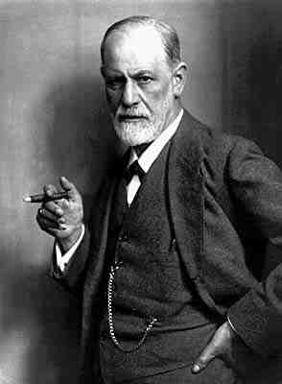
Psychoanalysis
Psychoanalysis is the brainchild of Sigmund Freud and his followers.
Psychoanalysis said that mental disorders resulted from conflicts of the unconscious mind.
Freud thought that behavior came from unconscious drives, conflicts and experience that we may not even have a memory of.
Sigmund Freud 1856-1939

Slide 26
Psychology Today
Psychology today arises from 9 main perspectives:
Biological
Developmental
Cognitive
Psychodynamic
Behavioral
Sociocultural
Evolutionary
Trait views

Slide 27
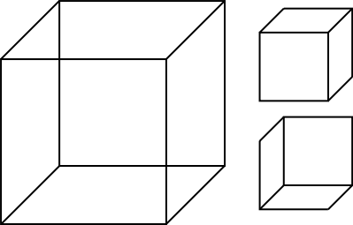
Psychology and Perspectives
The historical perspectives were much easier to identify and explain, as they were cut and dry. The modern perspectives are more convoluted and confusing and all have merit.
Necker Cube: Two key lessons for psychology
Introspection
Multiple Perspectives

Slide 28
Psychology’s Subfields
Basic Research
biological psychologists explore the
links between brain and mind
developmental psychologists study
changing abilities from womb to tomb
cognitive psychologists study how we
perceive, think, and solve problems

Slide 29
Biological View:
The biological view looks at how our physical make up and the operation of our brains influence our personality, preferences, behavior patterns, and abilities.
According to biological view, our behavior is a result of heredity, the nervous system and the endocrine system and environmental impacts (insults) such as disease.

Slide 30
Biological View Continued
Within the biological view is the theory of evolutionary psychology. This theory arises from the ideas of Charles Darwin.
Like Darwin, evolutionary psychologists see behavior and mental processes in terms of their genetic adaptations for survival and reproduction…survival of the fittest.

Slide 31
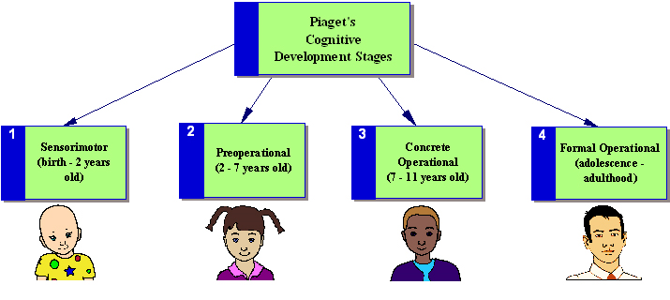
Developmental View
The developmental view emphasizes changes that occur across our lifespan.
This is the question of nature vs. nurture. What has a bigger impact on us, heredity or environment?

Slide 32
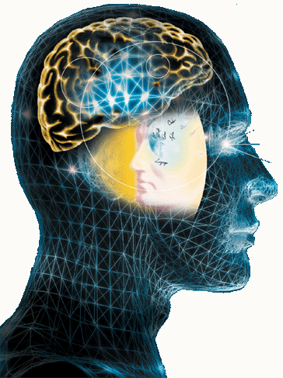
Cognitive View
According to the cognitive view, our actions are a direct result of the way we process information from our environment.
Cognitions are thoughts, expectations, perceptions, memories and states of consciousness.

Slide 33
Cognitive View
Cognitive psychologists are a combination of the best of structuralists, functionalists and gestalt traditions and ideas.
Modern cognitive psychologists have also borrowed theories from linguists and believe that our most basic language skills are prewired into our brains from birth.
L.A.D

Slide 34
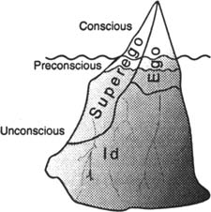
Psychodynamic View
The term psychodynamic comes from the thought that the mind (psyche) is a reservoir of energy (dynamics).
Psychodynamic psychology suggests we are motivated by the energy of irrational desires generated in our unconscious minds.

Slide 35
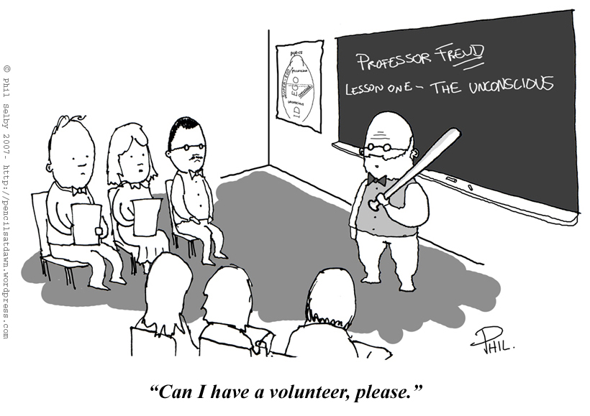
Sigmund Freud
The best known psychodynamic psychologist is Sigmund Freud who said the mind is like a mental boiler which holds the rising pressure of unconscious sexual and destructive desires, along with memories of traumatic events.

Slide 36
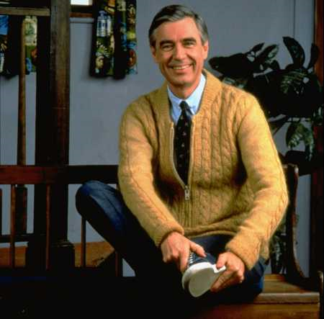
Humanistic Psychology
A viewpoint which emphasizes human ability, growth, potential and free will.
Much like the psychoanalytic perspective, it emphasizes our mental thoughts and process as the root of our behavior.
It, however, emphasizes the positive side of human nature. It has received a lot of criticism because it is not the most “scientific.”

Slide 37
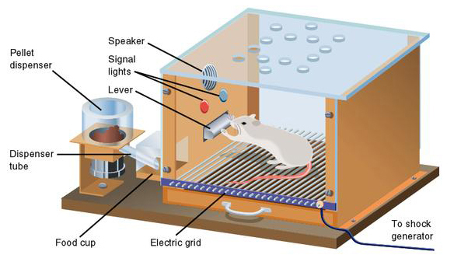
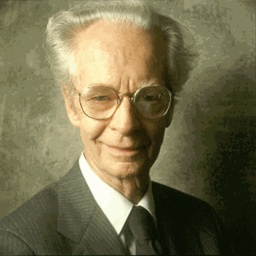
Behavioral View
A viewpoint which finds the source of our actions in the environmental stimuli, rather than in inner mental processes.
B.F. Skinner..rats.
Can you prove that you have a mind?
“The crucial age-old mistake is the belief that…what we feel as behave is the cause of our behaving.”
~B.F. Skinner

Slide 38
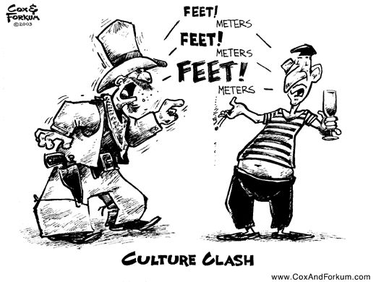
Sociocultural View
This view emphasizes the importance of social interaction, social learning and a cultural perspective.
Culture: a complex blend of beliefs, customs, values and traditions developed by a group of people and shared with others in the same environment.

Slide 39
Psychology’s Blindness
For many years, psychology was blind to the influence of culture on people’s behavior. Why might this be?
One possible explanation is that as recently as 30 years ago, 90% of psychologists were Caucasians from the U.S. and European university systems… groups with strikingly similar cultures.

Slide 40
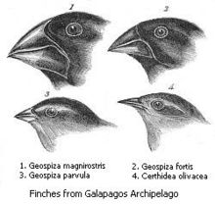
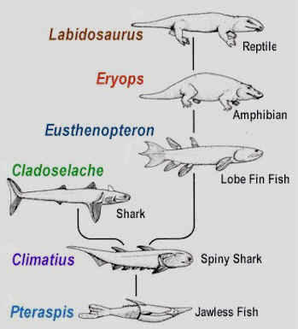
Evolutionary/ Socio-biological
This view of psychology looks at individuals’ behaviors through the lens of natural selection.
Behavior is adaptive and hereditary and cultural!
In this theory, genetics are not used a way to show how people are different, but rather the ways in which we have evolved.

Slide 41
Evolutionary Psychology
Evolutionary psychology is based on the arguments of Charles Darwin and his theories of evolution.
We will discuss Darwin in much more detail later on
Natural selection is the idea that characteristics of a species evolve in the direction of characteristics that give the fittest organisms a competitive advantage.
Controversial, but valid: While evolutionary psychology is valid, strict evolutionists are controversial saying that even the most destructive behaviors grow out of genetic tendencies.

Slide 42
Trait View
A psychological perspective that views behavior and personality as the products of enduring psychological characteristics.
Accordingly, the view says that behavior results from each person’s unique combination of traits.
Ex. Introversion or extroversion vs. mood swings

Slide 43
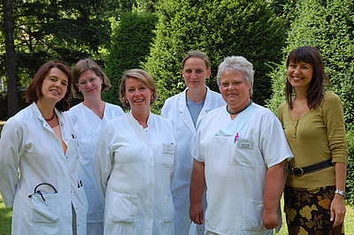
Changes in Psychology
In recent years, biological, cognitive and developmental perspectives have been gaining supporters.
In that time, behaviorism, and psychoanalysts (Freudians) have been losing supporters

Slide 44
What to Study From this Chapter
The table on page 19 (Table 1.1) has all 9 modern perspectives along with an explanation and definition.
The best way to study the 9 perspectives is to make note cards.

