Slide 1
Research Methods Chapter 2
AP Psychology
Holy Heart High School
Ms. C. Fahey
Adapted from:
Trevor Tusow

Slide 2
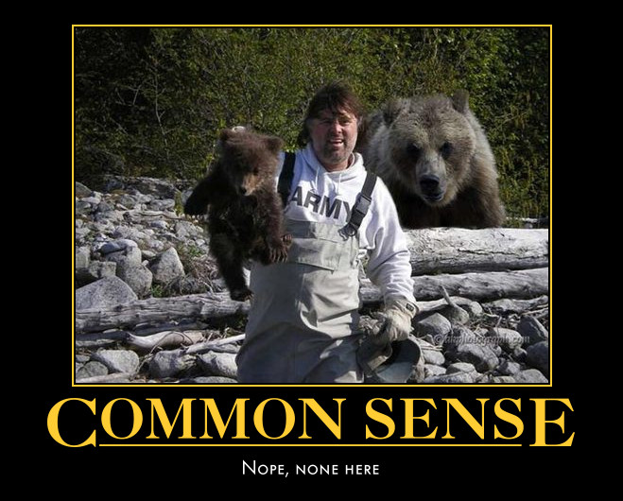
Why do we need research?
Why? Because just asking people how/why they felt and acted the way they did can be misleading.
Common sense isn’t all it is cracked up to be.

Slide 3
A Demonstration
Group B close your eyes.
Group A: Psychologists have found that separation weakens romantic attraction. As the saying goes “out of sight, out of mind.
Write down why this might be the case.

Slide 4
A Demonstration
Group A close your eyes.
Group B: Psychologists have found that separation strengthens romantic attraction. As the saying goes “absence makes the heart grow fonder.”
Write down why this might be the case.

Slide 5
A Demonstration
Find a member of the opposite group. Discuss the question below, being sure to provide evidence.
What impact does separation have on romantic relationships?
When both a supposed finding and its opposite seem like common sense, we have a problem.

Slide 6
Hindsight Bias
The problem we have is hindsight bias, or the feeling that because something has already happened, it is inevitable.
I-knew-it-all-along phenomenon

Slide 7
Another Demonstration…
Consider these three anagrams:
WREAT → WATER
ETRYN → ENTRY
GRABE → BARGE
How many seconds do you think it would take you to unscramble each of these?
OCHSA →

Slide 8
What’s the point?
Hindsight bias and overconfidence often lead us to overestimate our intuition (common sense). Scientific inquiry can help us move from illusion back to fact.

Slide 9
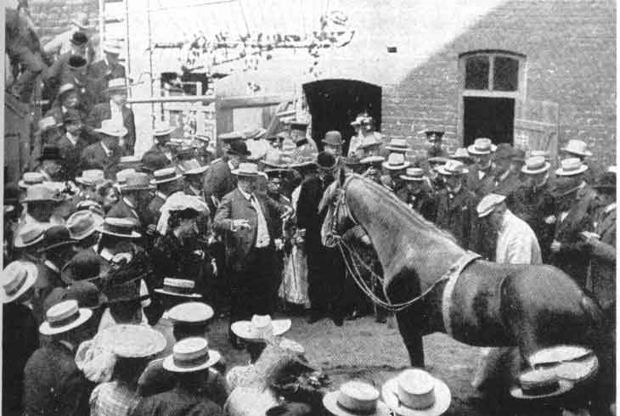
Clever Hans
Clever Hans the horse could do simple math and spell out the answers to simple questions. He wasn’t always correct, but he was most of the time.
While a team of scientists, veterinarians, zoologists and circus trainers could not figure out how Hans was correctly answer the questions, Oskar Pfungst, a psychologist did. What did he discover?

Slide 10
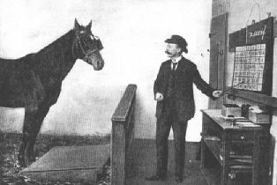
Hans’ Secret
While Hans could not do math or correctly answer questions on his own, he was very perceptive.
Hans was picking up on subtle body language given off by his owner who asked the questions.
When the owner was hidden from view, suddenly Hans could not answer the questions correctly.
How does this story relate to methodology?

Slide 11
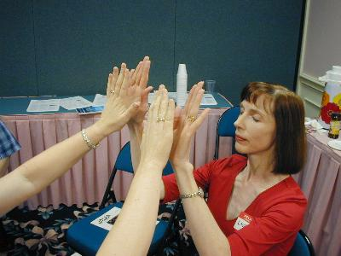
Emily Rosa
Emily Rosa was a 4th grader in Colorado in 1998. She entered a science competition with an experiment that challenged the legitimacy of therapeutic touch (TT).
We will use Rosa’s
experiment to look at
scientific method.

Slide 12
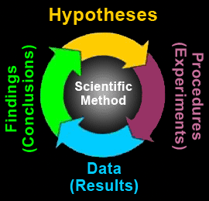
Scientific Method/Empirical Approach
The scientific method and empirical approach are 5 step processes for empirical investigation of a hypothesis, under conditions designed to control biases and subjective judgments.
Empirical investigation is the collecting of objective information, firsthand, by making careful measurements based on direct experience.

Slide 13
Psychology's Main Goal
The goal of psychology is to develop explanations for behavior and mental processes…explain why we do what we do.
A scientific theory is an explanation based on integrated principles that organizes observations and predicts behaviors or events.
Theory in everyday language is different than in science
A good theory simplifies and summarizes facts.
Too many facts about behavior to remember them all.
A good theory produces testable predictions called hypotheses

Slide 14
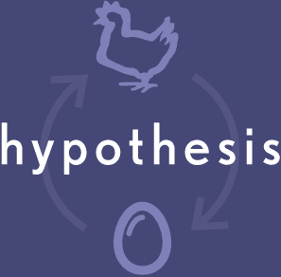
The 5 Steps of Scientific Method
1. Developing a Hypothesis:
Hypothesis: A statement predicting the outcome of a scientific study or describing the relationship among variables in a study.
A hypothesis literally means a little theory.

Slide 15
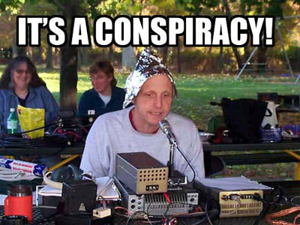
The 5 Steps of Scientific Method
All hypotheses must be testable and falsifiable, or shown to be either supported or incorrect.
Falsifiability is the possibility that an assertion can be shown false by an observation or experiment. That something is "falsifiable" does not mean it is false; rather, that if it is false, then this can be shown by observation or experiment.
A theory cannot be considered scientific if it does not admit the possibility of being shown false.

Slide 16
Falsifiable Revisited
Falsifiability or refutability is the logical possibility that an claim can be contradicted by an observation or the outcome of a physical experiment.
It means that if it is false, some observation or experiment will produce a reproducible result that is in conflict with it.
For example , "all men are mortal" is unfalsifiable: even if someone is observed who has not died so far, he could still die in the next instant. By contrast, "all men are immortal," is falsifiable by the presentation of just one dead man.
Immortal?

Slide 17
Operational Definition
All good hypotheses need an operational definition.
An operational definition is a specific description of the concepts involving the conditions of the scientific study.
Operational definitions are stated in terms of how the concepts are to be measured and what operations are being employed to produce them.
They are intended to eliminate bias.

Slide 18
Rosa and Pfungst’s Hypotheses
Rosa: If a TTP cannot see the which of their hands I am hovering over, they will not be able to identify the presence of my hand at any higher rate than 50%.
Hans: If Clever Hans cannot see his trainer, he will not be able to successfully do math or spell.

Slide 19
Performing a Controlled Test
2. Performing a controlled test: A hypothesis must undergo rigorous tests before it will be accepted as a legitimate theory.
To make a test controlled, one must account for the independent variable.
Independent Variable: A stimulus condition that the experimenter changes independently of all other carefully controlled conditions in the experiment.

Slide 20
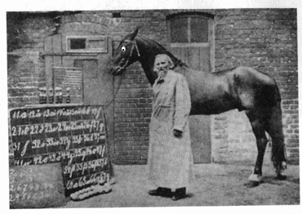
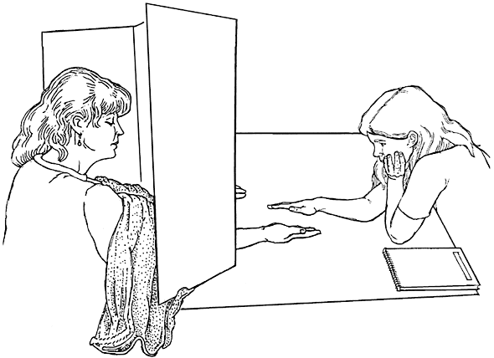
Independent Variable
In Rosa’s experiment, she tested 21 TT practitioners to see if they could sense which of their two hands was closest to her hand when they could not see it.
To do this, she made a cardboard screen with two holes in the bottom. The practitioners would put their hands through, palms up. Rosa would hold her hand, palm down a few inches from either of the practitioner’s hands.

Slide 21
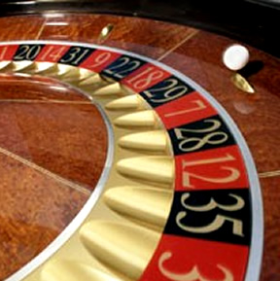
Eliminating Patterns
For both Rosa and Hans’ experiments, the presence of patterns in the experiment could have jeopardized the findings. To eliminate this Rosa and Pfungst used random presentation.
Random presentation is a process by which chance alone determines the order in which the stimulus is presented.

Slide 22
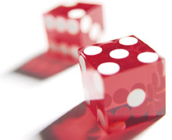
Randomization
In Rosa’s experiment, randomization was achieved by a coin flip to determine whether she put her hand above the practitioner’s left or right hand.
In the Hans experiment, Pfungst made sure to ask math questions with random answers in which there were no predictable patterns (answers of 2,4,6…).

Slide 23
Gathering Objective Data
3. Gathering objective data: getting information by direct observation that relies only on the independent variable and not on the experimenter’s hopes. This data is called the dependent variable.
Dependent Variable: The measured outcome of a study, or the response of the subjects in the study.

Slide 24
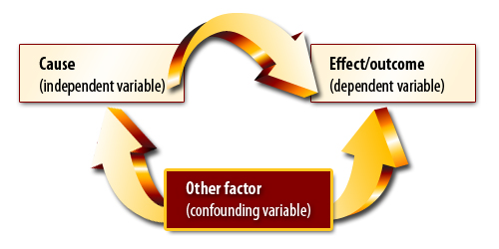
Confounding Variables
Confounding Variables: Variables that have unwanted influence on the outcome of an experiment.
Or, other possible explanations for the dependent variable (result).

Slide 25
Rosa and Hans
For Rosa’s dependent variable, she recorded whether the TT practitioner said “left” or “right,” and whether or not that was correct.
For Pfungst’s study of Hans, the DV was simply the horse’s hoof-taping in response to each question asked, making sure to keep track of the number of correct answers given.

Slide 26
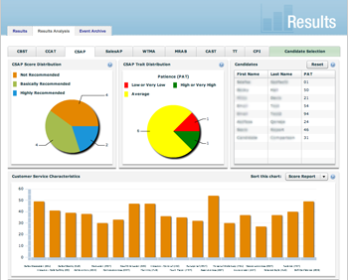
Analyzing the Results: Accepting or Rejecting the Hypothesis
4. Analyzing the results: This step consists of looking at the data collected and seeing if it supports or disproves the hypothesis.
We will briefly discuss stats next class, but it is not a major part of our psychology class. No worries, this is not a math class.

Slide 27
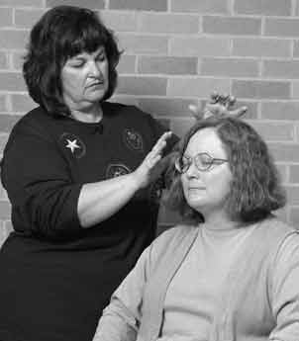
Rosa’s Analysis
In Rosa’s experiment, the analysis was pretty clear. By design, there was a 50% chance a practitioner could guess correctly. So in order to disprove her hypothesis, they would have to answer correctly significantly more than 50% of the time…they did not.
She concluded that TT practitioners could not detect the “human energy field.”

Slide 28
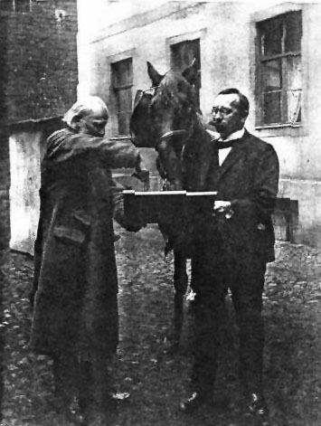
Pfungst’s Analysis
For Han’s the chance level of simply guessing the correct response was near zero, so any consistent level of correct responses would support the hypothesis that Hans could do math.
That hypothesis was rejected, however, as Hans was unable to correctly answer any questions in the absence of his owner.

Slide 29
Publishing, Criticizing and Replicating the Results
5. Publishing, criticizing and replicating the results: The last step of the scientific method is to have the results withstand the criticism and scrutiny of the science community.
Critics check each others’ work by replicating the study, sometimes under slightly different circumstances to see if the same results can be duplicated.
Replicate: To do a study over to see if the same results are obtained. To control for bias, the replication is most often done by someone other than the original researcher.

Slide 30
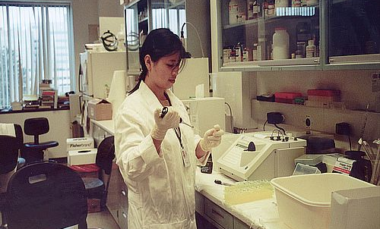
Methods of Research
Experimental Method: A kind of research in which the researcher controls and manipulates the conditions including the IV.
Experiments seek to isolate cause and effect.
Experimental method must account for independent variables, dependent variables and confounding or extraneous variables.
No single experiment is conclusive

Slide 31
The Challenges of Experiments
There are many challenges with conducting experiments. First one has to make sure that all groups being tested have the same conditions. This is called control.
Controls are used to eliminate confounding variables.

Slide 32
Representative Sample
Second, for an experiment to be valid, one has to make sure the subjects are drawn from a population which consists of everyone who fits the description of your test group. This is called a representative sample.
Does the group you are testing resemble the group you are drawing conclusions about?

Slide 33
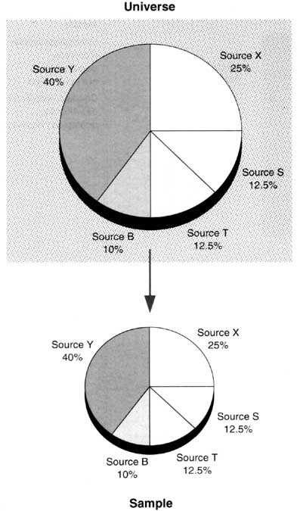
Representative Sample
Representative Sample: A sample obtained in such a way that it reflects the distribution of important variables in the larger population in which the researcher are interested-variables such as age, ethnicity, education….

Slide 34
Random Assignment
Third, once a population has been randomly selected for participation, we must put them into participant groups: Control group and experiment group.
Like selection for the experiment, placement into groups should be done randomly, meaning that each participant has an equal likelihood to be in either the control or the experiment group.
Why would random assignment be important?

Slide 35
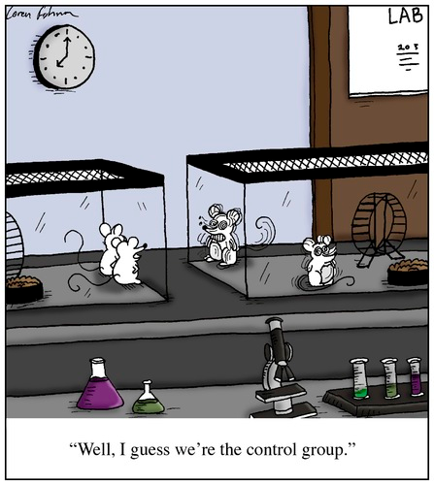
Control Group vs. Experiment Group
Control group: the group that is NOT exposed to the treatment.
Experiment group: the group in the experiment that IS exposed to the treatment.

Slide 36
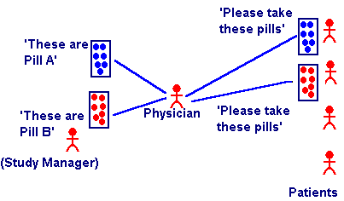
Increasing Reliability
Double Blind Study: An experiment where both the subject and the person administering the experiment do not know the nature of the independent variable being administered.

Slide 37
Experiment Check List
Experiments start with a testable prediction: hypotheses
Experiments aim to manipulate an IV
Experiments measure the DV
Experiments have at least two groups:
control and experimental
Experiments test the effect of the IV on the DV
Representative sampling is a must
Random selection is a must
Random assignment is a must

Slide 38
Non-Experiment Designs/ Quasi Experiments
Sometimes we are unable to do experiments for ethical or practical reasons. In this case we must do another kind of research.
-Ex post facto: Research in which we choose subjects based on a pre-existing condition.
-Ex: Cancer research.

Slide 39
Case Studies
Case studies are observational techniques that study one person/group in depth with the hope of revealing universal principles.
Case studies often suggest further directions for studies, but can be misleading if the person being studied is atypical.
Numbers can be numbing, but the plural of anecdote isn’t evidence…just because we get some facts, we cannot necessarily generalize.

Slide 40
Naturalistic Observation
Naturalistic observations are a method where subjects are observed in their natural environment.
Like all case studies, naturalistic observations do not explain behavior, they describe behavior.
Why would it be important for subjects to not know they are being observed?

Slide 41
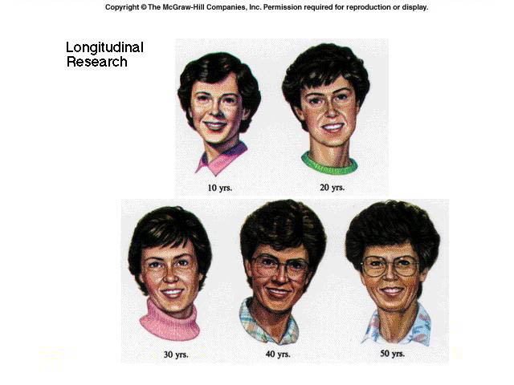
Longitudinal Study
In a longitudinal study, one group or subject is studied for an extended period of time to observe changes in the long term.
+ Same subjects for the entire study
- Time and expense

Slide 42
Cross-Sectional Studies and Cohort-Sequential Studies
These studies are designed to cut down on time and expense.
Cross-sectional studies look at a cross section of the population and studies them at one point in time.
Ex: No child left behind
Cohort-sequential studies look at a cross section of population and then studies them over a short period of time.

Slide 43
Correlation Studies
A correlation study is one where researchers try to show the relationship (or correlation) between two variables.
Correlation studies are largely based in statistics.
It is important to remember that correlation does not necessarily mean causation.

Slide 44
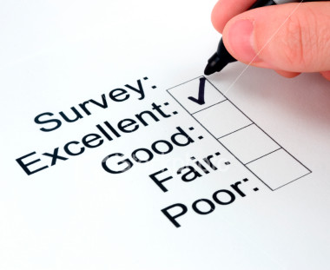
Surveys
A survey is a research technique using self reported attitudes or behaviors of a specific group
Usually by asking questions a random representative of the group.
What are some dangers of using a survey?

Slide 45
False Consensus
tendency to overestimate the extent to which others share our beliefs and behaviors

Slide 46
Surveys and Wording
Even subtle changes in the order or wording of questions can have a huge impact on results.
some words may seem to have only a subtle difference in their meaning but may drastically alter a person’s response to the question.
“not allowing” vs. “forbidden”
“aid to the needy” vs. “welfare”
“affirmative action” vs. “preferential treatment”
“revenue enhancers” vs. “taxes”

Slide 47
Remember...
Population
all the cases in a group, from which samples may be drawn for a study
Random Sample
a sample that fairly represents a population because each member has an equal chance of inclusion

Slide 48
Also...
Sampling technique is crucial to a good survey.
Population: All individuals that we are interested in drawing a conclusion about
Random sampling
Representative sample: Reflects important aspects of the population

Slide 50
Ethics in Research
Each university or group doing research must have an Institutional Review Board which is responsible for making sure research is preformed in an ethical manner.
The APA says deception is to be avoided whenever possible. However, when deception must be used, the subjects are to be debriefed as soon as possible after the study.

Slide 51
Using Data for Analysis
Frequency Distribution: A summary chart which shows how frequently each of the various scores in a set of data occur.
Battery life, minutes | Frequency (f) | Relative frequency | Percent frequency
360–369 | 2 | 0.07 | 7
370–379 | 3 | 0.10 | 10
380–389 | 5 | 0.17 | 17
390–399 | 7 | 0.23 | 23
400–409 | 5 | 0.17 | 17
410–419 | 4 | 0.13 | 13
420–429 | 3 | 0.10 | 10
430–439 | 1 | 0.03 | 3
Table: Life of AA batteries, in minutes

Slide 52
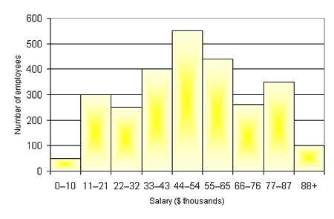
Using Data for Analysis
Histogram: A bar graph depicting a frequency distribution. The height of the bars indicates the frequency of a group of scores.

Slide 53
Mean, Median, Mode
Mean (average): The measure of central tendency most often used to describe a set of data.
To calculate mean, simply add all the scores and divide by the number of scores.
While the mean is easy to calculate, it has a big downside. It can easily be influenced by extreme scores.

Slide 54
Mean, Median, Mode
Median: A measure of central tendency represented by the score that separates the upper half of the scores in a distribution from the lower half.
The big advantage of this is the median is not effected by extreme scores.
Mode: A measure of central tendency which represents the score that occurs most often.

Slide 56
Mean, Median, Mode
The weekly salaries of six employees at McDonalds are $140, $220, $90, $180, $140, $200.
For these six salaries, find:
(a) the mean
(b) the median
(c) the mode

Slide 57
Mean, Median, Mode
Answers
Mean: 90+ 140+ 140+ 180 + 200 + 220 =$ 161.67
6
Median: 90,140,140,180,200,220
The two numbers that fall in the middle need to be averaged.
140 + 180 = $160
2
Mode: 90,140,140,180,200,220
The number that appears the most is $140

Slide 58
Statistical Reasoning
Range
the difference between the highest and lowest scores in a distribution
Standard Deviation
a computed measure of how much scores vary around the mean
Statistical Significance
a statistical statement of how likely it is that an obtained result occurred by chance

Slide 59
Standard Deviation
Standard Deviation (SD): A measure of variability that indicates the average distance between the scores and their mean.
A low standard deviation indicates that the data points tend to be very close to the mean, whereas high standard deviation indicates that the data are spread out over a large range of values.

Slide 60
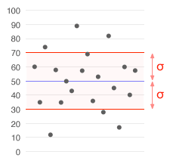
Normal Distribution
The standard deviation and mean together tell us a lot about the distribution of scores.
MEAN=50
SD=20
A data set with a mean of 50 (shown in blue) and a standard deviation of 20.

Slide 61
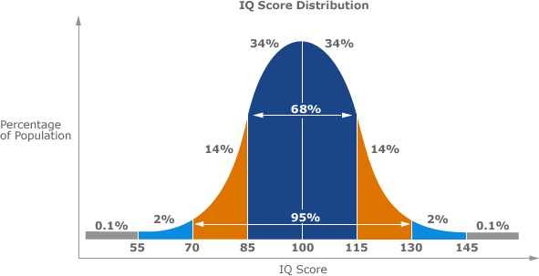
Normal Distribution
A normal distribution is a bell shaped curve.
A standard deviation of 15 accounts for about 68% of responses.

Slide 62
Skewed Distribution
A distribution is skewed if one of its tails is longer than the other.
The first distribution shown has a positive skew. This means that it has a long tail in the positive direction.
The second distribution has a negative skew since it has a long tail in the negative direction.
Finally, the third distribution is symmetric and has no skew (normal distribution).

Slide 63
A Skewed Distribution
Are the results positively or negatively skewed?

Slide 64
Correlation: Negative and Positive
Correlation: A relationship between two variables in which changes in one variable are reflected in the changes in the other variable.
Correlation Coefficient: A number between –1 and +1 expressing the degree of relationship between two variables.

Slide 65
Correlation
Measure associations between naturally occurring events or variables
X Y
monetary wealth happiness

Slide 67
Positive correlations
Indicate a direct relationship where factors increase or decrease together.
E.g. There is a positive correlation between the amount of television violence that a child watches and the amount of aggressive activity that they display (as one increases, the other increases);
E.g. A marked decrease in the amount of sleep one gets per night is positively correlated with decreased alertness and a decrease in their ability to perform on moderately difficult tasks (as one decreases, the other decreases).

Slide 69
Negative Correlation
Indicates an inverse relationship where one factor goes up while one goes down.
E.g. Increase the dosage of a certain painkiller and there is a decrease in pain symptoms.

Slide 71
Scatterplot
a graphed cluster of dots, each of which represents the values of two variables
the slope of the points suggests the direction of the relationship
the amount of scatter suggests the strength of the correlation
little scatter indicates high correlation
also called a scattergram or scatter diagram

Slide 72
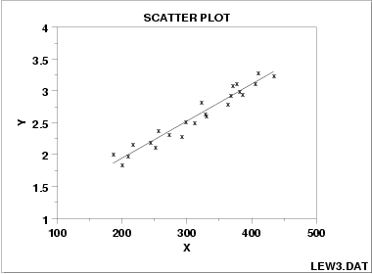
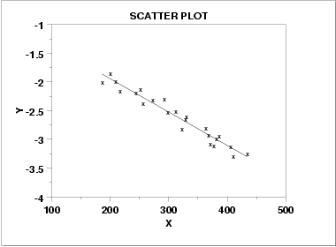
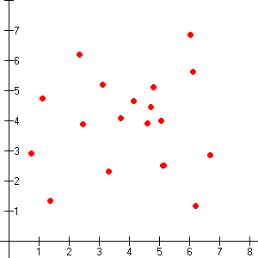
Comparing Correlation Coefficients
If the correlation coefficient is a positive number, there is a positive correlation (connection) between the variables.
Height and weight-the taller a person is, usually means they weigh more too
If the correlation coefficient is a negative number, there is a negative correlation (connection) between variables.
Education and years in jail—people who have more years of education tend to have fewer years in jail
If the correlation coefficient is 0, there is no correlation between variables.
Positive Correlation
Negative Correlation
No Correlation

Slide 73
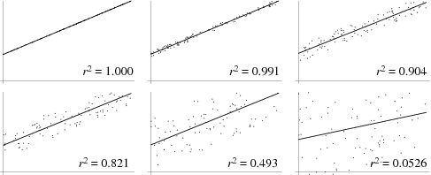
Positive Correlation Coefficients
Positive correlation coefficients indicate a stronger connection as they get closer to 1.

Slide 76
Correlation
NOTE: Correlation does not explain cause;
it simply shows a relationship (or not) between factors.
In order to isolate the cause we must carry out controlled experiments.

Slide 77
Correlation Practice
For each studies below, identify if there is a positive or negative correlation:
The more young children watch TV, the less they read (Kaiser, 2002)
The more sexual content sees on TV, the more likely they are to have sex (Collins et al. 2004)
The longer children are breast-fed, the greater their later academic achievements (Horwood & Ferguson. 1998)
The more often adolescents eat breakfast, the lower their body mass (Timlin et al. 2008)
Answers: negative, positive, positive, negative

Slide 78
Illusory Correlation
Correlation coefficients are important because they allow us to see relationships between variables and prevent us from “seeing” relationships that do not exist.
An illusory correlation is when believe there is a relationship between two things, we are likely to notice and recall instances that confirm our belief.
Ex. getting chilled wet causes people to “catch a cold”

Slide 79
Comparing Research Methods

Slide 80
Frequently Asked Questions about Psychology
Can laboratory experiments illuminate everyday life?
By intentionally creating a controlled, artificial environment in the lab, researchers aim to test theoretical principles. These principles help us to understand, describe, explain, and predict everyday behaviors.

Slide 81
Frequently Asked Questions about Psychology
Does behavior depend on one’s culture?
Culture—the enduring behaviors, ideas, attitudes, and traditions shared by a large group of people and transmitted from one generation to the next
Attitudes and behaviors do vary across cultures, but the principles that underlie them vary much less. Cross-cultural psychology explores both our cultural differences and the universal similarities that define our human kinship.

Slide 82
Frequently Asked Questions about Psychology
Does behavior vary with gender?
Gender is a basic fact of life. Although gender differences tend to capture attention, it is important to remember our greater gender similarities.

Slide 83
Frequently Asked Questions about Psychology
Why do psychologists study animals?
Some psychologists study animals out of an interest in animal behavior. Others do so because knowledge of the physiological and psychological processes of animals gives them a better understanding of the similar processes operating in humans.

Slide 84
Frequently Asked Questions about Psychology
Is it ethical to experiment on animals?
Only about 7 percent of all psychological experiments involve animals, and under ethical and legal guidelines these animals rarely experience pain. Nevertheless, animal rights groups raise an important issue: Even if it leads to the relief of human suffering, is an animal’s temporary suffering justified?

Slide 85
Frequently Asked Questions about Psychology
Is it ethical to experiment on people?
Occasionally researchers temporarily stress or deceive people in order to learn something important. Professional ethical standards provide guidelines concerning the treatment of both human and animal participants.

