Slide 1
Module 10: Drugs and Consciousness
Psychoactive Drug
A chemical substance that alters perceptions and mood
Physical Dependence
Physiological need for a drug
Marked by unpleasant withdrawal symptoms
Psychological Dependence
A psychological need to use a drug
For example, to relieve negative emotions

Slide 2
Dependence and Addiction
Big
effect
Tolerance
Diminishing effect with regular use
The body begins to stop producing these chemicals naturally
Withdrawal
Discomfort and distress that follow discontinued use
Drug
effect
Response to
first exposure
After repeated
exposure, more
drug is needed
to produce
same effect
Little
effect
Small
Large
Drug dose

Slide 3
Psychoactive Drugs
Depressants
Drugs that reduce neural activity
Slow body functions
alcohol, barbiturates, opiates
Alcohol -Decreases neural dopamine levels
Stimulants
Drugs that excite neural activity
Speed up body functions
caffeine, nicotine, amphetamines, cocaine
Hallucinogens
Psychedelic (mind-manifesting) drugs that distort perceptions and evoke sensory images in the absence of sensory input
LSD

Slide 4
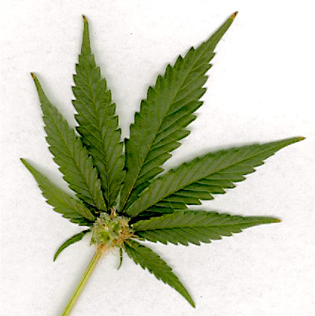
Effects of Drugs
Research tells us that the effects of drugs depends not just on its biological effects, but also on the psychology of the user’s expectations (Ward, 1994).
If one culture assumes that a particular drug produces euphoria and another does not, each culture may find its expectations fulfilled.
Marijuana seems to be a good example of this, and is currently at the center of national debates as to its value/danger.

Slide 5
Psychoactive Drugs-Depressants
Barbiturates
Drugs that depress the activity of the central nervous system, reducing anxiety but impairing memory and judgment
Opiates
Opium and its derivatives (morphine and heroin)
Opiates depress neural activity, temporarily lessening pain and anxiety

Slide 6
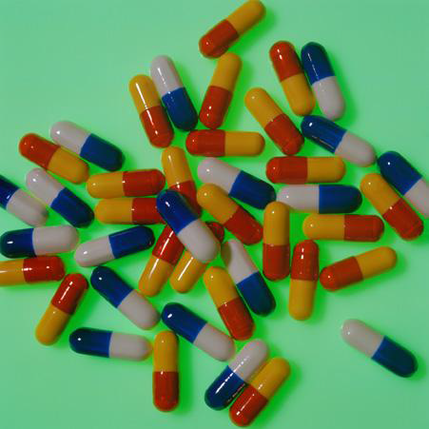
Barbiturates
Barbiturates are tranquilizers--drugs that depress central nervous system activity.
Examples: Nembutal, Seconal, Amytal
Effects: reducing anxiety and inducing sleep
Problems: reducing memory, judgment, and concentration; can lead to death if combined with alcohol

Slide 7
Psychoactive Drugs-Depressants
Narcotics
derived from opium plant
Alcohol
Opiates
- opium and its derivatives (morphine and heroin)
- opiates depress neural activity, temporarily lessening pain and anxiety
Ex. Oxycodone (oxycontin)

Slide 8
Opiates: Highly Addictive Depressants
Opiates depress nervous system activity; this reduces anxiety, and especially reduces pain.
High doses of opiates produce euphoria.
Opiates work at receptor sites for the body’s natural pain reducers (endorphins).
Opiates are chemicals such as morphine and heroin that are made from the opium poppy.

Slide 9
Effects of Alcohol Use
Impact on functioning
Slow neural processing, reduced sympathetic nervous system activity, and slower thought and physical reaction
Reduced memory formation caused by disrupted REM sleep and reduced synapse formation
Impaired self-control, impaired judgment, self-monitoring, and inhibition; increased accidents and aggression

Slide 10
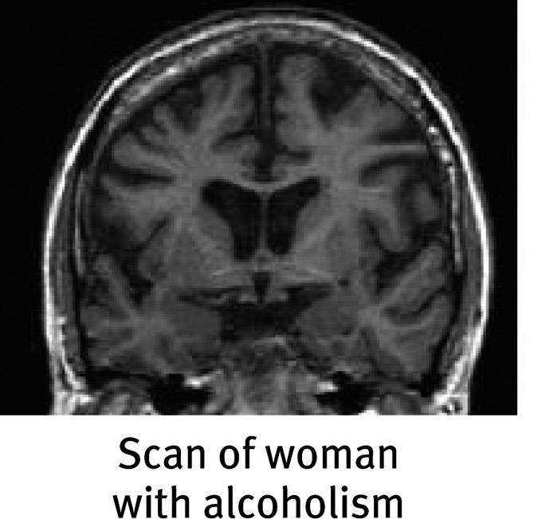
Effects of Alcohol Use

Slide 12
Psychoactive Drugs-Stimulants
Amphetamines (Stimulants)
Drugs that stimulate neural activity, causing speeded-up body functions (body temperature and heart rate) and associated energy and mood changes
Results in short term energy and euphoria
Originally diet drugs
Stimulate both
-Dopamine(pleasure system of the brain),
-Norepinephrine("flight or fight“)
Eventually reduces baseline dopamine level, leaving user permanently depressed
Ex: Cocaine

Slide 13
Caffeine
adds energy
disrupts sleep for 3-4 hours
Accelerates heart rate
- Constricts blood vessels
- Reduces adenosine
can lead to withdrawal symptoms: if used daily:
headaches
irritability
fatigue
difficulty concentrating
depression

Slide 15
Why do people smoke?
Starting to smoke: invited by peers, influenced by culture and media
Continuing: positively reinforced by physically stimulating effects
Not stopping: after regular use,
smokers have difficulty
stopping because of
withdrawal symptoms
such as insomnia,
anxiety, and distractibility

Slide 17
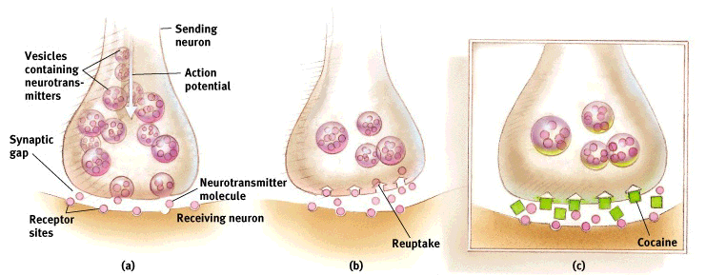
Cocaine Euphoria and Crash
Neurotransmitters carry a message from a sending neuron across a synapse to receptor sites on a receiving neuron
The sending neuron reabsorbs the excess neurotransmitters molecules, a process called reuptake
By binding to the sites that normally reabsorb neurotransmitters, cocaine blocks the reuptake of dopamine norepinephrine, and serotonin. The extra neurotransmitters therefore remain in the synapse, intensifying their normal mood.

Slide 18
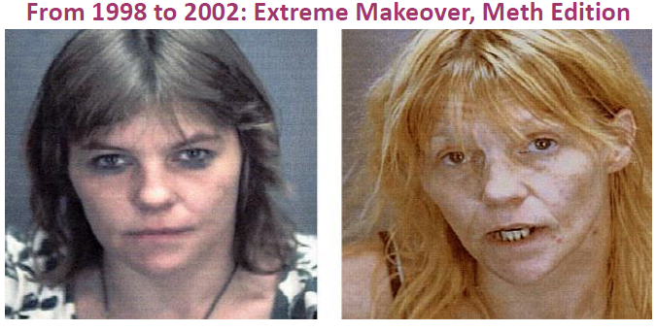
Methamphetamine
Methamphetamine triggers the sustained release of dopamine, sometimes leading to eight hours of euphoria and energy.
What happens next: irritability, insomnia, seizures, hypertension, violence, depression
“Meth” addiction can become all-consuming.

Slide 19
Psychoactive Drugs-Hallucinogens
Ecstasy (MDMA)
Synthetic stimulant and mild hallucinogen
Both short-term and long-term health risks
LSD
Lysergic acid diethylamide
A powerful hallucinogenic drug
Also known as acid
THC
The major active ingredient in marijuana
Triggers a variety of effects, including mild hallucinations

Slide 20
Ecstasy/MDMA (MethyleneDioxyMethAmphetamine)
Ecstasy is a synthetic stimulant that increases dopamine and greatly increases serotonin.
Effects on consciousness: euphoria, CNS stimulation, hallucinations, and artificial feeling of social connectedness and intimacy
What Happens Next?
In the short run, regretted behavior, dehydration, overheating, and high blood pressure.
Make it past that, and you might have:
damaged serotonin-producing neurons, causing permanently depressed mood
disrupted sleep and circadian rhythm
impaired memory and slowed thinking
suppressed immune system

Slide 22
Hallucinogens - LSD
LSD (lysergic acid diethylamide)
LSD and similar drugs interfere with serotonin transmission.
This causes hallucinations--images and other “sensations” that didn’t come in through the senses.

Slide 23
Hallucinogens- Marijuana/THC
Marijuana/THC (delta-9-TetraHydroCannabinol)
Marijuana binds with brain cannabinoid receptors.
Effect on consciousness:
- amplifies sensations
- disinhibits impulses
- euphoric mood
- lack of ability to sense satiety
What Happens Next?
Impaired motor coordination, perceptual ability, and reaction time
THC accumulates in the body, increasing the effects of next use
Over time, the brain shrinks in areas processing memory and emotion
Smoke inhalation damage

Slide 24
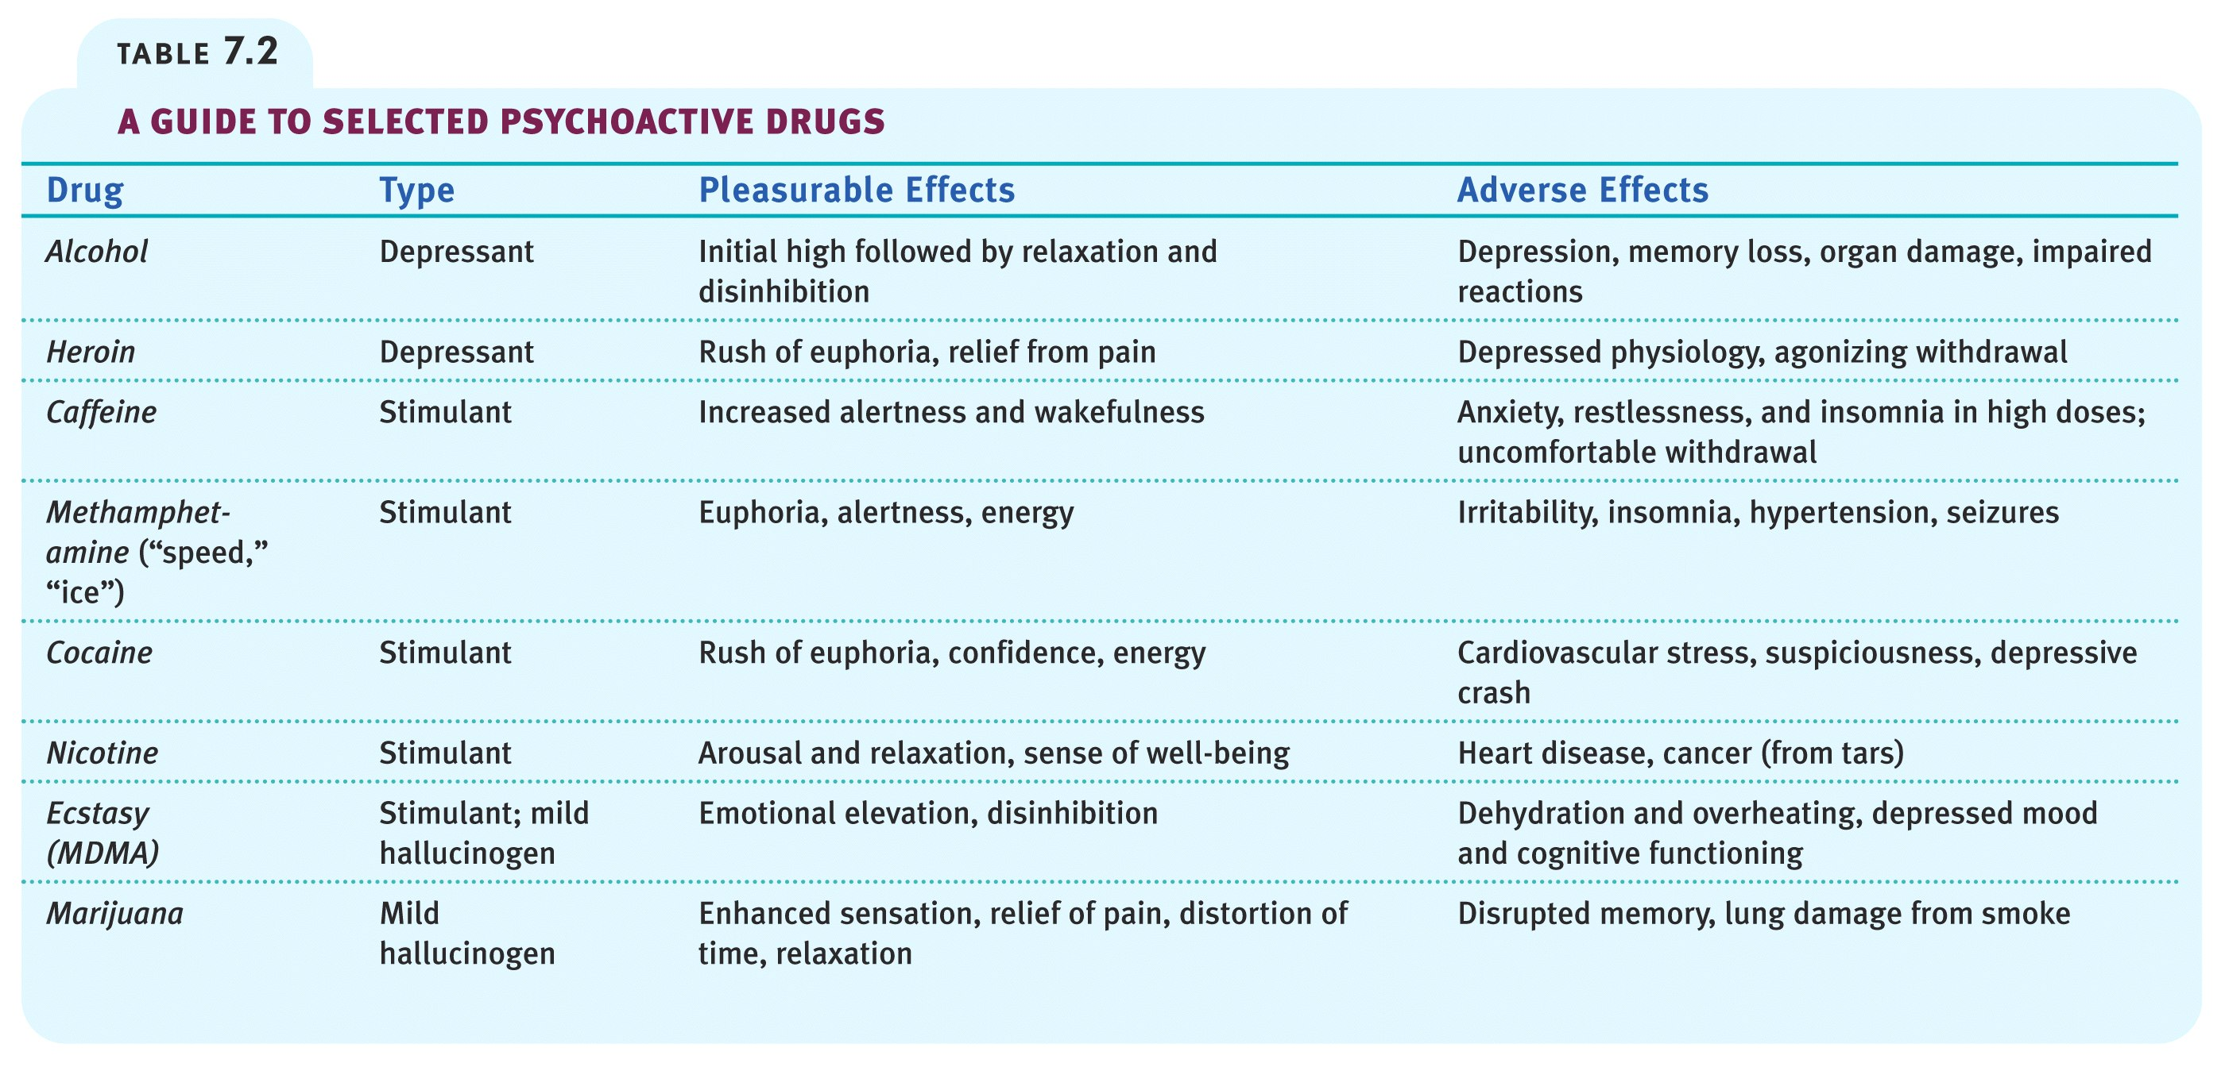
Psychoactive Drugs

Slide 26
Dependence on a substance (or activity?)
Tolerance: the need to use more to receive the desired effect
Withdrawal: the distress experienced when the “high” subsides
Using more than intended
Persistent, failed attempts to regulate use
Much time spent preoccupied with the substance, obtaining it, and recovering
Important activities reduced because of use
Continued use despite aversive consequences

Slide 27
What can turn drug use into dependence?
Biological factors: dependence in relatives, thrill-seeking in childhood, genes related to alcohol sensitivity and dependence, and easily disrupted dopamine reward system
Psychological factors: seeking gratification, depression, problems forming identity, problems assessing risks and costs
Social influences: media glorification, observing peers

Slide 28
Trends in Drug Use
80%
70
60
50
40
30
20
10
0
High school
seniors
reporting
drug use
Alcohol
Marijuana/
hashish
Cocaine
1975 ‘77 ‘79 ‘81 ‘83 ‘85 ‘87 ‘89 ‘91 ‘93 ‘95 ‘97 ‘99
Year

Slide 29
Perceived Marijuana Risk
100%
90
80
70
60
50
40
30
20
10
0
Perceived “great risk of
harm” in marijuana use
Percent of
twelfth
graders
Used marijuana
‘75 ‘77 ‘79 ‘81 ‘83 ‘85 ‘87 ‘89 ‘91 ‘93 ‘95 ‘97 ‘99
Year

