Slide 1
Consciousness and the Two-Track Mind Modules 7-10
AP Psychology
Ms. C. Fahey

Slide 2
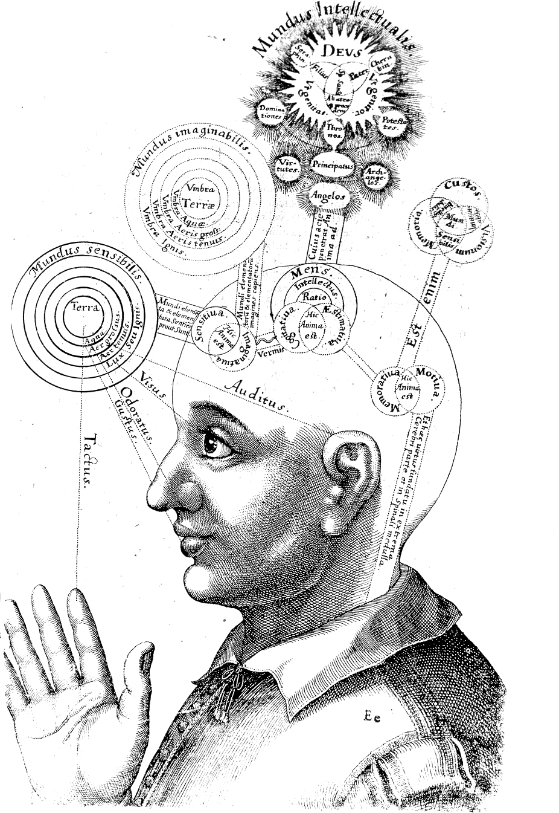
Module 7: The Brain & Consciousness
Consciousness: The process underlying the mental model we create of the world of which we are aware.
It is also a part of the mind from which we can potentially retrieve a fact, an idea, an emotion, or a memory and combine it with critical thinking.
Can you make an argument that you are who/what your consciousness allows?

Slide 3
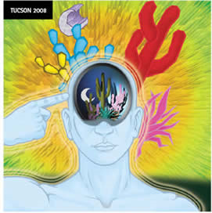
The Big Challenge
In psychology, the big challenge presented by consciousness is that it is so subjective and illusive.
How do we prove that we have consciousness?

Slide 4
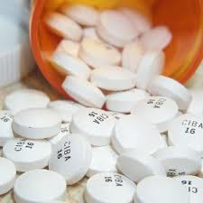
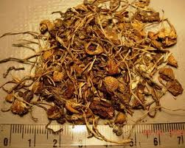
The Mind Returns
In the 1960s, psychologists began to question the behaviorist model for two reasons.
First, there were psychological issues which needed better explanation than behaviorism could offer.
Quirks of memory, perceptual illusions, drug induced states (very popular in the 1960s)

Slide 5
Competing Views (review of CH 1)
Structuralists used introspection (self-reporting) to find the boundaries of conscious thought.
Behaviorists, like John Watson, sought to take the mind out of psychology. After all, he argued, there is no real way to see inside of it.
As a result, psychology became a science of behavior without a consciousness or a mind.

Slide 6
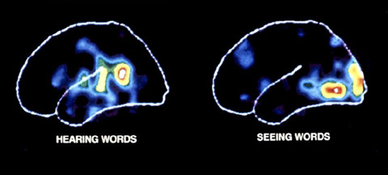
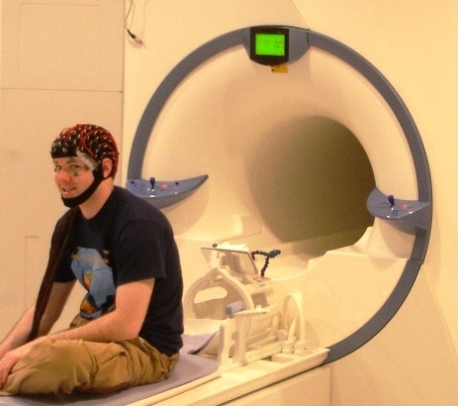
The Mind Returns
Second, technological innovations let psychologists look at the brain in ways that Watson had never dreamed about.
Cognitive neuroscience involved cognitive psychology, neurology, biology, computer science and linguistics.

Slide 7
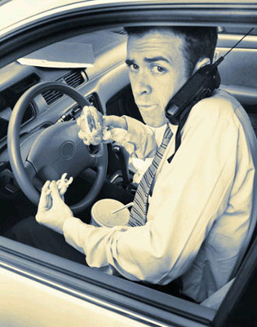
The Conscious Mind
The conscious mind can take on a variety of roles, but it must focus sequentially on one thing and then another.
Multitasking is not all it is cracked up to be.
Are the hands-free device laws in Newfoundland a good thing?

Slide 8
The Nonconscious Process
The nonconscious mind is great at multitasking. Where the conscious mind has the ability to focus on just one task, the nonconscious mind has no such restrictions.
The conscious mind has to process things serially, while the nonconscious mind can handle many streams of information at the same time, called parallel processing.
Walking, chewing gum and breathing

Slide 9
What Consciousness Does
Our consciousness has 3 main functions:
1. Consciousness restricts our attention.
It keeps our brain from being overwhelmed by stimulation by processing things serially and limiting what we notice and think about-this is called selective attention
2. Consciousness provides us with a mental “meeting place.”
Where sensation combines with memory, emotions and motives-this is the binding problem

Slide 10
What Consciousness Does
3. Consciousness allows us to create a mental model of the world that we can manipulate.
Unlike other, simpler organisms, we are not prisoners of the moment: We don’t just act reflexively to stimulation.
Humans are the only animal with the ability to set goals.

Slide 11
Mental Imaging
We can use our conscious mind to “zoom in” on an image, or to manipulate it.
Lets try it….
Close your eyes.
Picture a cat.

Slide 12
The Results
Is the cat black? Does it have a long tail? Does it have a collar on? Does it have short hair? Does it have white paws?
Psychologists have found that the smaller the detail, the longer people take to respond.

Slide 13
Levels of the Nonconscious Mind
There are two levels of the nonconscious (subconscious) mind: preconscious and unconscious.
Preconscious memories: Information that is not currently in consciousness, but can be recalled voluntarily.
Unconscious: Cognition (thought) without awareness.
Involves levels of brain systems that range from autopilot to those which can have subtle influences on consciousness and behavior.

Slide 14
What is Unconsciousness
A dictionary might define the term as being a loss of all consciousness, like when a person faints.
But in psychology, we define it a little differently. To show this, lets look at an example.
Fill in the blanks to complete the word below:
D E F _ _ _

Slide 15
Answer
Using a technique called priming, psychologists can have some influence on the answer people give.
This idea of priming is similar to asking “leading questions” in court, or framing questions by asking them in a way which increases the likelihood of certain answers.
There were a number of possible answers to the example: defend, defeat, defect, defile, deform, defray, defuse and define.
There is an increased likelihood you chose define. Why?

Slide 16
Freud’s View of Consciousness
According to Freud, there are three levels of consciousness:
Conscious: this is the part of the mind that holds what you’re aware of. You can verbalize about your conscious experience and you can think about it in a logical fashion.
Preconscious: ordinary memory. Although things stored here aren’t in the conscious, they can be readily brought into conscious.
Unconscious: Freud felt that this part of the mind was not directly accessible to awareness.
A dump box for urges, feelings and ideas that are tied to anxiety, conflict and pain.
These feelings and thoughts have not disappeared and are exerting influence on our actions and our conscious awareness

Slide 17
Freud’s View of Consciousness

Slide 18
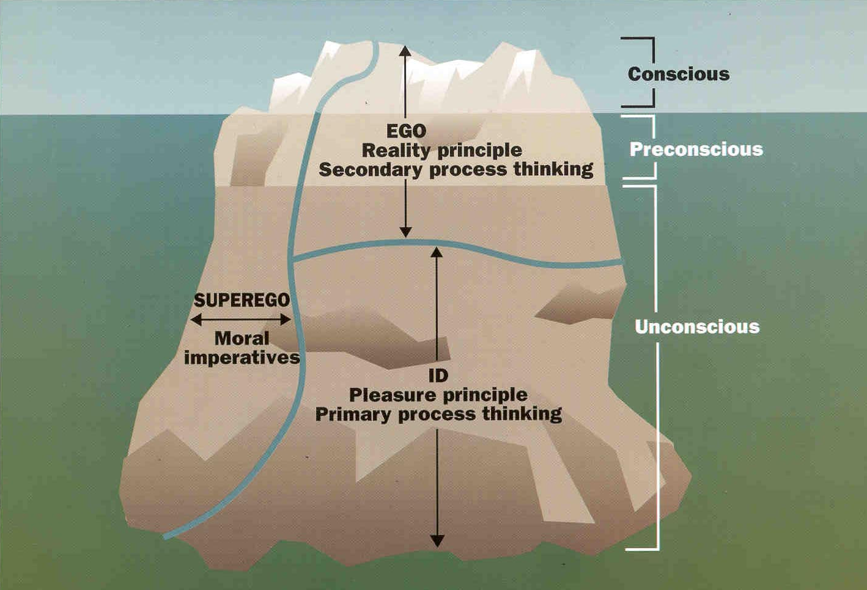
Freud’s View of Consciousness

Slide 19
More Freud…
The ego is based on the reality principle
Understands that other people have needs and desires and that sometimes being impulsive or selfish is bad-meet the needs of the id, with in reason.
The id is based on our pleasure principle.
The id wants whatever feels good at the time, with no consideration for the reality of the situation.
The superego is the moral part of us and develops due to the morals and ethics of our parents.
Many equate the superego with the conscience as it dictates our belief of right and wrong.
The ego is the strongest so that it can satisfy the needs of the id, not upset the superego, and still take into consideration the reality of every situation

Slide 20
Freud’s View of the Unconscious
Freud’s ideas have largely lost support in the psychology community, but in society as a whole, they still have lots of support.
One of Freud’s main ideas was that the unconscious mind served as a mental dungeon where terrible urges and threatening memories were kept “locked up” and outside of awareness.

Slide 21
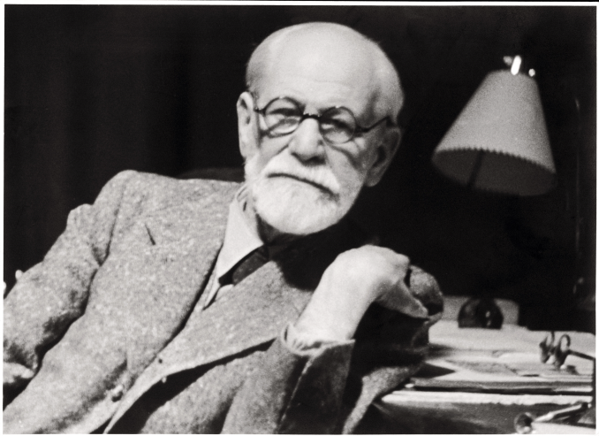
More Freud
Freud said that the unconscious mind had an especially important role in our relationships.
He said we chose mates who are, on an unconscious level, just substitutes for our fathers and mothers.
Oedipus Complex, Electra Complex and Penis Envy

Slide 22
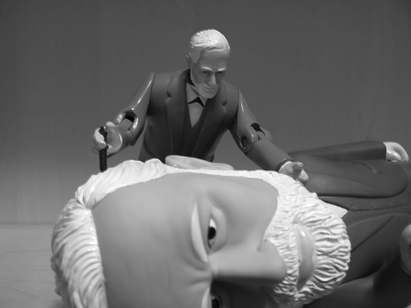
Nonconscious Mind Reality
For the most part, the nonconscious mind seems to devote its resources to simple background tasks such as screening the incoming stream of sights, sounds, smells and textures.
It alerts us to important things, like someone saying our name in a crowded room.
Freud Exploring the Nonconscious Mind

Slide 23
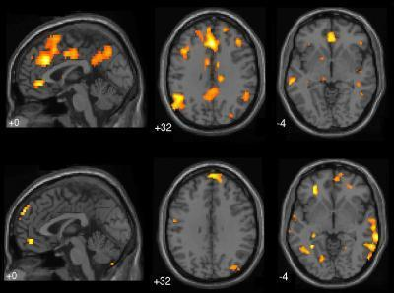
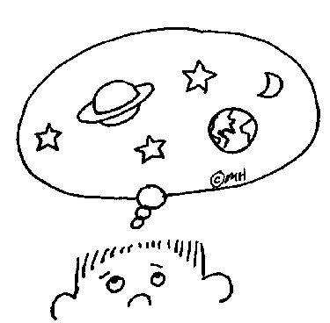
Daydreaming
Daydreaming: A common (and quite normal) variation of consciousness in which attention shifts to memories, expectations, desires or fantasies and away from the immediate situation.
Most people daydream everyday, however, it is much more common amongst younger adults.
Daydreams serve valuable functions such as planning and problem solving.
Brain scans of a wondering mind

Slide 24
Waking Consciousness
Daydreams and Fantasies
-Everyone fantasizes.
-Fantasizing or daydreaming may help reduce stress, or help us to "practice" for future events (adaptive).
4% of the population fantasizes so vividly that they have a Fantasy-prone personality.
As adults, they spend more than half their time fantasizing, which eventually leads to difficulties sorting fantasy from reality

Slide 25
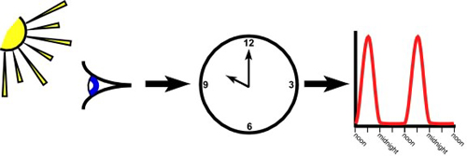
Module 8: Sleep and Dreams
Biological Rhythms:
Periodic physiological fluctuations which affect body processes like temperature, blood pressure, and the effectiveness of medicines.
We are aware of some of these rhythms, but most run on autopilot and aren’t given a second thought.

Slide 26
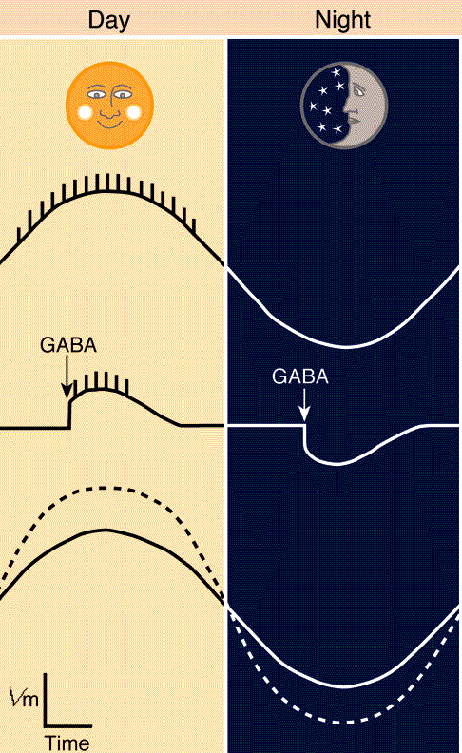
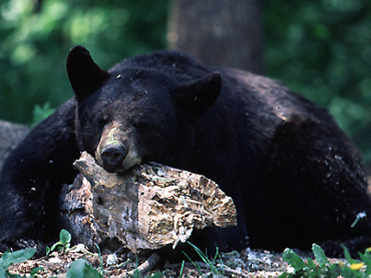
3 Main Biological Rhythms
Circadian Rhythms: Occur once during a 24 hour period.
Ex. Sleep-wake cycle
Ultradian Rhythms: Occur more than once a day.
Ex. Various stages of sleep each night
Infradian Rhythms: Occur once a month or a season.
Ex. Bears hibernating

Slide 27
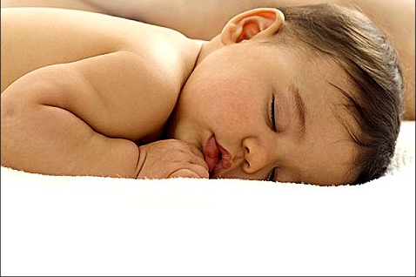
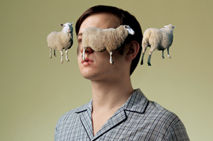
Why we sleep
Originally psychologists thought we slept because our neurons disconnected from each other causing us to simply “drift off.”
In reality, we do not have complete answers as to what causes us to sleep.

Slide 28
What We Do Know
We do know that the hypothalamus is the control center for our 24 hour rhythm of sleep.
The hypothalamus senses changes in light and dark and sends neurological messages to your brain and body that put you to sleep.
One of these neurological transmitters is melatonin, a hormone connected to the wake-sleep cycles that builds up while we sleep.

Slide 29
Theories of Sleep
While we do not know for sure why, sleep may have evolved for a few reasons.
Sleep protects us-evolutionary theory
Sleep helps us recuperate-repairs brain tissue
Sleeping to remember-helps rebuild our fading memories
Sleep to grow-during deep sleep the pituitary gland releases a growth hormone

Slide 30
Stages of Sleep
The sleep-wake cycle itself is circadian but we have ultradian cycles during our night’s sleep.
As you relax and try to go to sleep, your brain waves cycle more and more slowly.
Once you fall asleep, you will go through 4 stages of relatively quiet sleep before you go to the more active dreaming stage.

Slide 31
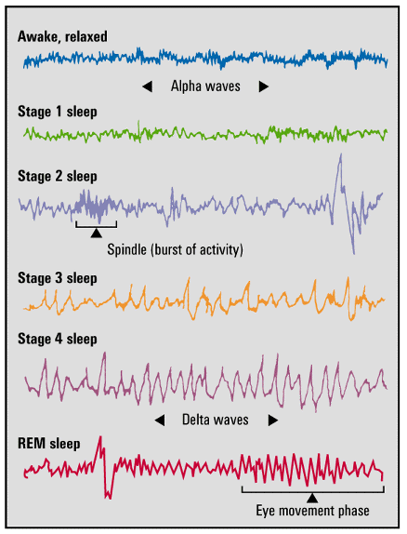
Brain Waves and Sleep Stages
Alpha Waves
slow waves of a relaxed, awake brain
Delta Waves
large, slow waves of deep sleep
Hallucinations
false sensory experiences

Slide 32
Stage 1
You will not know the exact moment when you enter Stage 1 of sleep.
It lasts only 5-10 minutes.
You are easily awaken from this stage and will probably insist that you were never asleep.
You may report dreamlike sensations of falling upon being waken up.
you experience hallucinations (experiences without real stimuli) such as hyponogogic sensations (floating weightlessly, knee jerks, etc.)

Slide 33
Stage 2
Your brain waves slow down even more.
"sleep talking" could start now or any stage after this.
Little brain wave-bursts called spindles are common during this stage.
The first time you enter this stage it will last about 20 minutes.
Over the course of the night, you will spend ½ of your sleep in this stage.

Slide 34
Stages 3 and 4
After about 30 minutes of sleep, your brainwaves slow down a lot.
Your brainwave cycles are less than 1 cycle per second, compared to 15 cycles per second when you first fall asleep.
This stage is called slow-wave sleep or delta sleep.
At Stage 3 - you are hard to wake.
The first time you are in these rejuvenation stages, it will last about 30 minutes.
At Stage 4 - Bed-wetting, sleepwalking or night terrors may occur.

Slide 35
Rem Sleep
The previous 4 stages have been part of N-rem, or non-rapid-eye-movement sleep.
After you reach Stage 4, your brain waves will begin to pick up a little more speed and strength. You will move back up through Stages 3, 2, and 1 and then enter your first period of Rem Sleep.

Slide 36
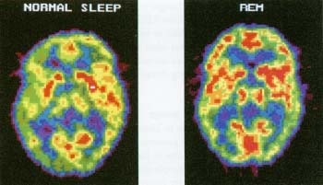
Rem Sleep
Rem sleep: A reoccurring sleep stage during which vivid dreams commonly occur.
It is also called paradoxical sleep because the muscles of the body are relaxed, but the other body systems are active.
Notice the increased activity of the brain, represented by the red areas

Slide 37
Stages in a Typical Night’s Sleep
Awake
Sleep
stages
1
2
3
REM
4
0
1
2
3
4
5
6
7
Hours of sleep

Slide 38
Stages in a Typical Night’s Sleep
Minutes
of
Stage 4 and
REM
Decreasing
Stage 4
25
20
15
Increasing
REM
10
5
0
1
2
3
4
5
6
7
8
Hours of sleep

Slide 39
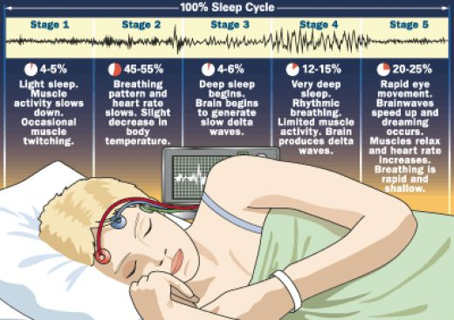
Rem Continued
The first period of Rem will not last long. When it is finished, you will return to Stage 1 of sleep and start the cycle over again.
The 90 minute ultradian rhythm continues all night, but stages 3 and 4 are eventually skipped.
The last 4 hours of sleep are spent between Stage 2 and Rem.

Slide 40
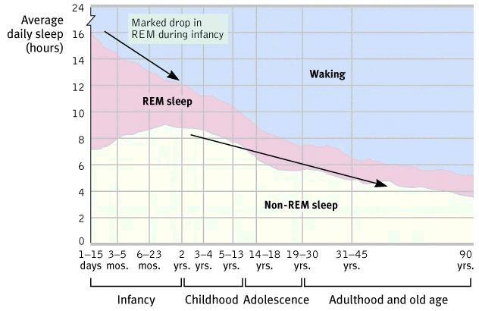
Sleep Across the Lifespan

Slide 41
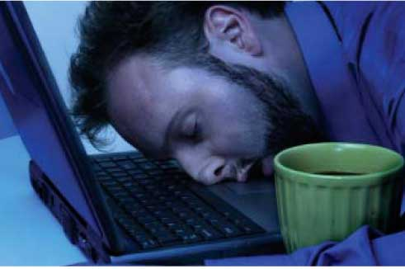
Sleep Debt
Most adults need to sleep about 8 hours, or a little bit more, to feel good and function efficiently. However, most Americans get significantly less than 8 hours of sleep.
Often times, we attribute afternoon drowsiness to a big lunch-really the result of sleep-debt.
Similarly, people say they fall asleep when they are bored. In reality, restlessness is the normal response to boredom, not sleepiness.

Slide 42
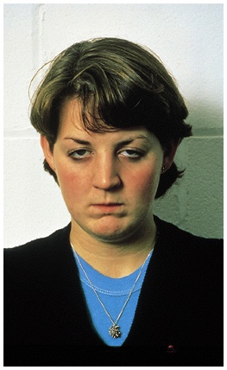
Sleep Deprivation
Effects of Sleep Loss
fatigue
impaired concentration
depressed immune system
greater vulnerability to accidents

Slide 43
Sleep Deprivation
Less sleep,
more accidents
More sleep,
fewer accidents
Accident
frequency
2,800
2,700
4,200
2,600
4000
2,500
3,800
2,400
3,600
Spring time change
(hour sleep loss)
Fall time change
(hour sleep gained)
Monday before time change
Monday after time change

Slide 44
Sleep Deprivation
BUT a sleep-deprived person does as well as anyone on highly motivating tasks (running, arcade games, boxing)
Purpose of sleep
- to help us regenerate
- tissues are restored and conserved,
- growth hormones are released from the pituitary gland.

Slide 45
Dreaming
Freud had many prominent thoughts on dreaming, as well as the nonconscious mind.
Freud said dreaming had two main functions: to guard sleep and serve as a source for wish fulfillment.

Slide 46
Manifest and Latent Content
Freud distinguished between the:
manifest content-the dream’s story line,
latent content-the (supposed) symbolic meaning.
For example, symbols of containers and long rigid objects could symbolize the male and female genitalia and give clues to sexual conflicts.
Freudian Dream Analyzer

Slide 47
What We Dream
Negative Emotional Content: 8 out of 10 dreams have negative emotional content.
Failure Dreams: People commonly dream about failure, being attacked, pursued, rejected, or struck with misfortune.
Sexual Dreams: Contrary to our thinking, sexual dreams are sparse. Sexual dreams in men are 1 in 10; and in women 1 in 30.

Slide 48
Truth About Dreams
Despite his theories there is no solid evidence to support Freud’s interpretations of latent dream content.
Dreams, do however, vary by age, gender and culture.
Children are more likely to dream about animals that are large and threatening, while adults dream more about pets.
Women are more likely to dream about men and women; men are more likely to dream about men.

Slide 49
Culture and Dreams
Many studies have supported the theory that culture plays a large role in dream content.
Ghana: Attacking cows
Americans: Public nakedness
Mexican-Americans: Death
There is strong support for the idea that dreams reflect life events that are important to the dreamer.

Slide 50
Dreams
Why do you have dreams that seem random?
Typically the first dream connects with events from the previous day. Later dreams tend to build on a theme in the previous dream.
Often times, the final dream is remembered most vividly, but has very little to do with the previous days events, or events that lay ahead.

Slide 51
Other Theories
Not everyone believes that dreams have meaning and relate to the day’s events.
Activation-synthesis theory says that dreams result when the sleeping brain tries to make sense of its own spontaneous bursts of activity.
A dream, then, is the brain’s way of making sense out of nonsense.

Slide 52
Modern Theories
Information Processing: An important memory-related function of sorting and shifting through the day’s experiences.
Physiological function: Neural activity during Rem sleep which provides necessary brain stimulation and growth.
Activation-synthesis: Our brain’s attempt to make sense of random neural firings in various parts of our brain.
Cognitive Theory: Dream are the embodiment of thoughts.
a dream is a pictorial representation of the dreamer's conceptions.

Slide 53
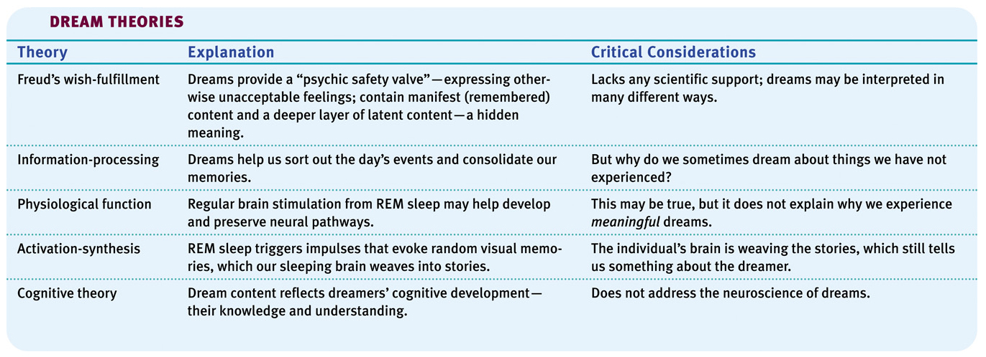
Summary of Dream Theories

Slide 54
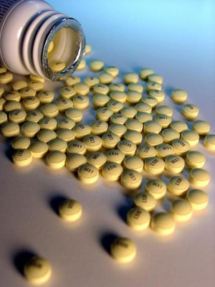
Sleep Disorders
Insomnia: Recurring problems fall or staying asleep.
There are lots of “remedies” which may actually worsen the problem.
Sleeping pills: addicting, prevent Rem sleep
Alcohol: Prevents Rem Sleep

Slide 55
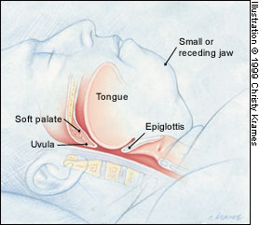
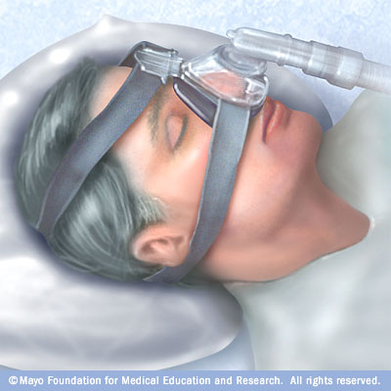
Sleep Disorders
Sleep apnea: A sleep disorder characterized by a temporary stoppage in breathing forcing the person to wake up.
Roughly 4 % of Americans have sleep apnea

Slide 56
Sleep Disorders
Narcolepsy: A sleep disorder characterized by uncontrollable sleep attacks.
Somnambulism: Sleepwalking. The sleepwalker can walk, talk and see, but will have little or no memory of the event when they wake up.
Night Terrors: A sleep related problem characterized by high alertness and an appearance of being terrified.
Bruxism: Teeth grinding.
Myoclonus: Sudden movement or flinch of a body part occurring in Stage 1 or 2.

Slide 57
Sleep Disorders
Night Terrors –not nightmares. When one experiences night terrors, they appear terrified but do not remember the ordeal the next morning.
-occur after 2 or 3 hours of sleep and while the person is in stage 4 sleep.
-The next morning the person hardly remembers what happened.
In contrast, nightmares happen in REM Sleep usually early in the morning.

Slide 59
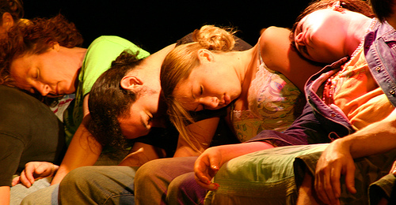
Module 9: Hypnosis
One of the more intriguing aspects of consciousness is hypnosis. The reality of hypnosis is far less intriguing than the anecdotal perception of what many of us have seen or heard.

Slide 60
Hypnosis
Hypnosis is a social interaction in which one person (the hypnotist) suggests to another person (the subject) that certain perceptions, cognitions or behaviors will spontaneously occur.
Does it work?
To a degree everyone is suggestible
20% are highly suggestible
The real power of hypnosis is not in the hypnotist, but in the subject’s own openness to suggestion.

Slide 61
Can Hypnosis Enhance Memory?
Although most people believe lost memories can be retrieved through hypnosis, something called age regression, 60 years of science dispute such claims.
In reality, “hypnotically refreshed” memories often combine facts with fiction as the hypnotist asks leading questions like “Did you hear loud noises?”
Banned as evidence in America, Australian and England

Slide 62
Can Hypnosis Enhance Memory?
“Hypnosis is not a psychological truth serum and to regard it as such has been a source of considerable mischief.”
–Researcher Kenneth Bowers
Thousands of examples of memories created under hypnosis come from people who reported seeing UFOs.
Studies reveal that most reposts of UFOs have come from people predisposed to believe in aliens, are highly hypnotizable, and have undergone hypnosis

Slide 63
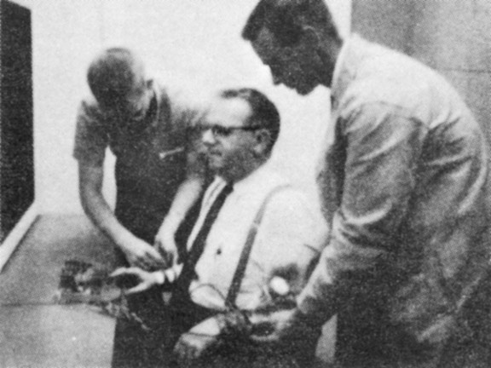
Can Hypnosis Make People Act Against Their Will?
The short answer is no, not anymore than an authoritative figure can make someone who is not hypnotized act against their will.
“The overt behaviors of hypnotic subjects are well within normal limits,” (Spanos 1982).
We will see the power of the authoritative figure again when we study social psychology in chapter 14.

Slide 64
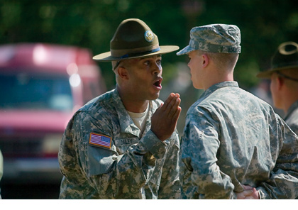
Can Hypnosis Make People Act Against Their Will?
Hypnotized people don’t do anything that unhypnotized people can’t also be convinced to do.
Studies show that an authoritative person in a legitimate context can induce people-hypnotized or not-to perform some unlikely acts.

Slide 65
Can Hypnosis be Therapeutic?
The short answer is yes….sometimes, kind of.
Posthypnotic suggestions, suggestions made during hypnosis, have helped alleviate headaches, asthma and stress-related skin disorders.
In other cases, clients whose therapy was supplemented with hypnosis showed greater improvement 70% of other patients.
Especially helpful with obesity
No help for smoking, drinking, drugs
No difference when patients were given the same positive reinforcement without hypnosis

Slide 66
Can Hypnosis Alleviate Pain?
Hypnosis can actually alleviate pain!
This happens because of disassociation
A split between levels of consciousness, hypnosis disassociates the physical stimulus of pain from the emotional suffering that defines our experience of pain
Called hypnotic analgesia
Selective attention we get caught up in the moment and do not feel the pain until later
Essentially distracting people from feeling pain

Slide 67
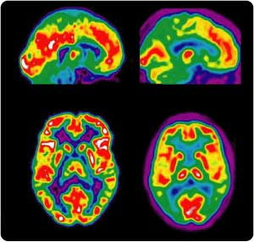
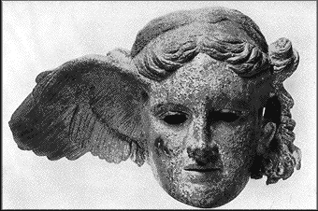
Can Hypnosis Alleviate Pain?
PET scans show that hypnosis reduces brain activity in a region that processes painful stimuli, but not in the sensory cortex that receives raw sensory input (Rainville 1997)
Hypnosis does not block sensory input, but it MAY block our attention to those stimuli.
PET Scans
Hypnos: Greek god of sleep

Slide 68
An Altered State of Consciousness?
We know hypnosis involves a heightened state of suggestibility, but some suggest it is more of a social phenomenon.
Some believe the hypnotic phenomenon is simply the workings of normal consciousness and the power of social influence-social influence theory
Not suggesting anyone is faking, but rather they get caught up in the role/moment. The more they trust the hypnotist, and feel motivated to demonstrate those behaviors, the more they allow that person to direct their attention

Slide 69
A Diverted Consciousness?
While most agree that hypnosis involves normal social and cognitive processes, some think it is more than “acting.”
The divided-consciousness theory is controversial, but suggests we can run on autopilot for well rehearsed tasks, while consciously working on another task.
One thing we know for sure, we process a lot of information outside of our conscious awareness…much of our behavior occurs on autopilot.

Slide 70
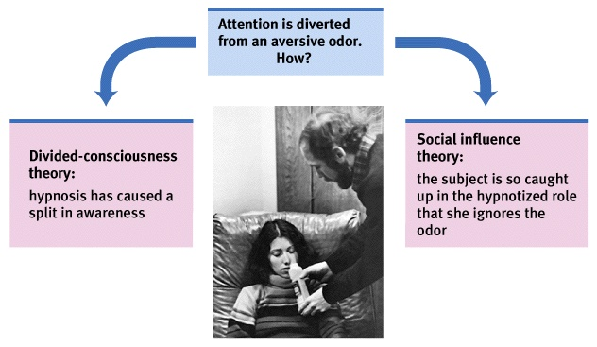
Explaining Hypnosis

