Slide 1
Unit 1: Matter & Energy for Life
Biology 2201
Booth Memorial High School

Slide 2
A Paradigm Shift
There was a change in the way that science viewed the “origins of life”.

Slide 3
Questions:
1. How did the scientists’ equipment evolve?
2. What are the strengths and weaknesses of their research?

Slide 4
Spontaneous generation (abiogenesis)
Resulted from conclusions drawn from “faulty or incomplete observations and lack of experimental control.”
Therefore, the concept was discredited, and biogenesis was supported, through use of controlled experiments.

Slide 5
Create a Time Line
Chronicle the development of the Cell Theory.
Students research one scientist.
Present the following info to teacher:
Scientists name
Time frame in which they worked
Their main contributions to the development of the cell theory.

Slide 6
Scientists
Needham
Redi
Spallanzani
Pasteur
Hooke
Leeuwenhoek
Schleiden
Schwan
Virchow

Slide 7
Student slides
Contents created by
Mrs. Templeman’s
Biology 2201 students

Slide 8
Robert Hooke (1635-1703)
English physicist, mathematician, and inventor.
1665 - He devised a compound microscope and discovered plant cells in cork tissue.
He published Micrographia. In his book, Hooke had used the term “cell” to describe plant tissue (from the Latin cellula meaning small room).
Hooke did not realize the significance of this discovery.
It was not until the 1670’s did a scientist by the name of Anthony van Leeuwenhoek, realized what the observations meant.

Slide 9
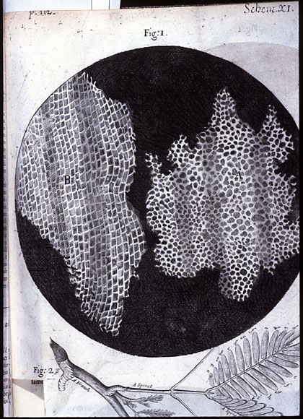
Hooke’s view of cells in cork tissue.

Slide 10
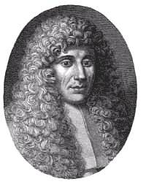
Francesco Redi (1626-1698)

Slide 11
Francesco Redi (1626-1697)
Italian physician (doctor)
1668: He conducted the 1st controlled experiment to disprove the theory of spontaneous generation.
He set-up flasks with meat in them:
uncovered flasks had flies laying eggs (maggots) on the meat.
flasks covered with gauze had no flies laying eggs.
Demonstrated that maggots were produced only after eggs were laid and not by spontaneous generation.

Slide 13
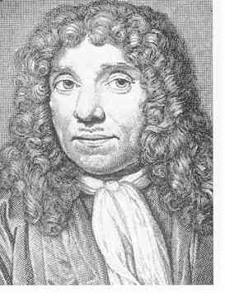
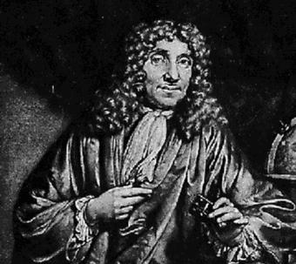
Antonie van Leeuwenhoek (1632-1723)

Slide 14
Antony van Leeuwenhoek (1632-1723)
Dutch (Netherlands). Studied microscopy (microbiology).
1674: Developed the first modern multiple-lens microscope. He improved the magnification. Some consider him the “Father of microscopy”.
Discovered many microbes called them “animalcules” (bacteria, protists, sperm cells, blood cells, foraminifera, nematodes, rotifers, and many more).
1683: He was the first to make observations about living bacteria by observing the plaque on his own teeth.

Slide 15
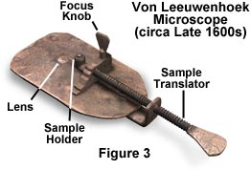

Slide 16
John Needham (1713-1781)
English scientist/naturalist & Catholic priest
1748: Offered what he considered to be proof of spontaneous generation.
He claimed that sealed flasks of mutton broth and hay infusions produced animalcules even after the broth had been boiled and corked tightly thus suggesting that microbes had developed from inanimate matter.
He spoke of the “vital force”.
His result was, however, an indication that he had not boiled his solutions for long enough, rather than a proof of spontaneous generation.
His experiments were challenged later on by Spallanzani.

Slide 17
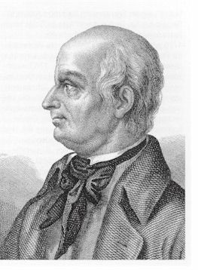
Lazzaro Spallanzani (1729 - 1799)

Slide 18
Lazzaro Spallanzani (1729-99)
Italian naturalist
1767-1768: Checked Needham’s spontaneous generation experiment by using flasks with slender necks that could be sealed or melted shut. With proper boiling, he found that the broth remained sterile indefinitely.
He proved that microbes are found in the air and can be killed by boiling. He paved the way for the work done by Pasteur.
He definitively disproved the theory of spontaneous generation.

Slide 19
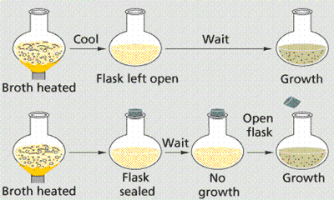
Spallanzani’s experiment:

Slide 20
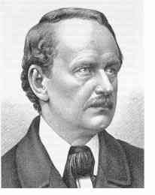
Matthias Schleiden (1804-1881)

Slide 21
Matthias Schleiden (1804-1881)
German botanist & microscopist
1838: Studied primarily cells in plants. Observed that “all plants are made of cells”.
Considered co-founder of the cell theory with Schwann.
1850’s: Stated that the 1st phase of generation of cells was the formation of the nucleus within the intracellular substance.

Slide 22
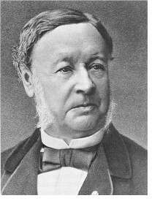
Did you know?
Schwann discovered the digestive enzyme pepsin.
Theodor Schwann (1810-1882)

Slide 23
Theodor Schwann (1810-1882)
German cytologist / physiologist
1838: He helped to identify cells as the fundamental particles of plants and animals.
1839: “All animals are made up of cells…”, “cells are organisms…and animals & plants are collectives of these organisms”.
He extended Schleiden’s cell theory to animals and recognized:
1. That some organisms are unicellular while others are multicellular.
2. Also recognized membranes, nuclei, and cell bodies to be common cell features and described them by comparison of plant and animal tissues.

Slide 24
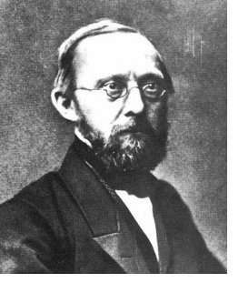
Rudolf Ludwig Karl Virchow (1821-1902)

Slide 25
Rudolph Virchow (1821-1902)
German pathologist
1855: Summarized the cell theory: “omnis cellula a cellula” (Latin) which means “all cells arise from cells”.
1858: Set out methods and objectives of pathology and demonstrated that the cell theory applied to diseased as well as healthy tissues.
He stated that diseases arose, not in organs or tissues in general, but primarily in individual cells.

Slide 26
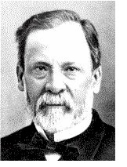
Did you know?
He developed the process of pasteurization of wine, beer and milk.
What is Pasteurization?
Microorganisms can be killed by heating the fluid to 55 °C for several minutes.
Louis Pasteur (1822-1895)

Slide 27
Louis Pasteur (1822-1895)
French microbiologist
1860-61: Pasteur disproves the spontaneous generation theory (see diagram that follows).
Discovered that microorganisms contaminated fermenting beverages (milk, juice, wine, beer).
1877-1887: Discovered three main bacteria to cause illness:
Staphlococcus, Streptococcus,Pneumococcus
1870: Established the Germ Theory of Disease (“most infectious diseases are caused by germs”) with Robert Koch.
1881: Develops Anthrax vaccine.
1885: Develops Rabies vaccine.

Slide 28
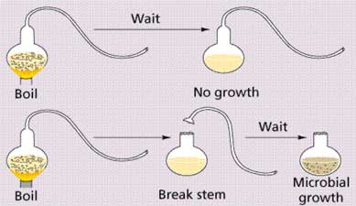
Pasteur’s experiment:

Slide 29
The Cell Theory
1. All organisms are made up of one or more cells and the products of these cells.
2. All cells carry on life activities.
3. New cells arise only from other living cells by the process of cell division.

